Slide 1
Dear students,
Welcome today our
English First Paper Class

Slide 2
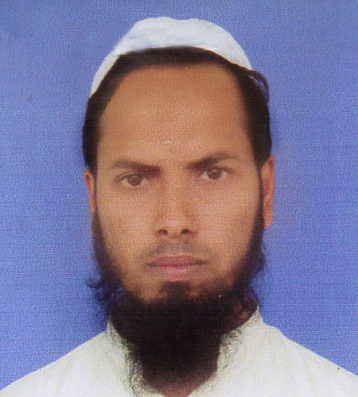
Teacher’s Identity
Md Nizam uddin ( Assistant Teacher)
Ranigonj High School
Ranigonj Bazar, Jagannathpur
Sunamgonj.

Slide 3
Class test – 31
Unseen passage-04
Louis Pasteur
Questions no- 04,05
Marks – 15

Slide 4
Louis Pasteur was a French chemist. He is remembered for his remarkable invention of the causes and preventions of diseases. Louis Pasteur was born on December 27, 1822 in Dole, Jura , France. He entered primary school in 1831. He left for Paris to join Pension of barbet but became homesick and returned home. In 1838, he got into the college Royal de Beasancon and received his BA degree in 1840. He did his B.Sc in Mathematics from Dijon in 1842. He received his medical license in1845 as a doctor. He was appointed professor of Physics at the Dijon Lycee in 1848. He invented the vvccines for Rabies in 1885. He died on September 28, 1895 at the age of 72.

Slide 5
4. Complete the table with information from the above passage.
Who / What | Events | Place | Year / Time | Contribution
Louis Pasteur | Was born | i)…….. | 1822
He | admitted | Primary school | ii)……...
iii)……. | Bachelor of science | Degree in mathematics | In 1842
His contribution | iv)……… |  | In 1885
Death |  |  | v)…………..
5. Write a summary of the above passage in your own words.

Slide 6
Matching with answer
In Dole, Jura, France
In 1831
Louis Pasteur
Invented the vaccines for Rabbits
On September 28,1895

Slide 7
Dear students,
Thank you
For joining our
English First Paper Class

