Slide 1










Slide 2

Introduction
Md. Ramzan Ali
Assistant Teacher English
Silumpur High School
Bagherpara, Jessore.
Unseen Passage
Subject: English 1st Paper
Class- Seven

Slide 3

Learning Outcomes
By the end of lesson the learners will be able:
1. to say true or false statements
2. to practice grammar (simple past).
3. to fill in the gaps with clues from the text.
4. to write a paragraph about the fox without
a tail.

Slide 4
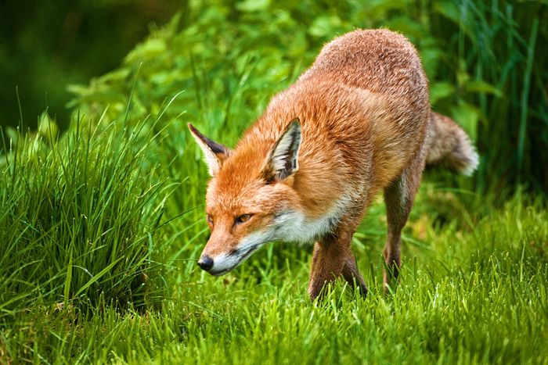

A fox is walking through the jungle.

Slide 5
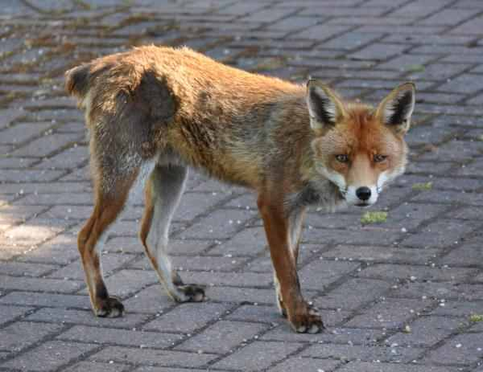

A Fox without a tail.

Slide 6

Lesson Declaration
The Fox Without A Tail

Slide 7

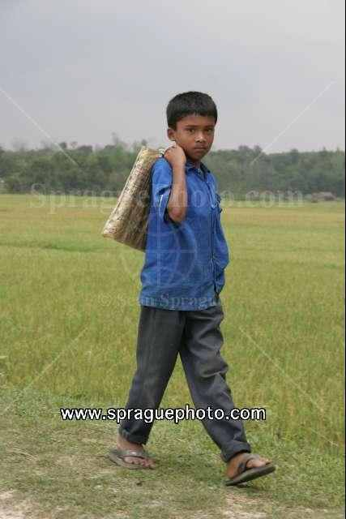
Vocabulary
ambush
Trap
Walk
march/hike

Slide 8

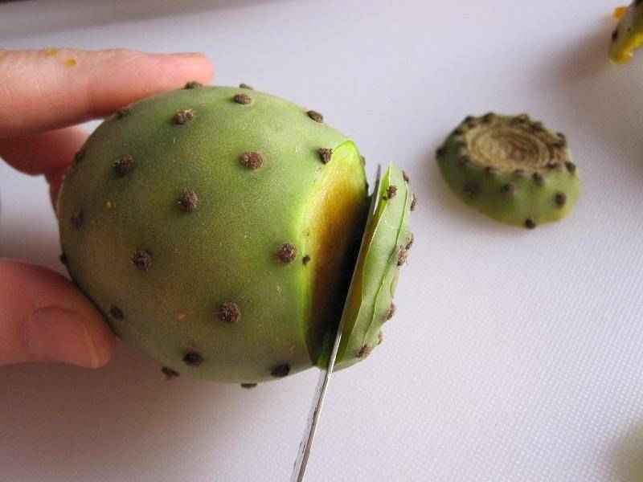
Jungle
forest
cut off
disconnect

Slide 9
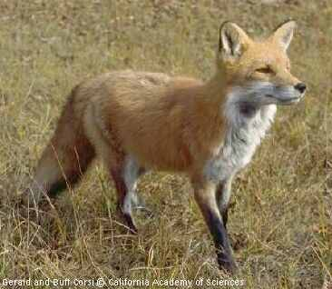
A fox is walking

Slide 10
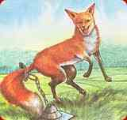
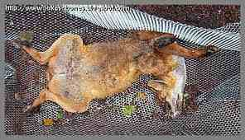

Fell in to a trap

Slide 11
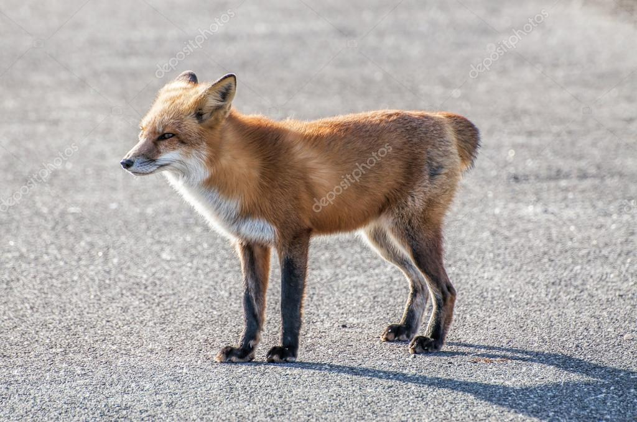
Lost his tail

Slide 12
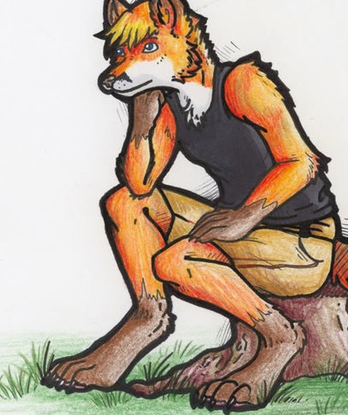

He is thinking & making plan.

Slide 13
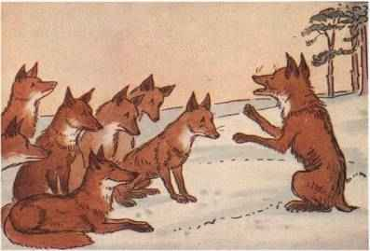

The foxes are meeting.

Slide 14
A fox was walking throw the jungle. He fall into a trap and left his tail behind. He felt very sad & ashamed. He called a meeting & told all the foxes cut off their tails. But a wise fox understood his plan & they went away.

Slide 15
Grammar presentation
subject + verb past form+ ext.
Mina told them about Mr. Fox’s tail.

Slide 16
Individual work
Write two true statements from the box.
Mr. Foxes did not know anything about Mr.
fox’s meeting.
Mr. Foxes did not know anything about Mr.
fox’s plan.

Slide 17
Group Work
Fill in the gap
Trap, sad, plan, ashamed, tail
Mr. Fox lost his tail in a ----.Then he felt very ----and----.So he made a --- .
Answer: Trap, sad, ashamed, plan.

Slide 18


EVALUATION
Who felt very pleased?
Give an example of past indefinite tense.
Who called meeting??
Change past tense.
Mr. Fox falls in to a trap.

Slide 19

HOME WORK
Write a short paragraph about the Fox without a tail.

Slide 20


