Slide 1

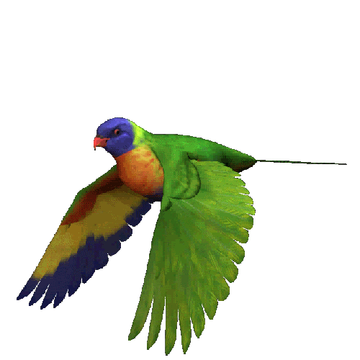
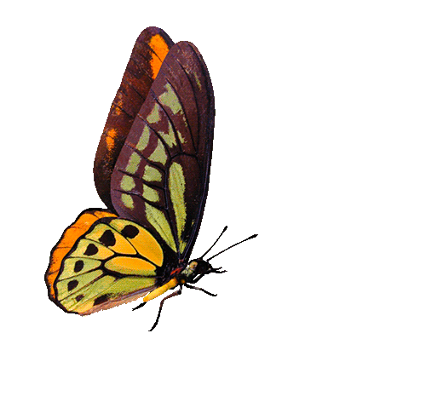
Welcome to all in my multimedia class “English For Today”

Slide 2
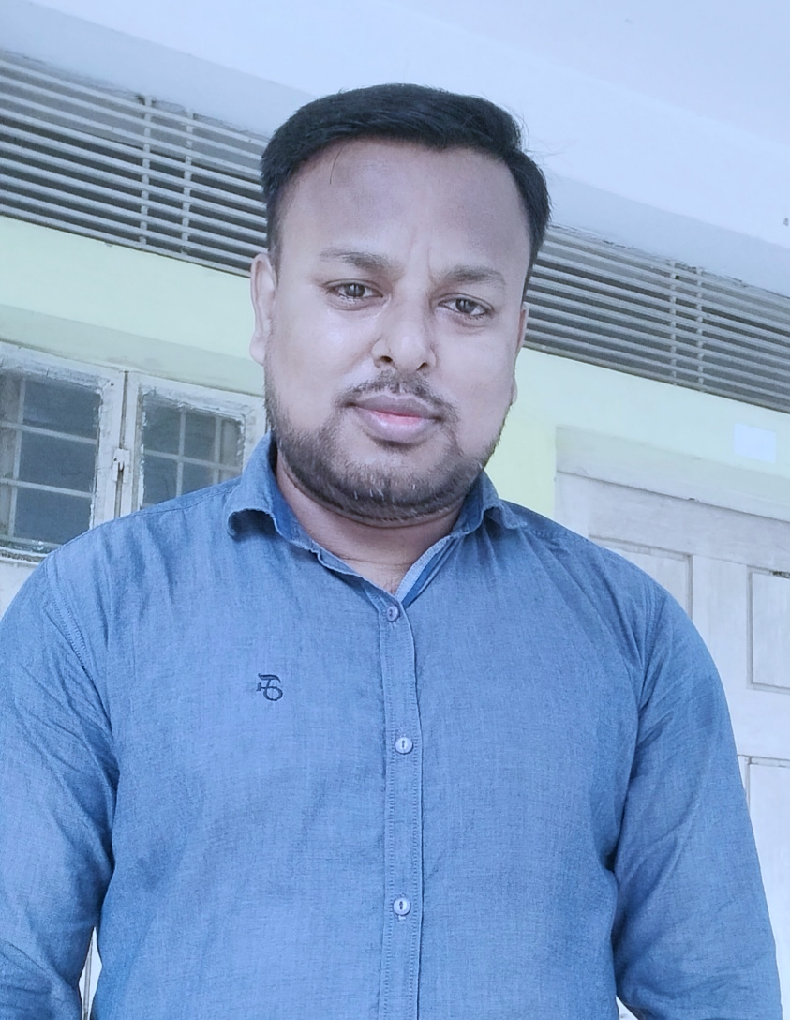




Teacher’s Identity
Samir Biswas
Assistant Teacher
Shaheberchar Govt. Primary School
Kashiani, Gopalganj

Slide 3



Subject’s Identity
Class: Three
Subject: English
Unit- 6, Lesson- 2
Topic- Steps Of Washing Hands
Time: 40 Minute
Date: 05.10.2026

Slide 4
Learning Outcomes
1. Learn and write the English names of hand-washing items (water, soap, tap, towel etc)
2. Understand the importance of keeping hands clean to stay safe from germs.

Slide 5
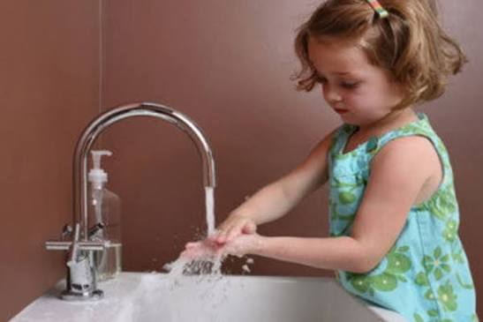
What do we use to wash our hands?
Why do we wash our hands?

Slide 6
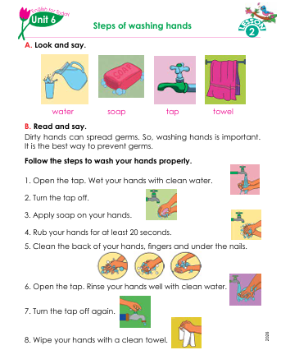
Our today’s Lession is
‘Steps Of Washing Hands’

Slide 7
Our today’s Lession is
‘Steps Of Washing Hands’

Slide 8
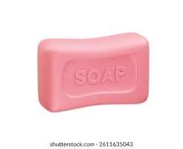
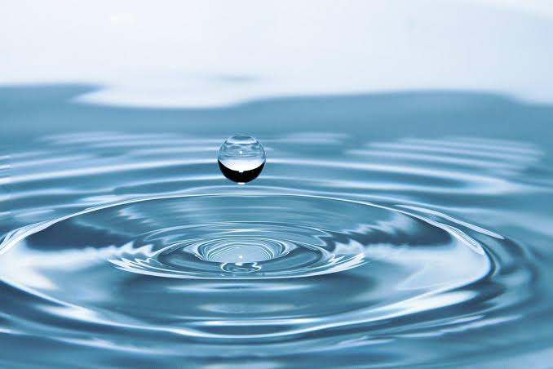
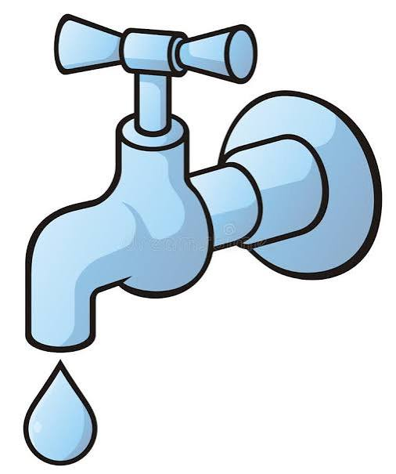

Let’s see some picture
Soap
Clean Water
Tap
Towel

Slide 9
Look at the picture, say the meaning and make a sentence
I wash my hands with soap
Soap

Slide 10
Look at the picture, say the meaning and make a sentence
I wash my hands with water
Water

Slide 11
Look at the picture, say the meaning and make a sentence
Water comes from the tap.
Tap

Slide 12
Look at the picture, say the meaning and make a sentence
The towel is clean.
Towel

Slide 13
Dirty hands can spread germs. So, washing hands is important. It is the best way to prevent germs.
নোংরা হাতে জীবাণু ছড়ায়। তাই হাত ধোয়া জ্রুরি। এটি জীবাণু থেকে বাঁচার সবচেয়ে ভালো উপায়।

Slide 14
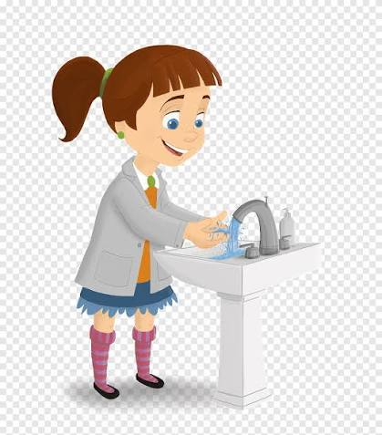
Open the tap.
Wet your hands with clean water.
1

Slide 15
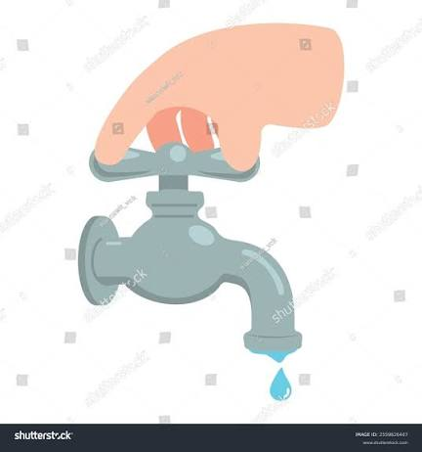
2
Turn the tap off.

Slide 16
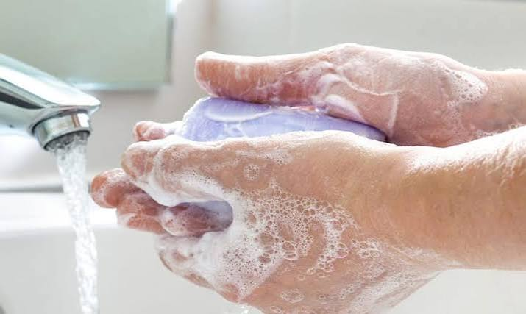
3
Apply soap on your hands.

Slide 17
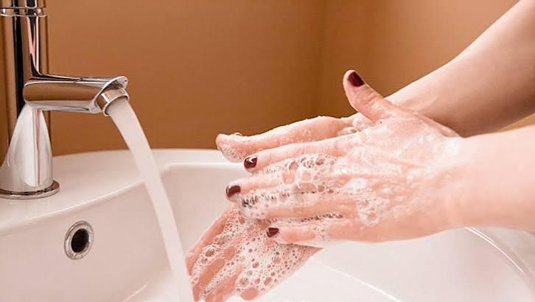
4
Rub your hands for at least 20 seconds.

Slide 18
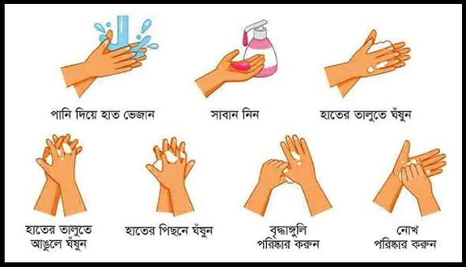
Clean the back of your hands, fingers, and under the nails.
5

Slide 19
Open the tap. Rinse your hands well with clean water.
6

Slide 20
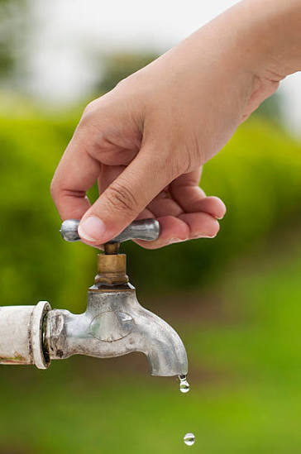
7
Turn the tap off again.

Slide 21
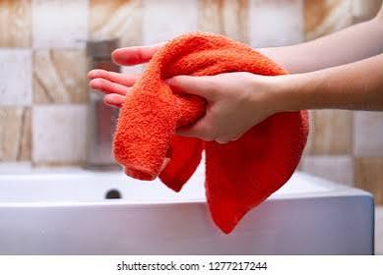
8
Wipe your hands with a clean towel.

Slide 22

Fill in the blanks.
20
germs
water
towel
germs
a. Dirty hands can spread ----------- .
b. Rub your hands for at least ---------- seconds .
c. Wipe your hands with a clean ----------- .
d. Wet your hands with clean ------------ .
20
towel
water

Slide 23
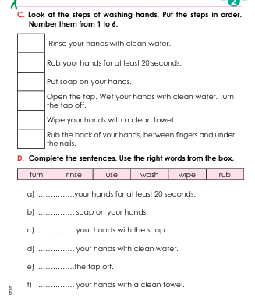



Slide 24
5
6
3
2
1
4

Slide 25
Write True or False:
False
True
True
True
1. Dirty hands keep us healthy.
2. Washing hands is important.
3. We need soap to wash our hands properly.
4. We should wipe our hands with a clean towel.

Slide 26
Answer the following questions:
Ques: 1. How long should we rub our hands ?
Ans: For at least 20 seconds.
Ques: 2. What do we need to wash our hands?
Ans: Water and soap.
Ques: 3. Why is washing hands important?
Ans: Because dirty hands can spread germs

Slide 27
Matching Column A with column B
Column A | Column B
Water | 1. To dry hands.
b) Soap | 2. To get clean liquid
c) Tap | 3. To clean hands with bubbies.
d) Towel | 4. To wet hands

Slide 28
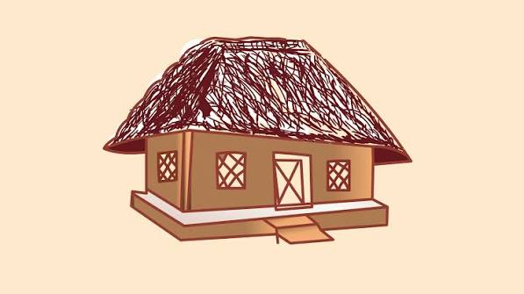


Home Task
You all should practice washing your hands at home.

Slide 29


Good by every one
Thanks to all
See you again.

