Slide 1

Welcome to today’s class

Slide 2


Teacher’s Identity
Md. Azim Uddin
Latifpur Government Primary School.
Sitakund, Chattogram.
E-mail: azimsitakund2012@gmail.com.

Slide 3


Lesson identity
Subject: English
Class: Five
Unit: 13, Quality Time Together
Activity: 1.1
Page: 69 - 72

Slide 4

Learning outcomes
Student’s will be able to
3.4.2 Answer simple questions appropriately and confidently.
5.1.2 Get the specific information from the simple text.
5.1.4 Get the general ideas from simple texts.
8.1.2 Recognise and use a range of words and phrases in written communication.

Slide 5
Review of the previous session
What did we learn in the last class?

Slide 6
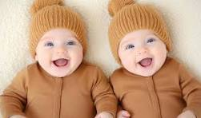
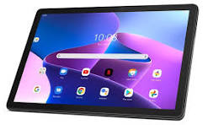
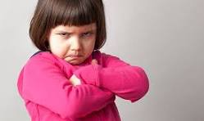
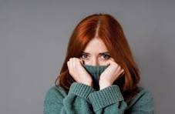
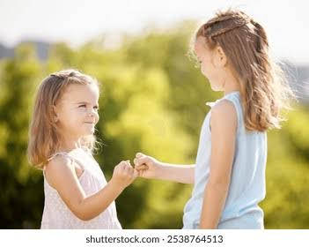
What do you see in the picture
Describe the pictures -
In the first picture I can see twins.
Second picture a tablet.
And third picture grumpy face.
fourth picture the girl is ashamed and fifth picture they are promising.

Slide 7
Presentation of today’s session
Today we will learn some new words with meanings and their uses.
Everybody open the textbook at page 71

Slide 8

Title of the lesson
We are going to read a text names
Quality Time Together
Today we will learn some new words with meanings and their uses.

Slide 9
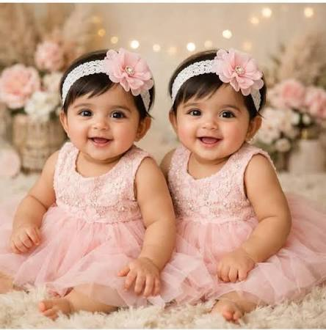
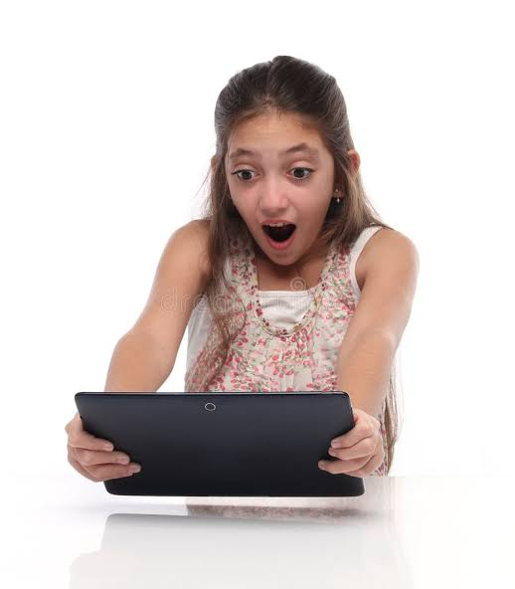
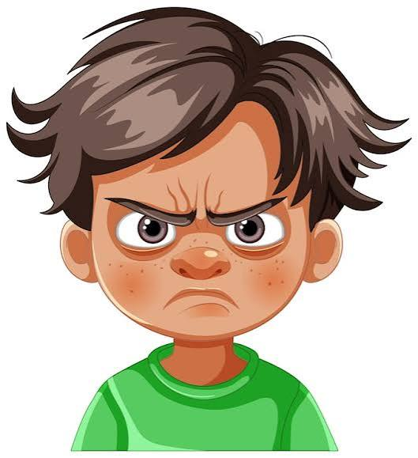
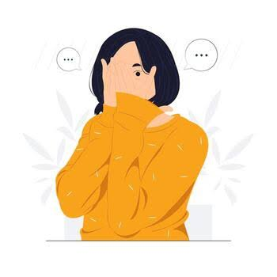
Free – teach the new words
Two children born at the same time to the same mother
Twins
A device with a screen used for connecting to the internet, watching videos, reading books etc.
Tablet
grumpy
Easily annoyed or unhappy
Causing slight anger
Annoying
To tell someone that you will definitely do something
Promise

Slide 10
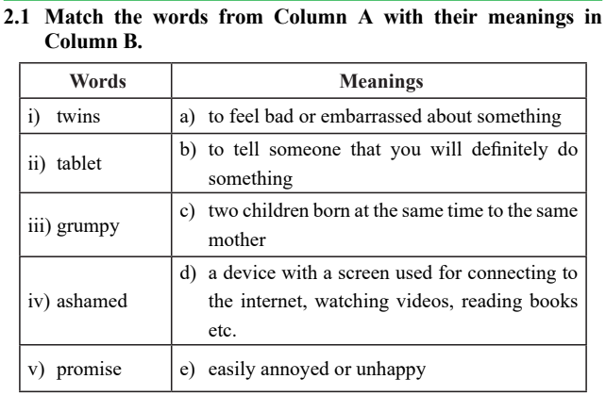
Match the words with their meanings

Slide 11
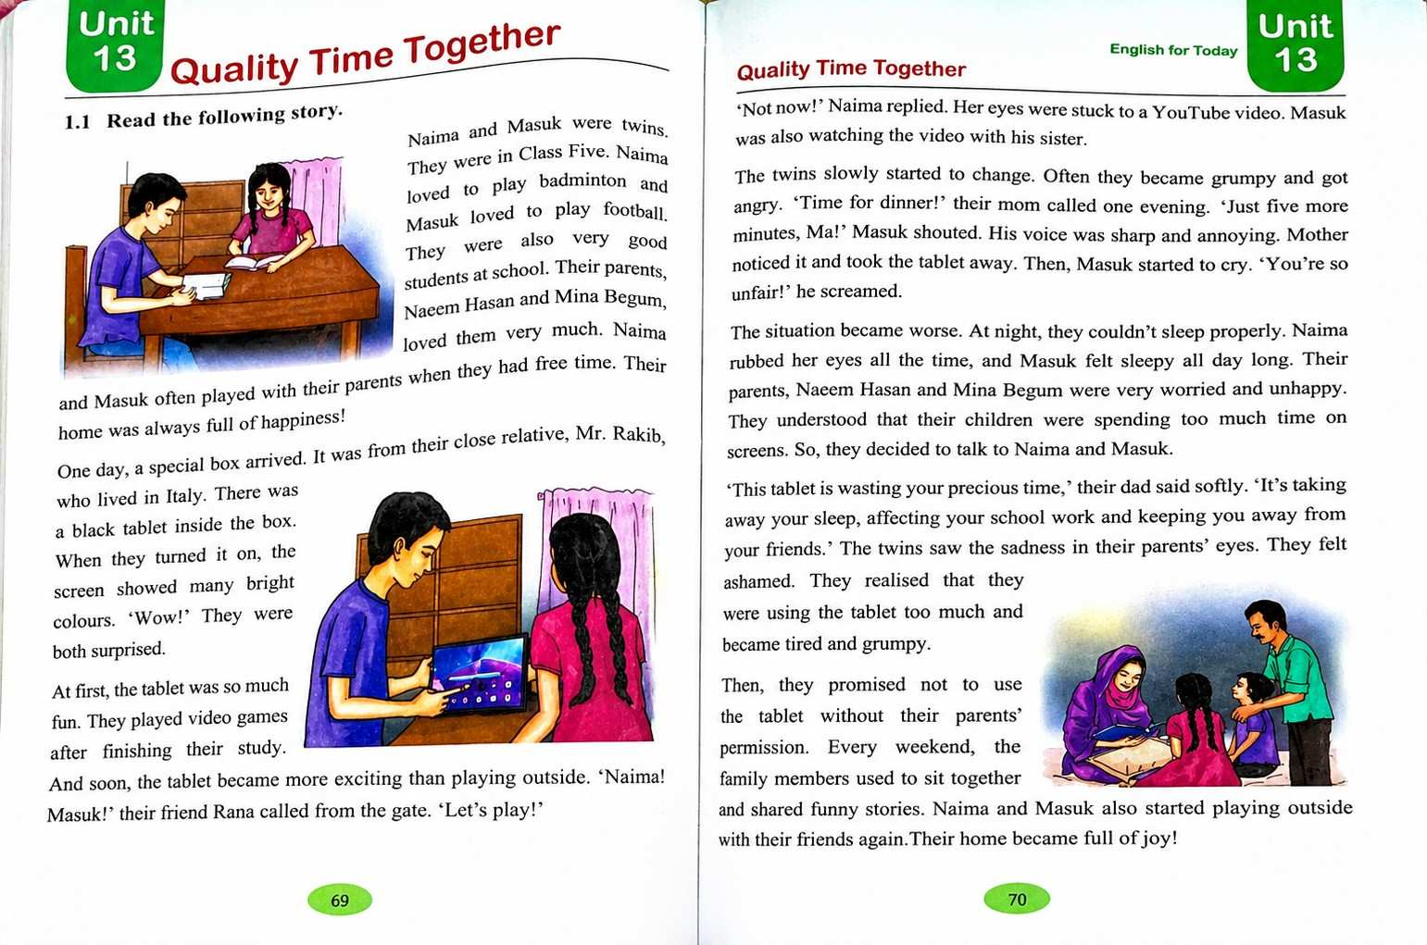

Summaeize the text with the whole class

Slide 12
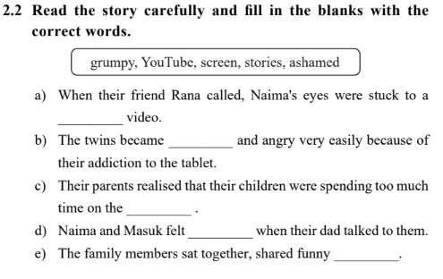
Discus the words and fill in the blanks

Slide 13
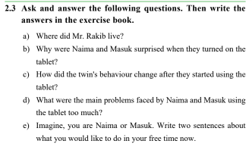
Discuss the answer with the whole class

Slide 14
Assessing learning
What do Naima and Masuk do in their free time?
Where did Mr. Rakib live?
Why did the situation become worse?
What did they promise to their parents?
Ask the following questions randomly

Slide 15
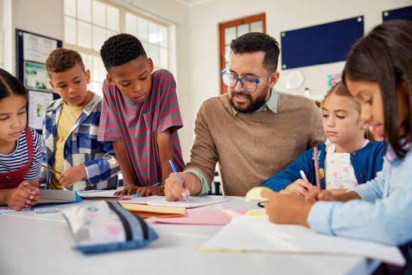
Feedback
I will support the students during the class who cannot re
I will support the students during the class who cannot read aloud the text properly.
d the conversation properly.

Slide 16
Summary of the session
What have you learnt today?
Ans: We have learnt some new words.

Slide 17

