Slide 1

Welcome

Slide 2
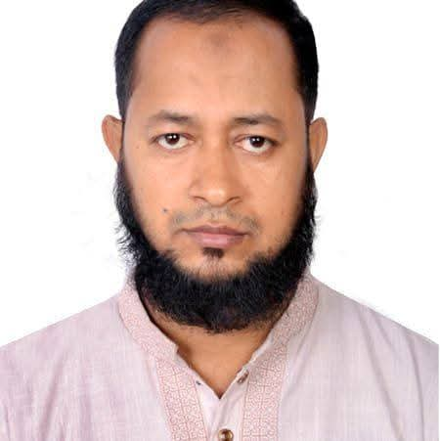
Introduce
Mohammed Firoj Alam,
Assistant Teacher,
Karim Ullah High School, Dagonbhuiyan, Feni
Mobile: 01815256368
Email: alamfiroj84@yahoo.com

Slide 3
Subject: English For Today
Class: Six/Seven
Lesson: Paragraph

Slide 4
Have you any room to read in your home?
What do we call that room?
Yes, Reading Room

Slide 5
Yes, Today’s Topic is……..
My Reading Room

Slide 6
Learning Outcomes
After this lesson the students will be able to
talk about a picture.
write a paragraph on “Your reading room”
write a paragraph on “Your class room”

Slide 7
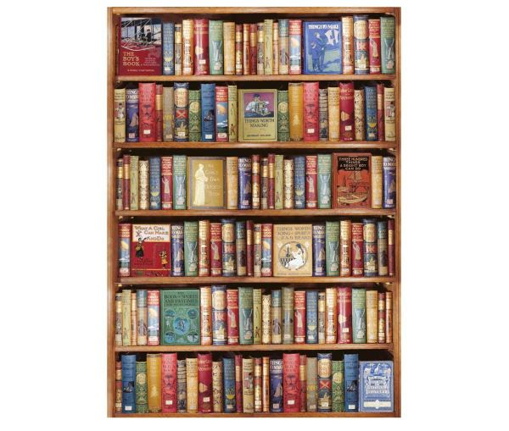
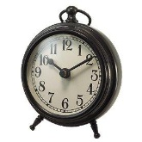
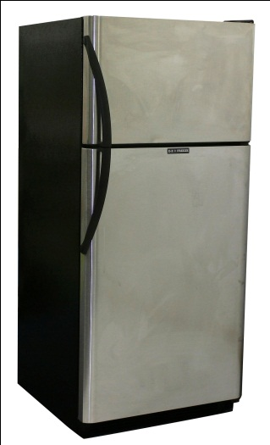
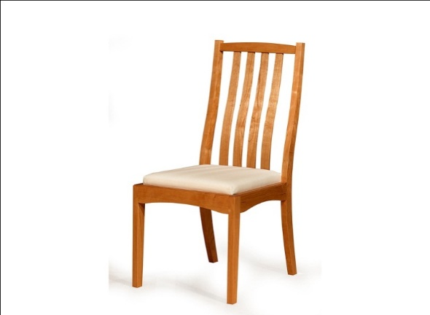
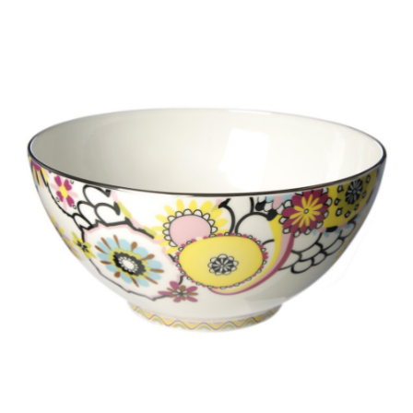
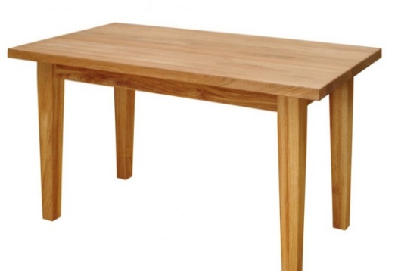
Look at the pictures and find out which things are usually needed in a reading room?
Bookshelf
Refrigerator
Table clock
Table
Bowl
Chair

Slide 8
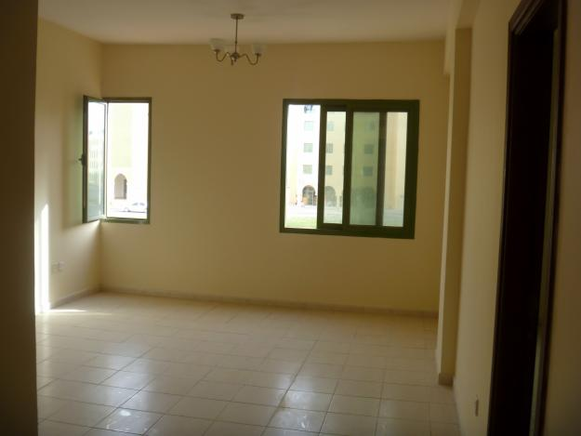
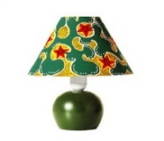
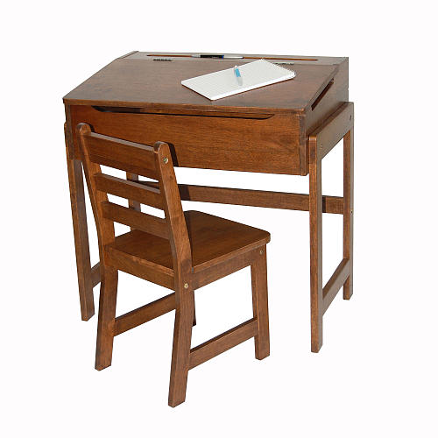
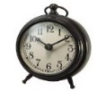
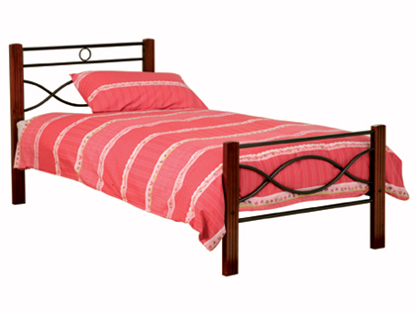

Look at the picture. This is Rohan’s reading room. Now describe the picture.
Notes:
It can be a pair work or teachers can ask few students to describe the picture.

Slide 9
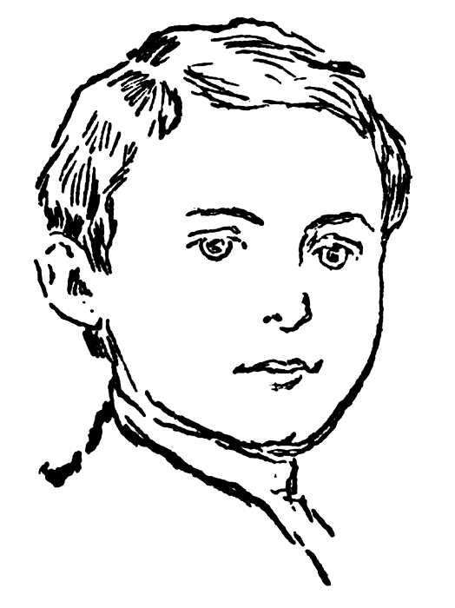







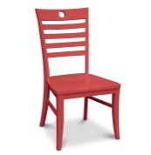

Re-write the following passage using the name of the pictures.
Rohan is a student. He has a reading room. It has two windows and one door. There are a ,a and a . On the table there are a and a . Books are nicely arranged in the bookshelf. His reading room is very neat and clean. It also serves the purpose of his room. loves his reading room very much.
Notes:
The students can write the paragraph using the clue. Then the teacher can ask 1 /2 students to read out the paragraph and tell the other students to check their answers. If it is needed teacher can correct their answers here.

Slide 10
Answering the following questions about “Your Reading Room”. (10 minutes)
1. What is a reading room?
2. What things are there in your reading room?
3. How is your reading room arranged?
4. How does it look?
5. How do you feel in your reading room?

Slide 11
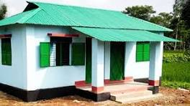
Homework
Write a paragraph about your own classroom.

Slide 12

Thank you all.

