Slide 1
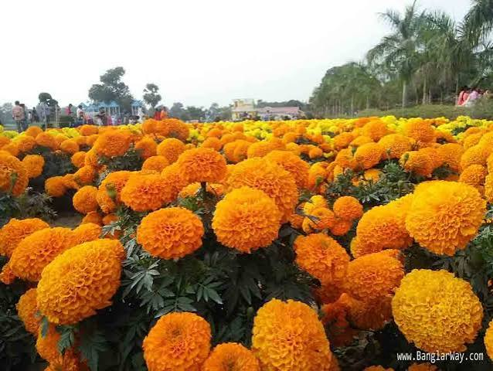
WELLCOME

Slide 2
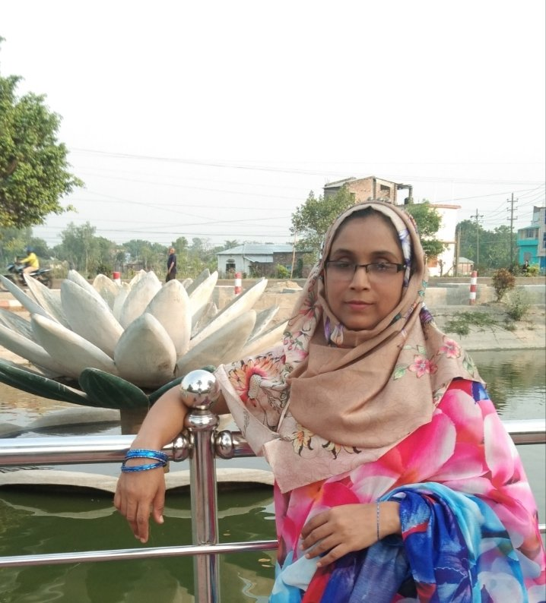


Class: One
Sub: English
Unit: 4
Lesson: 2
Session: 1
Activity:A,B
Page: 76,77

Slide 3
Learning outcomes
3.3.2 Ask simple questions for getting information and respond accordingly .

Slide 4
Let’s sing a song
Head.
Shoulders,knees and toes

Slide 5
Review of the previous session…….
Hi, I’m your English teacher .
What’s your name ?

Slide 6
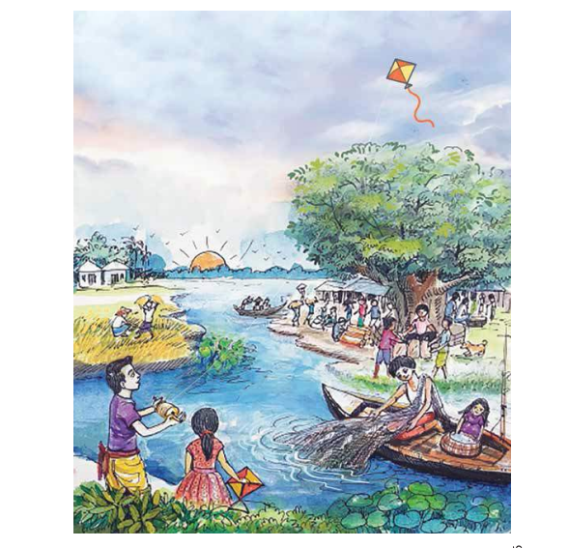
Let’ a picture
What can you see in the picture?
Say the name of the objects either in English or Bangla .

Slide 7
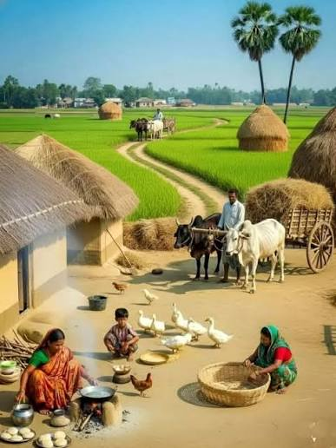
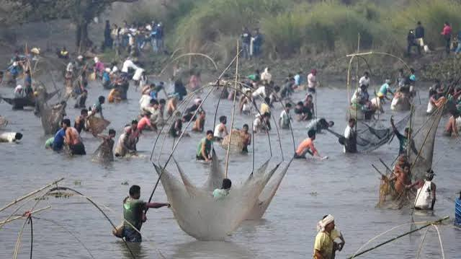
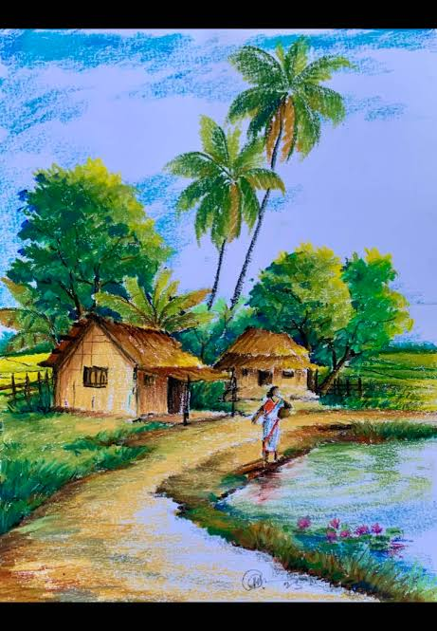
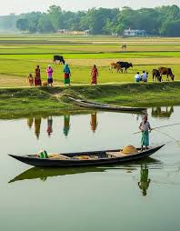
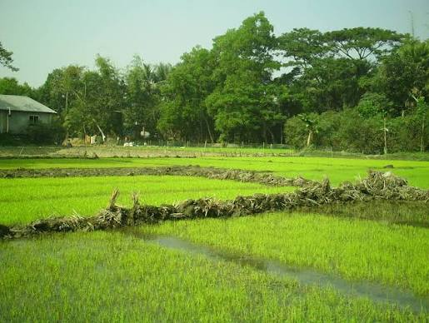
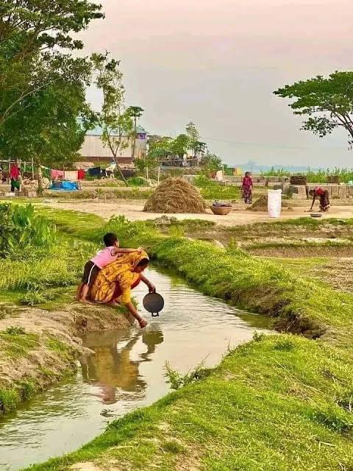
Let’s see more picture……
Where do you see the objects of the picture ? Are the objects in the city /village?

Slide 8
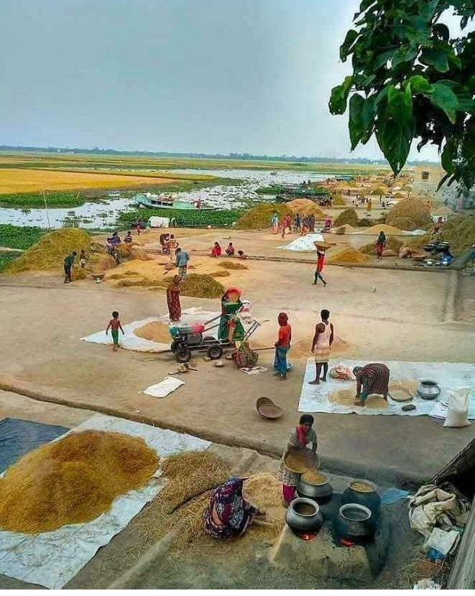
Today we are going to learn the names of objects in the village.

Slide 9
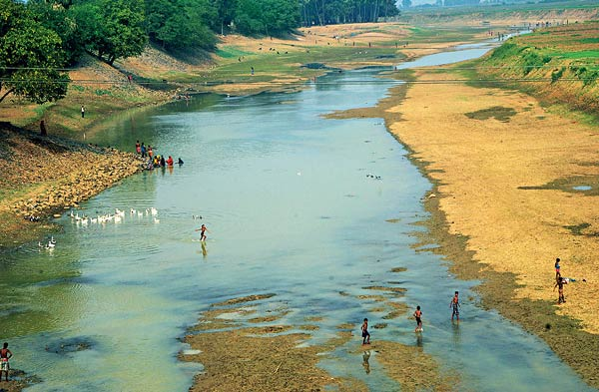
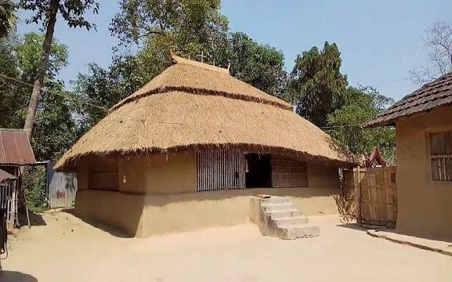
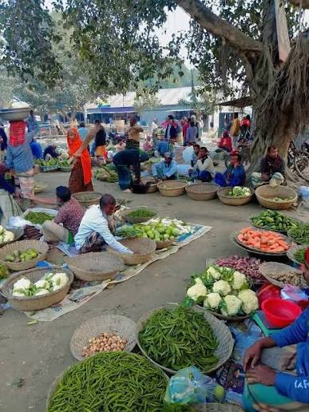


What’s this ?
Let’s see some picture

Slide 10
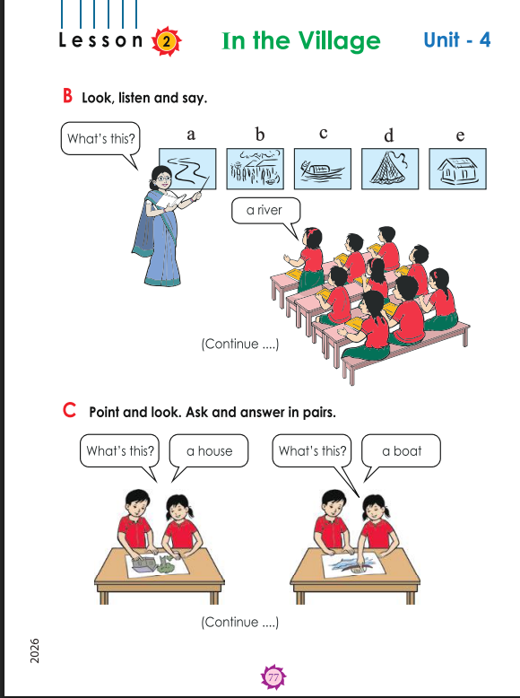
Open your book at page 76,77(activity A and B)

Slide 11
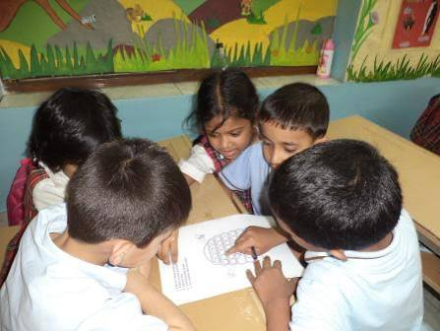
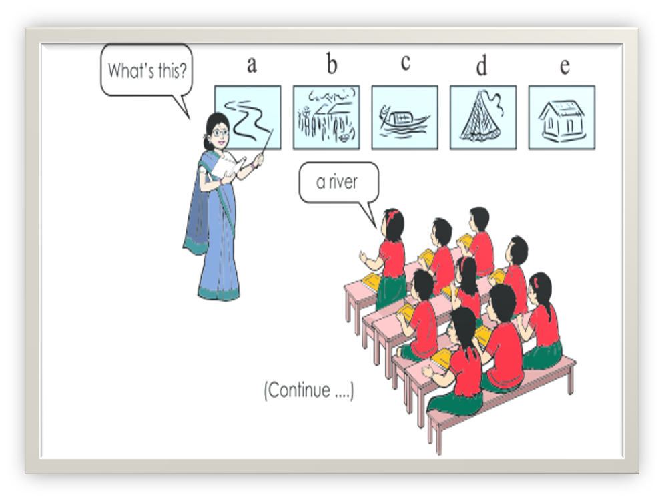
Group work
Make 4/5 Groups and practice the name of objects with proper pronunciation.

Slide 12

Pairwork
One student will point at the picture in your book (a river,a bazer,a boat ,a net, a house) and the other will say the word.
Changing the partner and repeat the pairwork .

Slide 13

Assessment
What’s this?

Slide 14

Today we have learnt the names of objects in the village

Slide 15

Thankyou

