Slide 1
Welcome
English First Paper Class

Slide 2
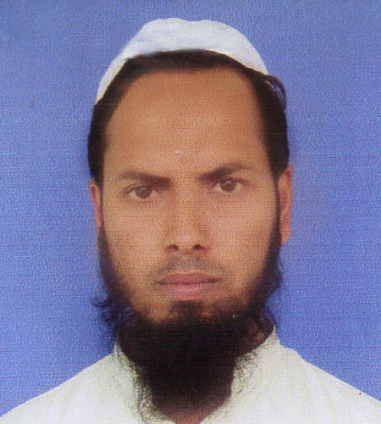
Teacher’s Identity
Md Nizam uddin ( Assistant Teacher)
Ranigonj High School
Ranigonj Bazar, Jagannathpur
Sunamgonj.

Slide 3
Class test – 03
Unit -04
Lesson- 06
Pahela Boishakh
Questions no- 02,03
Marks – 12
Time : 50 minutes

Slide 4
2. Answer the following questions.
What is Pahela Boishakh?
Which is a part of Bangalee culture ?
What do wear men and women on this day ?
What did organise colourful processions ?
Do you wear any special clothes on this occasion ?

Slide 5
3. Fill in the gaps with suitable words.
The celebration of Pahela Boishakh …….a)…… a day of cultural unity for the ……….b)…….nation. It is a ……..c)……day in the ………d)………of bangalee……….e)……….

Slide 6
Matching with answer
marks
whole
special
history
culture

Slide 7
Thank you for joining
English First Paper Class

