Slide 2

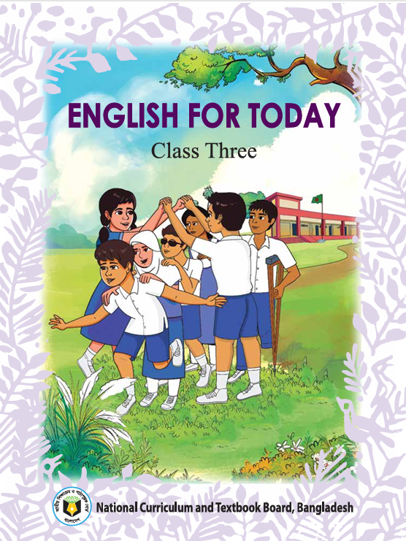
MD KOYES AHMED
Assistant Teacher
Mohammadpur A. Gofur GPS
Dakshin Surma, Sylhet.
E-mail: koyesdsurma.syl@gmail.com
Mobile: 01710504502.
Lesson Plan
Class: 3
Subject: English
Unit: 1
Lesson: 5 Goodbye 2
Page: 10, 11
Time: 45

Slide 3
Understanding simple dialogues about day-to-day activities for effective communication.
Exchanging greetings and farewells at different times for effective communication.

Slide 4
Lets sing a song

Slide 5
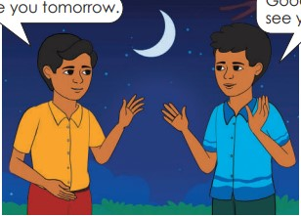
Good night, see you tomorrow.
Good night, see you in the morning.

Slide 6

Today’s Lesson
Goodbye 2

Slide 7
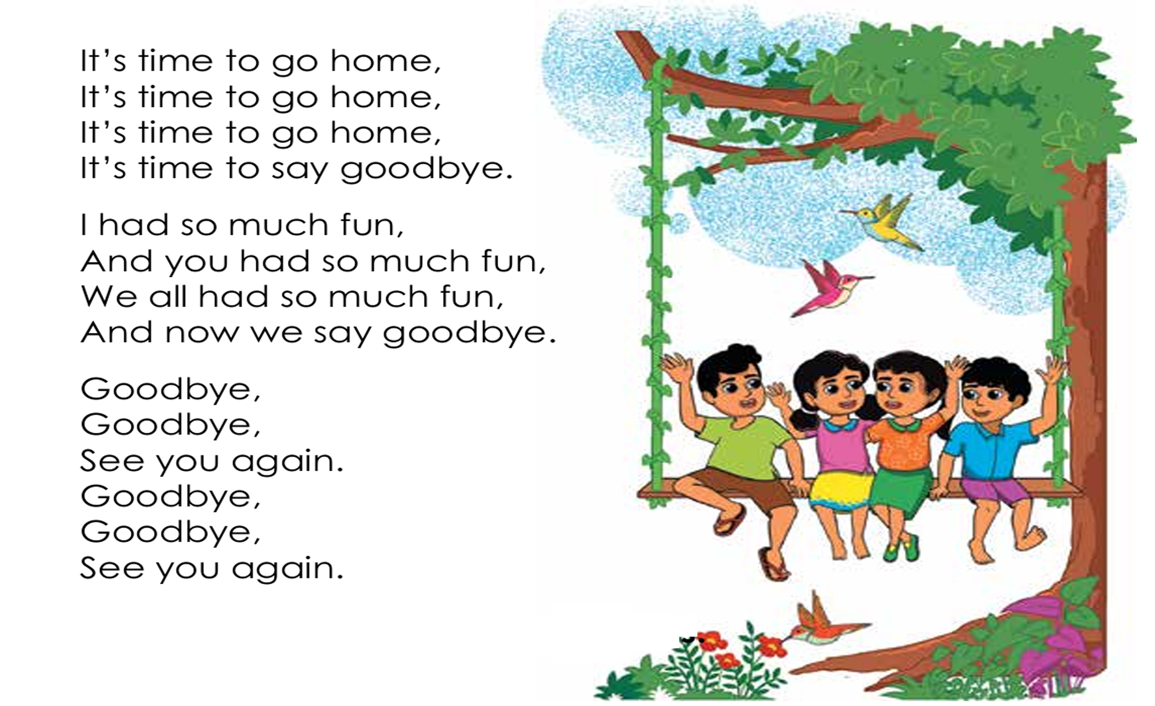

Slide 8
Lets sing the song in group with TPR

Slide 9
Look at the activity C of lesson 3.
Write the correct word in the box.
Roton: Good evening, Salma.
Salma: , Roton.
Roton: Meet my friend, Tanim. And Tanim, she is my friend, Salma.
Tanim: Nice to you.
Salma: meeting you too.
Good evening
meet
Nice

Slide 10
Look at the activity C of lesson 4.
Write the correct word/words in the box.
Asif: Hello Rina,how are you?
Rina: I’m , . And you?
Asif: I’m . are you going?
Rina: I’m going to the nearby shop.
Asif: , goodbye. you .
Rina: .
fine
thanks
fine
Where
Okay
See
again
Goodbye

Slide 11
Match the words in column A with column B
Column A | Column B
Nearby | Store
Shop | At present
Fun | Enjoyment
Again | Close
Now | Once more

Slide 12
Let’s practice:-
Open page number 10 and sing the song alone.

Slide 13
Write the song in your homework note.

