Slide 1


Slide 2
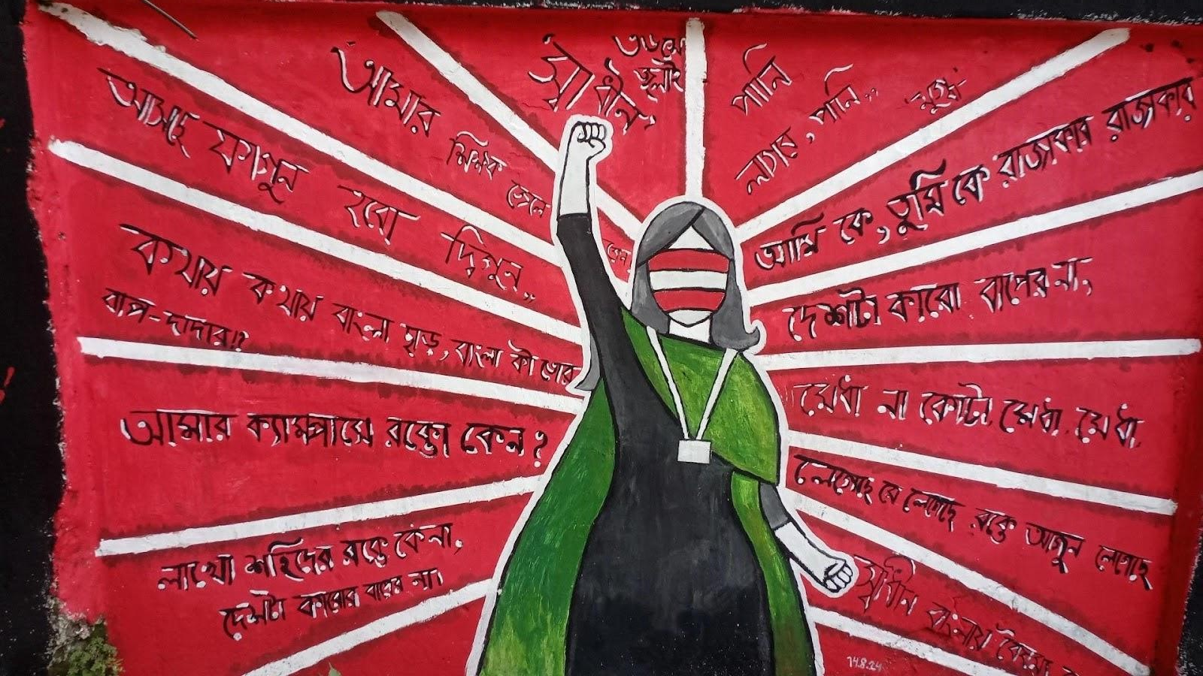
Warm-Up & Engagement (ওয়ার্ম-আপ)
"Have you ever seen messages or paintings on street walls?"
What messages did you see?
Who do you think created them?
What was the purpose?
স্থানীয় প্রেক্ষাপট:
Wall writings in Bangladesh (দেয়াল লিখন) — political slogans, social messages, and artistic expressions seen in our cities and towns.
For Better Understanding
See More Images Next Slide,,,

Slide 3
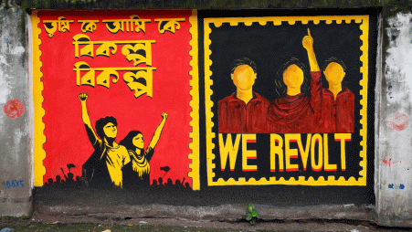
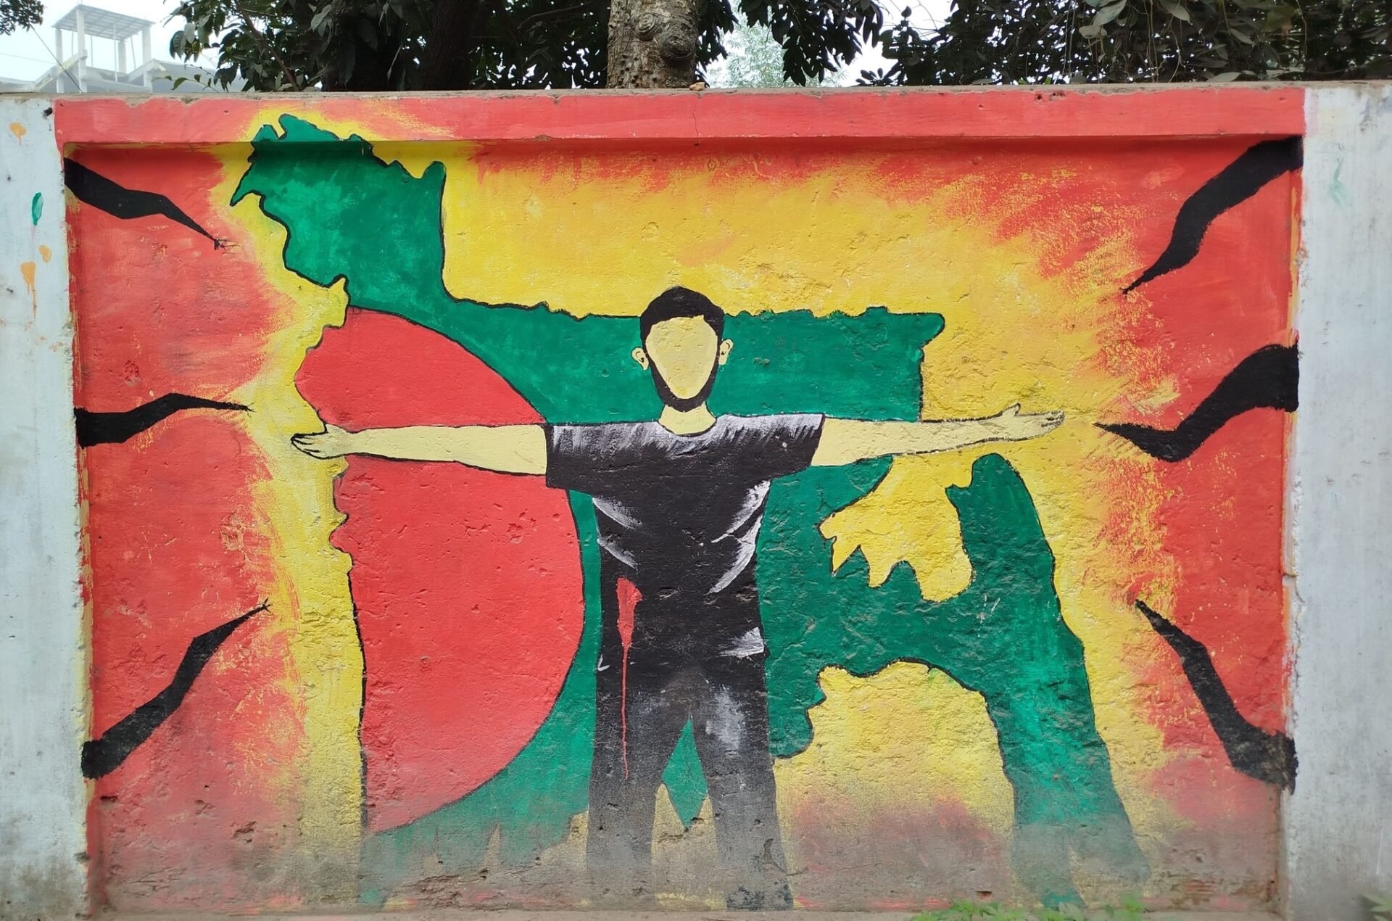
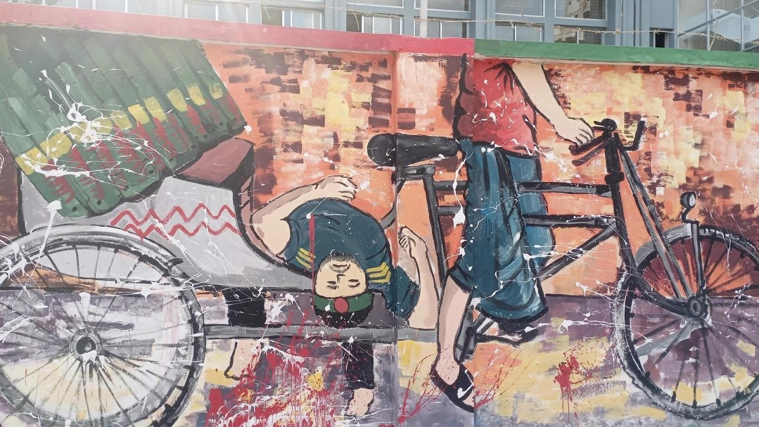

Slide 4
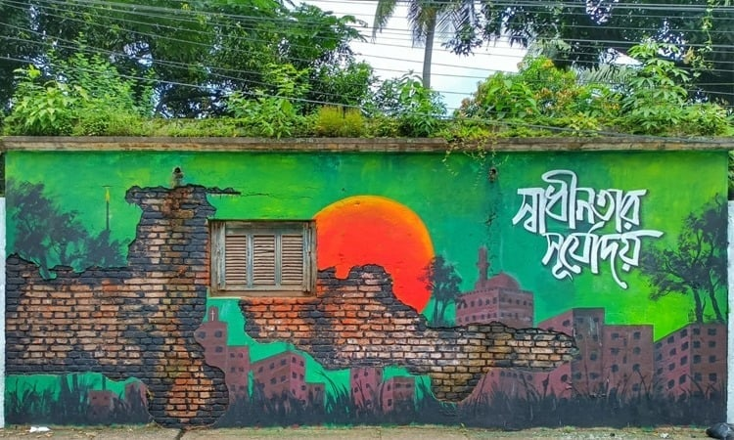

Slide 5
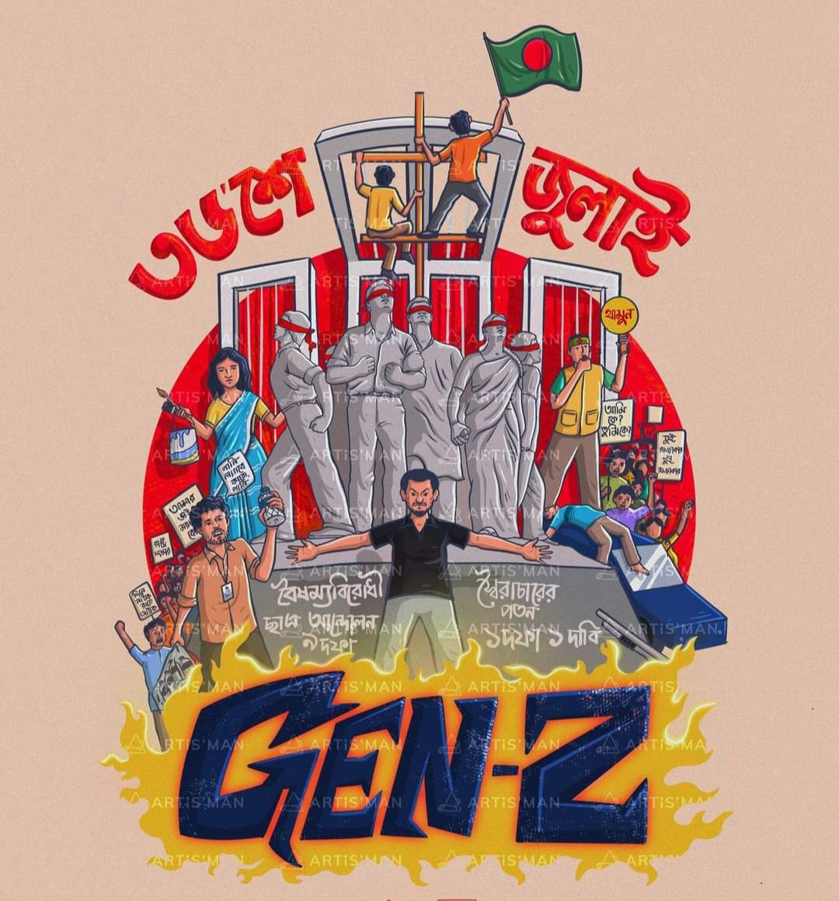
Todays Topic
Graffiti
(The Art of Public Expression)
Unit 16
English For Today
Class: 9-10
Subject: English First Paper
Prepared By:
See the Next Slide

Slide 6


Slide 7


Learning Outcomes (শিখনফল)
1
2
3
Understand Graffiti
Art vs. Vandalism
Key Vocabulary
What graffiti is and its social context
Differentiate between Street Art and Vandalism
New words with English & Bangla meanings
4
5
Exam Preparation
Social Analysis
Answer comprehension questions for exams
Graffiti as a tool for expression and awareness

Slide 8
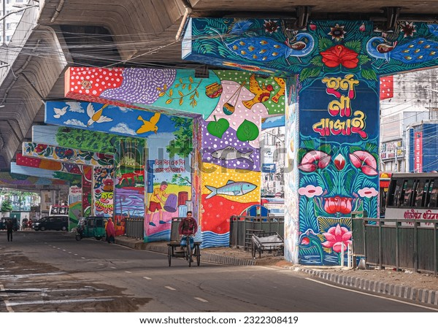

What is Graffiti? (গ্রাফিতি কী?)
Definition: Graffiti refers to images, slogans, or writings painted or drawn on public walls and surfaces.
Origin
Modern Era
Purpose
Key Message
Ancient Greece & Rome to modern street art movements
Emerged as a significant art form in 1970s–80s New York City
A tool for expressing thoughts, protest, and social awareness
Gives voice to those without access to traditional media

Slide 9
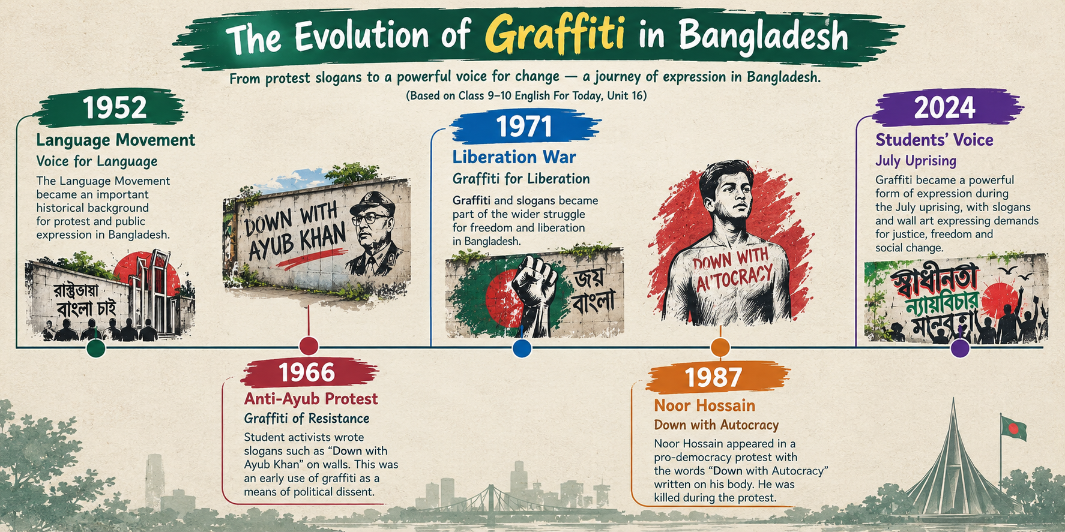

Slide 10
Key Vocabulary (গুরুত্বপূর্ণ শব্দার্থ)
Word | English Meaning | বাংলা অর্থ
Graffiti | Street Art / Wall Writing | দেওয়ালে আঁকা চিত্র বা লেখা
Vandalism | Destruction of public property | সরকারি বা পাবলিক সম্পত্তি বিনষ্টকরণ
Expression | Conveying feelings or emotions | মনের ভাব বা ক্ষোভ প্রকাশ
Mural | Large-scale wall painting | দেয়ালের উপর অঙ্কিত বিশাল চিত্রকর্ম
Protest | Expression of disagreement | সামাজিক বা রাজনৈতিক প্রতিবাদ
Tag | Artist's signature or mark | শিল্পীর স্বাক্ষর বা চিহ্ন

Slide 11

Art vs. Vandalism (শিল্প নাকি ভ্যান্ডালিজম?)
🎨 Artistic Graffiti (শিল্পসম্মত)
⚠️ Vandalism (ভ্যান্ডালিজম)
Created with a positive message or social awareness
Demonstrates artistic skill and creativity
Often done with community permission or in designated spaces
Adds beauty and meaning to public spaces
Done illegally without permission
Damages public or private property
Lacks constructive message or artistic value
Creates negative impact on the community
The difference lies in intent, permission, and artistic value — not just the act of painting on a wall.

Slide 12





Social Significance of Graffiti
Voice of the Common People
Historical Movements
Social Awareness
Used in civil rights, youth activism, and political change worldwide
"Save Nature," "Stop Violence," "Education for All," "Women's Rights"
সাধারণ মানুষের ভাষা — Gives expression to those without access to mainstream platforms
Cultural Identity
Youth Empowerment
Reflects local culture, traditions, and community values
Enables young people to participate in social discourse and creative expression

Slide 13

Classroom Activity (একক ও দলীয় কাজ)
📋 Your Task
Form groups of 4 students. Design a graffiti slogan for one theme:
Requirements: Catchy slogan (5–10 words) · Artistic elements · Explain message (2–3 sentences)
⏱️ Time: 10–15 min | 🎤 Present: 2 min per group
🌿 Environmental Awareness
⚡ Youth Empowerment
📚 Education for All
পরিবেশ সচেতনতা
যুব ক্ষমতায়ন
সবার জন্য শিক্ষা

Slide 14

Exam-Focused Comprehension (পরীক্ষার প্রস্তুতি)
1
Question 1
What makes graffiti a powerful tool for public expression? Explain with examples.
2
Question 2
How can we differentiate between artistic graffiti and vandalism? Give two points for each.
3
Question 3
Discuss the social significance of graffiti in historical movements.
4
Question 4
Why is graffiti considered the "voice of the common people"?
5
Question 5
Define 3 key vocabulary terms related to graffiti with their Bangla meanings.
💡 Tip: Use examples from your local context and current social movements when answering.

Slide 15
Summary & Homework (বাড়ির কাজ)
📌 Lesson Summary
📋 Guidelines
Graffiti is a form of public expression that reflects social, political, and cultural messages. When created with artistic intent and positive purpose, it becomes a powerful medium for youth empowerment and social awareness.
01
Structure
Include an introduction, 2–3 main points, and a conclusion
✏️ Homework Assignment
02
Write a short paragraph (120–150 words) on the topic:
Vocabulary
Use at least 3 vocabulary terms from today's lesson
"Graffiti as a Power of Youth Voice"
03
Real-World Example
Provide one real-world or local example of graffiti
04
Submission
Submit by next class

