Slide 1

Good
morning
Prepared by: Md. Saifuddin-Ass. Teacher , Afzal Nagar GPS. Satkania, Chattogram.

Slide 2
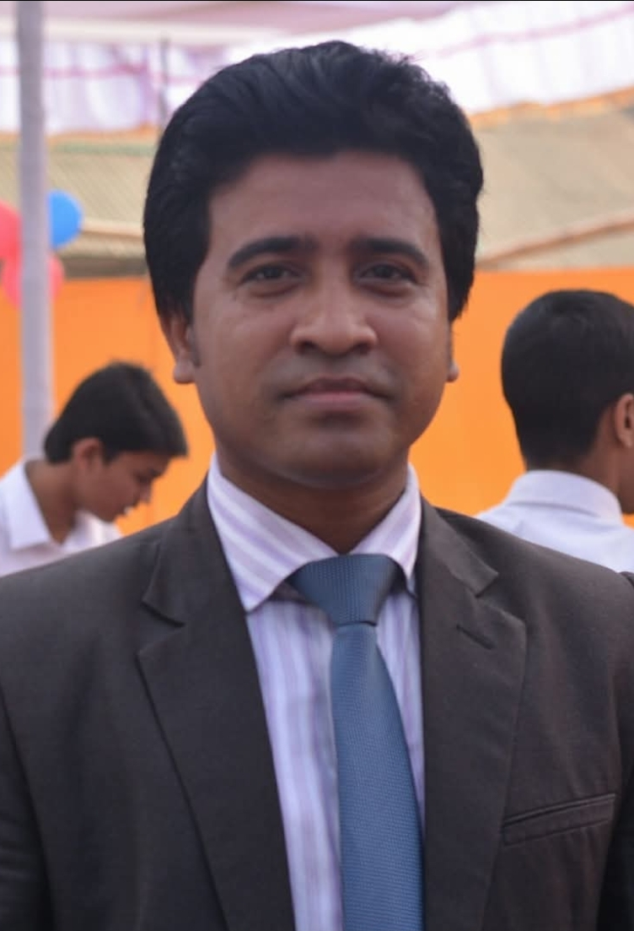
Teacher Profile
Md. Saifuddin
Ass. Teacher of Afzalnagar GPS.
Satkania, CTG.
Prepared by: Md. Saifuddin-Ass. Teacher , Afzal Nagar GPS. Satkania, Chattogram.

Slide 3

Let's see a picture!
Prepared by: Md. Saifuddin-Ass. Teacher , Afzal Nagar GPS. Satkania, Chattogram.

Slide 4
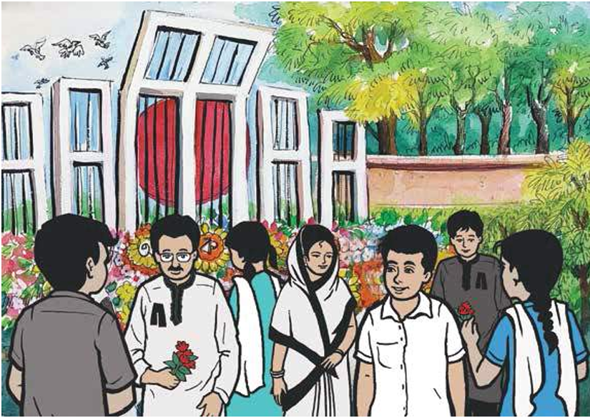
Prepared by: Md. Saifuddin-Ass. Teacher , Afzal Nagar GPS. Satkania, Chattogram.

Slide 5


How many trees in the picture?
Prepared by: Md. Saifuddin-Ass. Teacher , Afzal Nagar GPS. Satkania, Chattogram.

Slide 6


How many flowers in the picture?
Prepared by: Md. Saifuddin-Ass. Teacher , Afzal Nagar GPS. Satkania, Chattogram.

Slide 7
Let’s go watching a nice video of 7-8
https://www.youtube.com/watch?v=PfEqSjgW4tk&list=RDPfEqSjgW4tk&start_radio=1
https://www.youtube.com/watch?v=kdzD8Z2Ip6A&list=RDkdzD8Z2Ip6A&start_radio=1
Prepared by: Md. Saifuddin-Ass. Teacher , Afzal Nagar GPS. Satkania, Chattogram.

Slide 8


Let’s trace in the air
Prepared by: Md. Saifuddin-Ass. Teacher , Afzal Nagar GPS. Satkania, Chattogram.

Slide 9


Prepared by: Md. Saifuddin-Ass. Teacher , Afzal Nagar GPS. Satkania, Chattogram.

Slide 10


Prepared by: Md. Saifuddin-Ass. Teacher , Afzal Nagar GPS. Satkania, Chattogram.

Slide 11
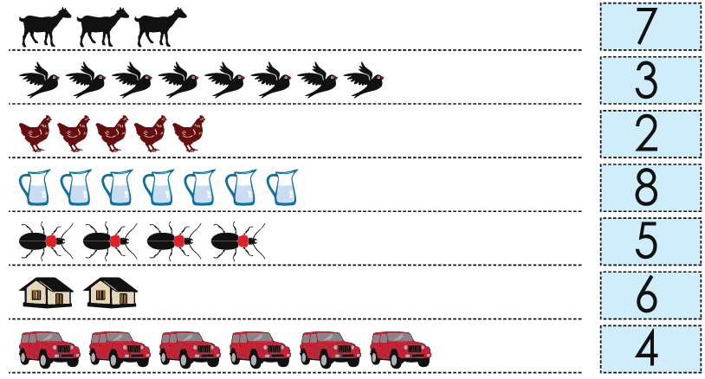
Count and match the numbers
Prepared by: Md. Saifuddin-Ass. Teacher , Afzal Nagar GPS. Satkania, Chattogram.

Slide 12
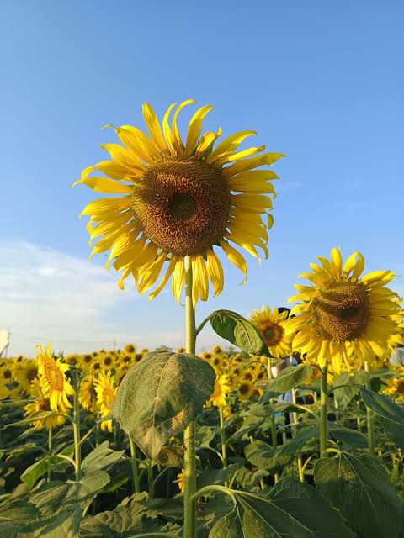
Thank you
for staying with me.
Prepared by: Md. Saifuddin-Ass. Teacher , Afzal Nagar GPS. Satkania, Chattogram.

