Slide 1
Dear students,
welcome today our
English First Paper Class

Slide 2
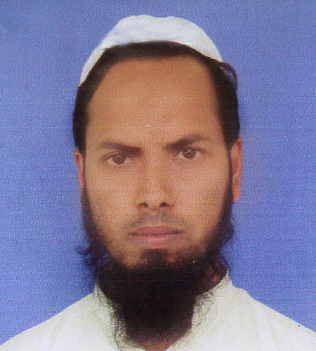
Teacher’s Identity
Md Nizam uddin ( Assistant Teacher)
Ranigonj High School
Ranigonj Bazar, Jagannathpur
Sunamgonj.

Slide 3
Class test – 08
Unit -08
Lesson- 03
The Statue of Liberty
Questions no- 02,03
Marks – 12

Slide 4
2. Answer the following questions.
Where is the Statue of Liberty situated?
When was the statue given?
Who is Auguste Bartholdi ?
Which country has given the statue ?
Do you think, it is the symbol of liberty enlightening in the world ?

Slide 5
3. Fill in the gaps with suitable words.
The Statue of Liberty, her……a)…and the…b)….she is……c)….. French has given the statue in the…..d)….. Now it is situated in the city of ………e)…..

Slide 6
Matching with answer
face
tablet
holding
USA/America
New York

Slide 7
Thank you
For joining our
English First Paper Class

