Slide 1


Slide 2
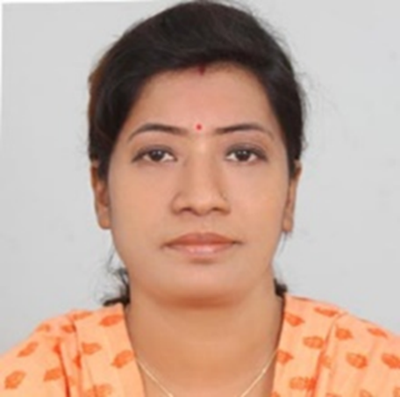
Teachers’ Identity
SUMI DAS
Assistant Teacher
Purba ziri Amania Lokman Hakim Model Govt. Primary School.
Patiya , Chattogram.

Slide 3
Lesson Introduction
Class :4
Unit :17
Title : The Land of Mountain (1.1, 1.2)
Page : 77,78

Slide 4
Learning Outcome
5.1.1- Get the specific information from simple texts.
5.1.2- Comprehend the general ideas from simple texts.

Slide 5
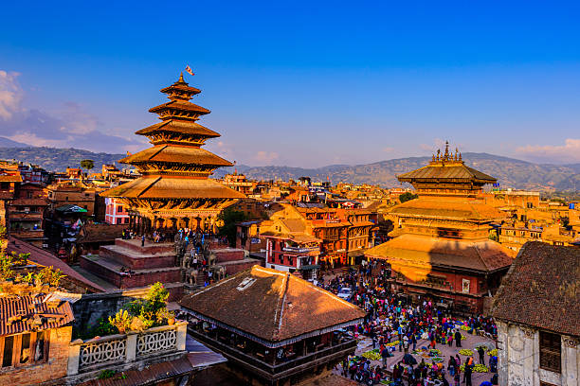
Do you know the name of this country?

Slide 6
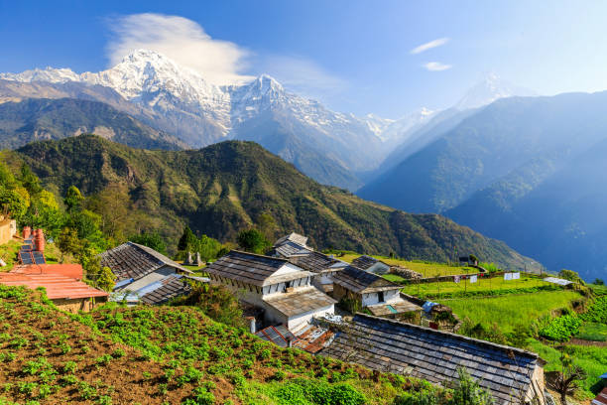
The Land of Mountain

Slide 7
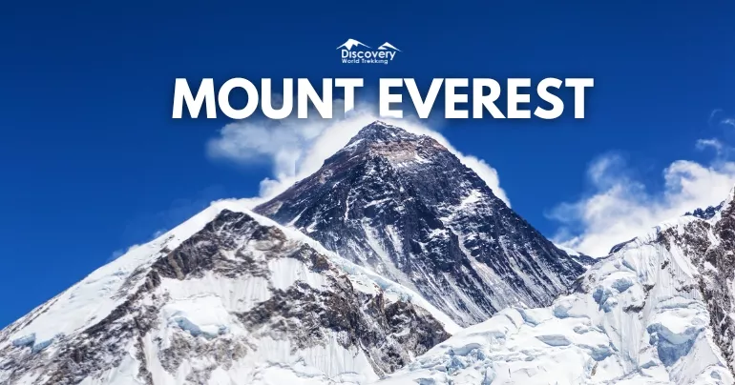
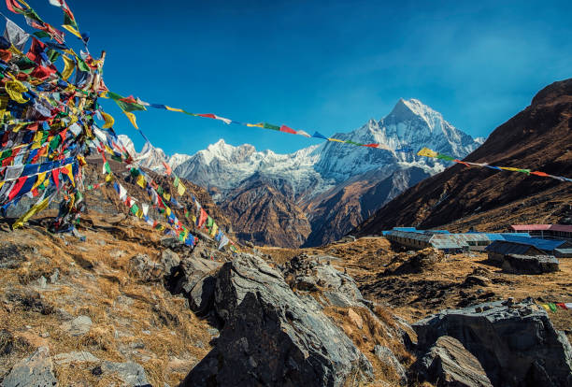
Mount Annapurna

Slide 8
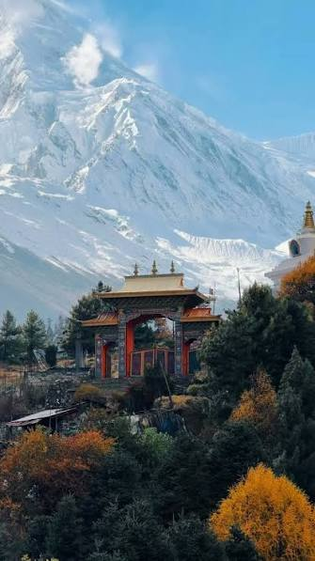
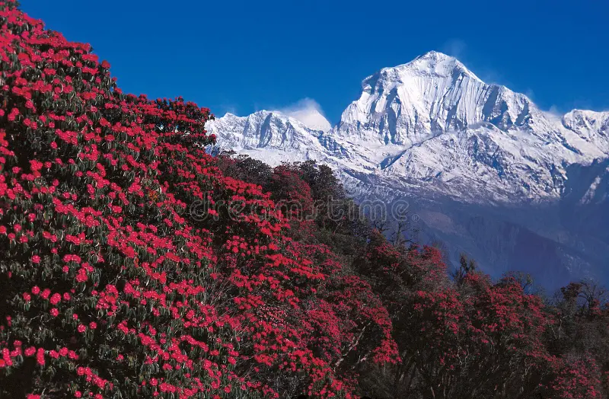
Mount Manaslu
Mount Daulagiri

Slide 9
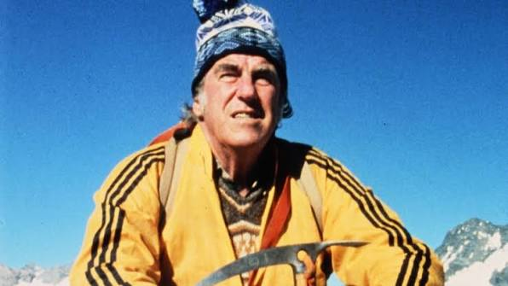
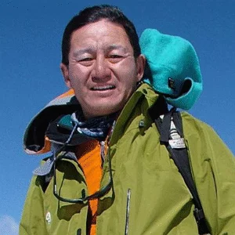
Sir Edmund Hillary
Tenzing Norgay
Nepal is a land of beauty. It is a country of mountains, hills, lakes, forests, and temples. It is famous for its high mountains such as Mount Everest, Mount Annapurna, Mount Manaslu , Mount Daulagiri etc. Mount Everest is the highest mountain in the world. Sir Edmund Hillary and Tenzing Norgay were the first to successfully reach the summit of Everest in 1953.

Slide 10
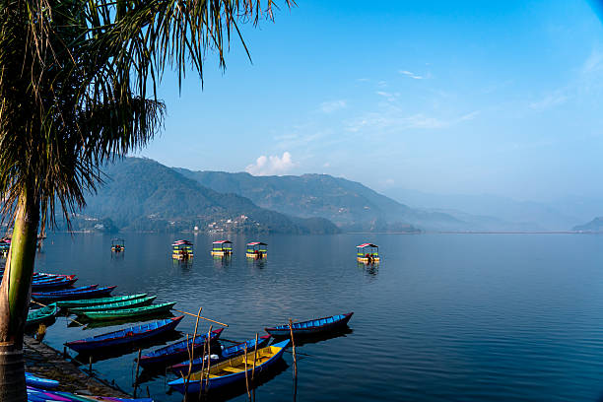
Besides mountains, Nepal has lovely lakes. One of the most famous lakes is Phewa Lake in Pokhara. You can ride on boats on the lake. The reflection of the mountains in the clear water will make you happy.

Slide 11
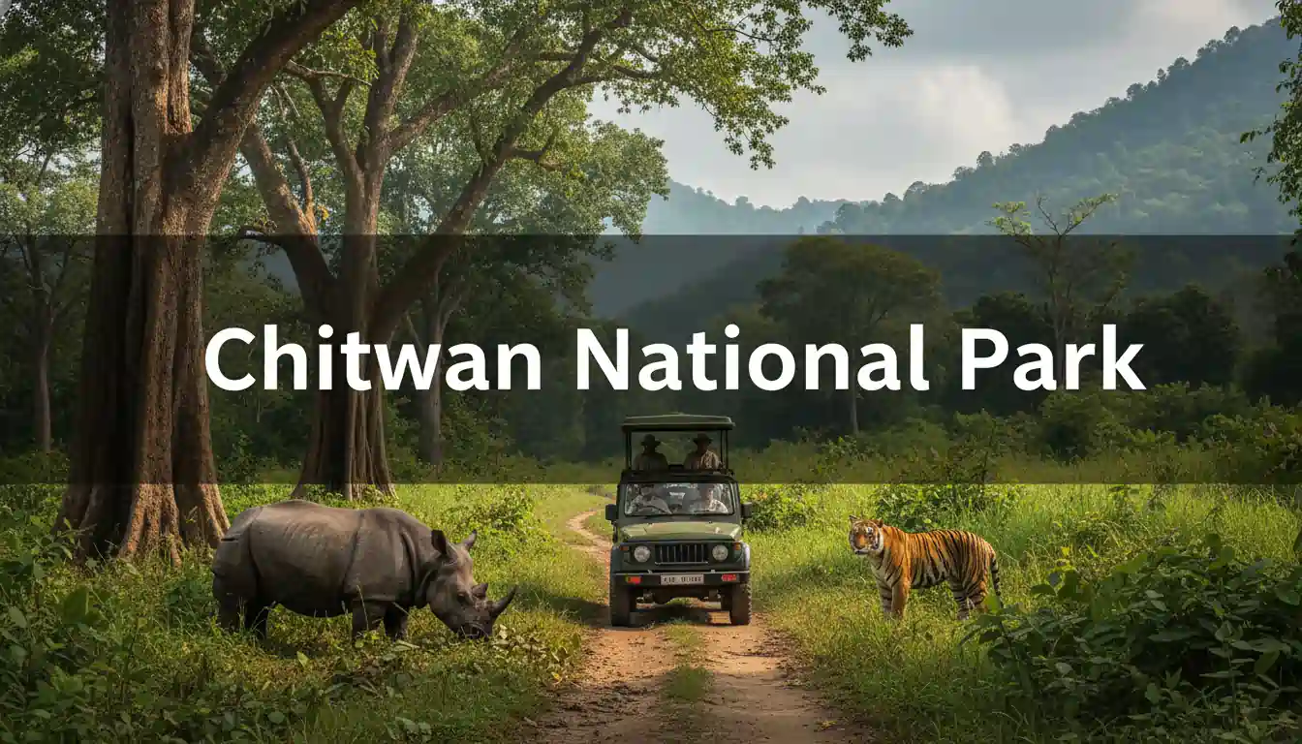
Nepal also has green forests filled with trees, animals and colorful birds. In Chitwan National Park, you can see elephants, rhinos and even tigers.

Slide 12
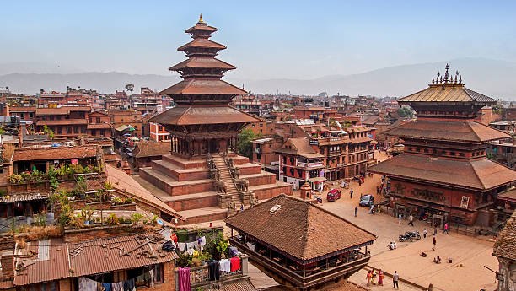
Kathmandu
In the capital city , Kathmandu, there are many old buildings, palaces and temples. They are very colourful.

Slide 13
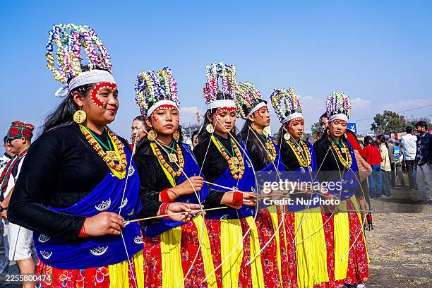
Nepalese like to dance and enjoy music in most of their festivals. They take a variety of foods during festivals. Nepal is truly a wonderful country.

Slide 14
