Slide 1

WELCOME
To
English Class

Slide 2
Presentation
For
Students of Class-vii
By-
A.K.M. Rezaul Karim
Senior English Teacher
BAF Shaheen College Dhaka.

Slide 3
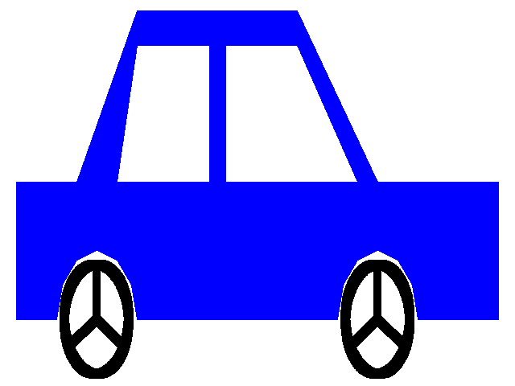
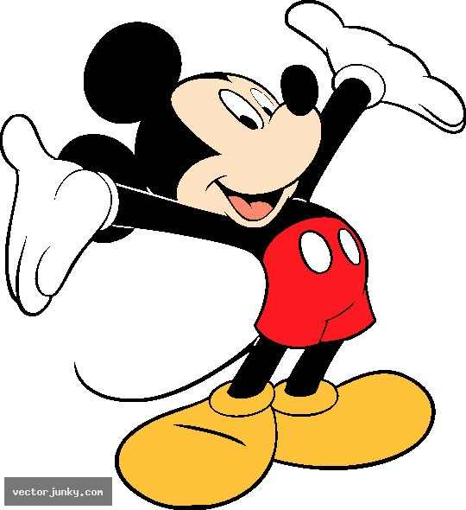
behind
Mr. Mickey is ___________the car.
on
Mr. Mickey is _____________ the car.

Slide 4
So, our today’s topic is ………………………..……..?
Preposition

Slide 5
Aims and Objectives:
By the end of the lesson you will have
practiced writing and speaking skill.
b) Learnt about preposition and their uses.
c) Talked about the location of different things using correct preposition.

Slide 6
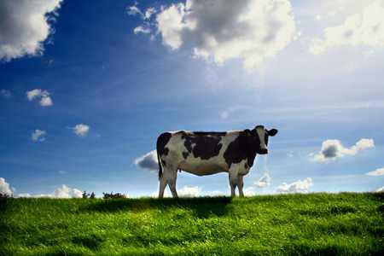
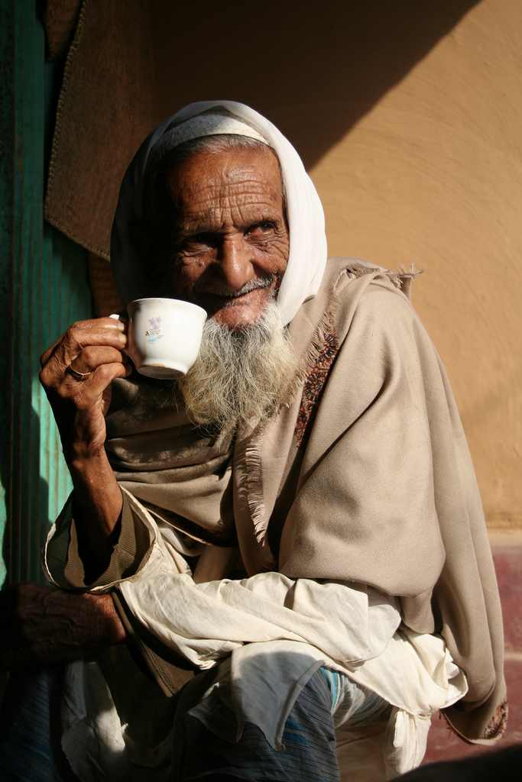
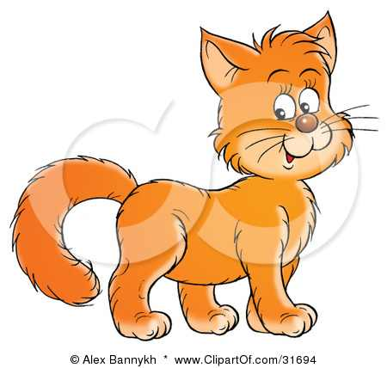
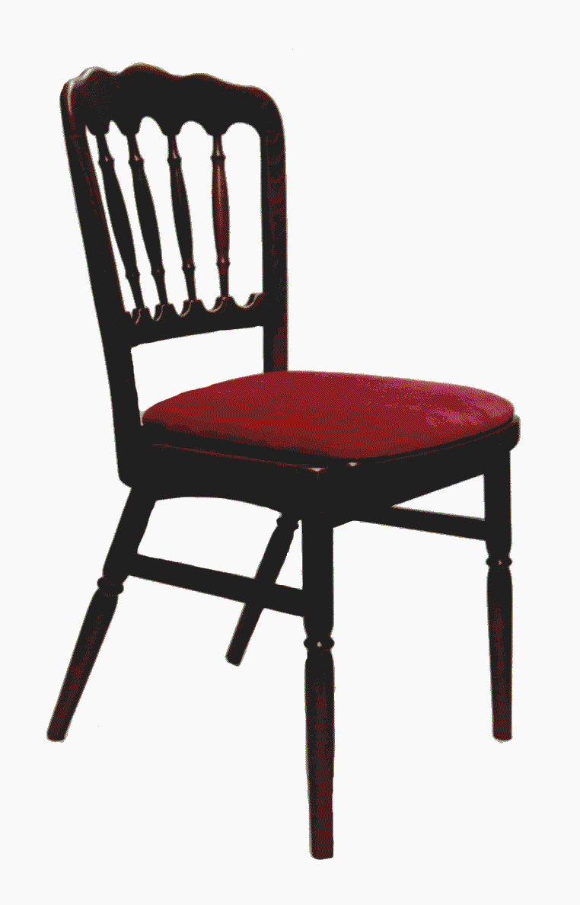
There is a cow in the field.
Cow in field
(Noun) Preposition Noun
The old man is fond of tea.
fond of tea
(Adjective) Preposition Noun
A cat is on a chair
The cat jumped off it .
Jumped off it
Verb Preposition pronoun

Slide 7
So, what is preposition?
Pre means before and position means place
Preposition means 'that which is placed before'.
Before what……………..?
Before noun or pronoun
So, preposition is a word that is placed before a noun or pronoun to show its relation with other words in the sentence.

Slide 8
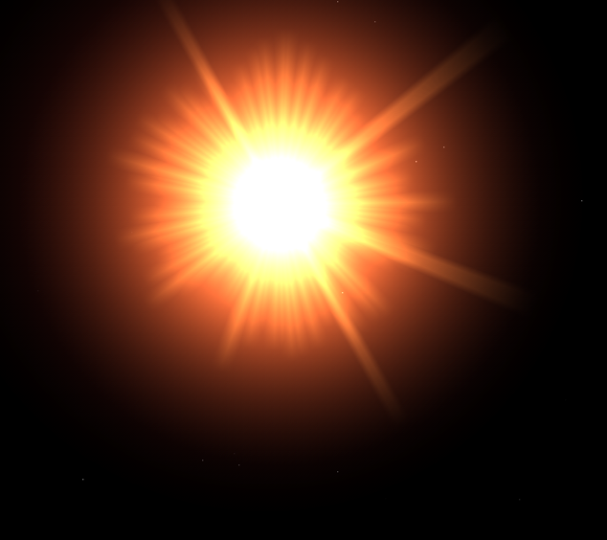
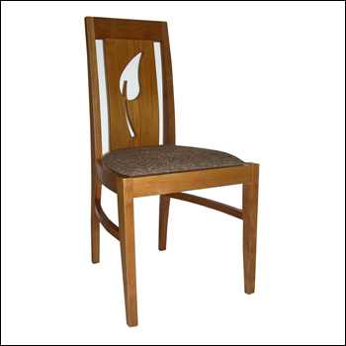
The sun is _________ the car.
above
over
The cat jumped ________ the chair.

Slide 10
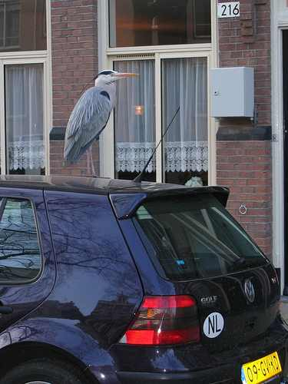
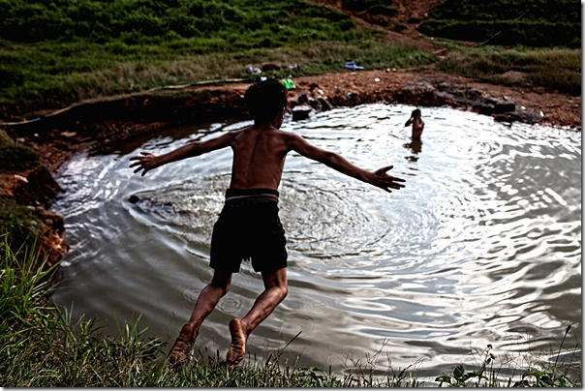
on
A bird is ____________ the car.
into
The boy jumps __________ the pond.

Slide 11
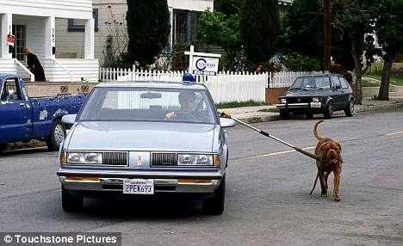
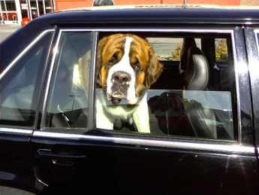
The dog is walking __________ the car.
by/beside
In/inside
The dog is sitting ___________ the car.

Slide 12

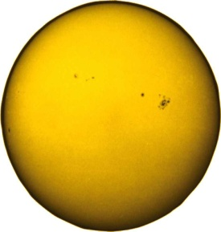
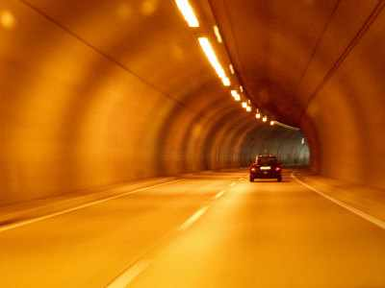
round
The earth moves ___________ the sun.
sun
sun
through
The car is going ___________ the tunnel.

Slide 13
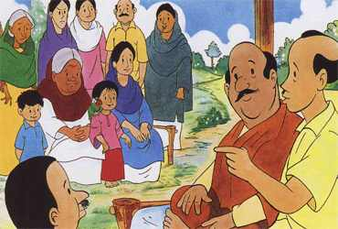
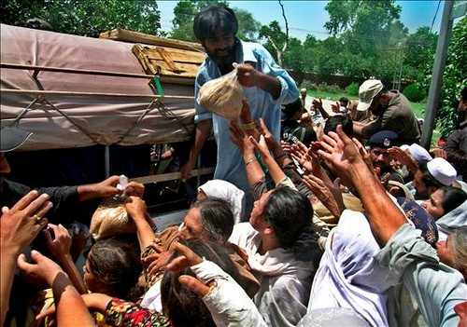
between
Mina is sitting ______________ her mother and grandmother.
Between – two/more individual persons/things
The man is distributing relief _______ the flood-affected people.
among
Among- more than two persons/things.

Slide 14
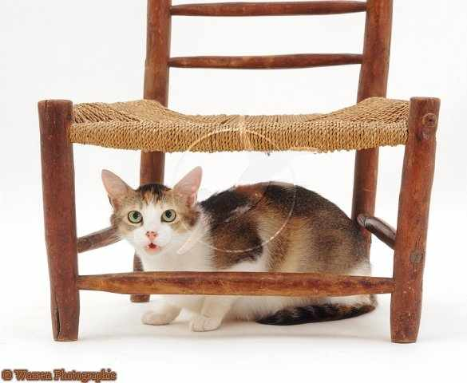
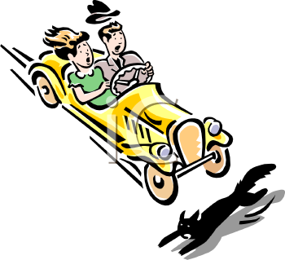
The cat is standing ________ the car.
behind
under
The cat is sitting ___________ the chair.
In front of
A black cat is running _________ the car.

Slide 15
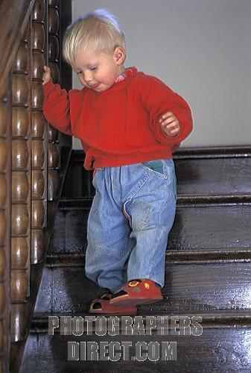
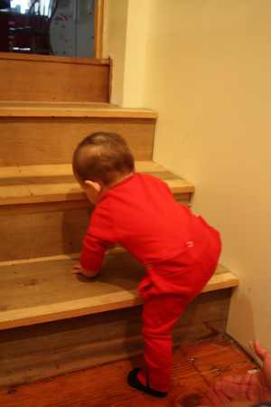
The boy is walking ______________ the stairs.
down
The child is walking _______________ the stairs.
up

Slide 16
Evaluation:

Slide 17
Fill in the blanks with preposition from the box.
on
in
over
by
between
among
above
into
The students are sitting _______ their class room.
The teacher entered __________ the classroom hurriedly.
Distribute the chocolates ________ the students.
The boy jumped ___________ the wall.
The roof ________ our head is white washed.

Slide 18
Homework:
Write ten sentences using the following prepositions.
On, over, above, in, into, between, among, behind, in front of, down

Slide 19


