Slide 1
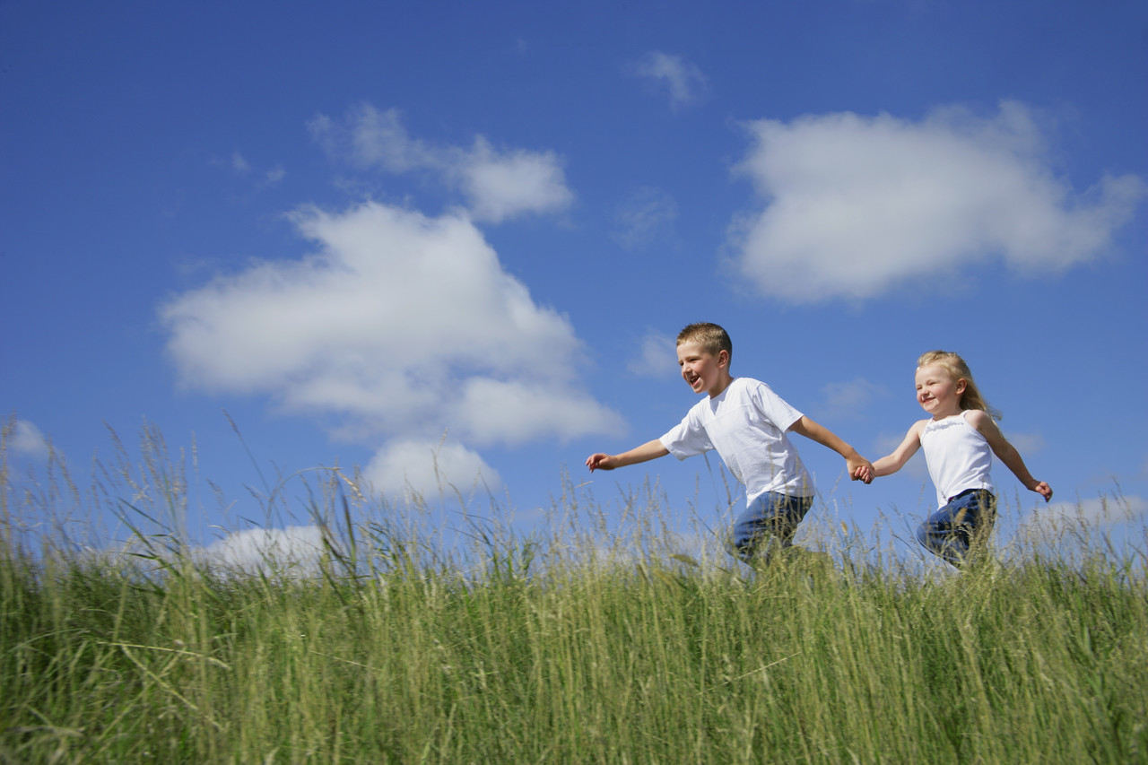
Welcome Everybody
To This Session

Slide 2
Teacher
Md. Kamal Uddin
Assistant Headmaster
Harinarayanpur High School
Maijdee Court, Noakhali

Slide 3

Date
27
N
O
V
E
M
B
E
R
2012
Class :
Ten
Ss Nos. :
80
Subject :
English
Paper :
First
Unit : 22
Lesson :6

Slide 4
outcomes
After This Lesson The Students
Will learn about the Liberation War of Bangladesh.
Will learn about the martyrs of Liberation War.
Will learn about the purpose of The National Memorial.
Will learn how Bangladesh became independent.

Slide 5
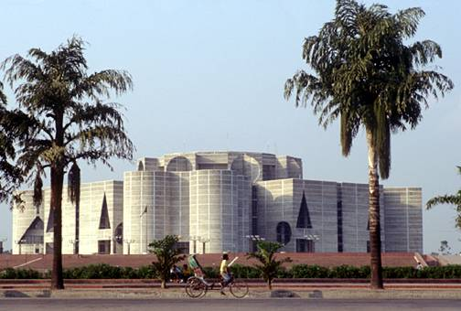
Let’s Look at the picture-
It’s our National Parliament Building

Slide 6

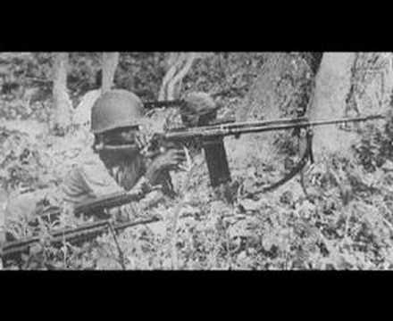
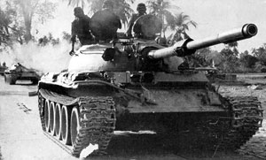
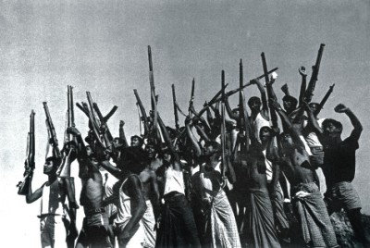
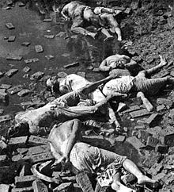
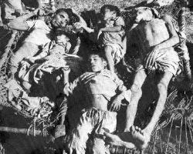
Let’s Look at some more Pictures :
The War Of Independece-1971
The Freedom Fighters
The Martyrs of The Liberation War

Slide 7
Now, let’s discuss about the pictures
These are-
the pictures of our War of Independence and the Martyrs who laid down their lives for our independence.

Slide 8
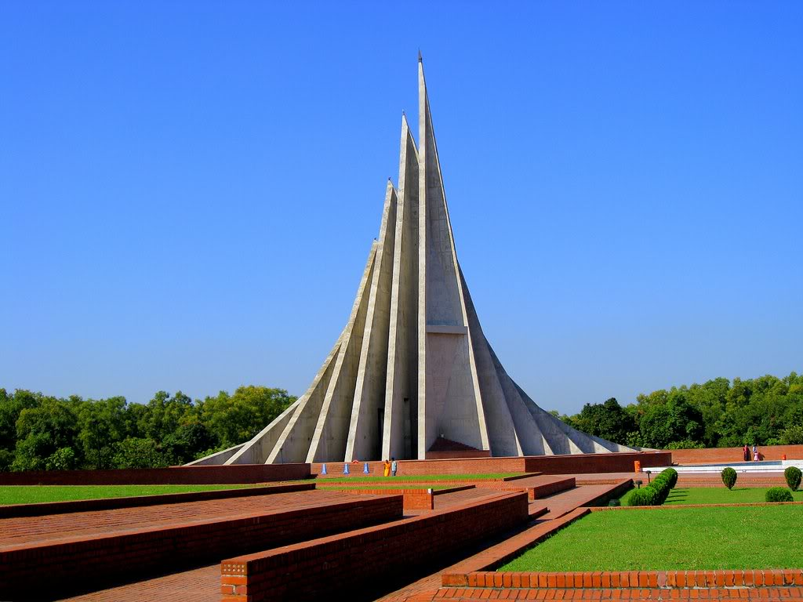
Title of Today’s Lesson
The National Memorial Of Bangladesh

Slide 9

Individual work- 4 Minutes
Now, Open at page 142
of your Text book and
read the passage silently.

Slide 10
Meanings of some hard words
Achievement
Earning
Immesureable
What can’t be measured
Prominently
Mainly
Oppressor
Torturer

Slide 11
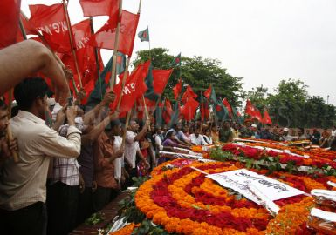

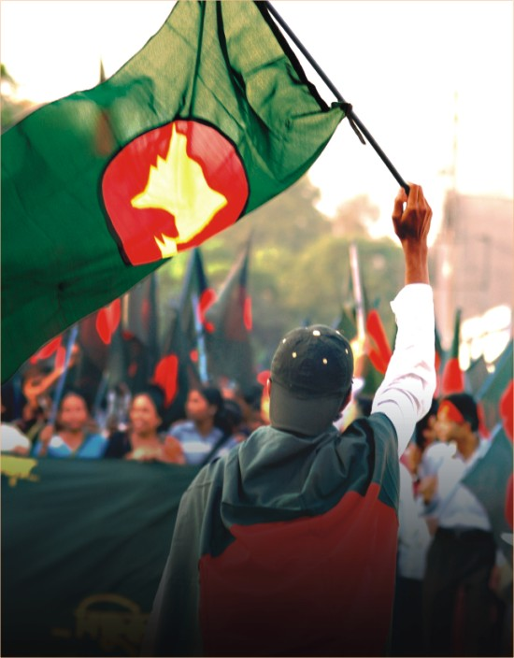
Let’s see the pictures and note how the Independence is observed.

Slide 12
Pair work. Time: 4 minutes
Now , answer the following questions
1
What is The National Memorial?
2
Where is it located?
2
How tall are the towers of it?
2
What is it built with and made of?

Slide 13
Now match your ideas with the following answers
Key-1
The symbol of the nation’s respect for the martyrs
Key-2
At Savar
Key-3
150 feet
Key-4
Built with concrete but made of blood

Slide 14
Group work. Time : 5 minutes
Write your ideas about the achievement of our War of Liberation.

Slide 15
HOME TASK
Write a paragraph within 70-80 words on ‘The National Memorial’.

Slide 16

THANK
YOU
ALL

