Slide 1
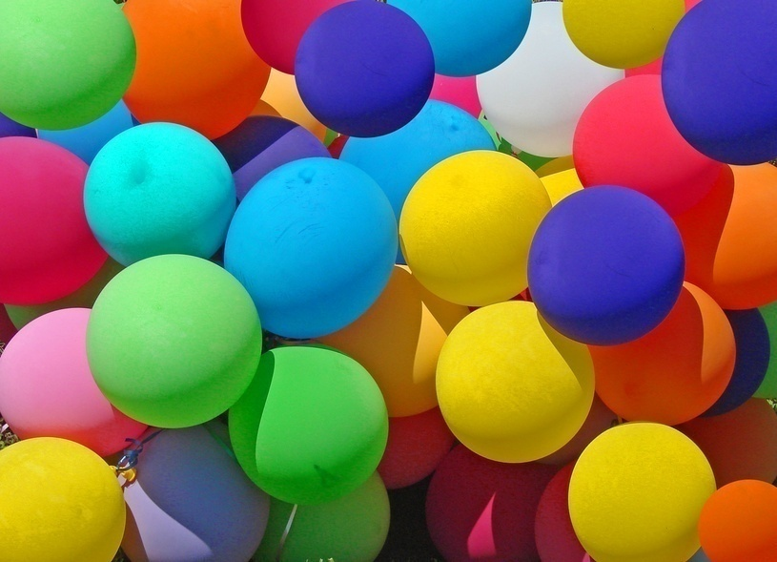
WELCOME

Slide 2
NuNuPrue Marma (H/T)
Panchari Bazar Model Govt.Primari School.

Slide 3
Class: One
Subject: English

Slide 5

Colours

Slide 6
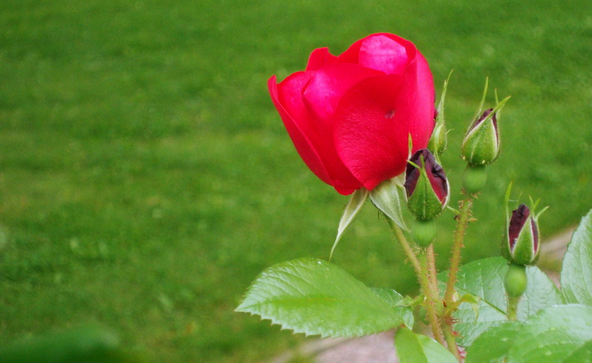
Red
Rose

Slide 7
Red, red,
A rose is red.

Slide 8
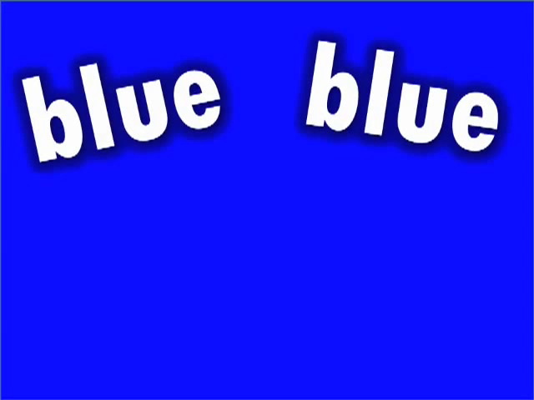

Slide 9

Blue
Sky

Slide 10
Blue, blue,
The sky is blue.

Slide 11
Green

Slide 12
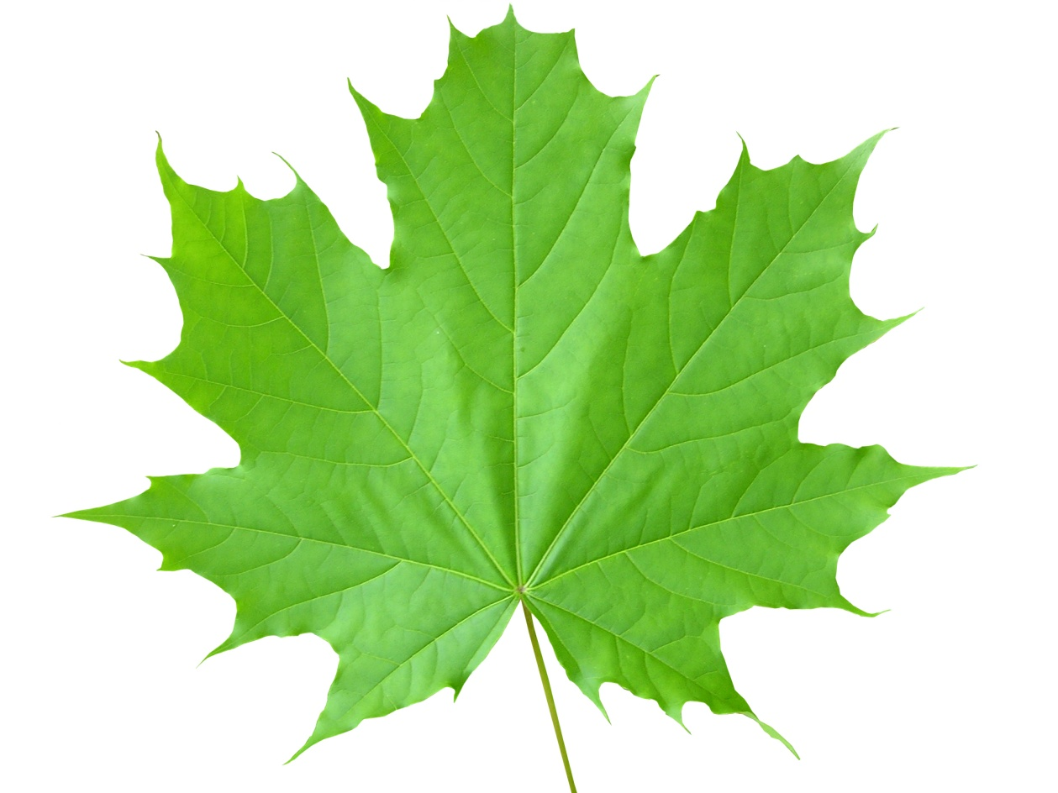
Green
Leaf

Slide 13
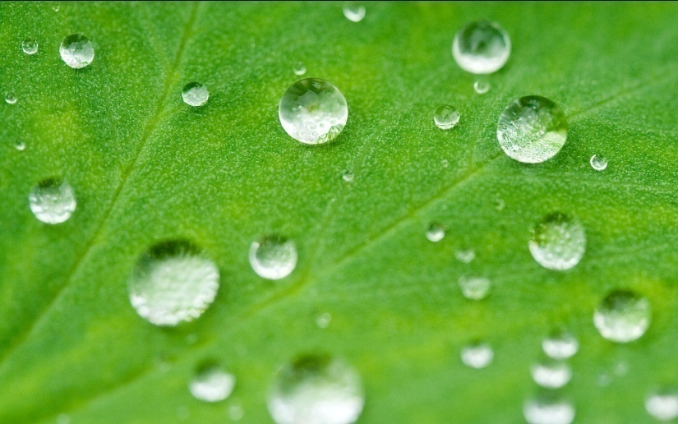
Green, green,
A leaf is green.

Slide 14
_{Black}
Black

Slide 15
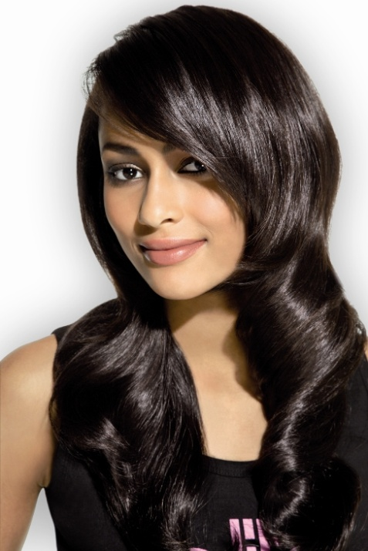
Black Hair

Slide 16
Black, black,
My hair is black.

Slide 17
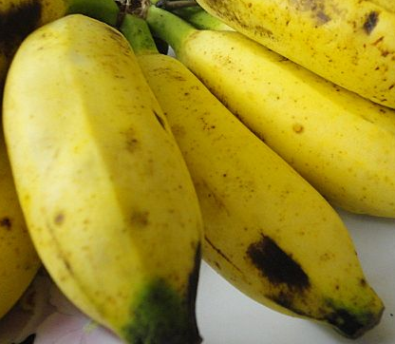
Yellow Banana

Slide 18
Yellow, yellow,
A banana is yellow.

Slide 19
Colours
Red, red,
A rose is red.
Blue, blue,
The sky is blue.
Green, green,
A leaf is green.
Black, black,
My hair is black.
Yellow, yellow,
A banana is yellow.

Slide 20
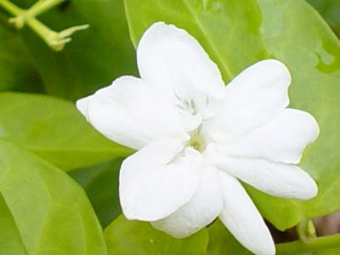
Thank You
Best of luck

Slide 21
Learning outcomes:
Students will be able to recite the rhyme with correct pronunciation.

