Slide 1

Welcome

Slide 2
MD RIAZUDDIN
ASST. TEACHER
GOURIPUR WEST.G.PRIMARY SCHOOL
DAUDKANDI .COMILLA
INTRODUCTION

Slide 3
CLASS-FIVE
SUBJECT-ENGLISH
LESSON-HAPPY BIRTHDAY

Slide 4
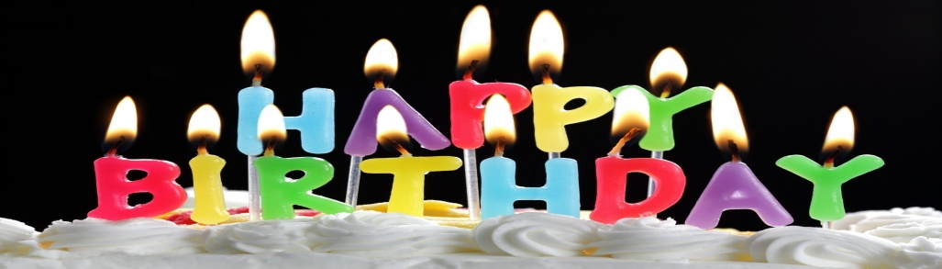
LEARNING OUTCOMES
1.Students will able describe a birthday

Slide 5
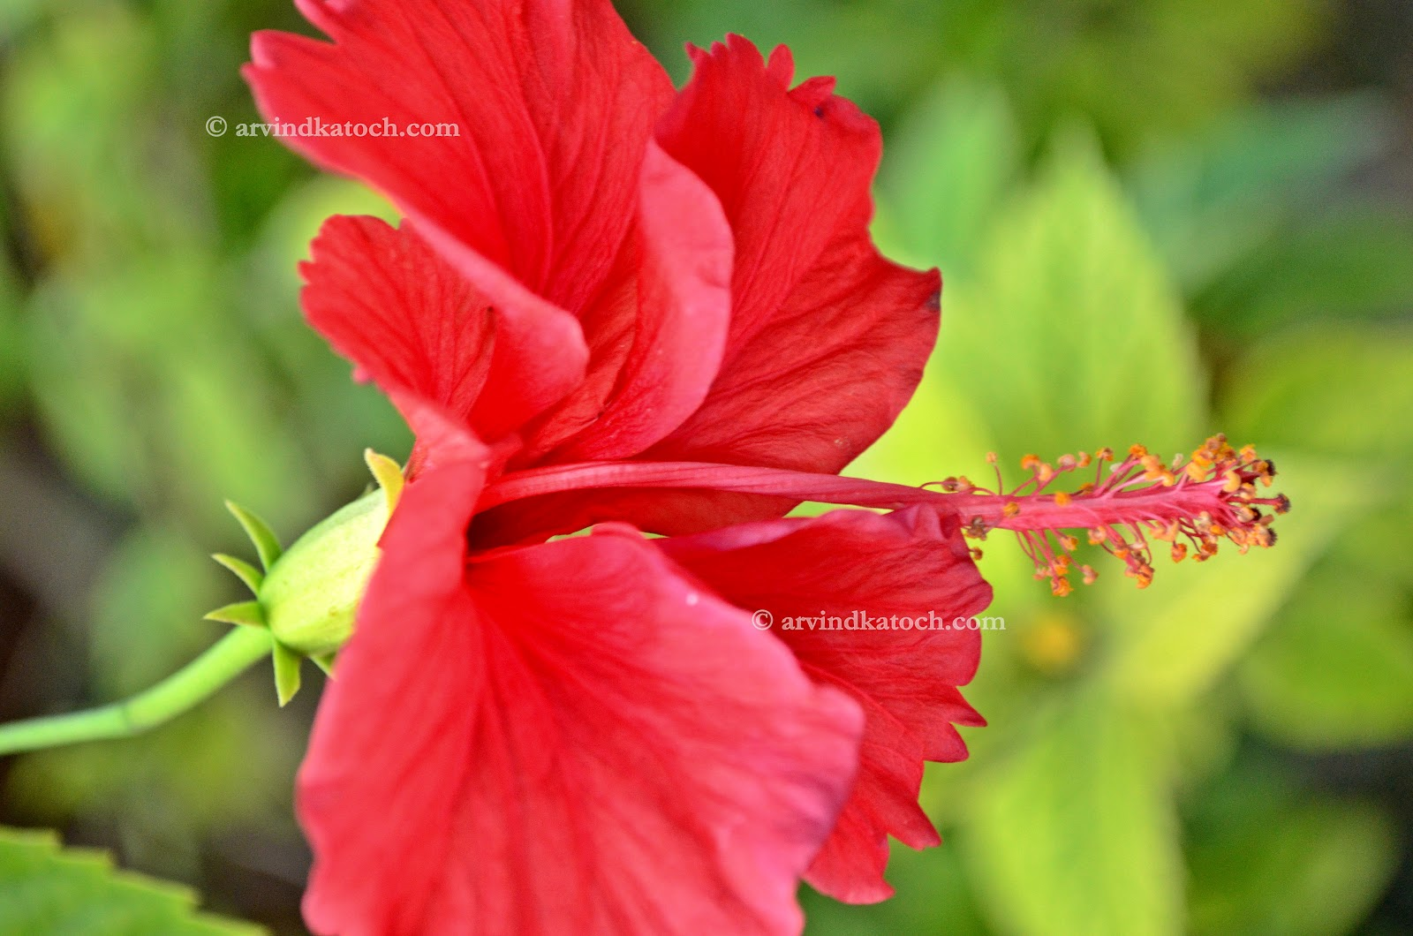
Safety environment by singing a song

Slide 6
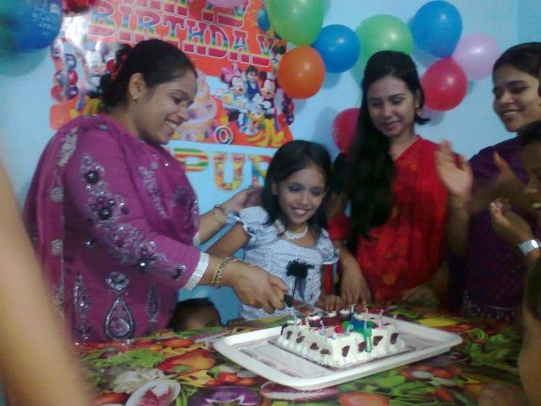

What do we can see in the picture?

Slide 7
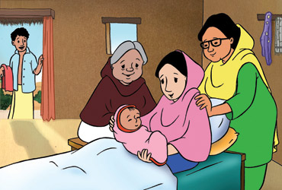
Lesson presentation

Slide 8
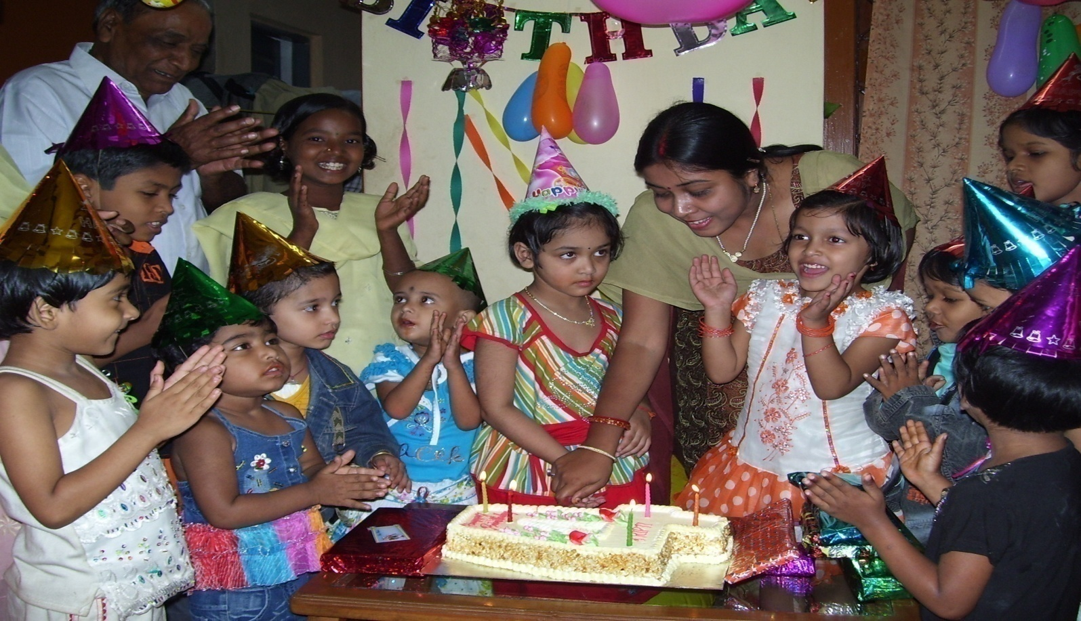
What are they doing?

Slide 9

1.When do we celebrate a birthday party?
2.What kinds of dress we put on? t
3.Who arrange the party?
1.We usually celebrate the party after
One year.
2.We usually put on new colourful dress
3.Our parents or best wisher arrange
The party.

Slide 10
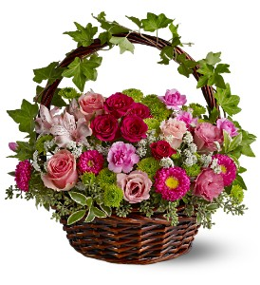
THANKS A LOT

