Slide 1

Welcome My dear students

Slide 2
Introduction
Md. Nurul Huda
Lecturer English
Fulbaria Degree College, Fulbaria, Mymensingh.
Class: Eleven
Subject: English
Time: 40 minutes

Slide 3
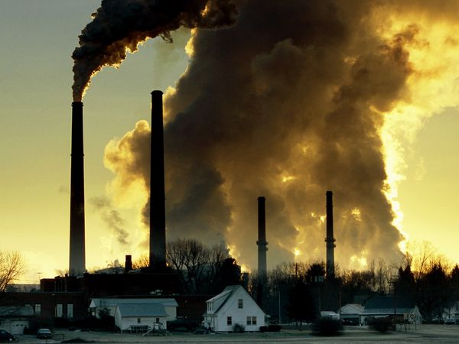

Slide 4
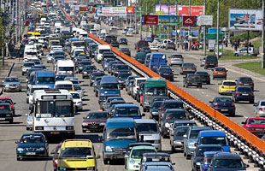

Slide 5

Unit: 6 Lesson 2: ( Part A- B.)
How the environment is polluted.

Slide 6
Learning outcome
The students will have
read a passage about environment pollution.
discussed some pollution related questions.
been able to make a questionnaire.

Slide 7
Presentation
Open the chapter Six, Lesson Two.
students will read the passage for reading skill development.

Slide 8
Pair work
The students
will discuss the causes of air pollution.
will make sentences on some new words such as waste, pollution, emit, dispose etc.

Slide 9
Group work
The students will talk about the sources of smoke.

Slide 10
Evaluation
How is the air polluted?
In how many ways can smoke be produced?
What is the main cause of air pollution in our cities?

Slide 11
Home work
The students will be told to write down five sentences on air pollution.

Slide 12
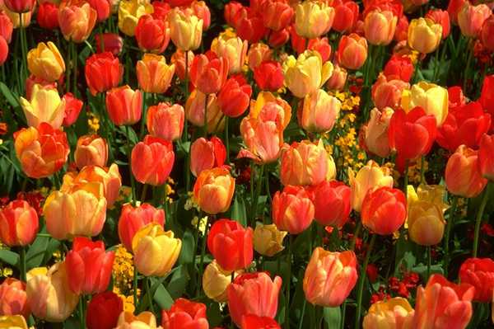
Thanks to all

