Slide 1

Welcome

Slide 2
Introduction
Name of Teacher: Md. Shahinur Rahman
Lecturer, English
Shamsul Hoq Mohila Fazil Madrasah
Gofargoan, Mymensingh
Class- 11
Subject-English

Slide 3


Warm up
Burning of fossil fuel

Slide 4
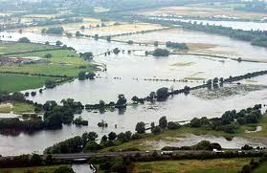
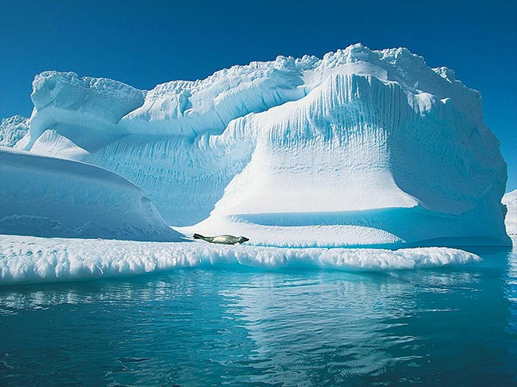
Talk about the pictures, like:
- what it is about
- when it happens
- what its effects are, etc.
Flood Ice melting

Slide 5
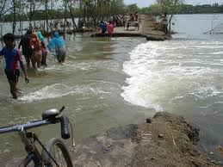
Result of global warming
Video
Lower southern part of Bangladesh, may go under water

Slide 6
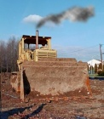
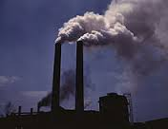
Co2
Fact gases from Factory
The World is getting warmer
Unit-6 Lesson -3

Slide 7
Learning outcome
Students will be able to-
* talk about the causes of green house effect.
*write down the name of green house gases.
*read a text with comprehension
* write about the consequences of global warming.

Slide 8
Work in pairs
Discuss about the natural calamities in Bangladesh.
Make a list of five calamities.
Possible answer:
1. Flood.
2. Cyclone.
3. Earth quake.
4. Draught.
5. Famine.

Slide 9
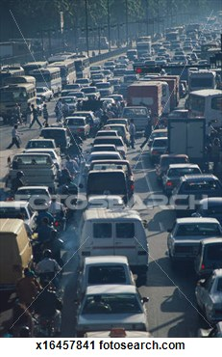
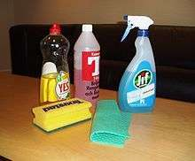
1. Clog up:
Vocabulary
Same as jam
Liquid or powder used for washing
2. Detergent:

Slide 10

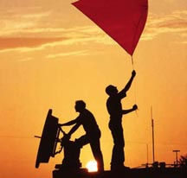
3. Pollutant:
Things that pollute like fume, chemical, waste etc .
4. Climatologist
Person who predict about climate

Slide 11
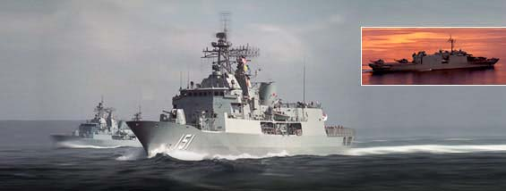
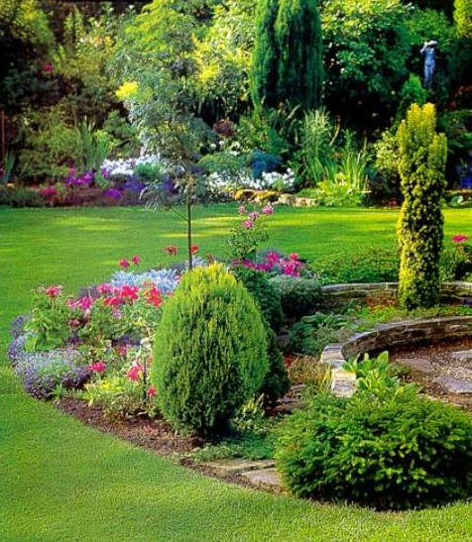
5.Maritime
About marine or ship
6. Wilderness
Woods or Forest

Slide 12
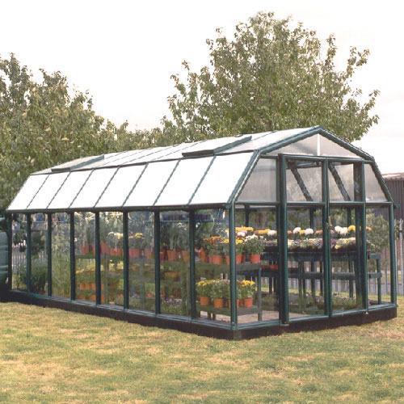
Green House

Slide 13
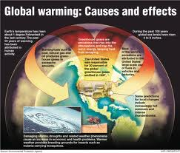
The heat being trapped

Slide 14


Increasing amount of carbon dioxide

Slide 15
Reading:
Read out the text (section B) and discuss the answers of the questions, that follow, in pairs.
Possible answers:
1. What do you understand by global warming?
2. What does global warming affect wildlife and wilderness?
3. How is deforestation related to the greenhouse effect?

Slide 16
(Section c)
Use the appropriate forms of the give n words to complete the following sentences.
Global, pollutant, disaster, Destruction, industrial
1. Global warming may have a ___effect on life.
2. Environment pollution is a big problem of_____ developed countries.
3. This problem should be ______.
4. _____ water is very bad for health.
5. The greenhouse effect a ______ phenomenon.

Slide 17
Group work: Making a poster

Slide 18
Get into groups of 5.
Select a group leader.
Discuss the impacts of environmental
pollution in Bangladesh.
Prepare a poster warning people about
the dangers of environment pollution.
The leader presents the poster.

Slide 19
Evaluation
Answering short questions.
1. What changes do you notice in our Environment?
2. Which gases are responsible for global warming?
3. When does carbon dioxide produce?
4. What will be the result of global warming?

Slide 20
Home Work
Write down five major challenges Bangladesh will face due to increasing global warming.

Slide 21

Thanks to all

