Slide 1

Welcome

Slide 2
Teacher Introducing
Najmunnaher
Asst: Teacher
Chandpara High School
Class:Six Subject:English1st

Slide 3
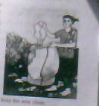

Slide 4
Enunciation
Today’s lesson
Thanks for your work

Slide 5
Learning outcome
1.Will be able to ask and answer the question.
2.Will be able to write a suitable word in each gap.
3.Will be able to learn new word.

Slide 6
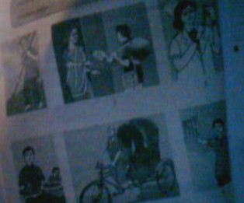
What do you see in the picture?
Nurse
Postman
Cleaner
Ricksha-pullers
Newspaper hawker
Waiter

Slide 7
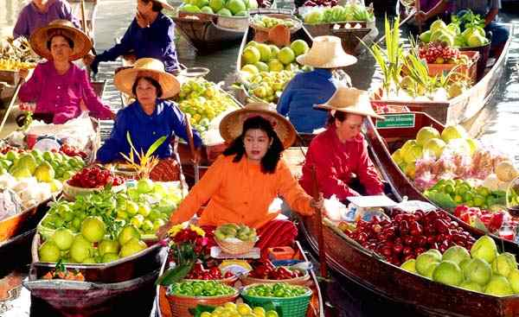
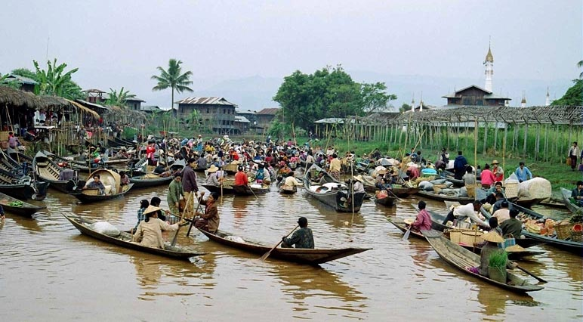

Slide 8


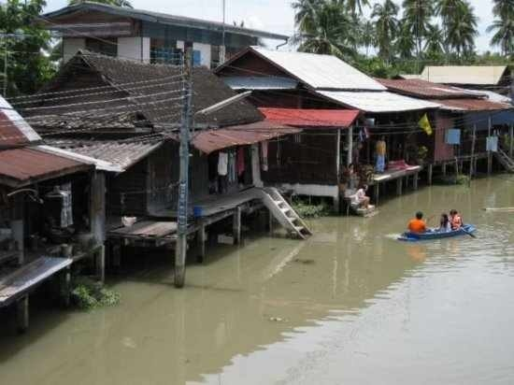
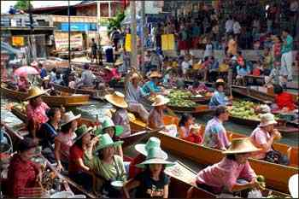

Slide 9
Group work
Look and say.Use suitable word from the box to
describe the profession of each person below.
Cleaner Nurse Newspaperhawker waiter
Rickshaw-puller Postman

Slide 10
Evolution
1.Read the passage.
Word meaning
Collect,Mind,Unhygienic,pile,job
Make sentence
Clean,Keep,Wake,Dirty,Became

Slide 11
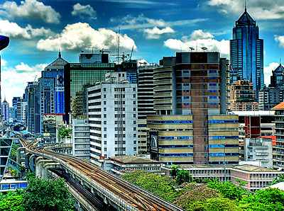
Vocabulary
Town
City

Slide 12
Home work
Write a paragraph on
Thanks for your work

Slide 13

Thanks

Slide 15


