Slide 1

Congratulation my dear student

Slide 2

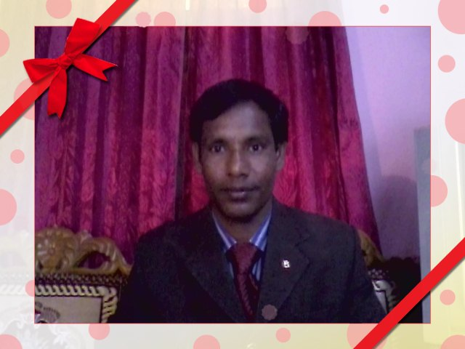

introduction
Mafidul islam
English teacher
Taluksakhati High School
Kaligonj, Lalmonir hat
Email: mofidulislam094@gmail.com
Mob: 01717820791

Slide 3

Subject: ENGLISH FOR TODAY
Class: Eight
Date: 12-07-2013

Slide 4
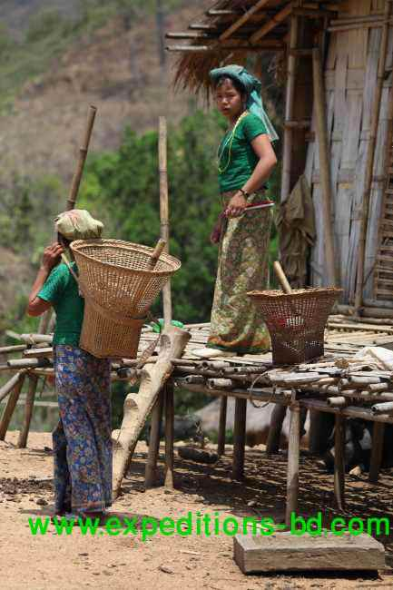
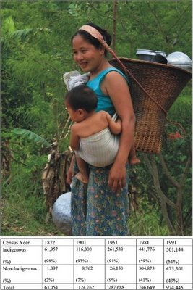
What do you see in the picture?

Slide 5
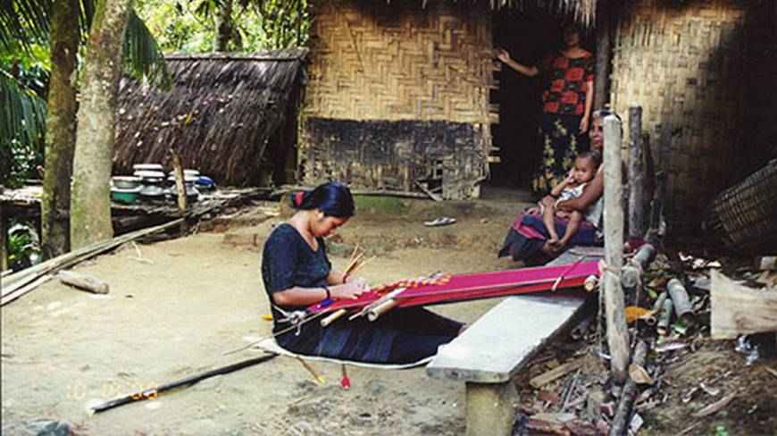
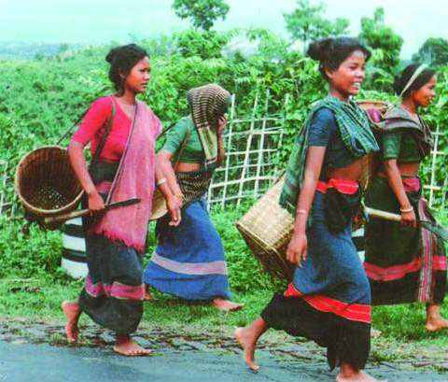
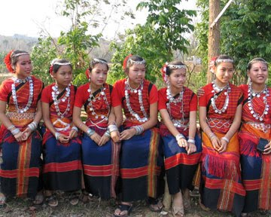
Look at the pictures and talk with your partner about them

Slide 6

Topic name
Unit—six.
Lesson 4:
Our ethnic friend

Slide 7
Learning outcome
By the end of the lesson SS. Will be able to----------
Ask and answer the question.
Vocabulary (lounge, immigration)
Write short composition.

Slide 8
Vocabulary
Ethnic------of the heathen, pagan.
Minority-------the smaller number or part.
Staple---------the principal element.
Maize--------Indian corn.
Wrestling--------a struggle between two to throw each other down.
Buffalo-----------ox

Slide 9
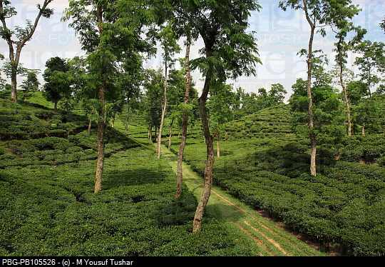
Read the text:
Most of these ethnic people living in Bangladesh have some common characteristics They have their own life styles.
Characteristics----marking characters.

Slide 10
They build there houses on bamboo or wooden platforms called ‘machang’

Slide 11
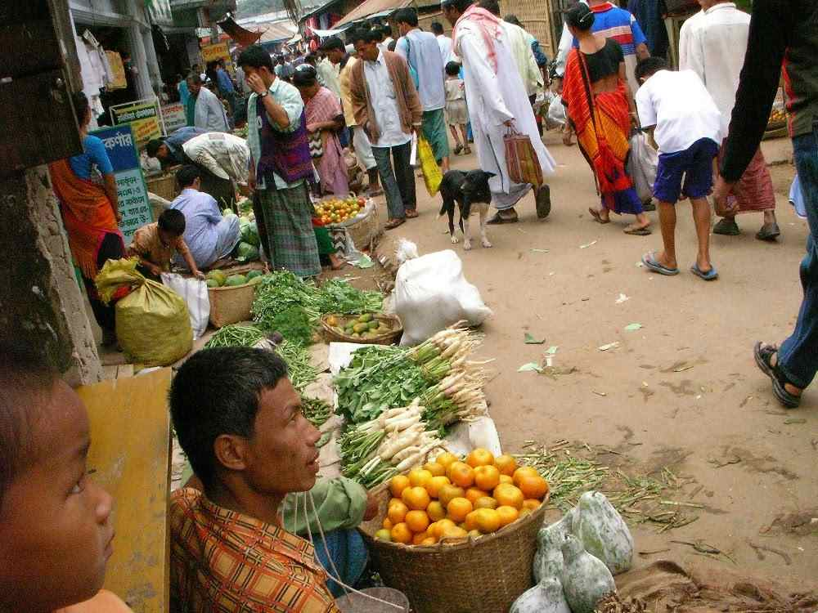
They eat vegetables, maize and fish

Slide 12
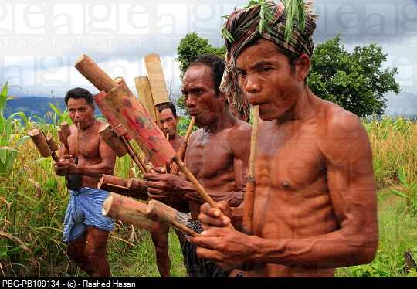
Man wear lungis and women wear thamis or sarongs and angis.

Slide 13
Women weave their own clothes

Slide 14
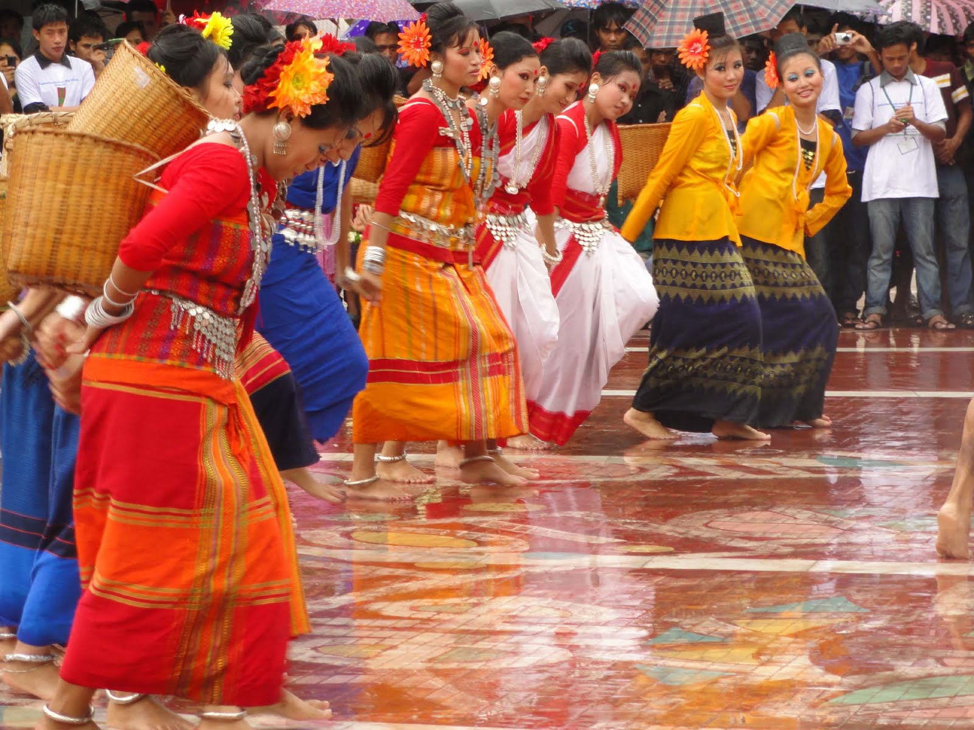
They are fond of songs, music, dances, theatre and fair.

Slide 15
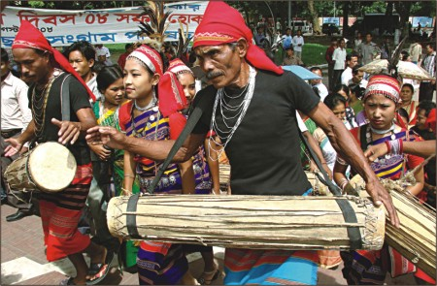
Traditional musical instruments used are Drums and bamboo flutes

Slide 16
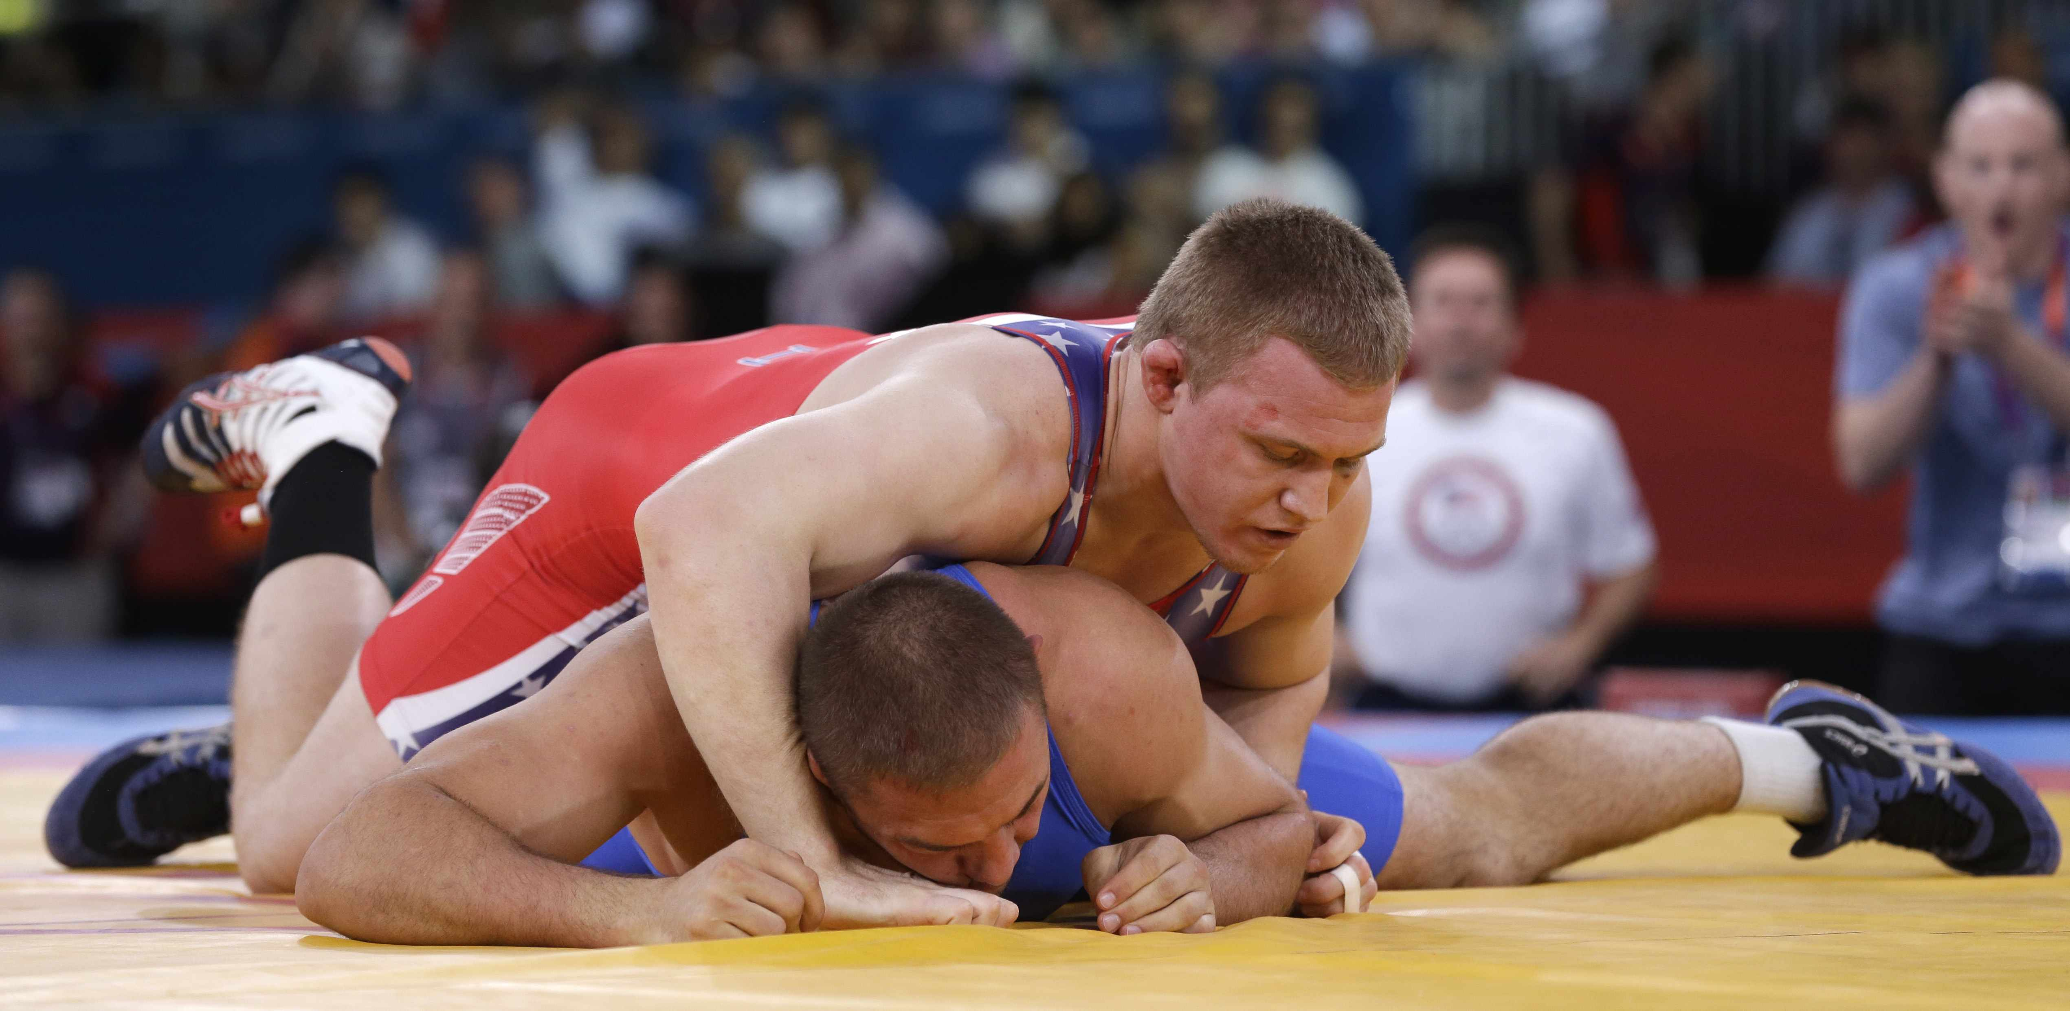
Wrestling is a popular sport for them.

Slide 17
Pair work
Favorites
wresting
bugle
rice
staple
weave
lungi
machang
lifestyles
follow
The tribal people (a)-------------------------their own (b)--------------------. The platform they build their houses on is called (c)---------------------Men wear (d)---------------------. Women (e)----------------their won clothes. Their (f)--------------------food is (g)-------------------.They are fond songs, dance, music, and (h)----------------------. (i)------------------------is their (j)-------------------sport.

Slide 18
Evaluation
1) What is the main occupation of the ethnic people?
Main occupation is Farming.
2) What are the religions of these people?
Hinduism, Christianity, and Buddhism.
3) What do the women wear?
Thamis or sarong
4) What is their staple food?
Rice

Slide 19
Home work
Write a paragraph based on the information about ‘Ethnic’ people in Bangladesh.
Write the information in the correct sequence as it appears in the text.

Slide 20

Thank you everybody

