Slide 1
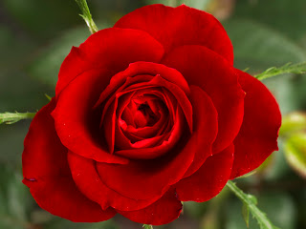
Welcome

Slide 2
Teacher’s Identity
Name: Md.Bul bul Husain
Post: Assistant Teacher (English)
School’s Name: Chantara Gano High School
Upazilla: Ghatail
Dist.: Tangail

Slide 3
Lesson Information
Class- Eight
Sub: English second Paper
Unit- Three, Lesson-one
Time: 50 minutes
Date:01.07.2013

Slide 4
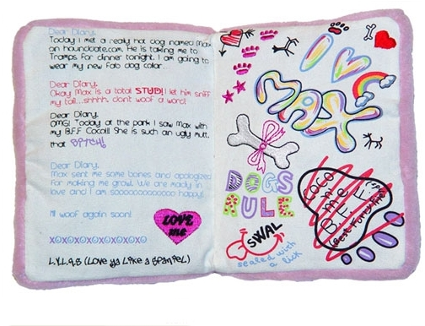
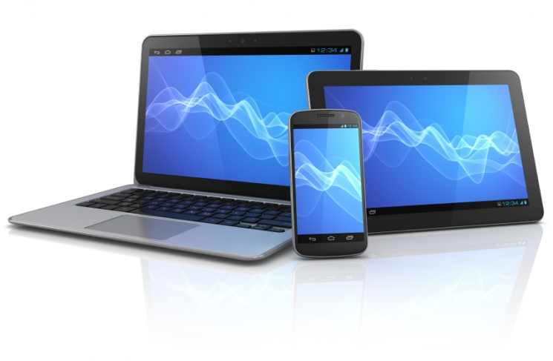
……….. diary
………….computer
I need a diary.
You need a computer.

Slide 5
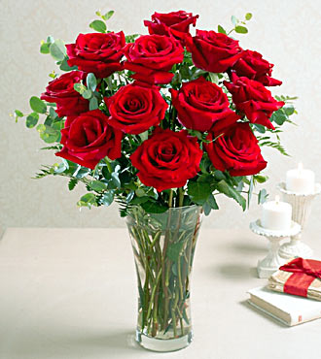
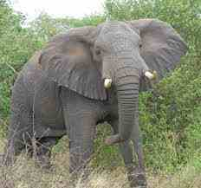
………………Elephant
………………..Roses
This is an elephant.
The roses are very beautiful.

Slide 6
Today we will learn about ‘Articles’.

Slide 7
Learning outcomes
By the end of the lesson, learners will have to-
learn about articles and kinds of articles.
differentiate definite and indefinite articles.
use articles.

Slide 8
The three words ‘A’, ’an’, and ‘The’ are called articles .
There are two kinds of articles. Indefinite and definite article..
Articles
Indefinite articles- ‘A’, ‘An’
Definite article -The

Slide 9
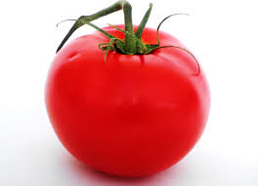
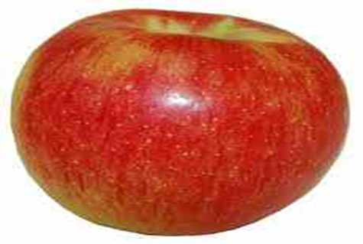

This is a tomato.
.
A or an is called Indefinite article. They do not point out any person or object particularly. Such articles point out the nouns in general.

Slide 10
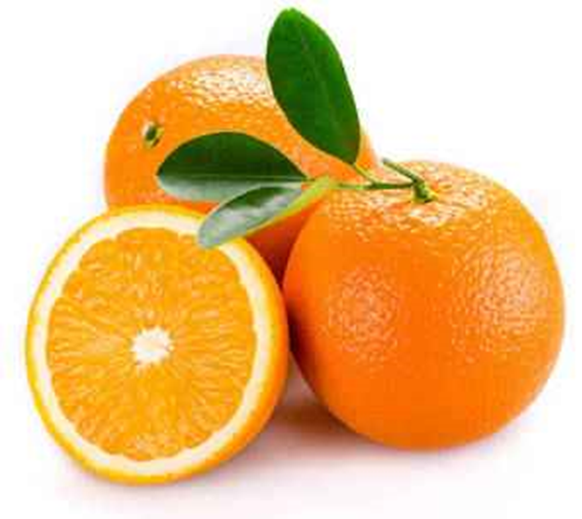
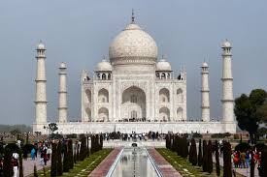
The oranges are juicy fruit.
The Tajmahal is one of the wonders of modern architecture and technology .
‘The’ is termed as definite article. It points out any particular person or object,but not in general.

Slide 11
Discussion
How many kinds of articles?
So, what is Article ?
There are two kinds of article. Indefinite Article and Definite Article
The three words ‘a’ ‘an’ and ‘the’ are called articles, These are also adjectives as a parts of speech.
A or an is called Indefinite article. They do not point out any person or object particularly. Such articles point out the nouns in general.
‘The’ is termed as Definite Article. It points out any particular person or object, but not in general.
Notes:
s

Slide 12
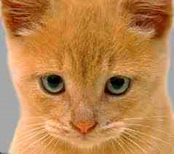
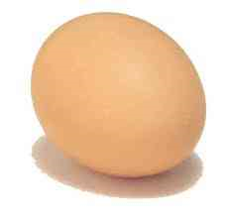
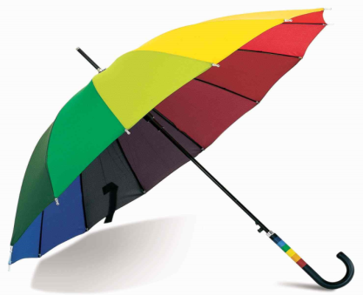
Uses of articles
Here is a cat.
Here is an egg.
Here is an umbrella.
The cat is a pet animal.
‘A’ is used before a word beginning with a consonant sound.
‘An’ is used before a word beginning with a vowel sound.

Slide 13
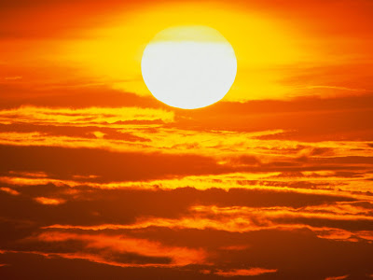
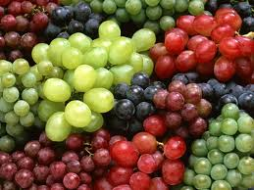
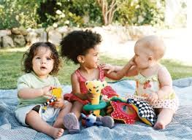
The sun is very hot.
The grapes are fresh.
The is used to indicate person or object definitely.
The children look very nice.

Slide 14
Fill in the gaps with appropriates articles.
Individual Work
1.The girl has eaten ……… orange.
2.He is …... unique boy.
3. Rima is ……… intelligent girl.
4. I read ……… holy Quran every day.
5. …… cow is a useful animal.

Slide 15
Group works
Fill in the blanks with appropriates articles.
The Quran is (a)…..holy book. It is (b)…..guide book for (c) ….Muslims. It is (d)….complete code of life for all. (e) …. Impure man can’t touch it.

Slide 16
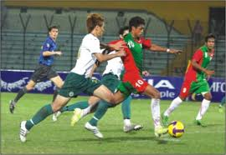
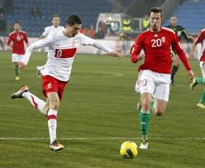
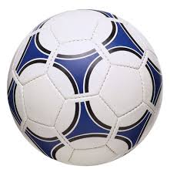
Football match

Slide 17
Evaluation
Fill in the gaps with appropriates articles.
Football is (a)…..popular game in our country. It thrills not only (b) …..players but also the spectators. It is (c)…..foreign game. It is popular all over(d)…… world. It is played in (e)…..open field.

Slide 18
Home work
Fill in the gaps with appropriates articles.
A computer is (a)…….ultra modern invention. It is (b)…….electronic device for storing and analysing (c)… information. It works on (d)……basis of commands by (e)……..operator.

Slide 19
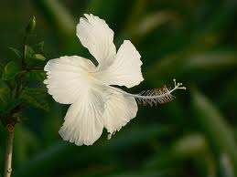
Thank You, every body.

