Slide 1

WELCOME

Slide 2
INTRODUCING(পরিচিতি)
TEACHER
MD.MIZANUR RAHMAN
ASST.TEACHER
NOAGAON JK HIGH SCHOOL,RAMGONJ,
LAKSHMIPUR
CLASS
CLASS: VIII
SEC. –A
SUB.-ENGLISH 2ND PAPRE
PRESENT STU.-70
TOTAL STUDENT: 80
DURATION: 45 MIN.
DATE: 01JUNE,2013

Slide 3



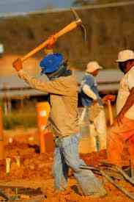
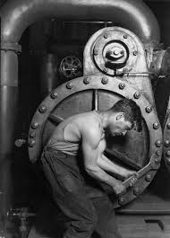
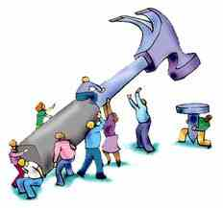
পূর্ব জ্ঞান যাচাই
Look at these picture. What are the people doing?

Slide 4
LEARNING OUTCOMES( শিখন ফল)
By the end of the lesson the students will be able to
understand about verb (verb কি বুঝতে পারবে)
define verb(verb এর সংজ্ঞা দিতে পারবে)
classify of verb(finite, nonfinite verb এর প্রকারভেদ করতে পারবে)
verb এর ব্যবহার করতে পারবে।

Slide 5
Dig
create
Hit
drink
Talk
Learn
Play

Slide 6
VERB IS DOING ANYTHING.
(কোন কিছু করাকে verb বলে)
Example:
Allah has created us.
The farmer digs the soil.
They are talking.
. We play football
Hit the iron while it is hot.
We enjoy the game.

Slide 7
CLASSIFICATION OF VERB
(Verb এর প্রকারভেদ)
verb
ক্রিয়া
Finite verb
সমাপিকা
Non Finite verb
অসমাপিকা

Slide 8
Finite verb(সমাপিকা ক্রিয়া)
The verb that can makes a complete sense without the help of any verb is called finite verb.
Example:
We want to go to the field to play.
He knows everything.
The beautiful bird is singing a sweet song.
The old sailor sat on a stone.
The girl came to house.

Slide 9
Non Finite verb(অসমাপিকা ক্রিয়া)
The verb that can not makes a complete sense without the help of a finite verb is called Non finite verb.
Example:
1.He wants to know.
2.She is ready to sing a song.
3.The farmer is going to the field to dig the soil.
4.You are requested to come.

Slide 10
একক কাজ
Find verb in the following list:
Write your answer on your paper.
Create , education , draw
fly , computer , know
butterfly , help , on
sing , very , learn

Slide 11
একক কাজের সমাধান
fly
computer
Create
Education
sing
draw
know
butterfly
on
help
Learn

Slide 12
দলীয় কাজ
B Group
A Grou p
Underline the finite verb in the following sentences:
1.The boy broke the glass.
2.She wants to sing a song.
3.The moon gives us light at night.
Underline the non finite verb in the following sentence:
1.The boy wants to break the glass.
2.We eat to live.
3.She began to sing a song

Slide 13
দলীয় কাজের সমাধানঃ
A Group
B Group
Underline the finite verb in the following sentences:
1.The boy break a glass.
2.She wants to sing a song.
3.She gives me a book.
Underline the finite verb in the following sentences:
1.The boy wants to break the glass.
2.We eat to live.
3.She began to sing a song

Slide 14
সার সংক্ষেপঃ
আজ যা শিখলাম-
Verb কি ?
Verb এর প্রকারভেদ (Finite,Non Finite)
Verb এর ব্যবহার ।

Slide 15
মূল্যায়ন
Draw দিয়ে sentence তৈরী কর।
কয়েকটি verb এর নাম বল ।

Slide 16
বাড়ীর কাজঃ
১০ টি Verb লিখবে ।
Verb গুলি ব্যবহার করে Sentence লিখবে।

Slide 17

THANKS

