Slide 1
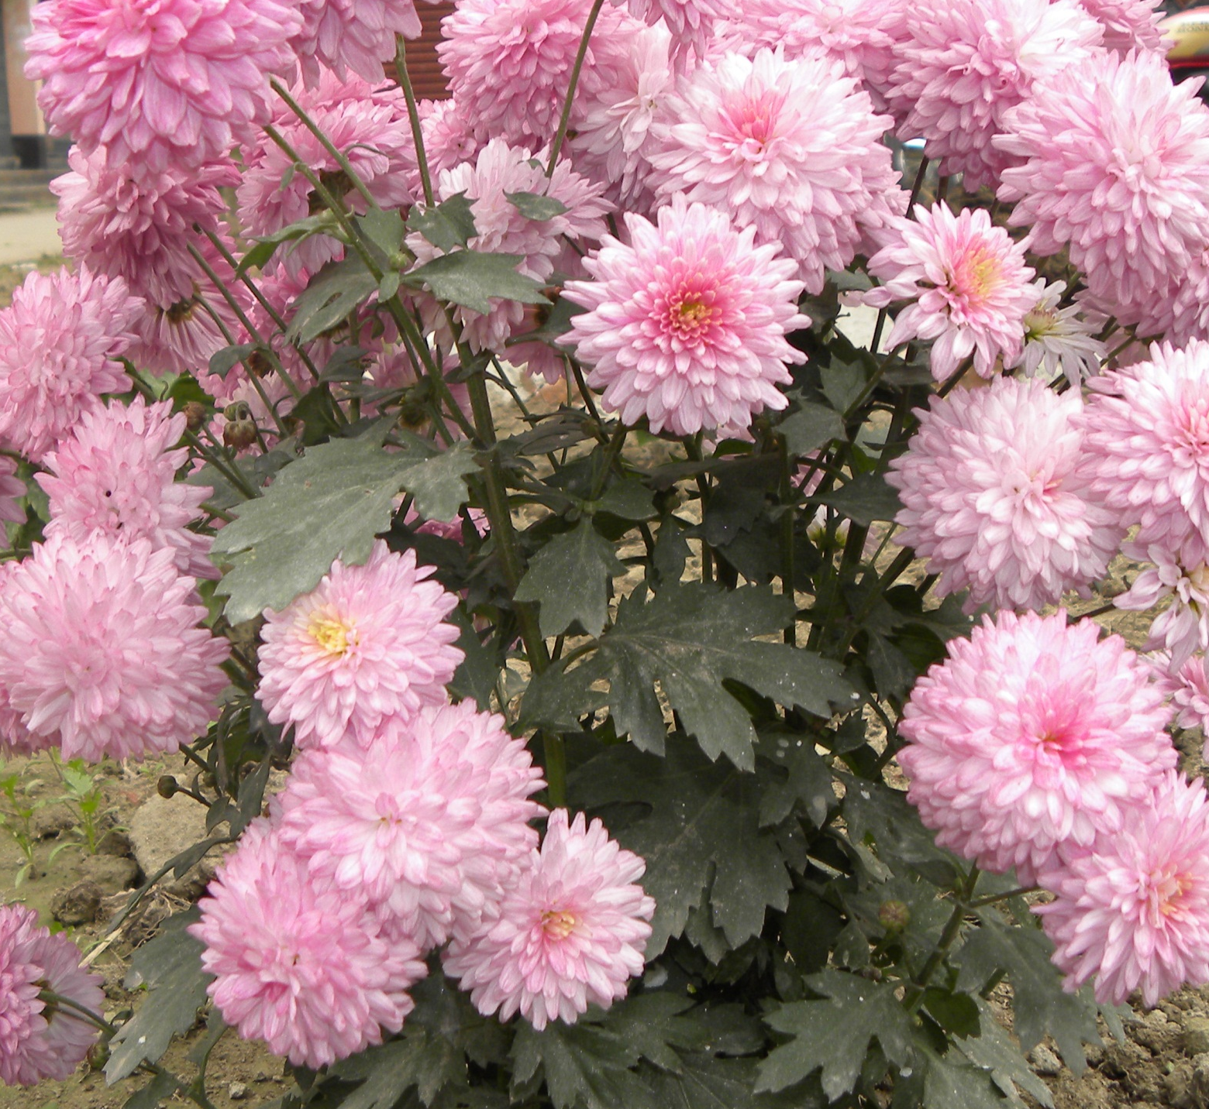
Welcome

Slide 2
Introduction
Class : Eight
Subject : English
Unit : One
Lesson : One
Time : 40 minute
Date : 23/01/2013

Slide 4
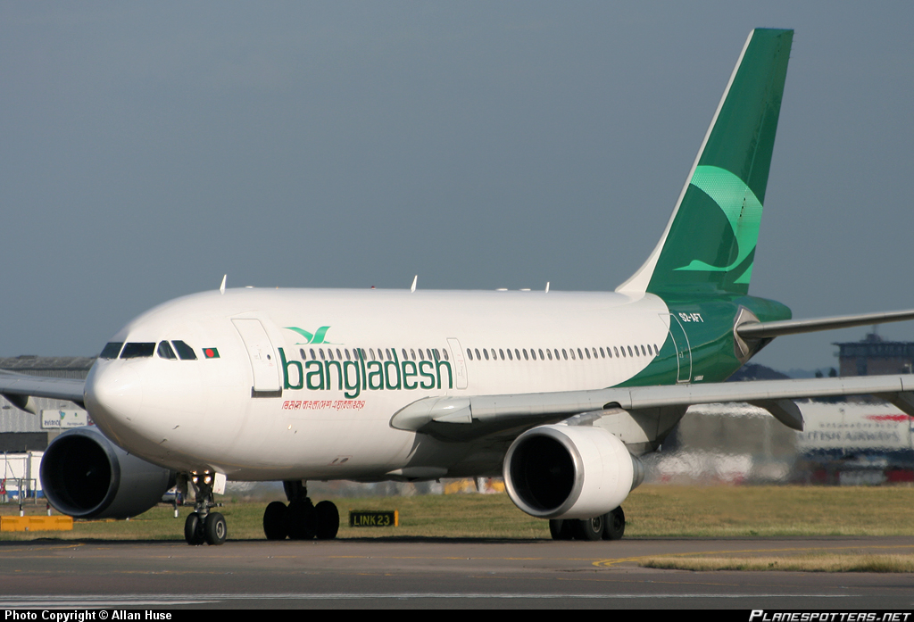
AT THE AIRPORT

Slide 5
Objectives
Students will be able to……….
Read and understand text.
Tell the meaning and use of ‘lounge’, ‘immigration’, Thailand, London
Use Present Continuous indicating Future.
Use Start + V- ing

Slide 6
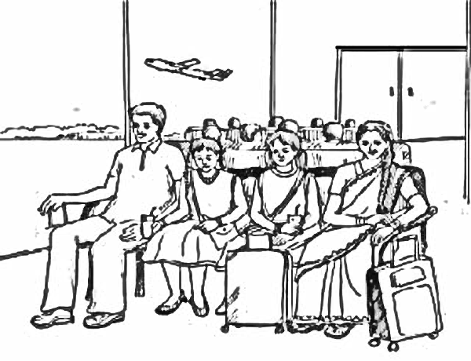
Talk about the picture

Slide 7
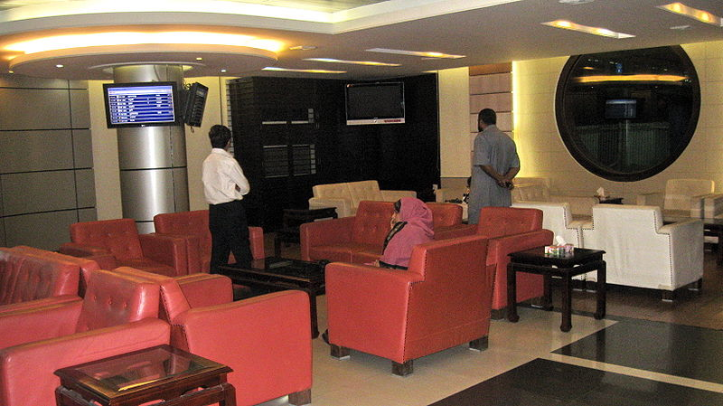
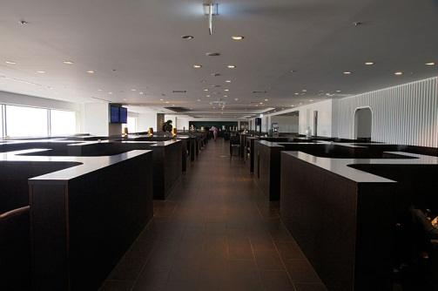
Vocabulary
Lounge :
A sitting space

Slide 8
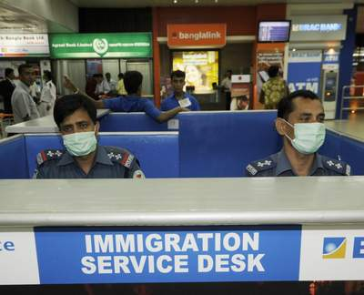
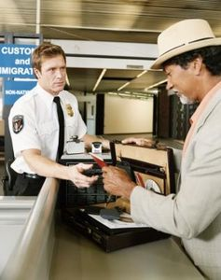
Vocabulary
Immigration :
The act of entering a country for permanent settlement

Slide 9
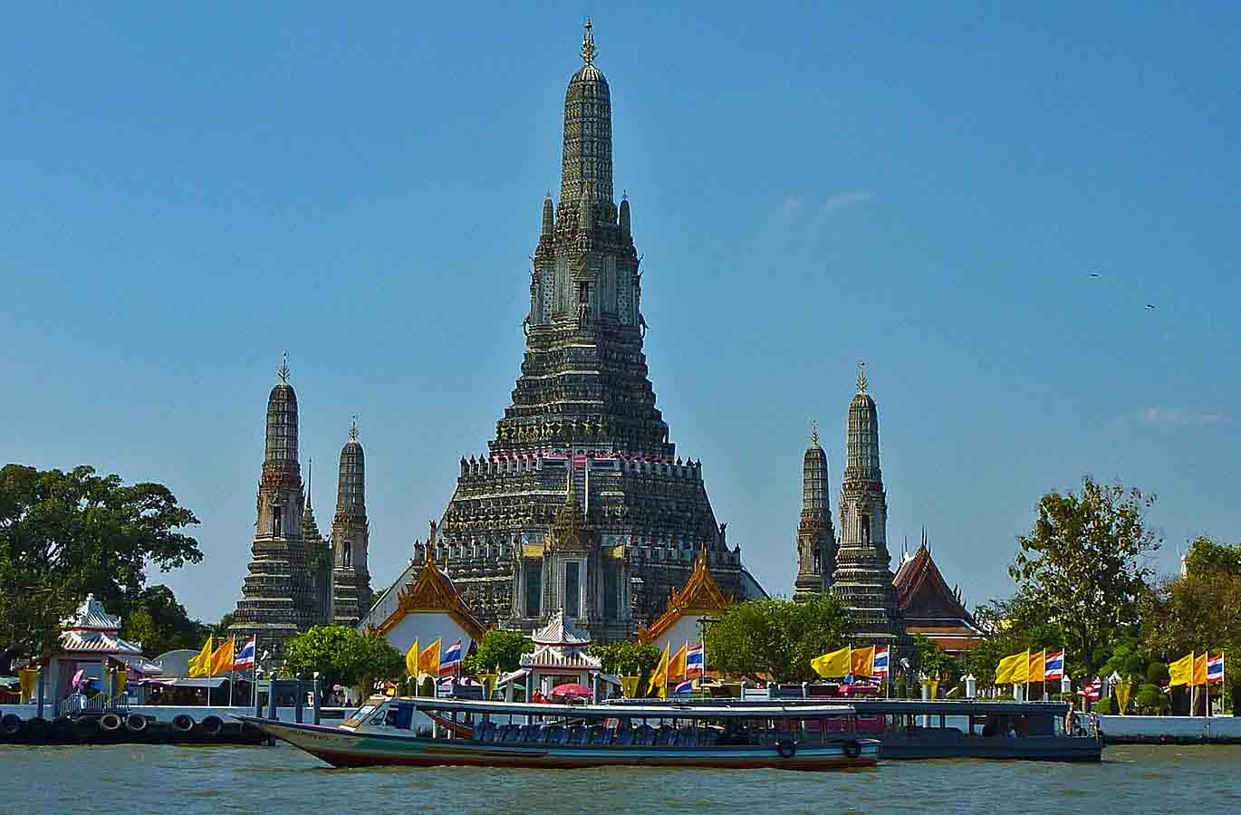
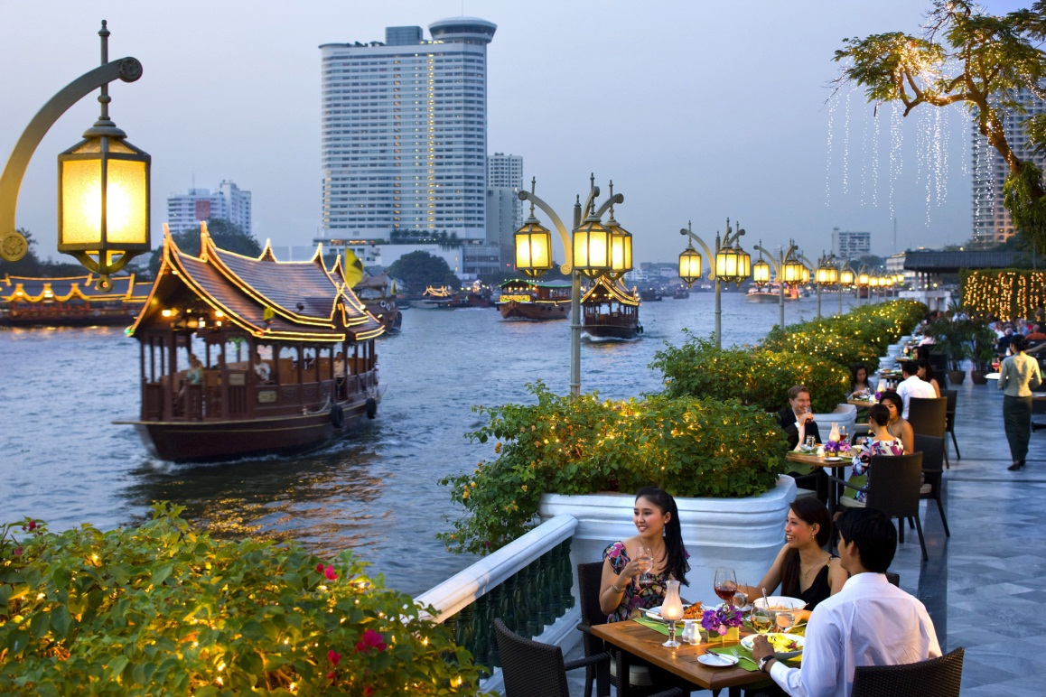
Vocabulary
Bangkok :
The capital of Thailand

Slide 10
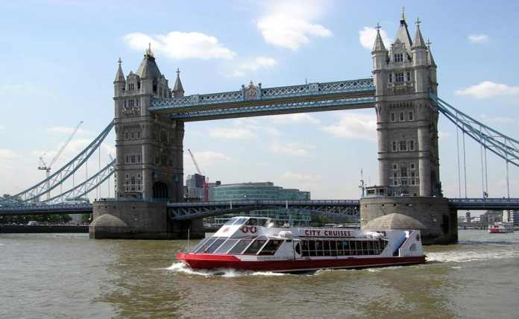
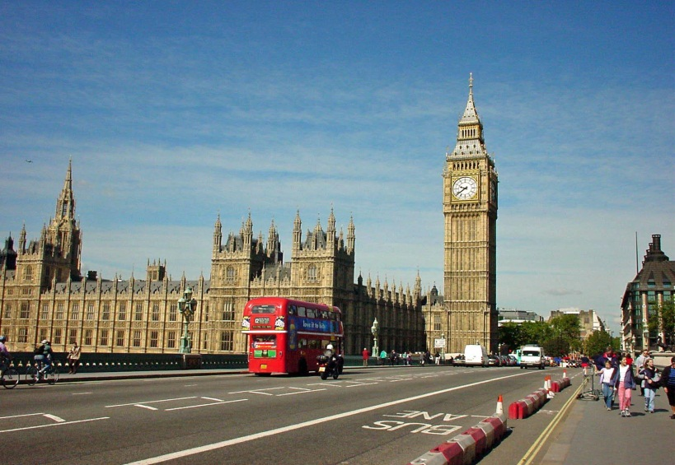
Vocabulary
London :
The capital of England and the Great Britain

Slide 11
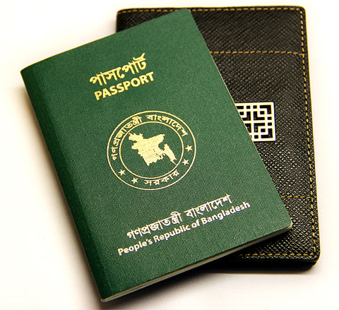
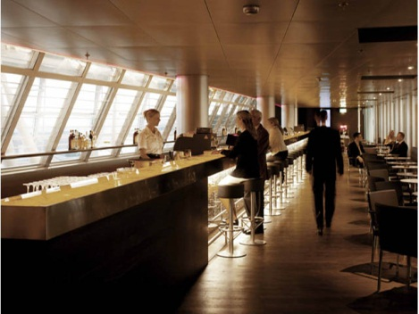
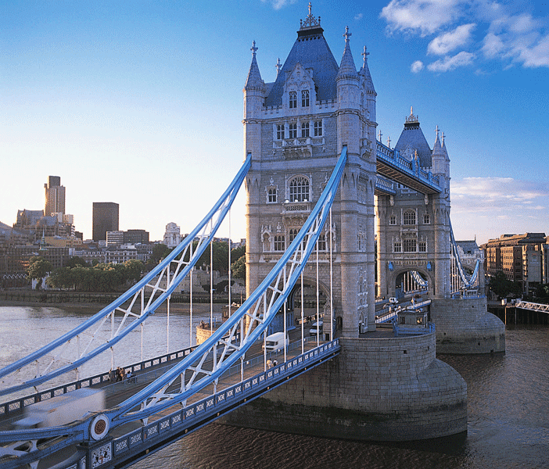
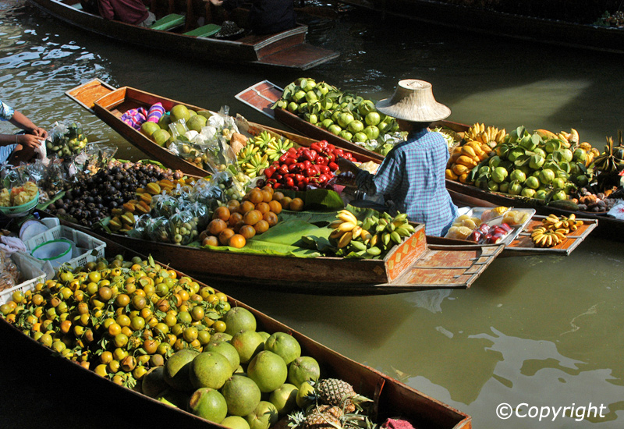
Make Sentences in pair
Lounge
Immigration
London
Bangkok

Slide 12

SILENT READING
Read the passage in Section B silently and answer the following questions.
Why is Mita excited?
Why aren’t Mita’s parents going with her?
What does an immigration officer do at the airport?

Slide 13
GRAMMAR
They are waiting in the lounge.
You are watching TV.
Think about some more Examples.
You are learning English now.
Present Continuous Tense
Sub + am/is/are + V - ing
Present Continuous Tense is used to express what we are doing and what is going on now.

Slide 14
GRAMMAR
They are waiting in the lounge.
They are flying by Bangladesh Biman.
They will fly by Bangladesh Biman.
Think about the
difference
of these sentences
2nd Example indicates Future
Present Continuous Can be used to indicate near Future

Slide 15

Structure
Mita, Zara and her parents start filling in the forms
The two cousins start planning what they would do once they reach Bangkok
Sub + Start + V - ing
Present continuous
We use ‘Start + v-ing’ to indicate the starting point of present continuous tense

Slide 16
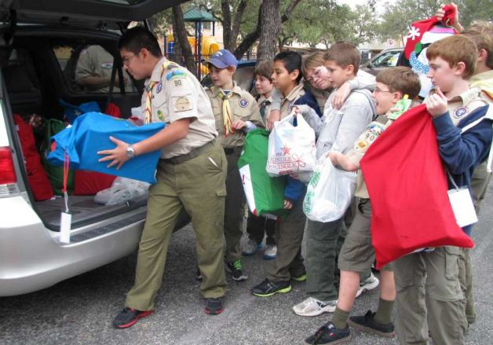
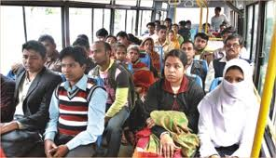
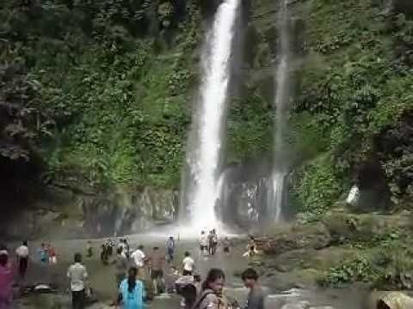
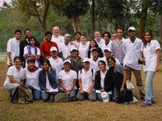
Writing
Now Read the instruction in Section D and write a short composition about your experience of travelling.

Slide 17

Home work
Suppose you will travel somewhere in the next vacation. Write a short composition on your preparation.

Slide 18
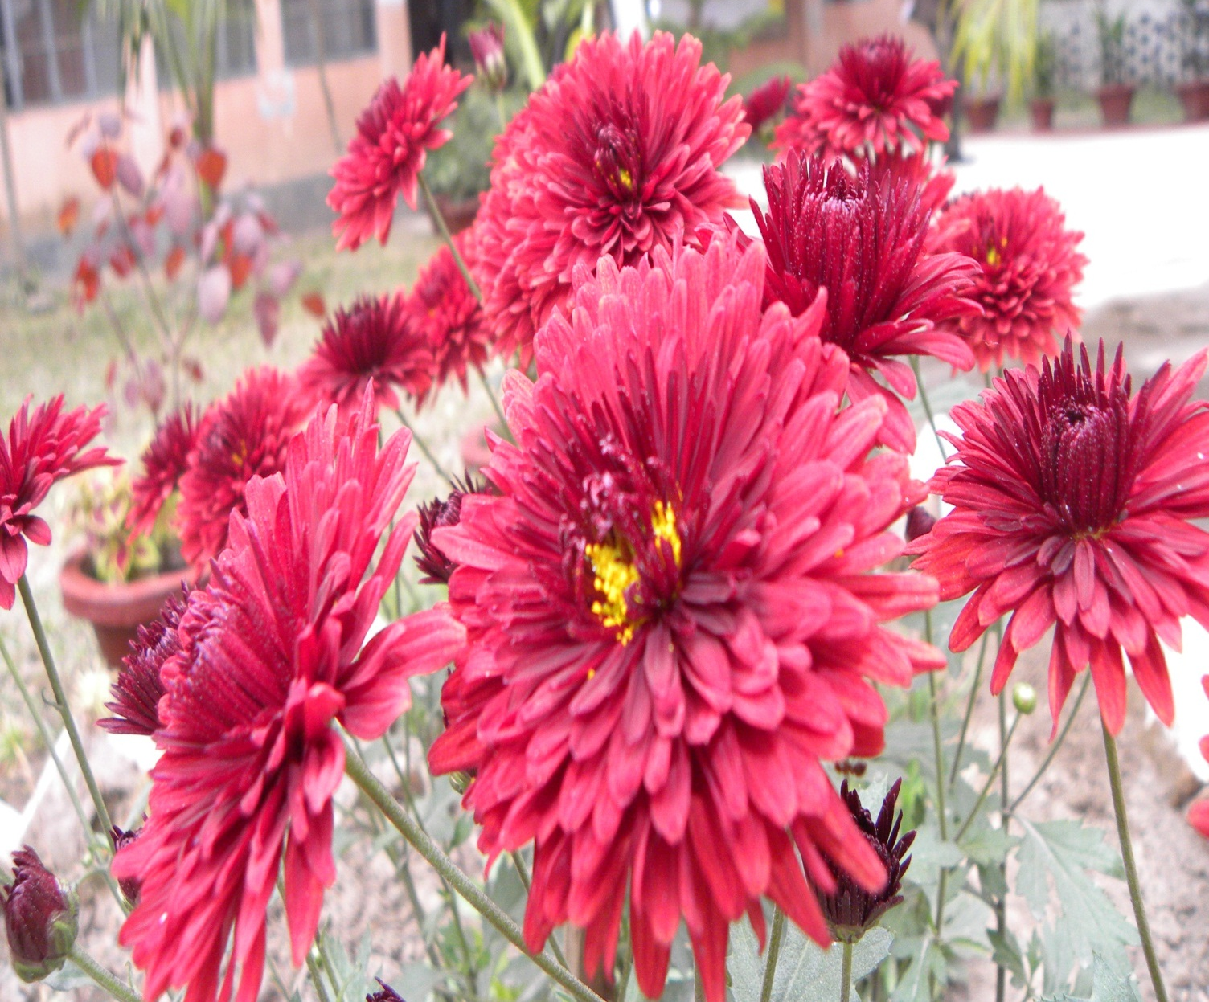
Thank You

