Slide 1






T0 MY PRESENTATION MD. SHOBHAN
LECTURER, DEPARTMENT OF PHYSICS MILESTONE COLLEGE, DHAKA.

Slide 2

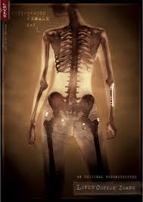
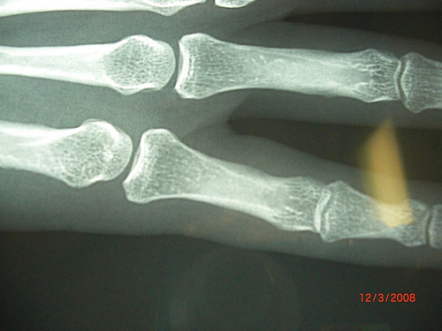
CHAPTER TWENTY FOUR
MODERN PHYSICS
CLASS- IX

Slide 3
LEARNING OUTCOME
They will be capable to say the …
X-ray and production of X-ray
Difference between X-ray and general light
Classification and uses of X-ray

Slide 4


Production of X-ray

Slide 5


Slide 6
General Light
X-ray
X-ray can ionize a gas.
It can not ionize a gas.
X-ray is not perceptible.
It is divided into different colours.
It can penetrate any opaque body.
It can not penetrate any opaque body.
It’s wave lengths is low.
It’s wave lengths is high.

Slide 7
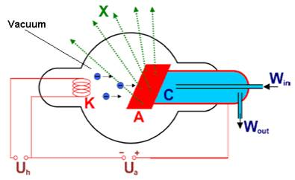
Soft X-ray:
ray
- +
24 volt
1200 volt

Slide 8
Hard X-ray:
ray
- +
24 volt
30000 volt

Slide 9


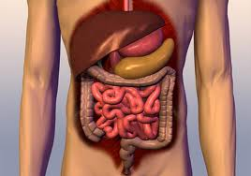
X-ray in medical science
Soft x-ray

Slide 10

X-rays in industries

Slide 11

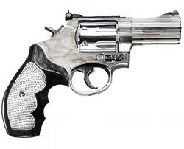
X-ray in detective works

Slide 12
GROUP WORK
X-ray in medical science
X-ray in industries
X-ray in detective works

Slide 13
Evaluation:
What are the difference between soft and hard X-rays ?
What are the properties of X-rays ?

Slide 14
Home Task
Analyze with comparison of general light with X-rays.

Slide 15

ANY QUESTION ?

Slide 16
THANKS TO ALL

