Slide 1
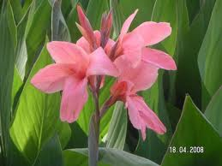
Welcome

Slide 2

Teacher Introduction
Yeasmin Akter
Assiantant Teacher
Ramkrishna pur Govt. priamry school.
Homna ,Comilla.

Slide 3

Class –One
Sub:English

Slide 4
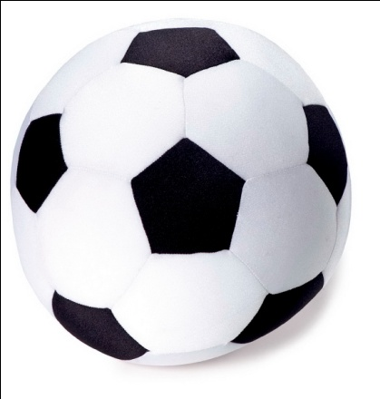
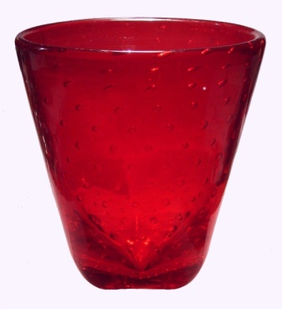


Look
ball-1
Glasses-2
Fiowers-3

Slide 5
Learning outcome
Student will be able to say and write numbers(1-5)

Slide 6

Lesson 2: Numbers(1)

Slide 7

Presentation

Slide 8

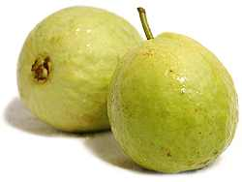
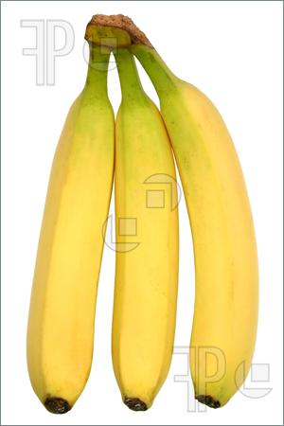
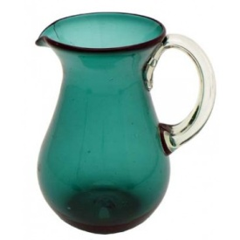

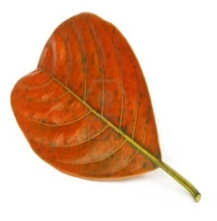




Ball-1
Guavas-2
Bananas-3
leaves
Jugs-4

Slide 9


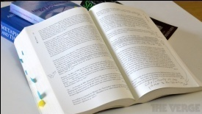





Group work
1
2
3
4
5

Slide 10
Evaluation

Slide 11

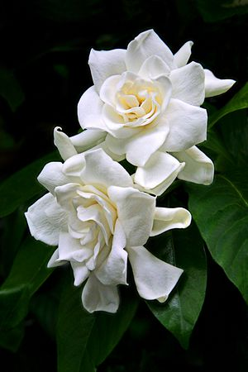

?
?
?

Slide 12

Thank you all

