Slide 1

welcome

Slide 2
Md. Ariful Anwar
Lecturer in English
M A Hashem college
Begumgonj, noakhali
E-mail- jabedarif@ymail.com

Slide 3

Class-(XI)
Subject: English 1st Paper
Unit-18, lesson-2
Date – 14 -05-2013

Slide 4
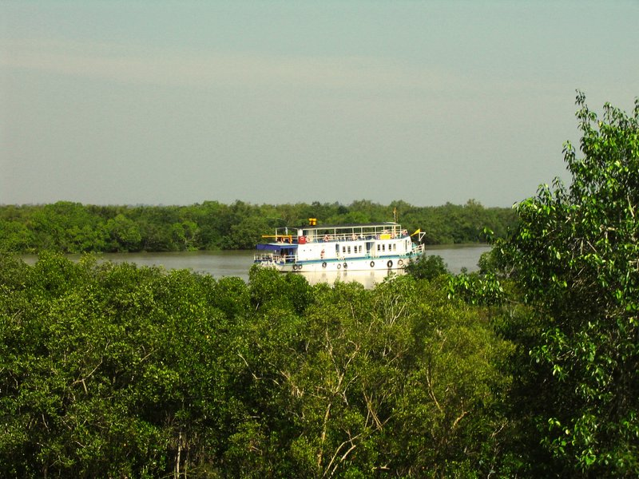
The largest mangrove forest in the world
The Sundarbans of bangladesh

Slide 5


Learning output
Students will know the definition of world heritage site
Will introduce the world heritage sides in Bangladesh
Will know details about the Shat Gombuj Mosque

Slide 6

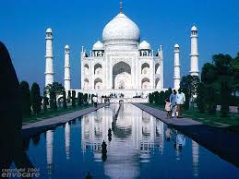
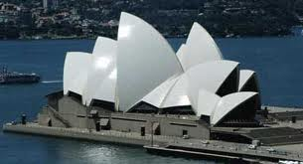
World heritage sites
Taj Mahal
Opera house
India
Australia

Slide 7


Definition of world heritage site
A world heritage site is a place(natural or cultural)
Which has universal value
Recognised by a 21 member international committee of UNESCO

Slide 8

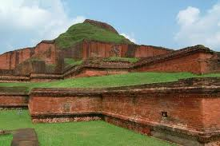
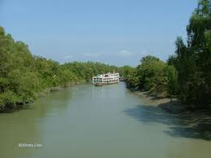
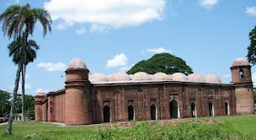
The world heritage sites in Bangladesh
Buddhist Bihar
The sundarbans
Shatgombuj mosque

Slide 9
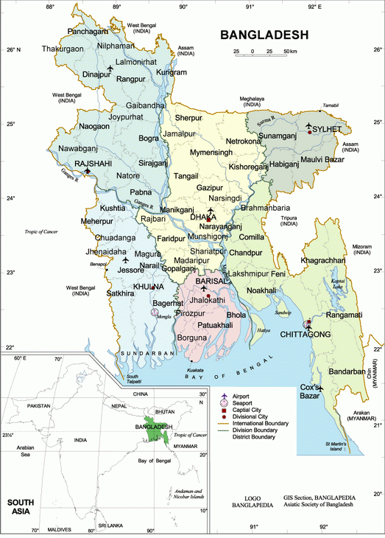
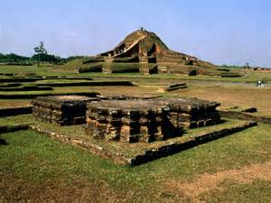
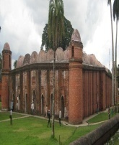
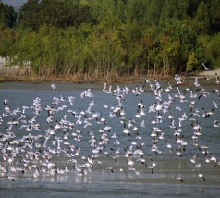
three world heritage sites on the map of Bangladesh

Slide 10

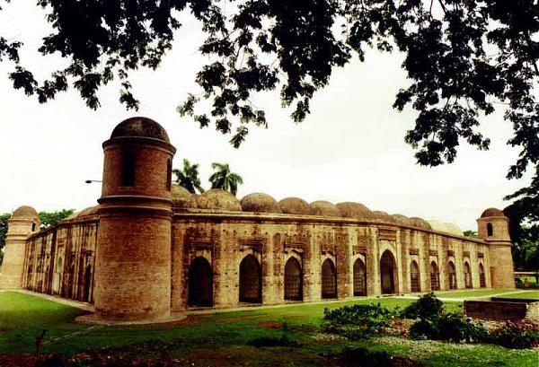
Description of the shatgombuj mosque

Slide 11
A moghul arcchitectural site
Situated at suburbs of Bagerhat
Has sixty pillars and seventy seven domes
Founder, khan Jahan Ali

Slide 12
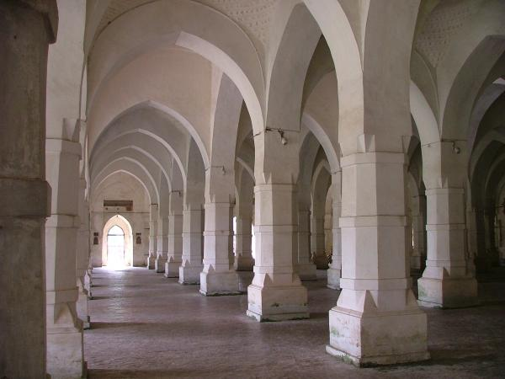
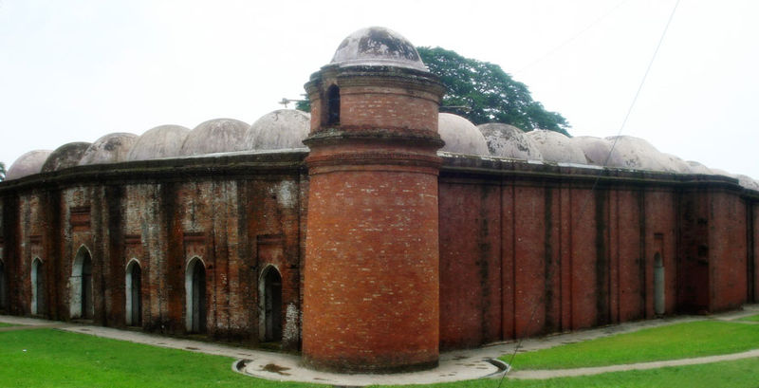
pillar
dome
Inside of the mosque
Outside of the mosque

Slide 13
Grammar-structure
Subject
The shatgombuj mosque
have/has
has
object
Sixty pillers and seventy seven domes

Slide 14
Negative form
Subject
Have/has no
object
World heritage site
Maldives
has no

Slide 15


Group work
Make a dialogue about world heritage sites in Bangladesh and practice it with each other

Slide 16
evaluation
How many world heritage sites are there in Bangladesh?
Where is the Shatgombuj mosque located?
Make a sentence with the structure of (sub + have/has + object)

Slide 17
Home work
Make a list of world heritage sites and identify the location of the sites

Slide 18

Thank you

