Slide 1
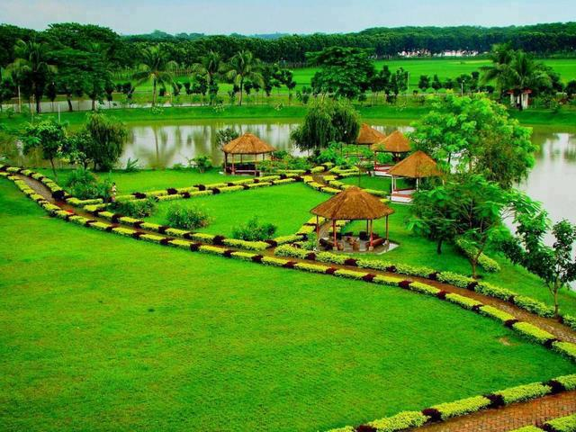
Welcome

Slide 2
INTRODUCTION
ROUFUN NAHAR
Assistant Teacher,
Jamalpur Govt. Girls’ High School,
Jamalpur.
SUBJECT: English 2nd Paper
CLASS: Six
TOPIC: Present Continuous Tense
TIME: 40 minutes

Slide 3
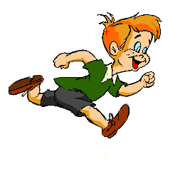

What is the boy doing?
The boy is running.
What is the bird doing?
The bird is flying.

Slide 4
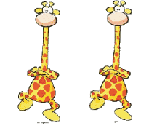
What are the giraffes doing?
The giraffes are dancing.

Slide 5

Today’s Topic
Present Continuous Tense
The present continuous tense is used for something happening now. The action is not finished.

Slide 6
OBJECTIVES OF THE LESSON
By the end of the lesson the students will have practised
*The structures of the present continuous tense
Subject + am/ is/are + verb + ing + others
Subject + am not/is not/are not + verb + ing + others
Am/Is/Are + subject + verb + ing + others
Speaking, Reading and Writing Skills using present continuous tense

Slide 7
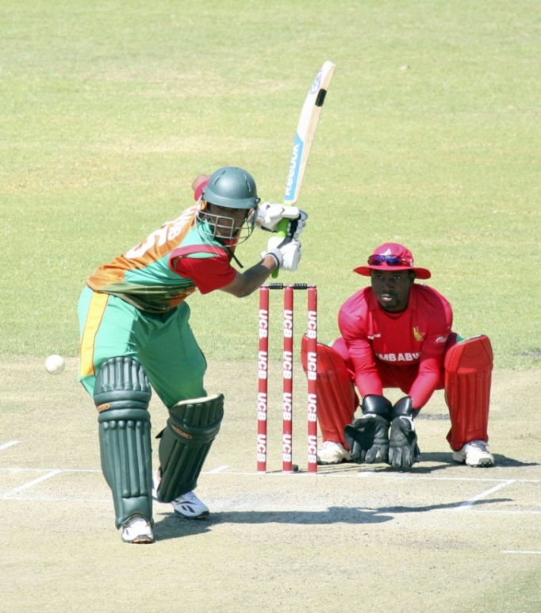
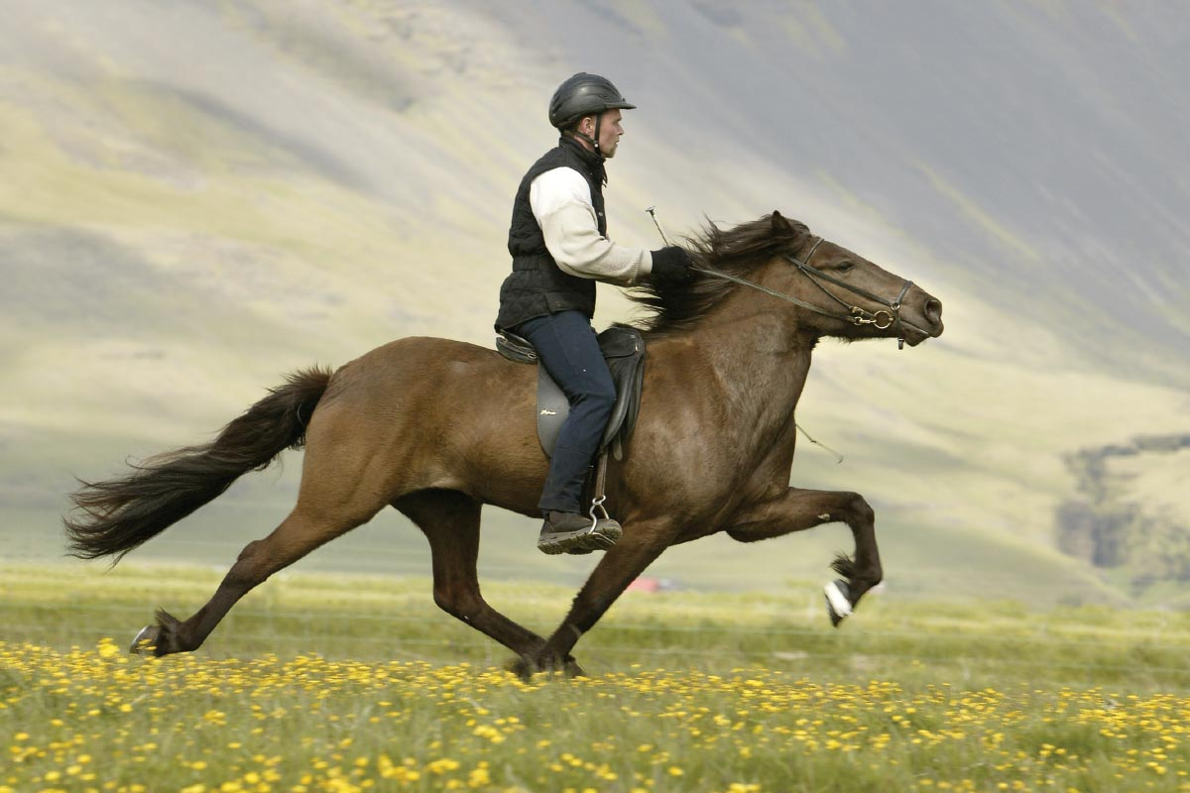
Answer the questions and notice the red colored words
Are they playing cricket?
Yes, they are playing cricket.
Is the man riding a bicycle?
No, the man is not riding a bicycle?
The man is riding a horse.

Slide 8
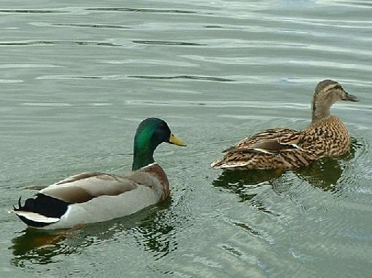
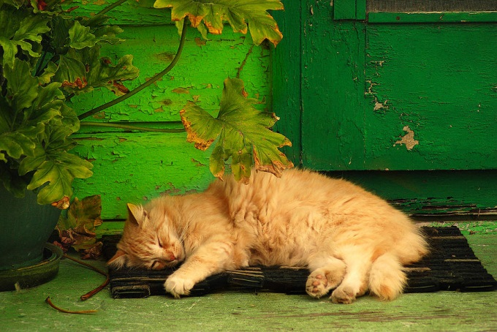
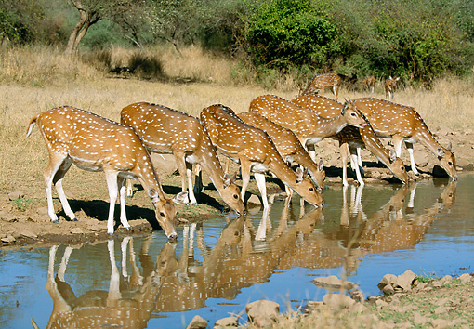
What are two ducks doing in the water?
Two ducks are swimming in the water.
Is the cat sleeping?
Yes, the cat is sleeping ?
What are deer doing?
Deer are drinking water.

Slide 9
Structure Of present Continuous Tense
Affirmative | Subject | am/is/are | verb | ing | Others
I am doing my homework.
Negative | Subject | am not/is not/are not | verb | ing | others
I am not doing my homework.
Interrogative | Am/Is/Are | Subject | verb | ing | others
Am I doing my homework?

Slide 10
Where these are used
am
I
is
He, She, 3rd person singular number, It, That
We, They, 3rd person plural number
are

Slide 11
Make sentences from the jumble words. (pair works)
are
I
taking my bath.
am
Mangoes
tasting sweet.

Slide 12

Read all the sentences first and find out which sentences are present continuous tense say tick for them if not say cross for them. (Pair work)
1. They go to school everyday.
x
2. Shila is making a cup of tea.
_/
3. Arpon played badminton yesterday.
x
4. It is not raining now.
_/

Slide 13
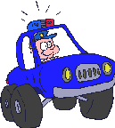
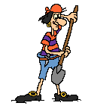

Look at the pictures and write what they are doing in each picture. Write them in 3 structures of present continuous tense. (Pair work)
1
2
3

Slide 14
Evaluation
A police is driving a car.
A police is not driving a car.
Is a police driving a car?
A man is digging soil.
A man is not digging soil.
Is a man digging soil?
The chickens are eating.
The chickens are not eating.
Are the chickens eating?

Slide 15

Homework
At your home look around and write what the people are doing. Write 10 sentences with present continuous tense.

Slide 16

THANK YOU ALL

