Slide 1

Greeting

Slide 2
Teacher’s Identity
Towhedul Islam
Assitant teacher
Porshuram Model Govt. Primary School
Porshuram,Feni

Slide 3
Class: Five
Sub:English

Slide 4
Learning outcomes
The students will be able to -
a)draw Shapes
b) recognise various Shapes
c ) learn the meaning of the new words

Slide 5
Watch the video

Slide 6
Lesson Declaration
Look at Mr Shape

Slide 7
Look at Mr shape
Mr Shape

Slide 8

Circle

Slide 9
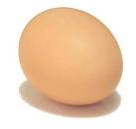
Oval

Slide 10
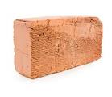
Rectangle

Slide 12
New words
Square
Oval
Triangle
Circle
Rectangle

Slide 13
Evaluation
I will ask them the following questions by the showing picture :
1.What is this?
2. Draw three shapes and name them?

Slide 14
Hometask
Match
Square
Oval
Triangle
Circle
Rectangle

Slide 15
Thanks

