Slide 1

Welcome
Batch- 23 ID- 23
Class- VII
Lesson- Articles

Slide 2
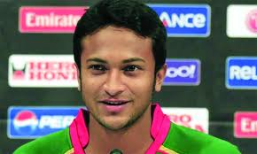
A player

Slide 3

An actor

Slide 4
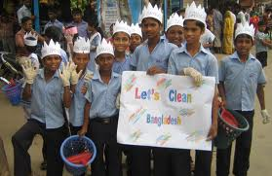
The students

Slide 5
A player
An actor
T The students
Articles

Slide 6
To say the definition of articles.
To use various types of articles.
To explain the classification of articles.
By the end of the lesson, learners will be able :
Learning outcomes

Slide 7

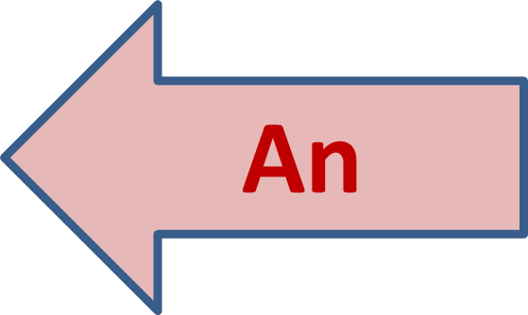
A player
A, An & The are called Articles.
An actor
The
The students

Slide 8
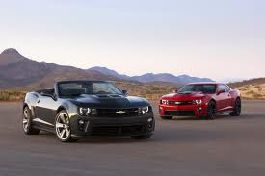
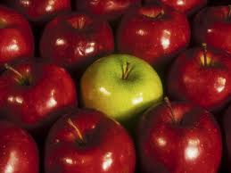
The red car
The black car
I need a car.
The red apple
The green apple
I want an apple.
Things in general are called Indefinite Articles.
Things in specific are called Definite Article.

Slide 9
Classification of Article
Articles
Indefinite
Definite
A
An
The

Slide 10


Uses of A
We must use A before them
A lot of
A few
A bed of roses
Idioms & phrases
One taka note
( O=Wa )
University
( U=U )

Slide 11
Some examples using article A
He has bought a new pen.
I have a one-taka note.
It is a union.

Slide 12
Uses of An
We must use An before them
a+m= M a+l = L
Vowels
‘H’ silence

Slide 13
Some examples using article An
He has bought an umbrella.
Mr. Salam is an honorable man.
Our Headmaster is an M.Ed.

Slide 14
We must use The before them
Uses of The
Newspapers
Unique things
Name of ocean, sea, river
Country’s short name

Slide 15
Some examples using article The
The world is round.
I am from the USA.
I love to read the Daily Star.

Slide 16
Group work
European
According to the pictures, write 5 sentences using A, An & The.

Slide 17
Evaluation
What is article?
Write the kinds of articles with an example.
Say 2 rules of using definite article.

Slide 18
H w
Write the name of 5 things around you using A, An & The.

Slide 19
Thanks

