Slide 1
Welcome

Slide 2
Todays Lesson
Class-Three
Subject-English
Learning outcomes
-Student`s will be able to know pronunciation and understand the text.
-They will able to use over,in,on and under prepositions.

Slide 3
Presented by
Md. Bakkar Siddique
Assistant Teacher
Manikkhari Govt. Primary
School

Slide 4
Create emotion-by reciting a rhyme
Lesson Title
Preposition (in,on,over,under)

Slide 5
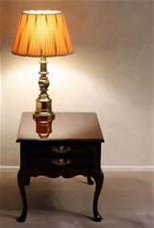
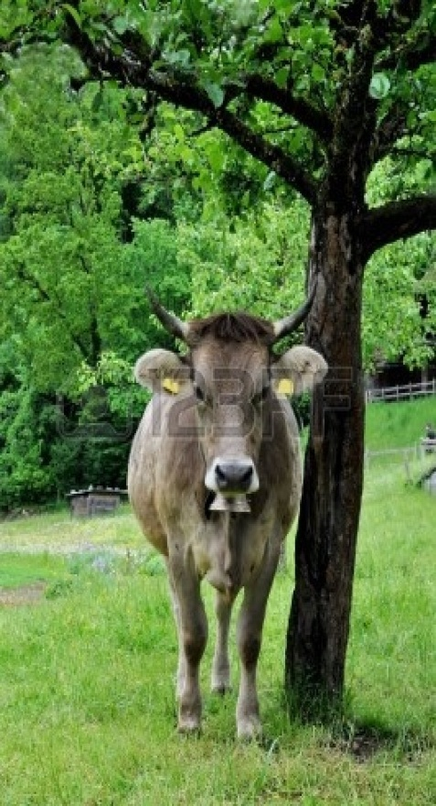
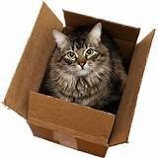
Look at the picture
What are you see in the picture ?

Slide 6
Say with me
The umbrella is over his head
The cat is in the box

Slide 7
Say with me
The cow is under the tree
The lamp is on the table

Slide 8
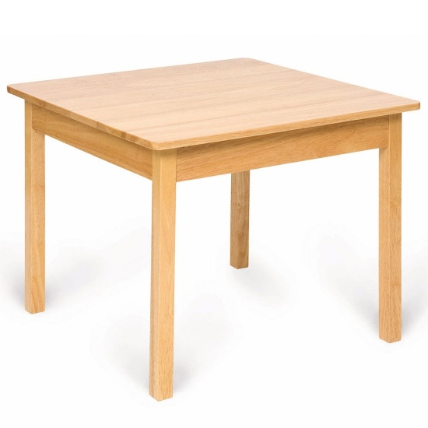
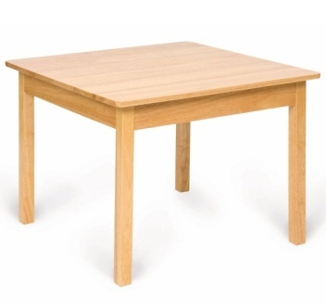
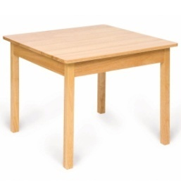
1
Group-1
Where`s the book / ball ?

Slide 9
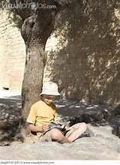
Group-2
Where`s the boy / pen / umbrella /cat ?

Slide 10
Match sentence with the picture :
The pen is in the box.
The cat is in the box.
The boy is under the tree.
The book is on the table.

Slide 11
Evaluation
The cat is........the box .
Fill in the
blanks in
your khata:
The lamp is...... the table .

Slide 12
Open your book at page 55 and read silently

Slide 13
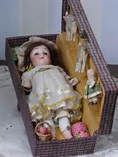
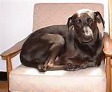
Where`s the
doll / dog ?

Slide 14
No more today .
Thank you

