Slide 1
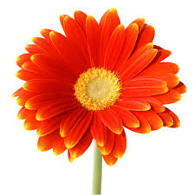



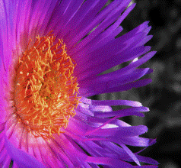

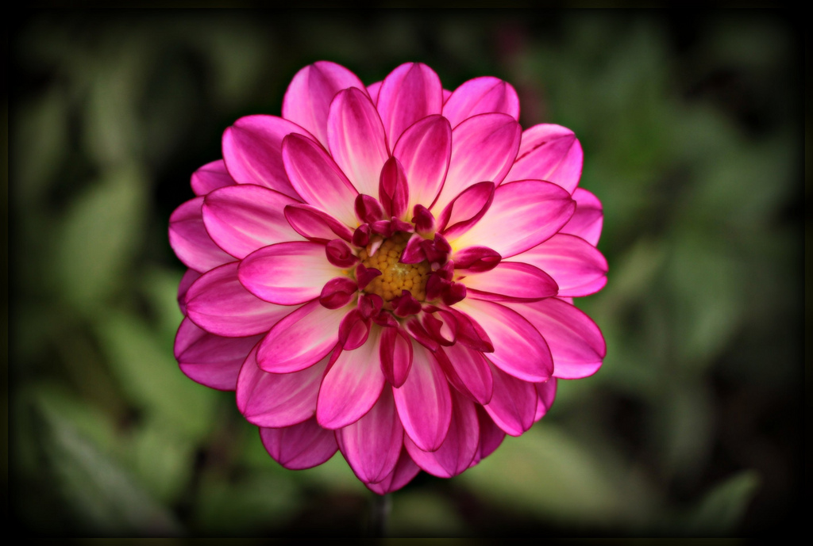
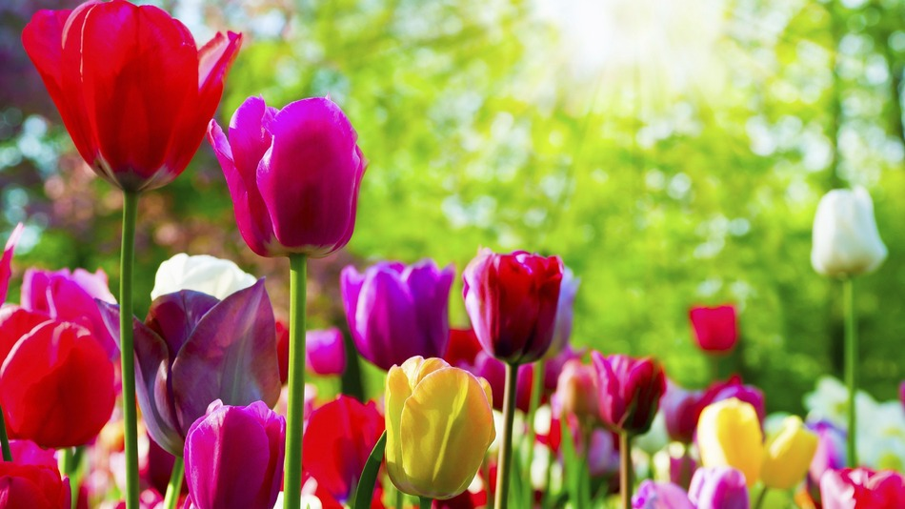

WELCOME

Slide 2

introduction
Sabina yasmin
Assis.teacher
Tulatoly govt.primary school
Chandina,Comilla

Slide 3
Lesson Introduction
Class:Two
Subject:English
Lesson:Two
Unit:Colour’s(4)

Slide 4
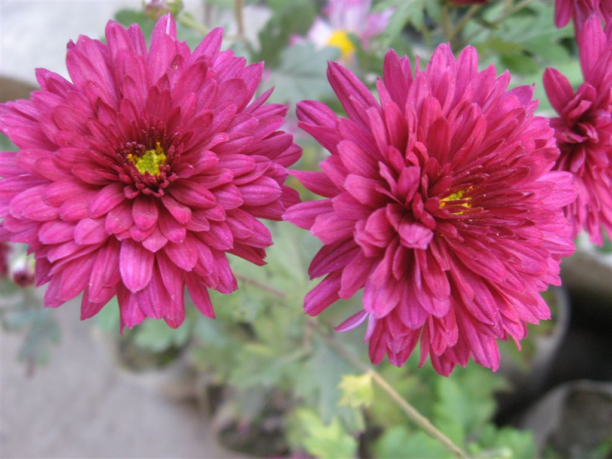
Learning outcomes
Student’s will be able to-
1. Ricognize about different colours.

Slide 5


Slide 6
Colours

Slide 7
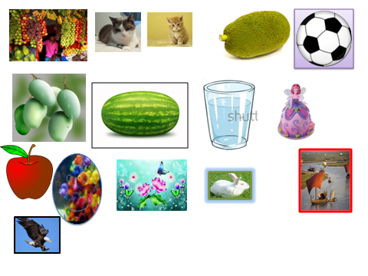
Red,red,red
The apple is red.

Slide 8
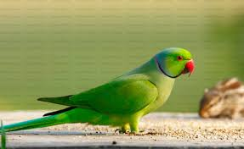
Green,green,green
The parrot is green.

Slide 9
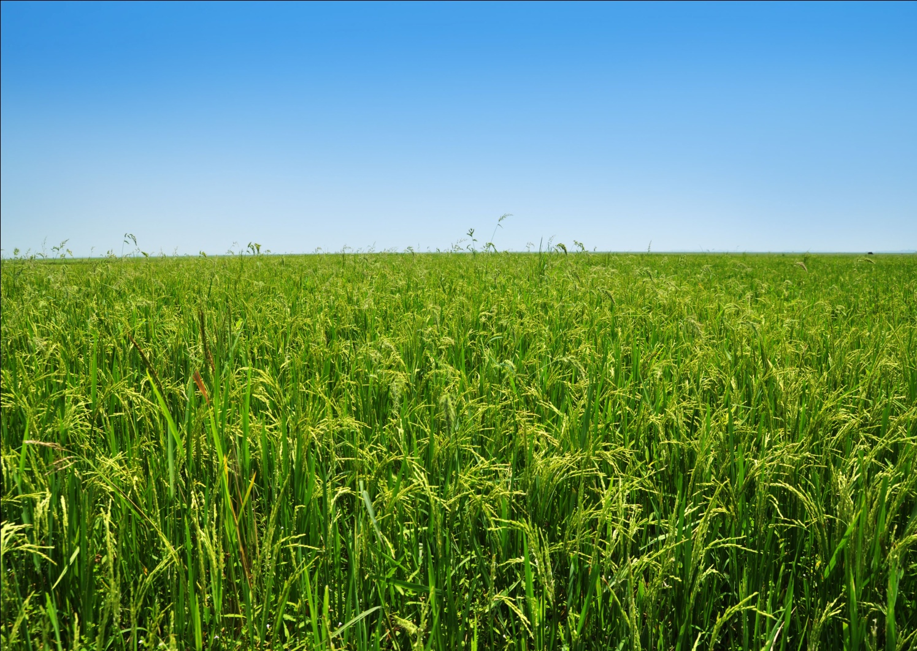
Blue,blue, blue The sky is blue

Slide 10
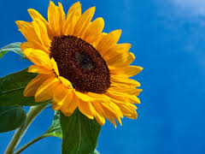
Yellow,yellow,yellow
The sunflower is yellow.

Slide 11
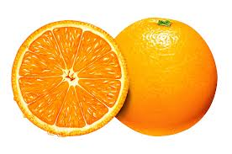
Orange,orange,orange
The fruit is orange.

Slide 12


Violet,violet,violet
These grapes are violet.

Slide 13
Indigo,indigo,indigo
This kite is indigo.

Slide 14

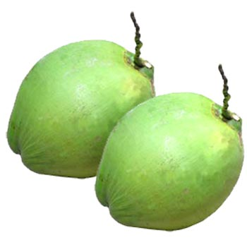
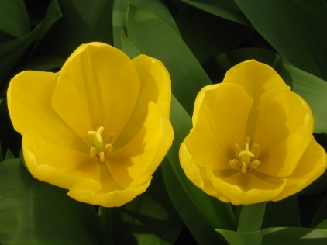
red
green
blue
yellow

Slide 15

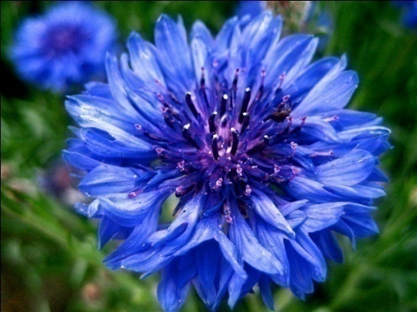
orange
violet
indigo

Slide 16
Lets find out the colour(with card)

Slide 18
Colour the shape to information:
Group (sun):
red
indigo
orange
green
blue
violet
Group moon:
Group star:
yellow
red
green

Slide 19
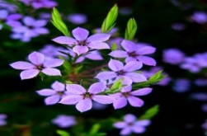
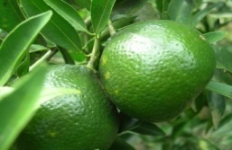

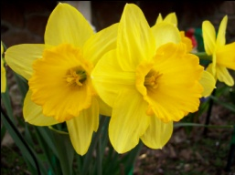

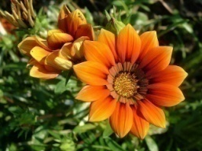

picture
colour
yellow
orange
violet
blue
green
indigo
red

Slide 20

THANKS

