Slide 1
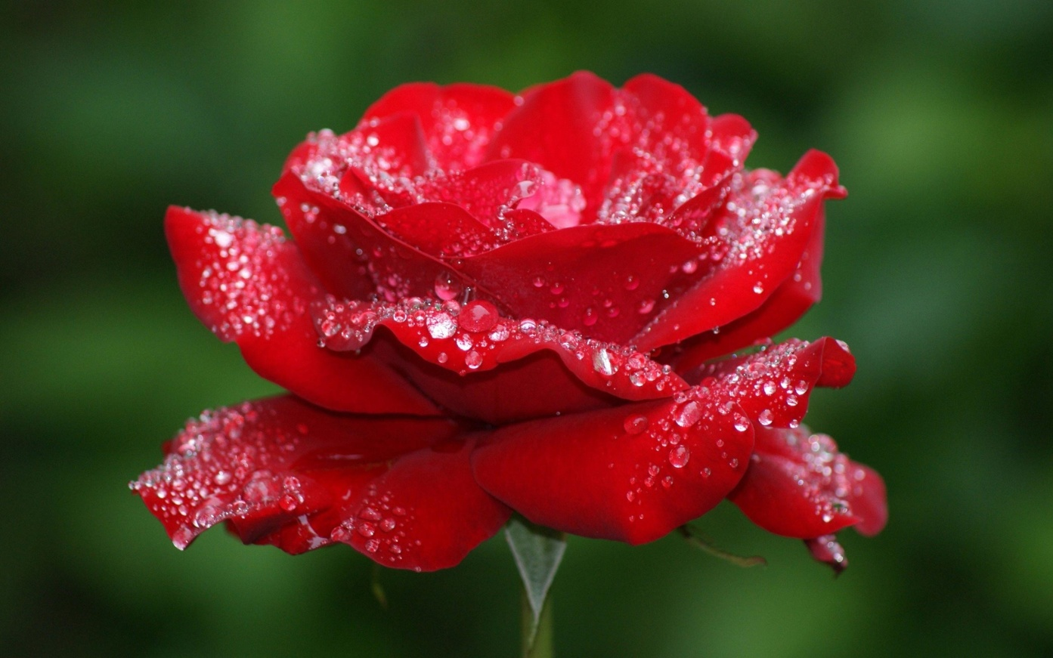

Slide 2
Edited by: Sadhan Kumar Haldar Assistant Teacher Sundarpur Govt. Primary School Moheshpur,Jhenaidah

Slide 3
Class:Two Subject:English

Slide 4
Colours song video

Slide 5
Lesson Whole:Unit 5 Lesson 4:Colours (4) Look,listen and say. (Red,Green and Blue)

Slide 6
Learning Outcomes: 1.Ss will be able to listen attentively. 2.Ss will be able to say the name of colours. 3.Ss will be able to match words with colours.

Slide 7
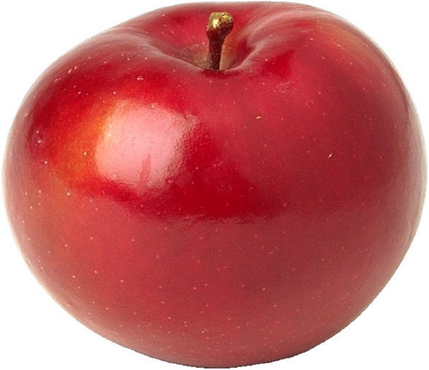
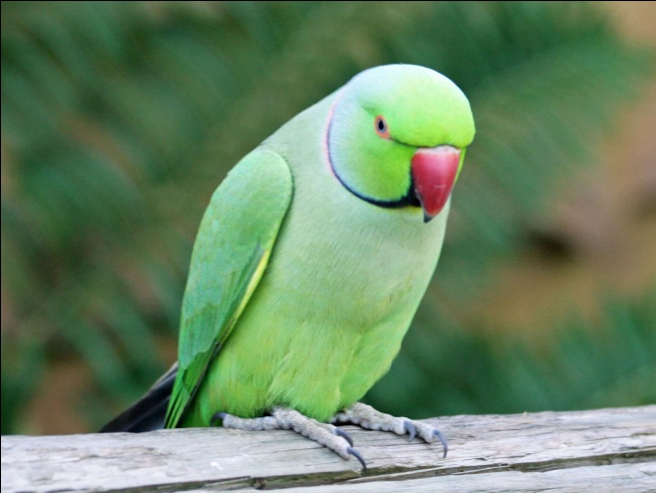
Red,red,red
The apple is red.
Green,green,green
The parrot is green.
Blue,blue,blue
The sky is blue.

Slide 8
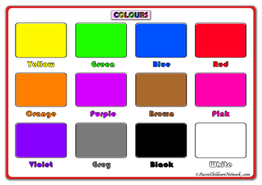

Slide 9
I will ask Ss to find out Red,Blue and Green colour by using real materials such as colour paper.

Slide 10
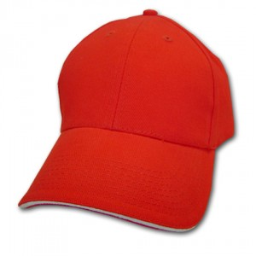
Red
Blue
Green

Slide 11
Goodbye

