Slide 1


Welcome to my dears

Slide 2

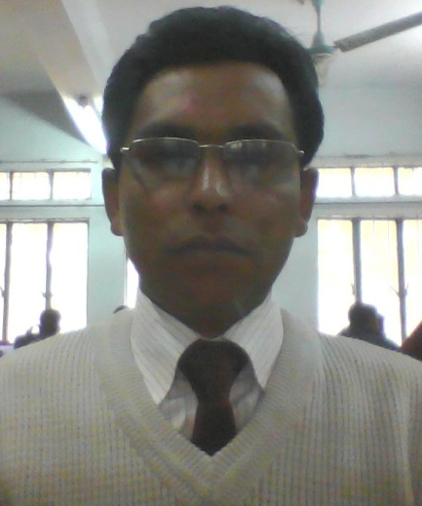
Class conducted by
M.Obyed Ullah Akund
B.A(Hon’s),M.A(English),M.Ed-
Lecturer in English, Kaichapur, Phulpur,Mymensingh.
Cell Phone: 01717563011
Email: obyed1976@gmail.com

Slide 3

Session Introduction
Subject : English.
1st Paper
Class: XI
Class duration: 45 Mins
Date : 25/10/2015

Slide 4
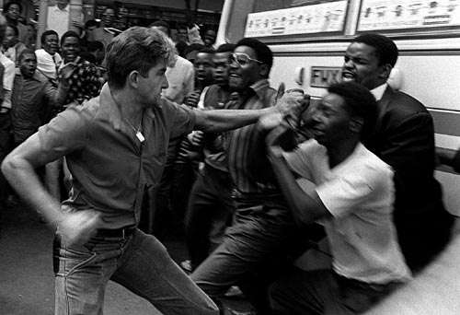

What do you see in the picture ?
Blacks are tortured by the white people

Slide 5
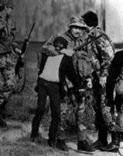
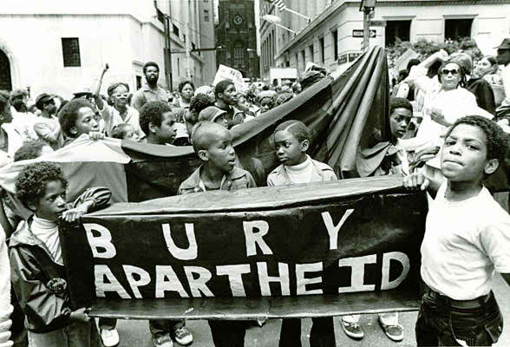
See other Pictures & try to guess

Slide 6
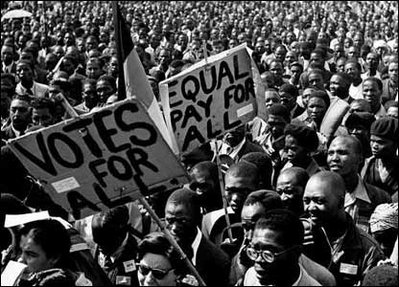
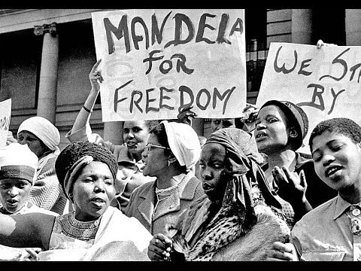

Slide 7

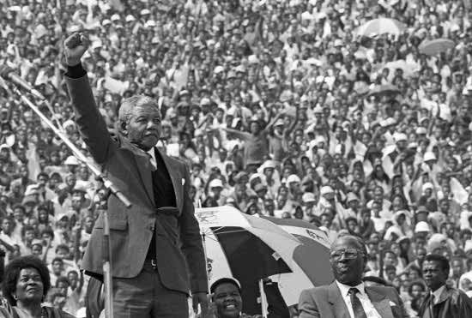
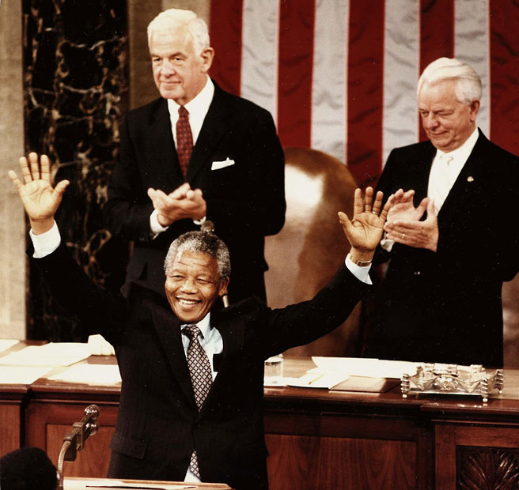
Look at these pictures & think

Slide 8
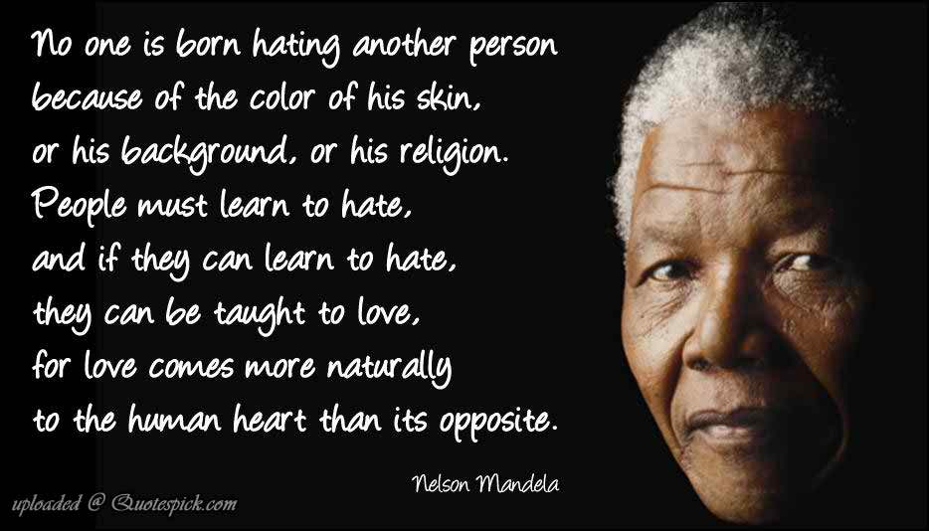
Read this Message

Slide 9
TODAY’S TOPIC:
Nelson Mandela, from Apartheid Fighter to President
Unit- 1, Lesson -1

Slide 10

Objectives
To talk about Nelson Mandela & about the oppression of the black people by the white people i,e about apartheid
To find out some new words & knowing its meaning for enriching vocabulary
To answer comprehension questions based on text.
To practise grammatical usage in different situation in accordance with the question’s pattern
Developing 4 skills

Slide 11

Meaning of some new words for enriching vocabulary

Slide 12

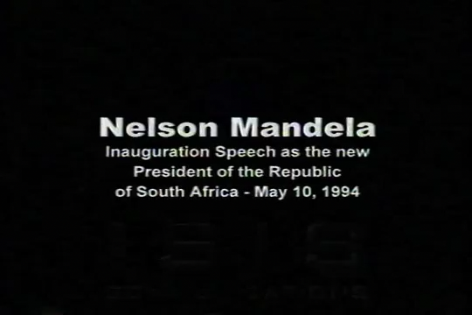
Let’s watch a video & find out new words given in the text

Slide 13
New words | Bengali meaning | Meaning | synonym
Apartheid
Reconciliation
Embody
Emancipation
Intensely

Slide 14
Let’s see the meaning & its synonyms

Slide 15
New words | Bengali meaning | Meaning | synonym
Apartheid(n) | জাতি বিদ্বেষ | discrimination among the races | inequity,injustice,disproprtion
Reconciliation(n) | সমন্বয়সাধন, পুনর্মিলন | The process of making consistent or compatible | Reunion, bringing together
Embody (v) | মূর্ত করা, সংগঠিত করা | To give a concrete form to, organize | Exemplify,realize,reify
Emancipation(n) | মুক্তি, বন্ধন মুক্তি | The state or fact of being liberated | Liberation, freedom, unrestraint
Intensely(adv) | গভীরভাবে/তিব্রভাবে | Of an extreme kind | Deeply, extremely, strongly

Slide 16
New words | Bengali meaning | Meaning | synonym
Healing
Repression
Chasm
Domination
Harmony
Clan
Laud

Slide 17

Let’s see the meaning & synonyms

Slide 18
New words | Bengali meaning | Meaning | synonym
Healing(N) | আরোগ্য | The act or process of regaining health | Cure ,remedy
Repression(N) | দমন নিতি,অবদমিত কামনা-বাসনা | The act of repressing | Oppression, fascism
Chasm(N) | ফাটল | A gap among the races | Crack ,fracture, breakage
Domination(n) | আধিপত্য,শাসন, | Often arbitray, rule | Supremacy, superiority
Harmony(n) | মিল, ঐকতান | A consistent, pleasing arrangement of parts | Union,concord
Clan(n) | গোত্র | A group of people who share the same interest | Tribe,race

Slide 19
Try to give the answer of the multiple choice(indivdual)
Nelson Mandela is considered as a -
Symbole of destruction
Emblem of peace and harmony
Icon of love
Epitome of democracy

Slide 20
Let’s see the answer of the multiple choice
Nelson Mandela is considered as a -
Emblem of peace and harmony

Slide 21

What does ‘apartheid’ refer to in the title ?
Discrimination
Distance
Apart
Conversation

Slide 22
What does ‘apartheid’ refer to in the title ?
Discrimination

Slide 23
Mandela wanted to ------
Eliminate race disparity
Establish race discrimination
Healing of the wounds
Mend the chasms that divided them

Slide 24
Mandela wanted to ------
Eliminate race disparity

Slide 25
The word ‘emancipation’ in line 5 stands for--
Participation
Bondage
Encouragement
Liberation

Slide 26
The word ‘emancipation’ in line 5 stands for--
Liberation

Slide 27
Mandela fought for the ------ throughout his life.
Asian
South African
African
Black American

Slide 28
Mandela fought for the ------ throughout his life.
African

Slide 29
Open text Book & Read the text silently for 5 minutes and discuss in pair & try to make the question’s answer (Pair Work) 5 Mins
What special quality of Nelson Mandela do you observe from the regarding of the passage?
How long was he imprisoned? Why ?
What did Nelson Mandela personify?
“Don’t call me .I’ll call you .” When and why did Nelson utter these words?
With whom did Mandela share the Nobel Peace Prize and what was his speciallity ?

Slide 30

Read carefully & try to fill up the gaps (Group work)
One of the greatest advances in modern technology has been invention of computer.It is a great (a) ___ of science.It is (b)____ in all arenas of ©_____ . It is getting developed (d)____ and more day by (e) ____ .A time may come (f)_____ it will be possible (g)____ people of all ages (h)_____ use computer in various (i)____ . Then human life will (j)____ more easy and comfortable.

Slide 31
Let’s see the answer of the gaps (Group work)
One of the greatest advances in modern technology has been invention of computer.It is a great (a) wonder of science.It is (b) used in all arenas of © knowledge . It is getting developed (d) more and more day by (e) day .A time may come (f) when it will be possible (g) for people of all ages (h) to use computer in various (i) fields . Then human life will (j) be more easy and comfortable.

Slide 32

Let’s sum up today’s lesson in key points

Slide 33
Main Name : Rolihlahla Mandela
Occupation : Activist, Politician, Philanthropist,Lawyer
Pollitical Party: African National Congress
Imprisonment : 1962-1990 (28 Years)
Religion : Methodist
Date of Birth : 18 July 1918
Nick name : Madiba ,Tata, Dalibunga

Slide 34
Fought for : Against Apartheid
Notable Work : Long Walk to Freedom
Date of death : 05 December 2013(Aged 95)
Retirement from Politics : 1999
Awards : Shakharov (1988),Varat Ratna(1990), Nobel Peace Prize(1993)
Elected First African President : 1994-1999

Slide 35
Name of Reference book or source for getting more information about the topic
Nelson Mandela’s Book- Long Walk to Freedom
From searching Google

Slide 36

Topic for the next class-
The Unforgettable History
Unit-1 ,Lesson -2
Grade- xi

Slide 37
Home Task
Write down a brief history of the struggle of Nelson Mandela

Slide 38


