Slide 1
to every body

Slide 2
Teacher’s Identity
Md. Eusuf Ali M A M Ed.
Assistant Teacher
Bakrikandi Adarsha High School
Debidwar- Comilla
Mobile No. 01944689392

Slide 3
Introduction to the lesson
Grade -Seven
Subject: English-2nd paper
Unit-11
Lessons: 3
Time: 45 minutes
Date:29/08/2015

Slide 4
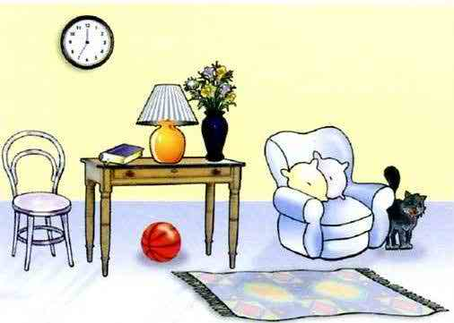
Look at the pictures (2 minutes)
a. The lamp is on the table.
b.The ball is under the table.
c.The cat is by the Sofa.
d.All things are in a room.

Slide 5
Today’s Lesson is----------
Preposition

Slide 6
Learning out comes
By the end of the lesson Ss will be able to---
1. Define preposition.
2. Make a list of simple preposition.
3. Make sentences using preposition . (on, in, at, with. Under).

Slide 7
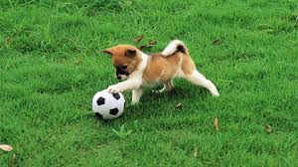
Look at the pictures (2 minutes)
The books are in a bag.
The dog is playing with a ball.
The Rabit is on the table.

Slide 8
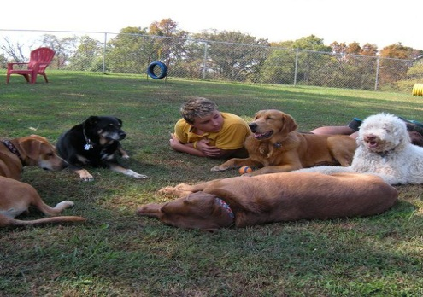
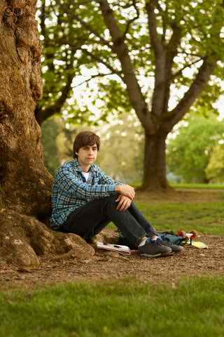
Look at the pictures (2 minutes)
They are at the mitting.
He is waiting for his friends.

Slide 9
Preposition is a compound word---- Pre means before (পূর্বে) position means position (অবস্থান)

Slide 10
Individual work(2 minutes)
Ss will write the defination of preposition.

Slide 11
Defination of Preposition
Preposition is a word which sits before noun or pronoun to show the relation of the noun or pronoun with any other words in the sentences.

Slide 12
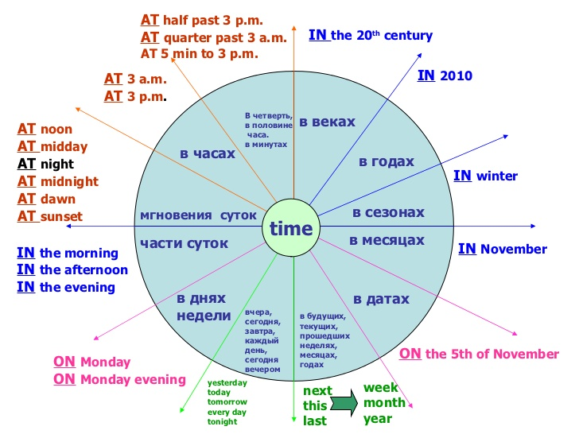
Look at the Sentences (2 minutes)
We live in Dhaka.
He comes of a Muslin family.
Asif will come on Monday.
Shipra leaves for Dinaj pur by 10am.
She is going to school.
He is in good health.
We live at Homna in Comilla.
I want a piece of paper.
i. Rafiul killed the snake with stick.

Slide 13
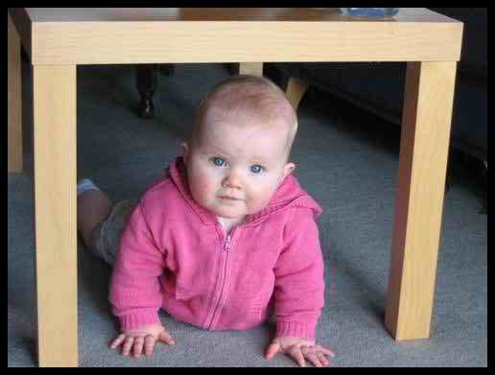
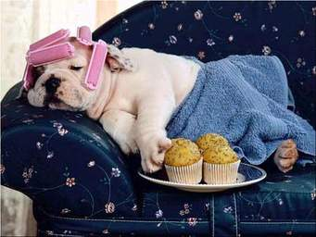
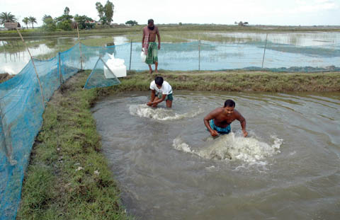
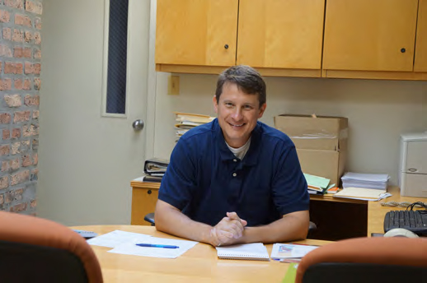
Look at the pictures (2 minutes)

Slide 14
Group Work (2 minutes )
Write a list of simple preposition.

Slide 15
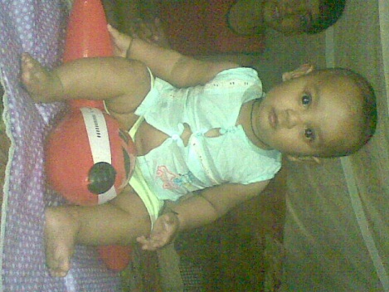
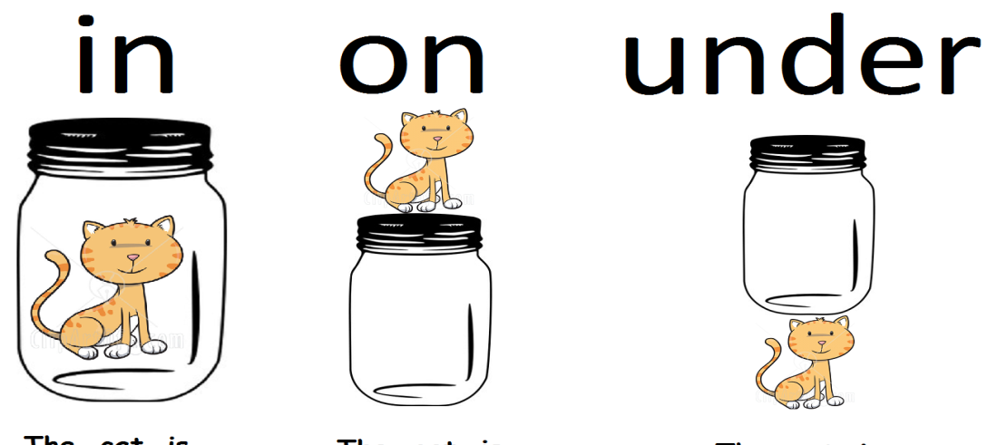
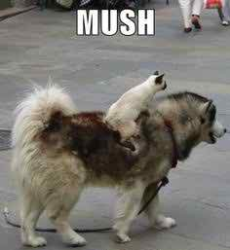
Look at the pictures (2 minutes)

Slide 16
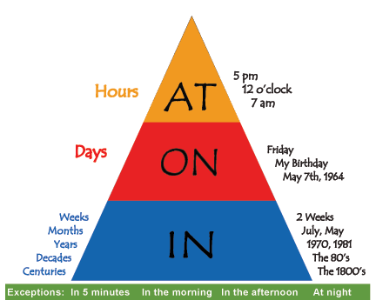
Look at the preposition piramid

Slide 17
Pair work ( )
Ss will write 5 sentences

Slide 18
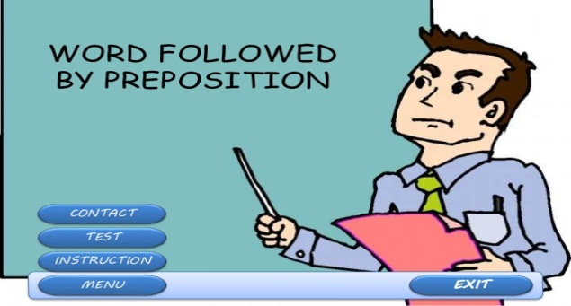
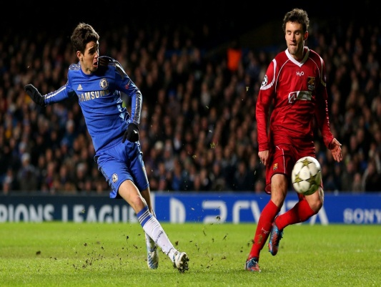
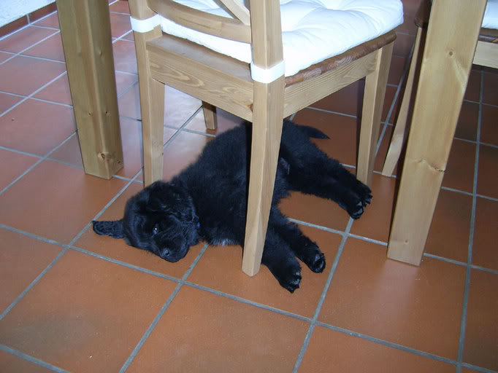
Evaluation
1.What is preposition?
2. Say 3 simple preposition?
3. Make sentence with following picture:

Slide 19
Home Task
Write ten sentence with the following prepositions –
in, on, at, with, by.

