Slide 1


Slide 2
Teachers Introduction:
Name:Md.hafizur Rahman
Assistant teacher
Mosangoan Government Primary school
Mobile: 01716-437086
Email:hafizict5@gmail.com
Lesson Introduction:
Subject: English
Class: five
Content no:9

Slide 3
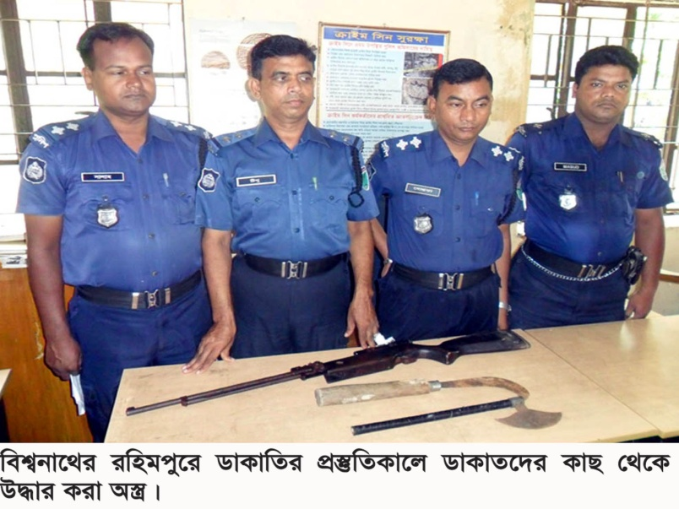
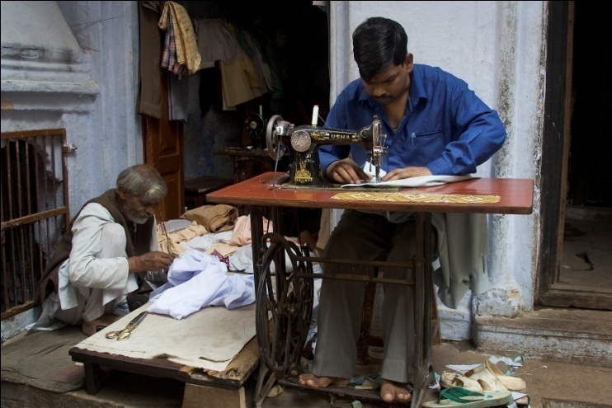
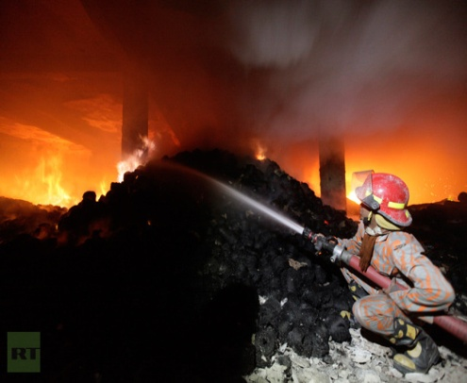
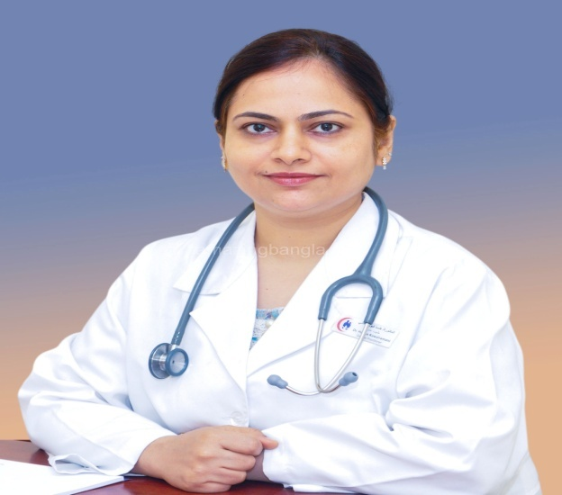
police
tailor
Fire fighter
doctor

Slide 4
A Firefighter
(Raju is---------------to become fire fighter)

Slide 5
Learning outcomes:
Student will be able to-
-listening to understand and enjoy the stories,
-read the simple stories
-write the short and simple paragraphs by arrange set of question
-write the answer of the short question
-say what about people and talk about object and event

Slide 6
New word
panicked
Full time
volunteer
Put out

Slide 7

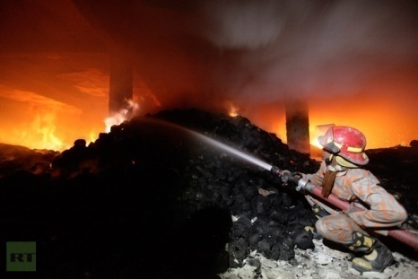
Full time
All time
He is my full time partner
To close
Put out
I put out the lamp

Slide 8
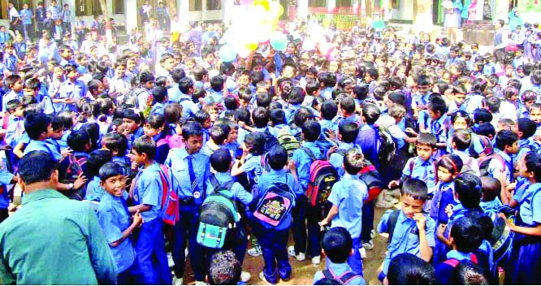
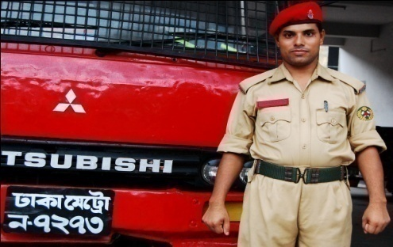
Panicked
fear
He got panicked from the accident.
Volunteer
Who works willingly
I am volunteer in this game

Slide 9

Raju is a firefighter

Slide 10
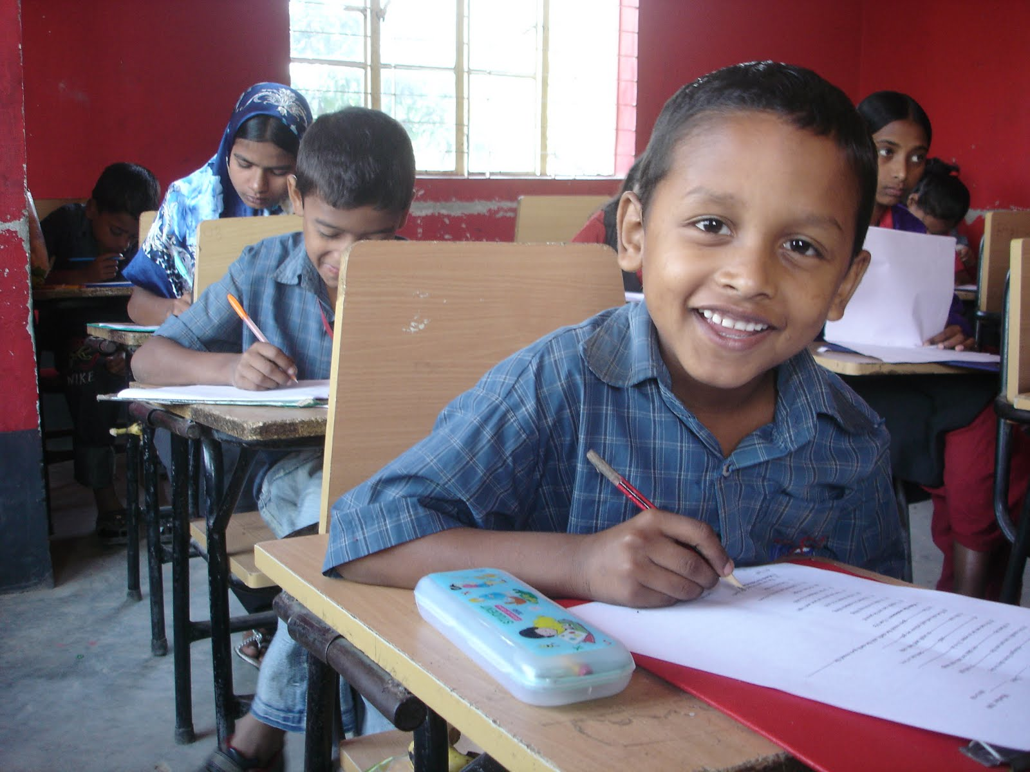
long time ago, when Raju in class five,

Slide 11
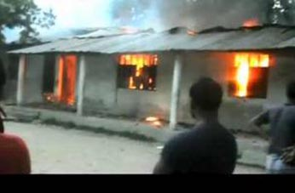
there was a fire in school building

Slide 12
Every one got panicked

Slide 13
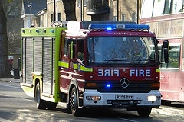
But soon a Fire brigade came

Slide 14
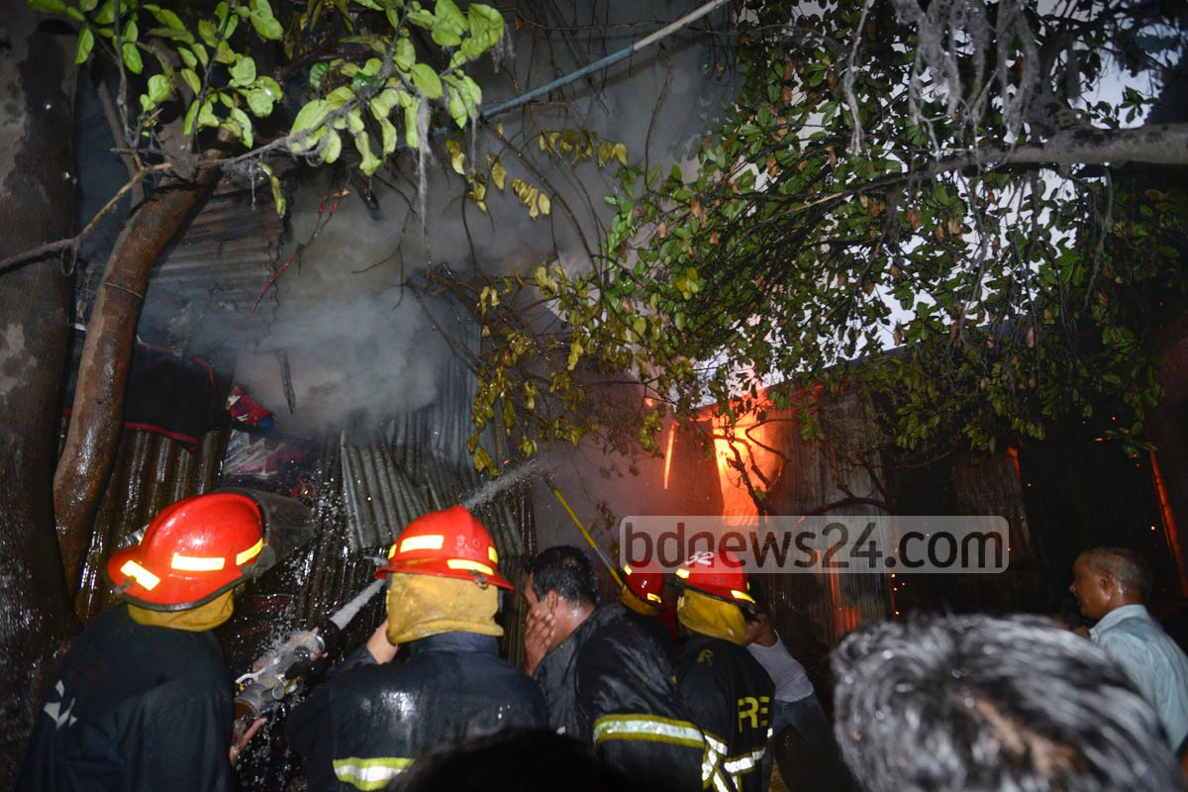
Put out fire

Slide 15

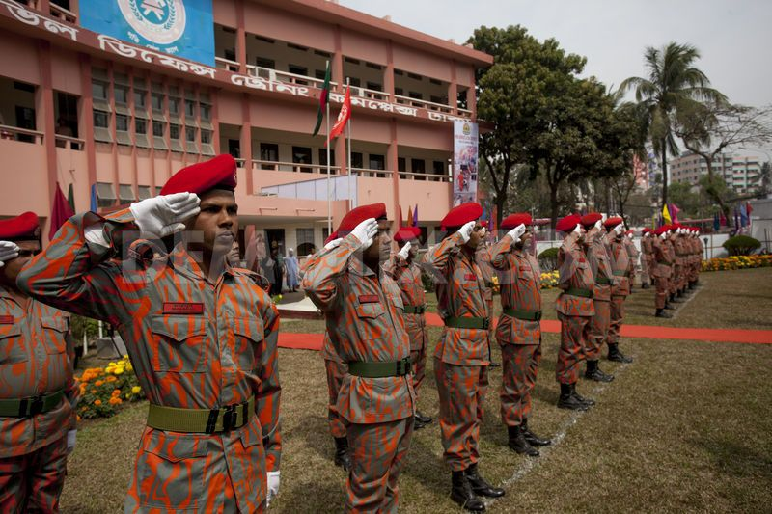
Raju
Fire department
after finishing the H.S.C Join a volunteer the fire department

Slide 16
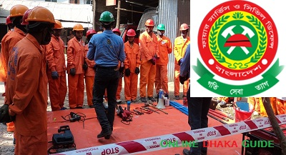
Now, Raju is a full time fire fighter

Slide 17

His man job is Putting out fire

Slide 18
TEACHER`S
LOUD READING

Slide 19
Student loud reading
(with correct pronunciations and intonation )

Slide 20
Group work
Match the meaning of the word-
1-paniked
2-put out
3-volunteer
-to close or protect
- who works willingly
-fear/frighten/alarm
1-fear/frighten/alarm
2--to close or protect
3-fear/frighten/alarm
Answer the short question-
1-when was Raju join as a volunteer?
2-who put out the fire?

Slide 21
Individual work
Fill the blank
1-Every one got
2-a put out fire
panicked
firefighter
Choose the best answer
1-when was Raju joined the fire department?
(a)Before HSC(b)after HSC(d)before SSC(C)after eight 2-Now Raju is a –
(a)full-time fire fighter(b)half time fire fighter
(c)Volunteer (d)none of them

Slide 22
TASK
Write five other profession that you know.

Slide 23


