Slide 1
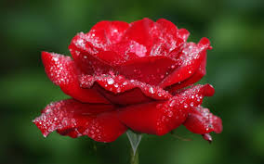
Welcome To You All

Slide 2
Teacher’s introduction
Shima Rani Banik
Assistant Teacher
Ali Azam High School and College
Munshirhat,Fulgazi,feni.

Slide 3
Lesson introduction
Class :6
Subject:English 2nd paper
Time:50minutes

Slide 4
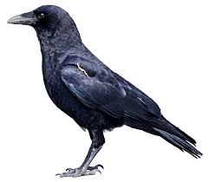
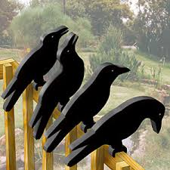
Do you know these birds?

Slide 5
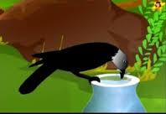
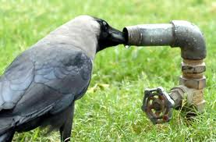
What is it/she doing?

Slide 6
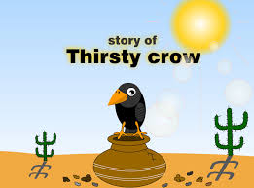
Thank you.Our topic’s name is
“A Thirsty Crow”.Now we are going to write a story on this.

Slide 7
Learning Outcomes
After completing the lesson,students will be able to:
1.Describe the story
2.Develop 4 skills
3.Tell the meaning of the words
4.Say the moral of the story
5.Write another story like this.

Slide 8
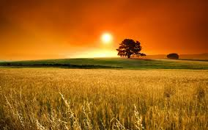
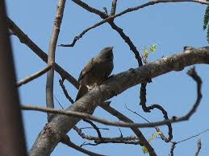
It was a summer day and a crow became
Very thirsty.

Slide 9
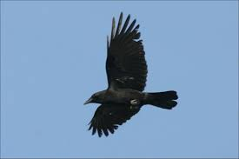
It began to move here and there in search of drinking water but in vain.

Slide 10
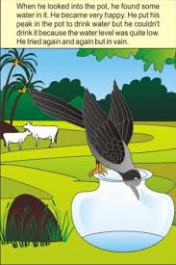
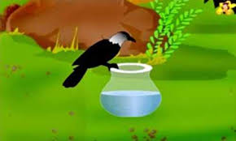
The crow did not lose hope.It,at last,
Noticed a jar at a little distance.
If flew down to it.There was a little water at the bottom of the jar.But it was too low for the crow.

Slide 11
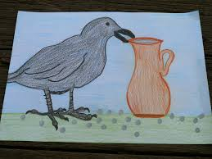
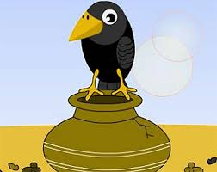
The crow tried to upset the jar.But the crow was not too strong to do it.
The crow was in a fix what to do.Reasonably she became very disappointed.She was thinking what could be done.

Slide 12
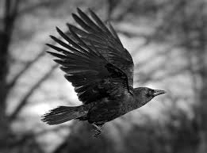
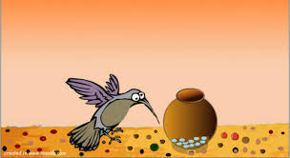
But she could not find any means to quench her thirst.At last, losing heart when she was aboout to fly away,she saw some pieces of stones lying at a little distance.

Slide 13
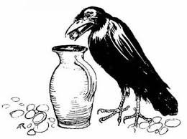
At once she hit upon a plan.She got to the stones and took a piece of stones in her mouth.

Slide 14
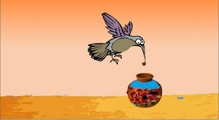
She flew to the pitcher and dropped the stone into it.

Slide 15
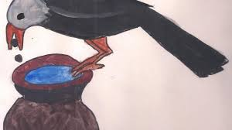
She continued the same task for several times and gradually the level of water was rising.

Slide 16
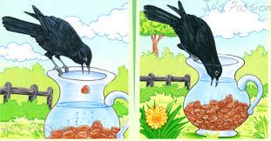
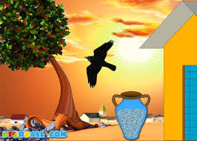
At last the water level came within her reach.Then she drank water to her heart’s content and flew away.

Slide 17
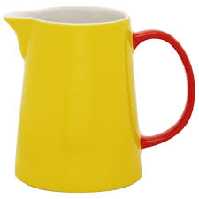
Word Meaning of the new words
Pitcher-A water jug or jar
A pitcher contains water

Slide 18
Disappointed- Frustated,Loss of hope
The crow became disappointed

Slide 19
Quench- Satisfy
At last water quenched the crow’s thirst.

Slide 20
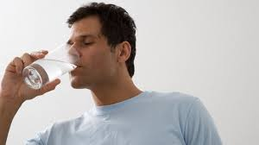
Content - Satisfy
He drank water to his heart’s content.

Slide 21
The moral of the story
Where there is a will there is a way.

Slide 22
Class work
1.The story has given us a message.
What was that?
2.Why did the crow disappoint?

Slide 23
Home Work
How did the crow able to rise the level of water? Explain.

Slide 24
Thank you to all of you

