Slide 1
Welcome To You All

Slide 2
Teacher’s Identity
Shima Rani Banik
Assistant teacher,
Ali Azam High School and College
Munshirhat,Fulgazi,Feni.

Slide 3
Lesson Introduction
Class:9
Subject:English 1st Paper
Time:50 minutes

Slide 4
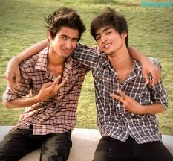
What do you see in the picture?

Slide 5
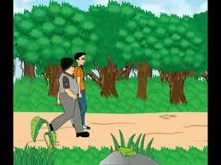
What do you see in the picture?

Slide 6
Thank you.Today we shall write a story on A Tale of Two friends

Slide 7
Learning outcomes
Students will be able to
1.Describe the story
2.Develop 4 skills
3.Tell the meaning of a new words.
4.Say the moral of the story
5.Write another story like this.

Slide 8
Learning outcomes
Students will be able to
1.Describe the story
2.Develop 4 skills
3.Tell the meaning of a new words.
4.Say the moral of the story
5.Write another story like this.

Slide 9
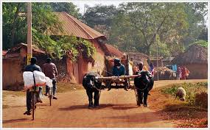
There were two friends.They lived in a certain village.

Slide 10
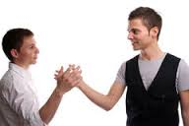
They promised that they would help each other at the time of danger.

Slide 11
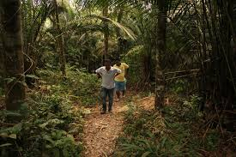
One day they were passing through a deep forest.

Slide 12
Suddenly a bear came in front of them.So, both of them were afraid and were at a loss what to do.

Slide 13
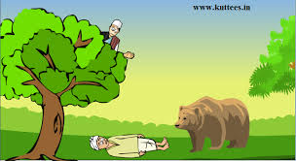
One of them knew how to climb a tree.He at once climbed a tree and hide himself.

Slide 14
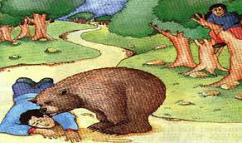
The other man,finding no way ,fell on the ground and held his breath pretending to be dead.

Slide 15
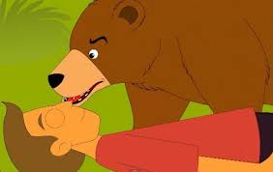
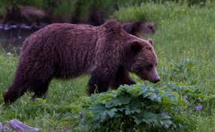
The bear came up to him and smelt his nose,ears,and face,took him to be a dead man and left the place.

Slide 16
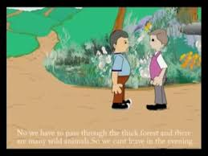
When the bear was gone ,the man in the tree came down and said,”Thank God that you are saved .

Slide 17
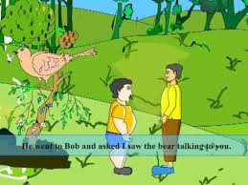
But friend ,I saw the bear put its mouth very close to your ear.Did it say anything to you?.

Slide 18
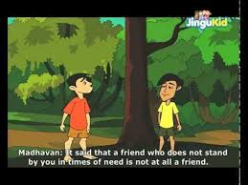
The friend replied,”Yes, the bear told me not to trust a friend who left me in a danger to seek his own safety”.

Slide 19
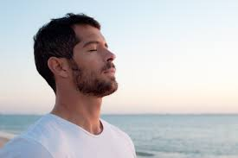
Word Meaning of The New Words
Breath-Inhale.
The man is breathing in a fresh air.
Pretend-Feigned.
He is pretending to be dead.

Slide 20
Moral of the story
A friend in need is a friend indeed

