Slide 1
WEL COME

Slide 2
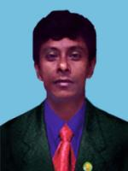
SUSHIL BISWAS (Head Teacher)
Chulkati Ghanoshyampur Secondary School.
Chulkati, Bagerhat.

Slide 3
Lesson Introduce
Sub- English 1st Paper
Class- lX
Topic- The Maghs
Unit- 17
Lesson- 1

Slide 4
Main purpose :
*After this lesson the learners will be able to tell about the life style of the Maghs & other tribal people of Bangladesh.

Slide 5
Lesson objectives : Speaking, Listening, Reading & Writing.

Slide 6
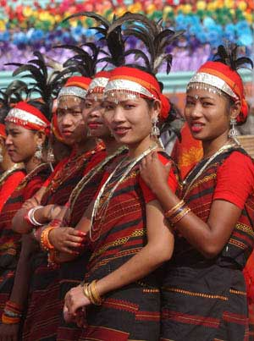
What is this picture?

Slide 7
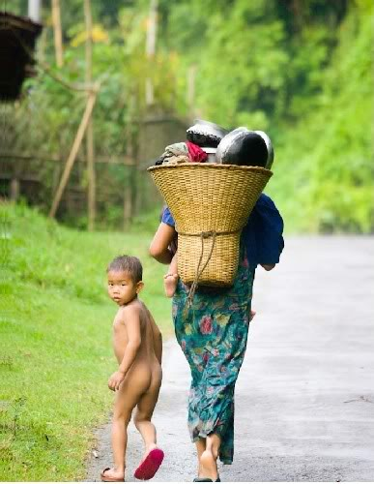
What can you see in the picture?

Slide 8
Now we will discuss about
The Maghs

Slide 9
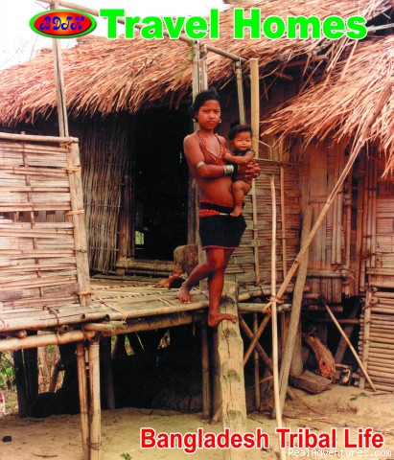
There are many kinds of tribal people of Bangladesh. One of them is the magh. Their houses are somewhat different from ours. They build their houses on high platform about 6-8 feet high from ground so that their houses do not become damp and can protect themselves from insects & animals.

Slide 10
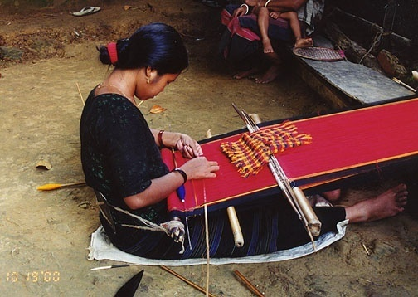
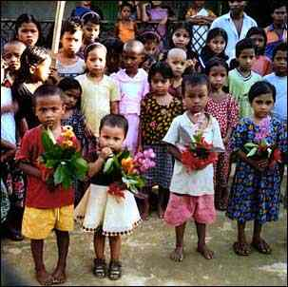

Slide 11
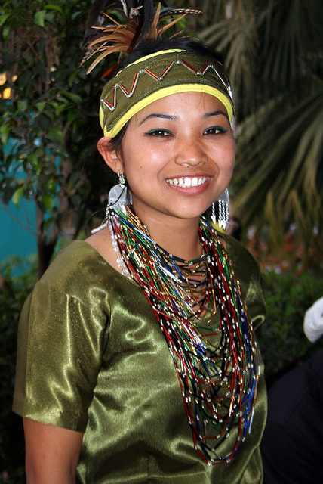

Slide 13
Individual work :
Where do the Maghs live?

Slide 14
Discuss & write down about their food habit.
Group work :

Slide 15
Fedback – (1) Someone come from group A. (a)Have you heard the name of tribal people? (b) Why do the maghs build their houses on high platform? (2) Someone come from group B.
Where do the Maghs live?
How are their dwelling places?
What is their main profession?

Slide 16
Home work
How do they prepare their festival food?

Slide 17
THANK YOU

