Slide 1
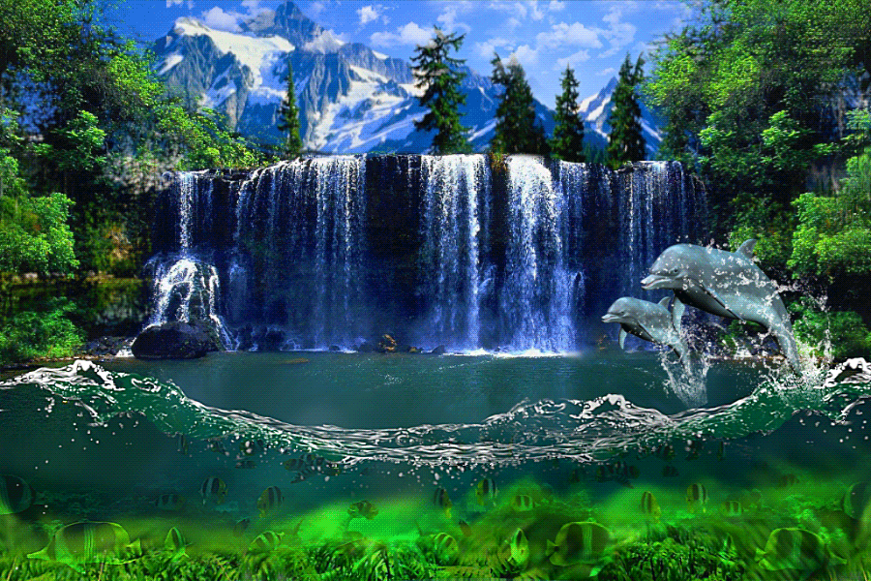
Welcome to this session

Slide 2
Introduction of the Teacher & Class
Shima Rani Banik
Assistant Teacher
Ali Azam High School and College
Munshirhat,Fulgazi,Feni.
Class:ix-x,English 1st paper.
Time:50minutes.Date: 16.10.15

Slide 3
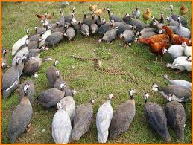
Can you guess something about the picture ?

Slide 4
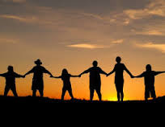
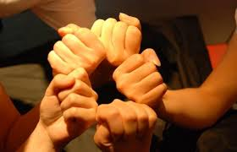
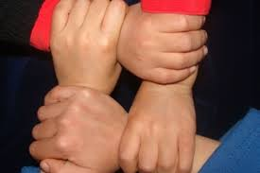

Slide 5
Topic’s Name
Unity is strength

Slide 6
Learning Outcomes
After completing the lesson,students will be able to
1.Describe the story.
2. Tell the meaning of the words .
3.Say the moral of the story .
4.Write another story like this .

Slide 7
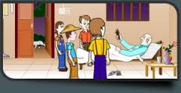
Once there was an old farmer in a certain
village.He had four sons.

Slide 8
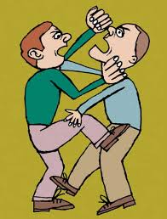
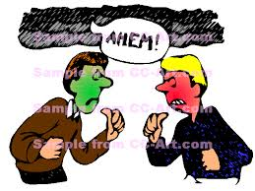
They were very fond of quarrelling and used to quarrel among themselves all the time .

Slide 9
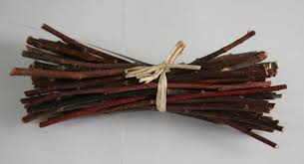
So,there was no peace in the house and this made the old man extremely anxious.He tried to bring them to their senses but failed.
At last he hit upon a plan.He called all his sons and asked them to bring a bundle of sticks.

Slide 10
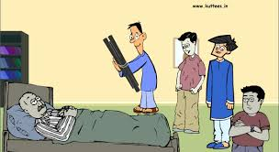
Accordingly,they brought a bundle of sticks.

Slide 11
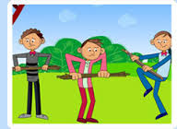
Then the farmer asked them to break it.The three sons tried one after another .But none
Could break it.

Slide 12
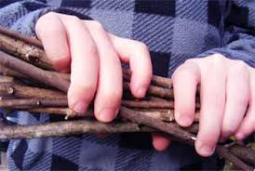
Then their father asked them to untie the bundle and told each of his sons to take one
Stick.

Slide 13
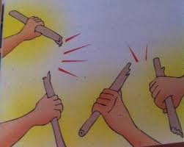
Each of the boys took one stick.Their father
asked them to break the sticks.Now they broke them easily.

Slide 14
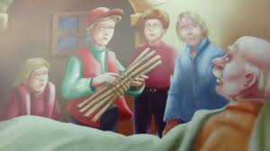
Then the farmer told his sons,”if you live together,nobody can harm you and if you are separate,anybody will break you like the single broken sticks”.

Slide 15
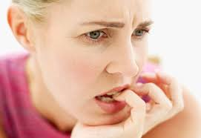
Word meaning
Anxious
Meaning
Concerned,
Worried.
She looks like very anxious .

Slide 16
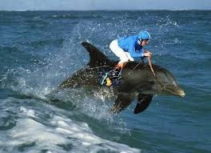
Extreme
Meaning
Too much,
Excessive,
Highest
He is extremely courageous man .

Slide 17
Accordingly
Meaning
So,consequently,
Therefore
Accordingly,they brought a bundle of sticks.

Slide 18
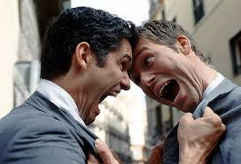
Quarrel
Meaning
Argue,
dispute
They are quarreling .

Slide 19
Moral of the story
United we stand, divided we fall

Slide 20
Class work
The story has given us a message.
What was that? Explain .

Slide 21
Home Work
Write an another story like this

Slide 22
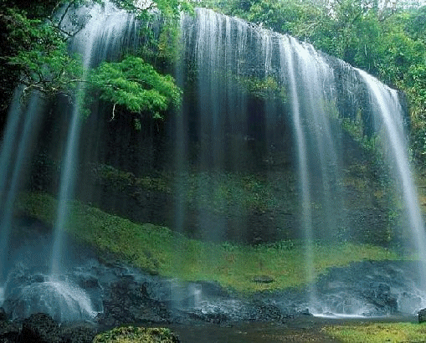
Thank You

