Slide 1


WELL COME

Slide 2

Most. Sharmin Akther
Assistant Teacher.
Kayempur Govt. Primary School.
Khansama, Dinajpur.
Class : Three
Subject: English
Lesson: 1-3
Unit: 6, numbers.

Slide 3

Studentes will be able to:
2.1.1 recognize and read cardinal numbers up to 100.
2.1 write cardinal numbers up to 100 in figures.
Learning outcomes.

Slide 4


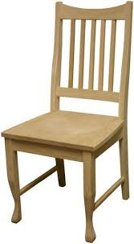
Number

Slide 5

6
Six

Slide 6
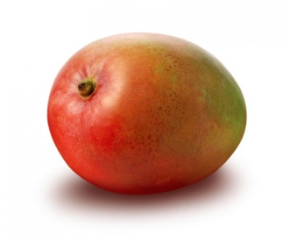
7
Seven

Slide 7

8
Eight

Slide 8
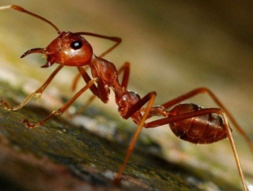
9
Nine

Slide 9
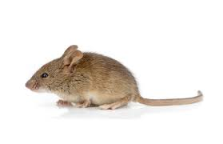
10
Ten

Slide 10

Count and write the number in words
Six
Seven
Eight
Nine
ten

Slide 11
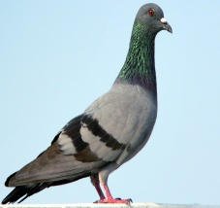

Count, Write the number or word.
Six
6
7
Seven
8
Eight
9
Nine
10
ten

Slide 12


Re-arrange the number in word
Nine
Six
Ten
Eight
Seven
Six
Six
Seven
Eight
Nine
ten

Slide 13


Write the numbers in words.
6
Six
7
Seven
8
Eight
9
Nine
10
Ten

Slide 14
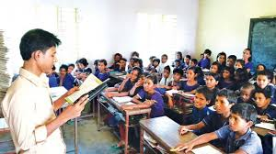
Teachers reading

Slide 15
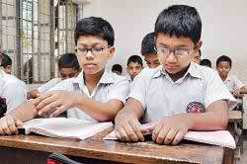
Students reading

Slide 16

Match
6
7
8
9
10

Slide 17
Groupwork
Group: A
Groupwork: B
Groupwork: C
Write the number in word 6- 10.

Slide 18
Evaluation
Write the number in word (6 to 10)

Slide 19

Thanks

