Slide 1


R
R
RISHA
R
R

Slide 2
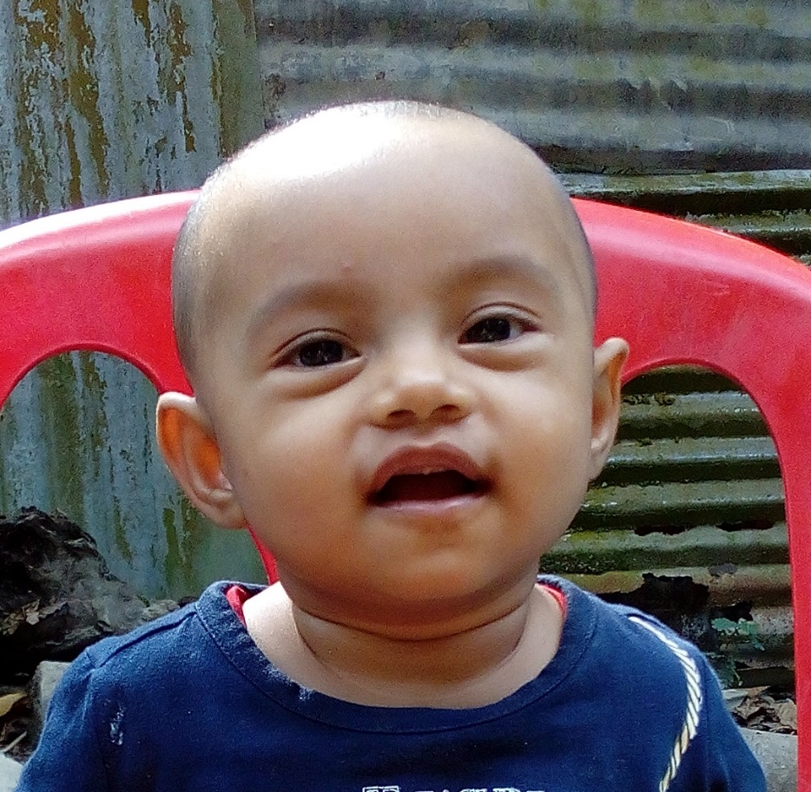
R
I
RISHA
S
A

Slide 3
SAMDANI
SIZAN
SIMAN
JOHORA
RISHA

