Slide 1
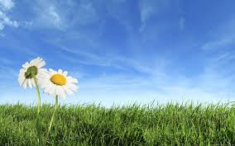



Slide 2
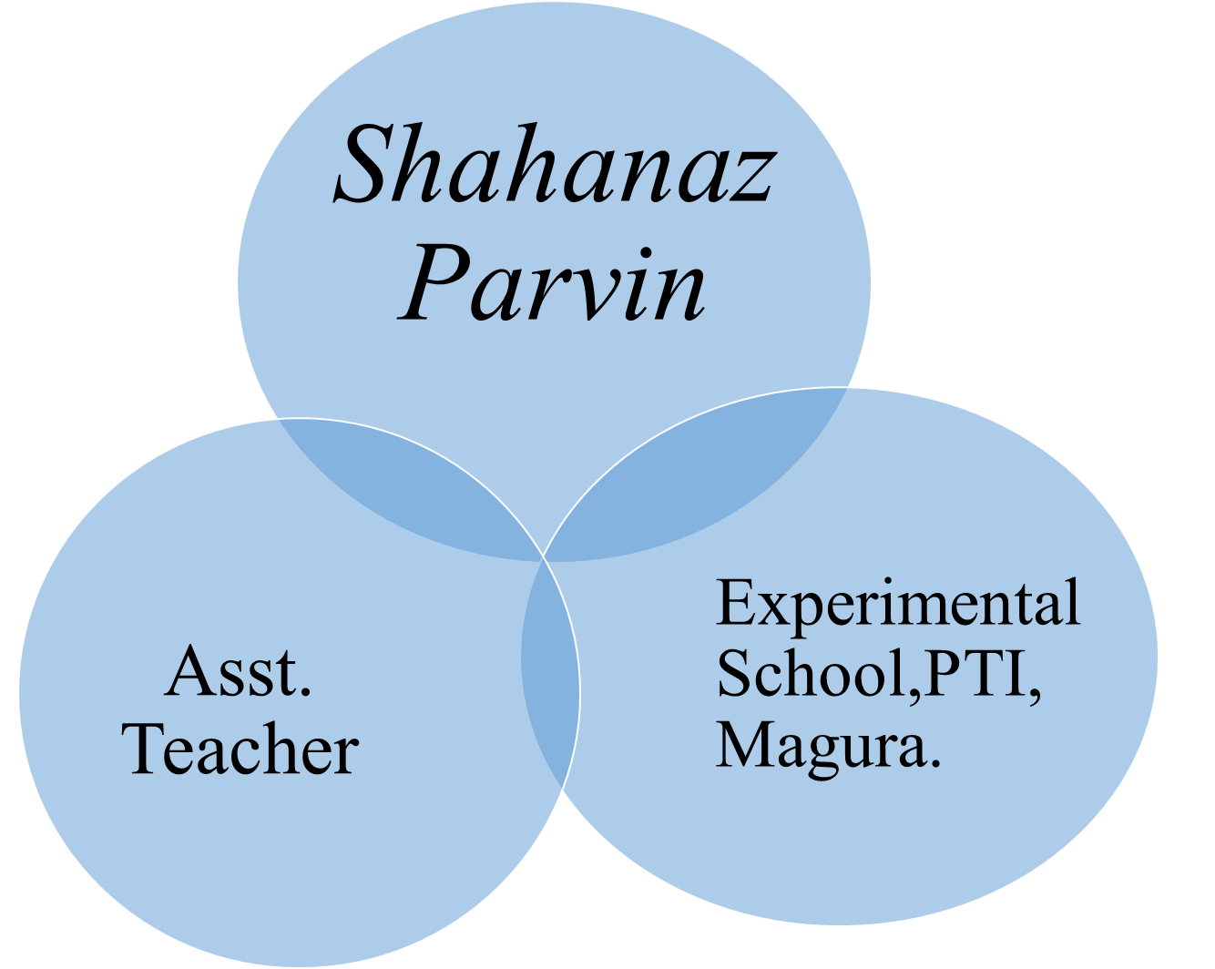
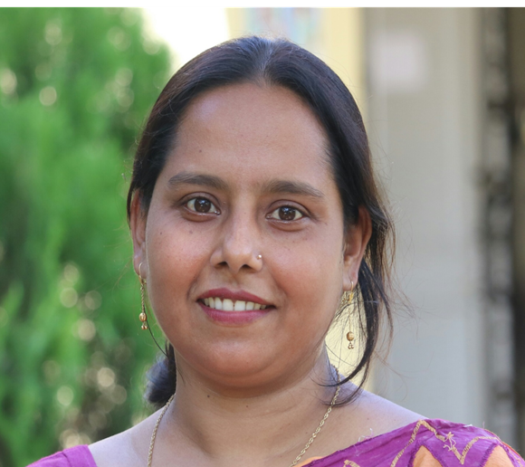

Slide 3

Sub: English
Class: TWO
Unit: 8
Lesson:4-5
How many…?
Time: 40 mins

Slide 4

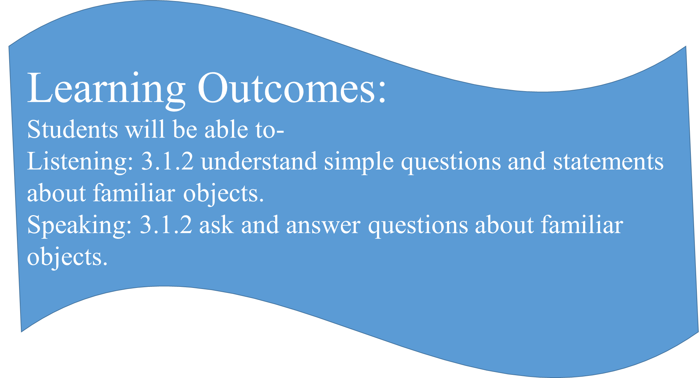

Slide 5
Watch the video then I will ask you a question.
How many little ducks?

Slide 6
Today we will learn `How Many…….?`

Slide 7
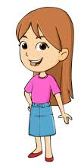
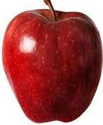
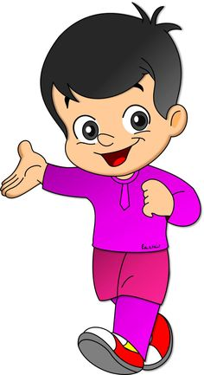
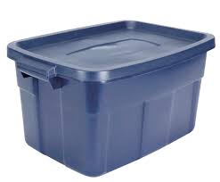
How many apples?
There are 4 apples.

Slide 8
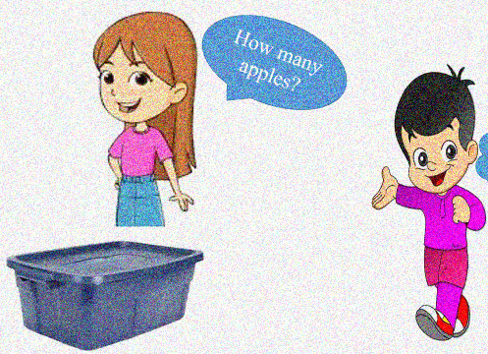
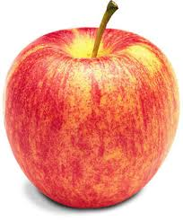
Now there are 3 apples.

Slide 9
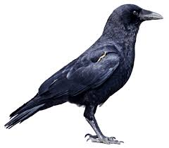
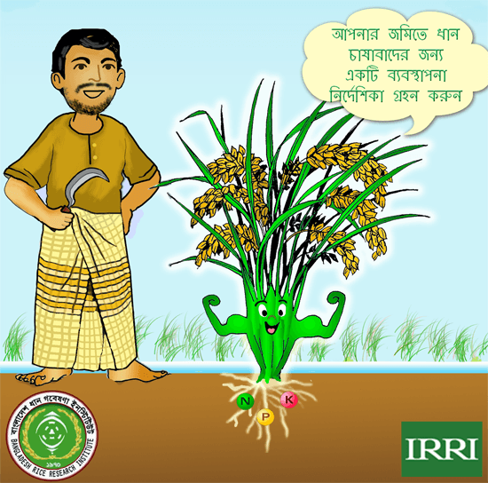
Students will count and say how many…..?
4
3
4
7
1
4
8

Slide 10
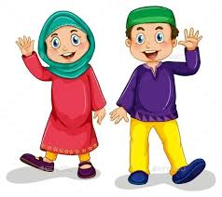
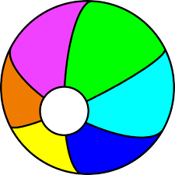
How many balls?
There are 5 balls.

Slide 11
Open your book at page 17.

Slide 12
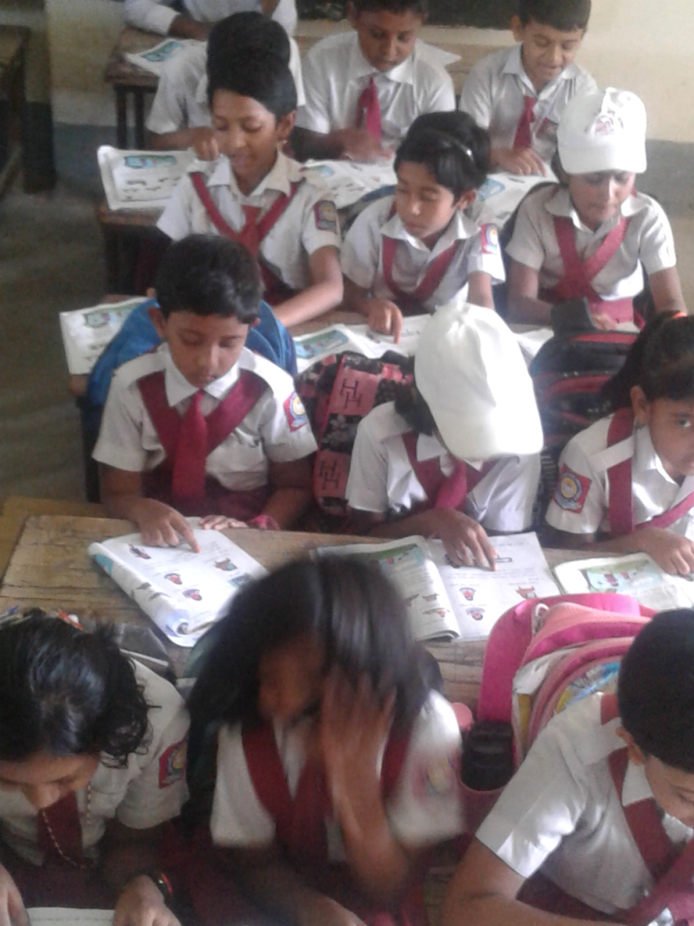
Listen first and then read with your teacher.

Slide 13
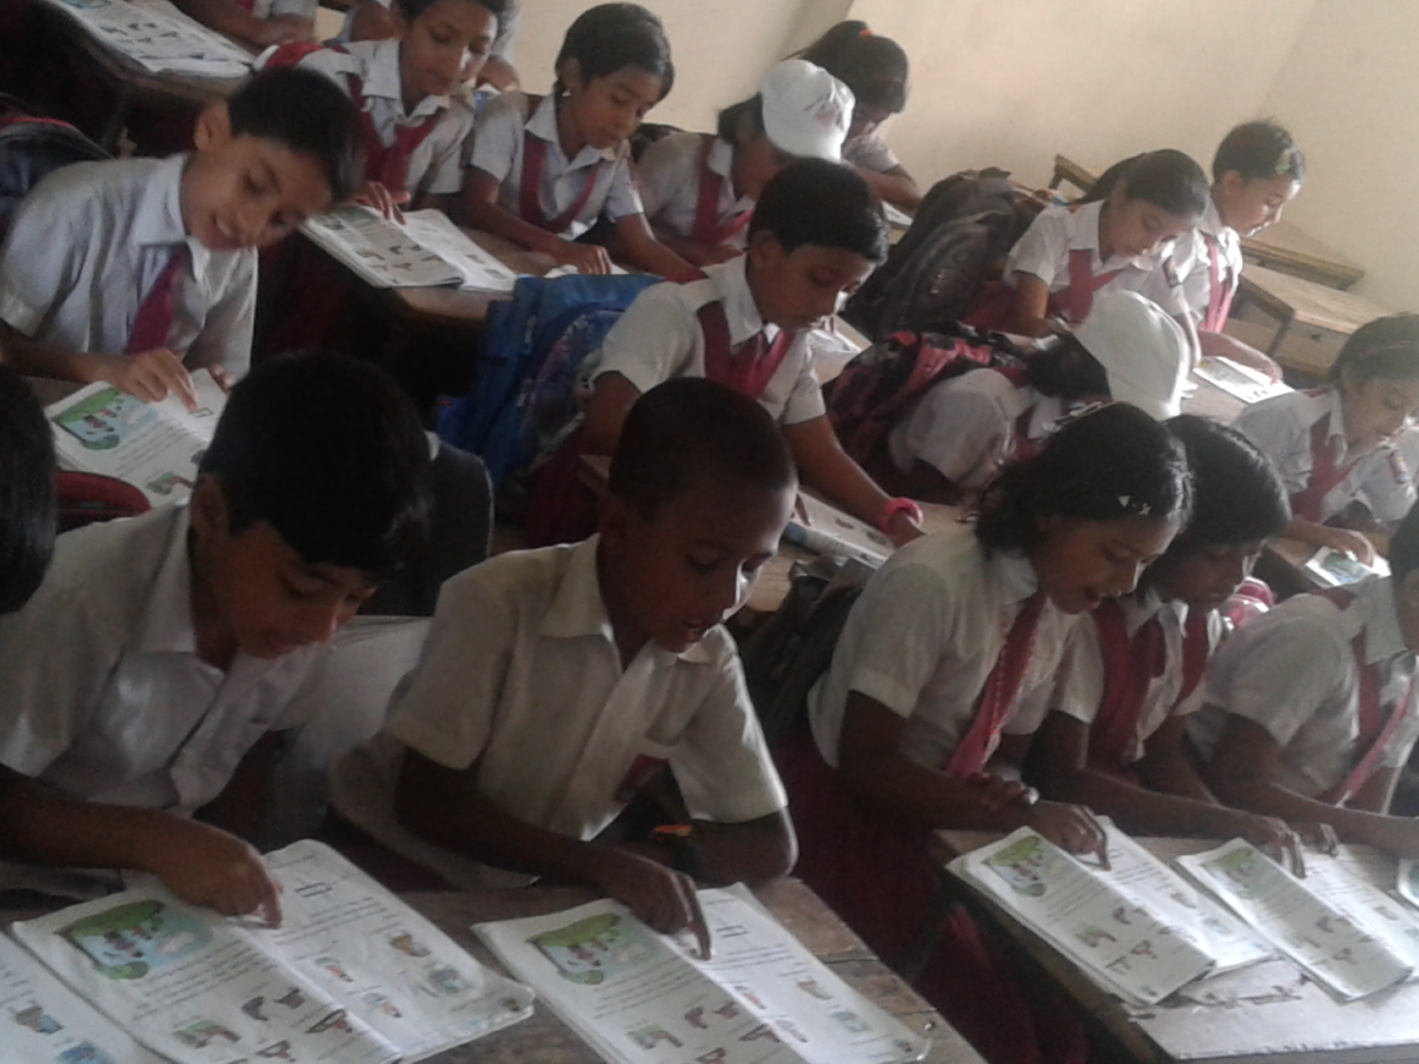
Read the page

Slide 14
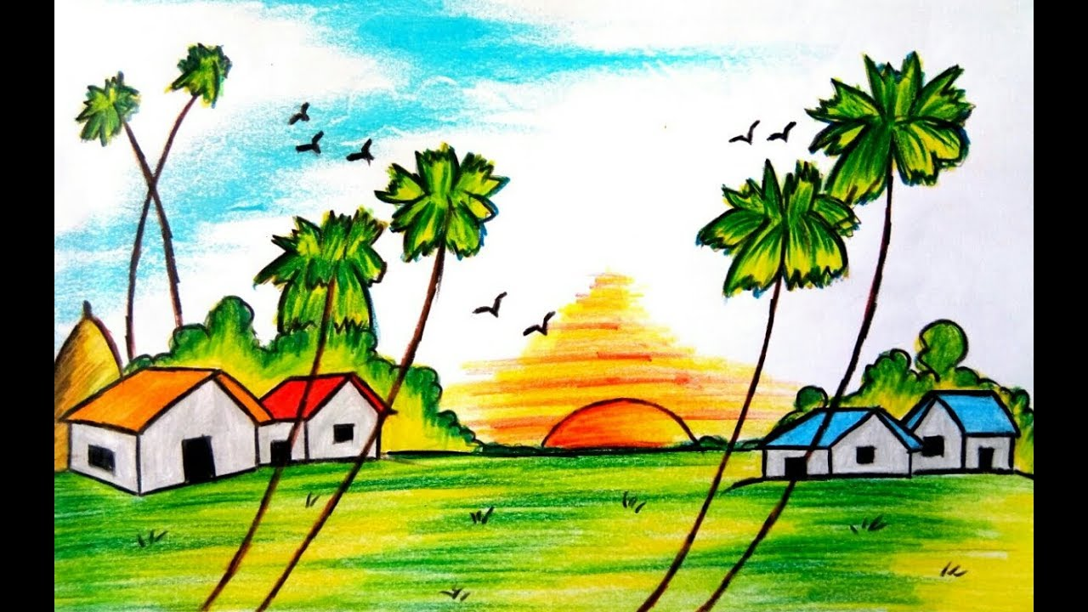
Watch the picture and discuss in group:
How many trees?
How many birds?
How many huts?
How many sun?

Slide 15
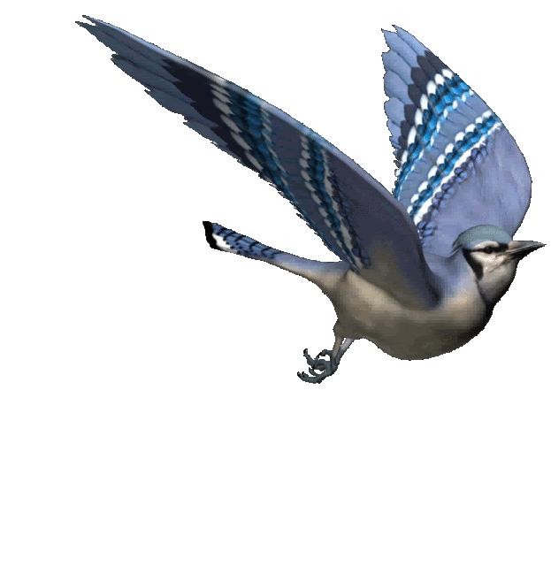
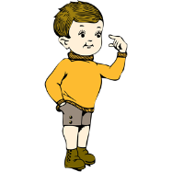
How many birds?
Discuss in pairs and give the answer.

Slide 16
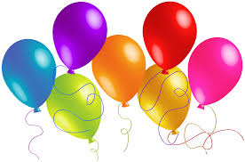
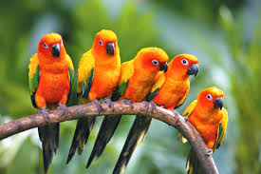
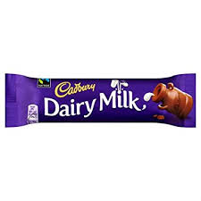
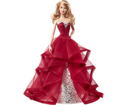

Card Matching Game:
5
7
5
2
Let’s check your answers.
Notes:
I will make some picture cards and push them on push pin board. I put some number cards on the table. Students will come in front and take a number card from the table and match them as below. 1st one is done.

Slide 17
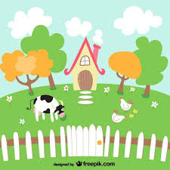
I will ask students `How many….?`about different things in the picture (individually).

Slide 18
Assessment:
How many circles?
Notes:
I will put 3 or 4 water bottles on the table.

Slide 19

Students will count the objects in their classroom mentioned by teacher. Such as-
How many students are in first bench?
How many water bottles are on the table?
How many windows?
How many doors?
How many blackboard?
Notes:
I will put 3 or 4 water bottles on

Slide 20



