Slide 1

welcome

Slide 2

Md.Naim uddin
Assistant Teacher(computer)
Ins:Ludiara jahir ahmed girls high school
Class:Eight
Sub:English ist paper
Unit: Three
Lesson: One
Period : One
Time: 45min
Date:05/10/17

Slide 3


Slide 4
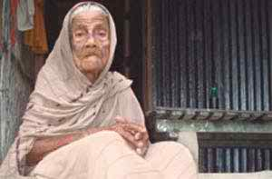
ILL HEALTH

Slide 5
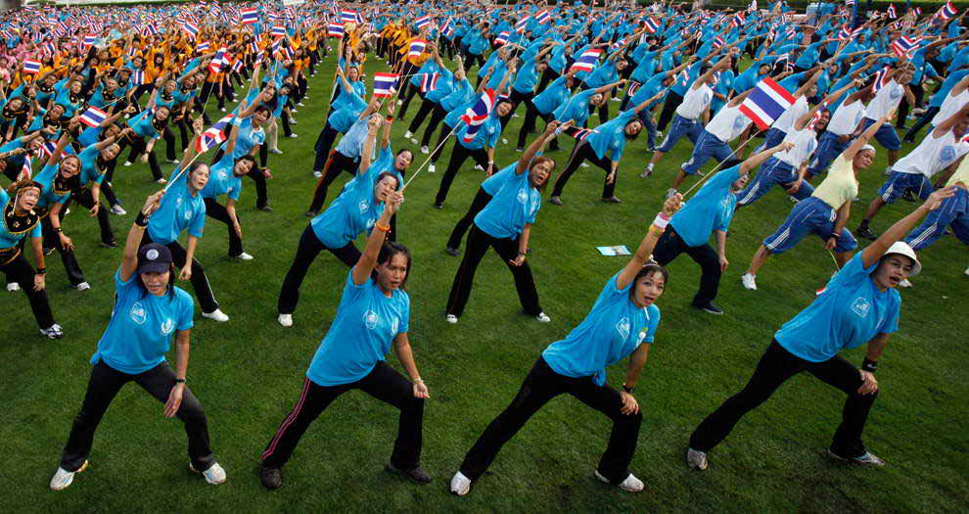

Slide 6
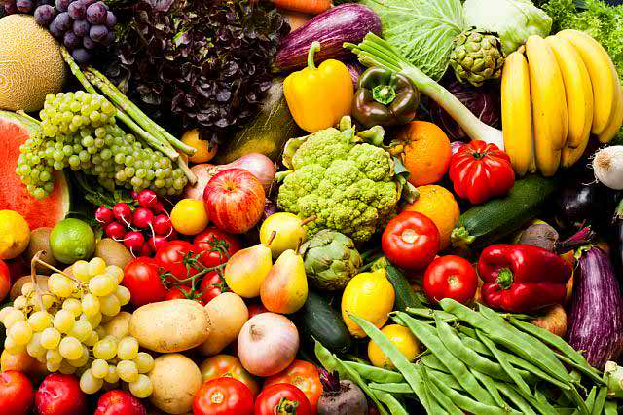
NUTRIOUS FOOD

Slide 7
Declaration Of Lesson
Health and Hygine

Slide 8
Learning out comes
A)Read and understand texts through silent reading.
B)Ask and answering question about health.
C)Practise key words .
D)Write answer to the questions about lesson.

Slide 9
KEY WORD MEANING AND MAKE SENTENCE
Essential
Importance
Diseases
Ill Health
Concentrate
Attention

Slide 10
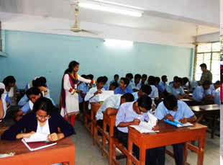
SILENT READING

Slide 11
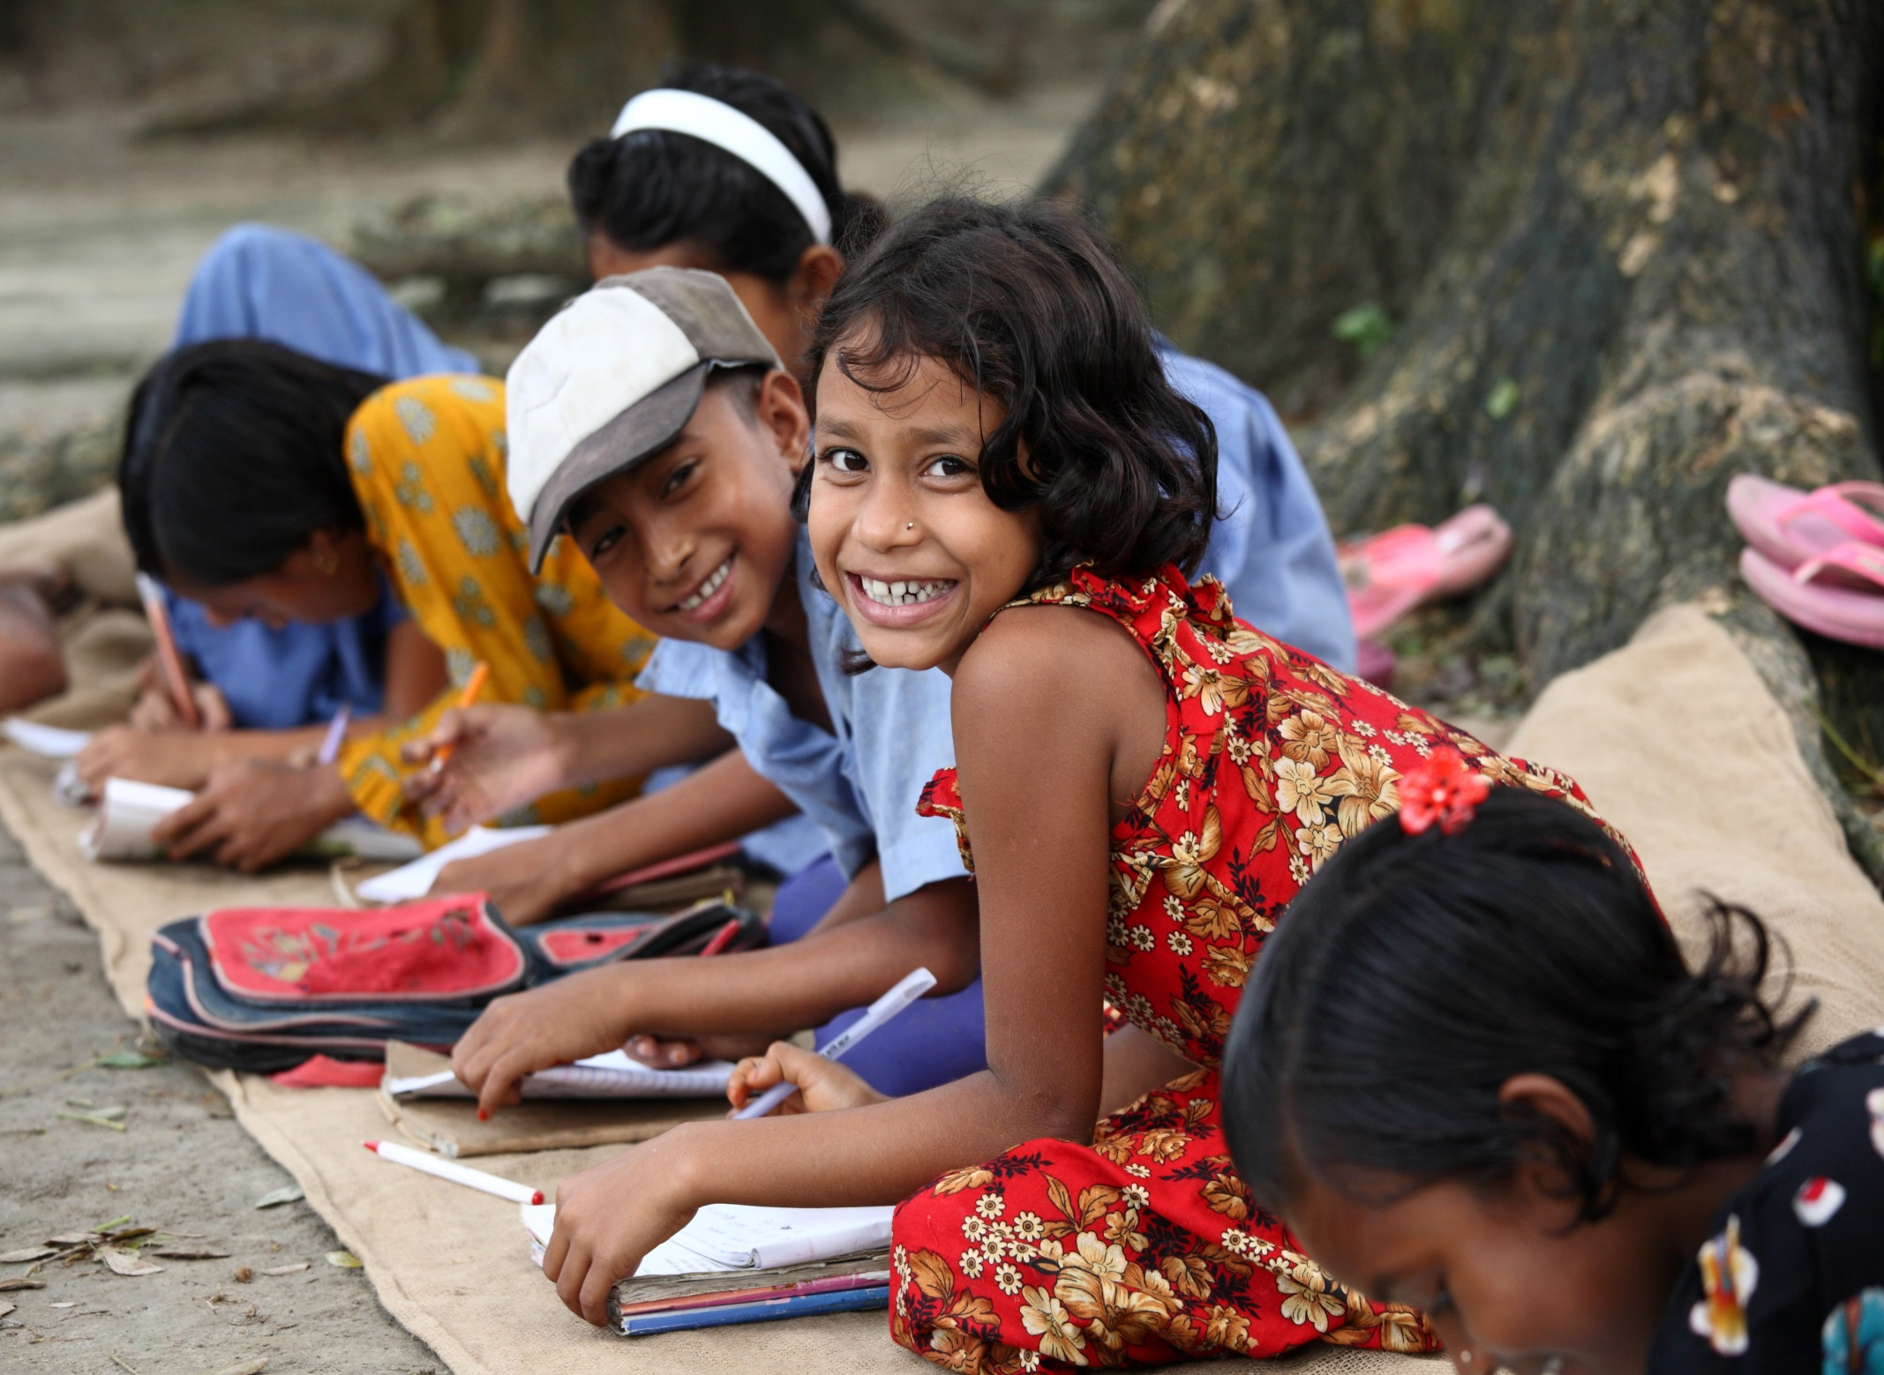
INDIVIDUAL WORK CONTINUE

Slide 12
INDIVIDUAL WORK ASKING QU
(a)Good Health means?
(b)What is Nutrious Food?

Slide 13
Teacher discuss about the content
Give pair Work
(a)Why is Good Health Essential For Us?
(b)Why is physical Exercise Necessary?

Slide 15
Group Work
(a)Why we have take good food?
(b)What is essential for lead a happy life?

Slide 16
Evaluation
(a)Health means?
(b)In the picture .who is ill health?
(c)What is good food ?

Slide 17
HOME WORK
**Write a short paragraph about good health.

Slide 18

THANKS
Best life to you all

