Slide 1



Slide 2


Suprakash Biswas
Asst. English Teacher
S.S Sheikhmatia Secondary School
Nazirpur, Pirojpur
01711288308

Slide 3

LESSON INFORMATION
    English 1st paper
    Class: Eight
    Unit: Five
    Time : 50

Slide 4

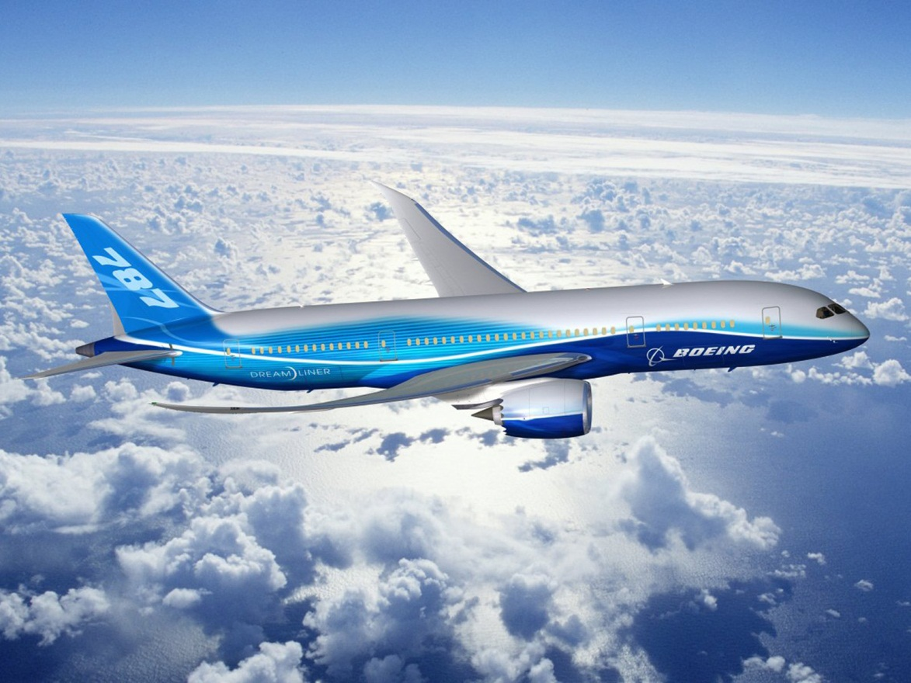
What do you see in the picture?

Slide 5

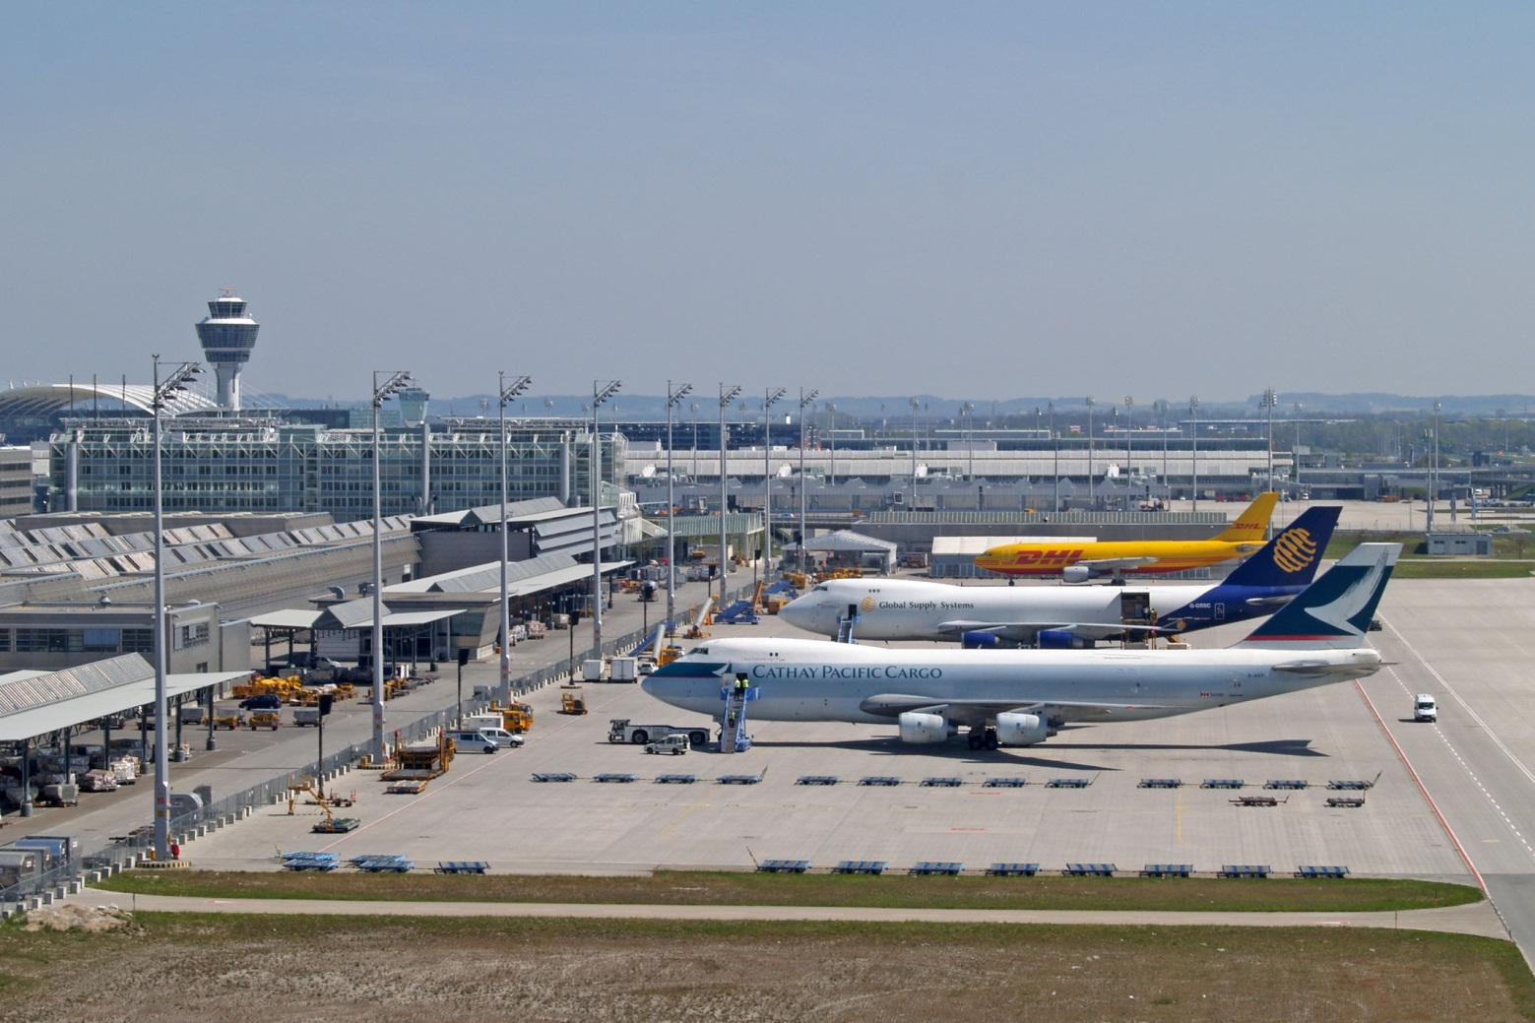
Can you guess where the place is?

Slide 6

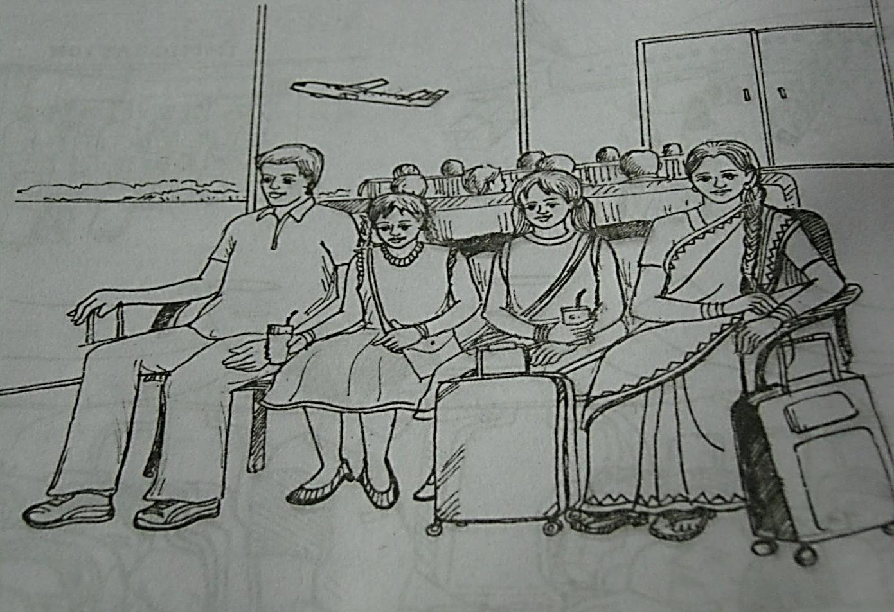
Our Today’s Lesson
At The Airport

Slide 7
OBJECTIVES OF THE LESSON
By end of the lesson the students will be able to…….
Ask and answer questions. (Speaking skill)
Read and understand text. (Reading skill)
Write answers to questions. (Reading & Writing skill)
Write a short paragraph. (Writing skill)
Understand new words

Slide 8
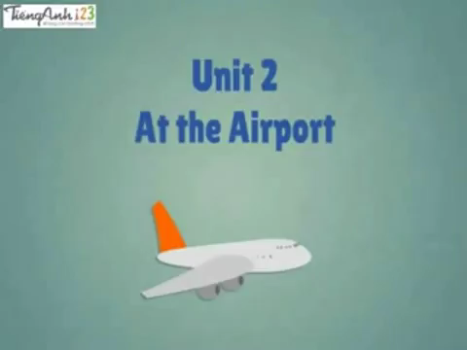
Look at the video

Slide 9
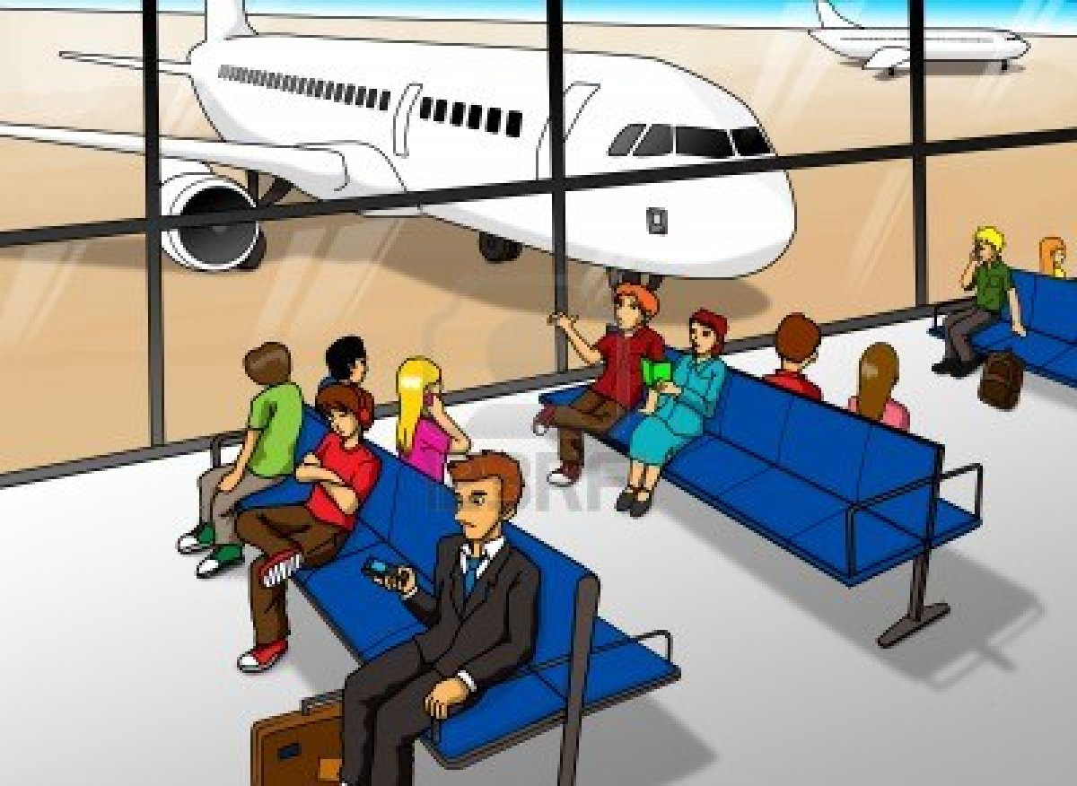
Lounge
A waiting room at an airport

Slide 10
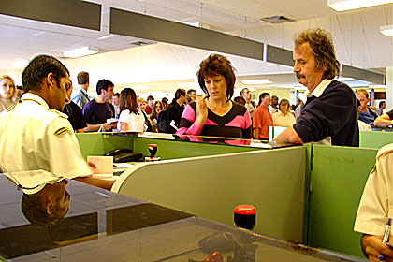
The place at an airport or country's border where government officials check the documents of people entering that country.
Immigration

Slide 11

Talk about the above picture with your partner according to the following questions.(3min.)
Pair work
What do you see?
Can you guess where it could be?
Who are the people in the picture?
What could be their relationship?

Slide 12

Read the text from the book and write answer of the following questions.
1. Why is Mita excited?
Ans: Mita is excited because this is her first time to board a plane.
2. Why aren’t Mita’s parents going with her?
Ans: Mita’s parents were too busy with their work.
3. What does an immigration officer do at the airport?
Ans: An immigration officer checks passport and stamps it.

Slide 13
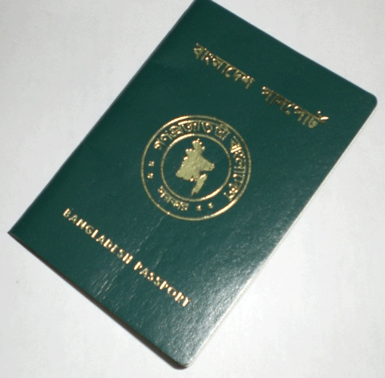
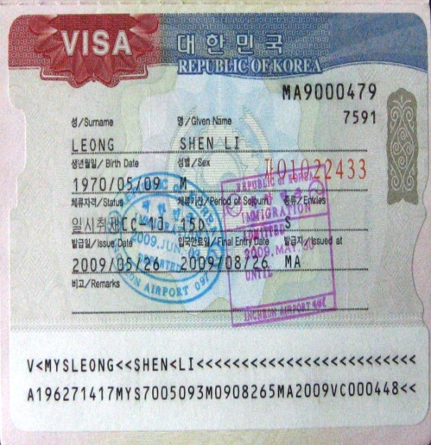
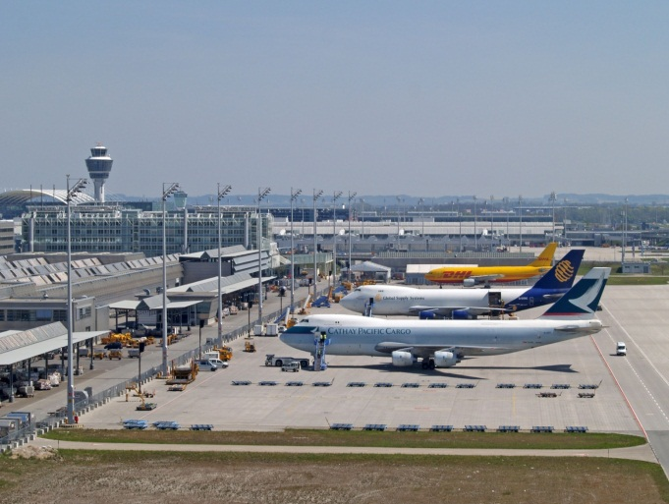
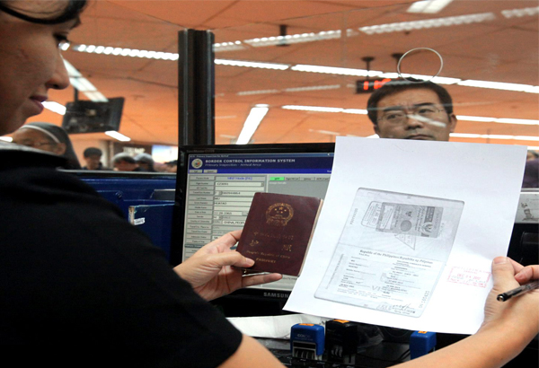
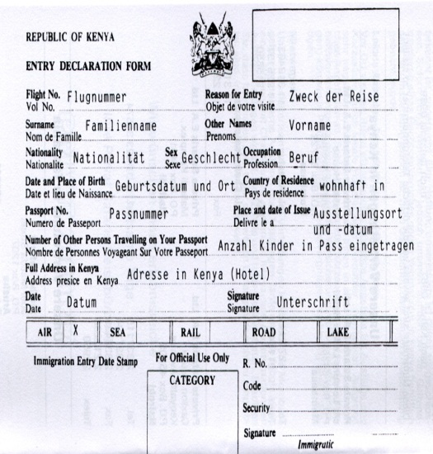
Preparation for going abroad

Slide 14
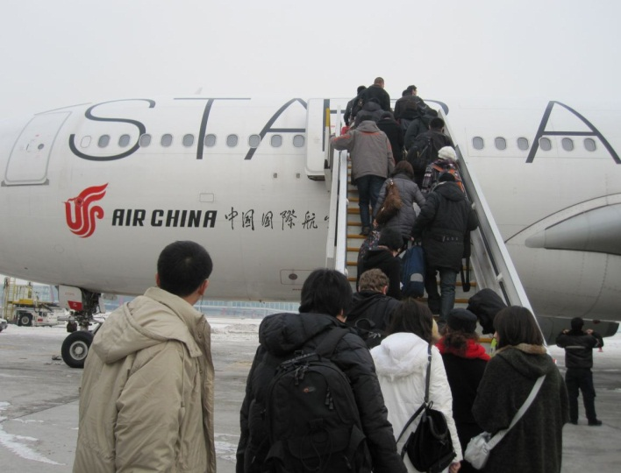
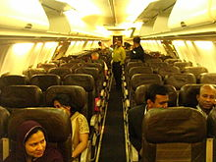
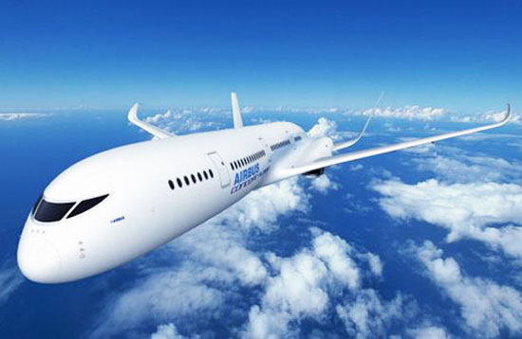
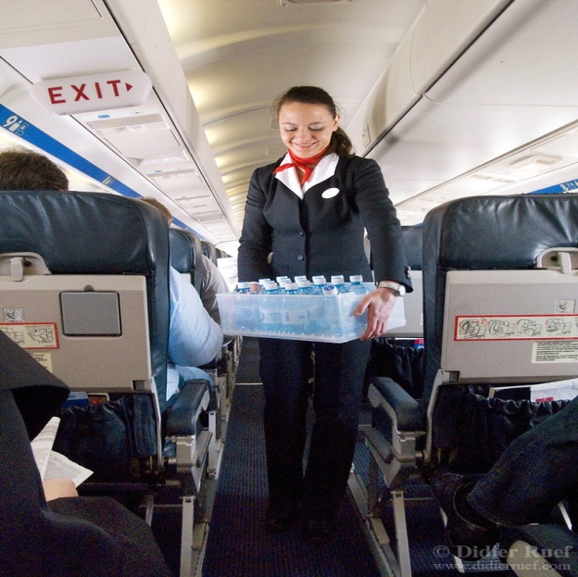
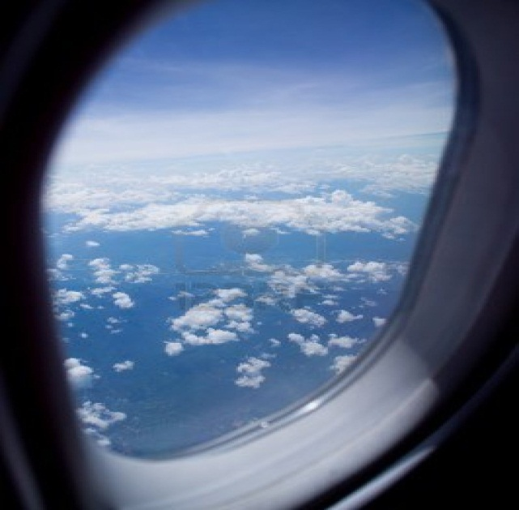
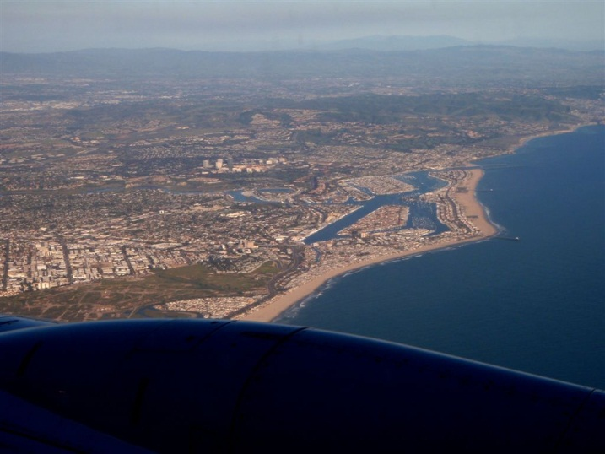
On the way while travelling
Boarding on the plane
Having seat
Plane flying
Air hostess’ service
Exciting view from the window

Slide 15

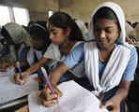
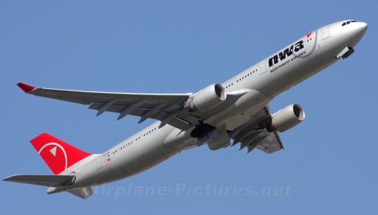
GROUP WORK
Think you are going to travel to India by a plane.
Now write 10 sentences about your preparation before travelling . (05 min.)

Slide 16

Evaluation
1.Why do you need a passport?
2. What does air hostess do?
3.Why do you need a seat belt?
4.Why was Zara excited?

Slide 17


Think you are going to travel to your Chittagong by a train. Now write a short paragraph about your preparation before travelling and your experience on the way. (Not more than 10 sentences)

Slide 18


