Slide 1
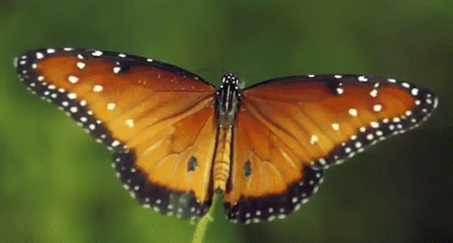
WEL COME

Slide 2
ANWAR HOSSAIN
HEAD TEACHER
TANKRISHNONAGAR GOVT PRIMARY SCHOOL
BHAIRAB, KISHOREGONJ

Slide 3
Class: Three Subject: English
Lesson: 4-6 Lesson unit: A.Read.

Slide 5
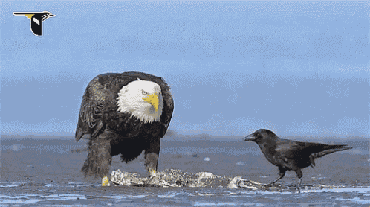
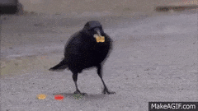

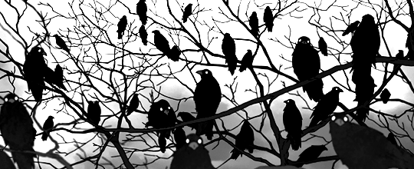
Look at the picture and say what can you see in the picture?

Slide 6
Todays Lesson
What do they do?

Slide 7
Learning outcomes: Students will be able to
1.1.1 recognize English sound differences in the context of words
1.1.2 say words phrases and sentences with proper sounds and stress.
5.1.3 read text

Slide 8
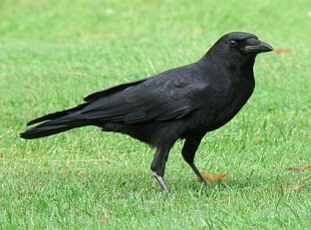
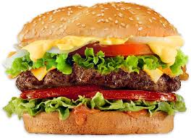
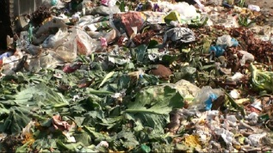
New words
Crow
fly
food
dirty

Slide 9

Open your book page 47

Slide 10
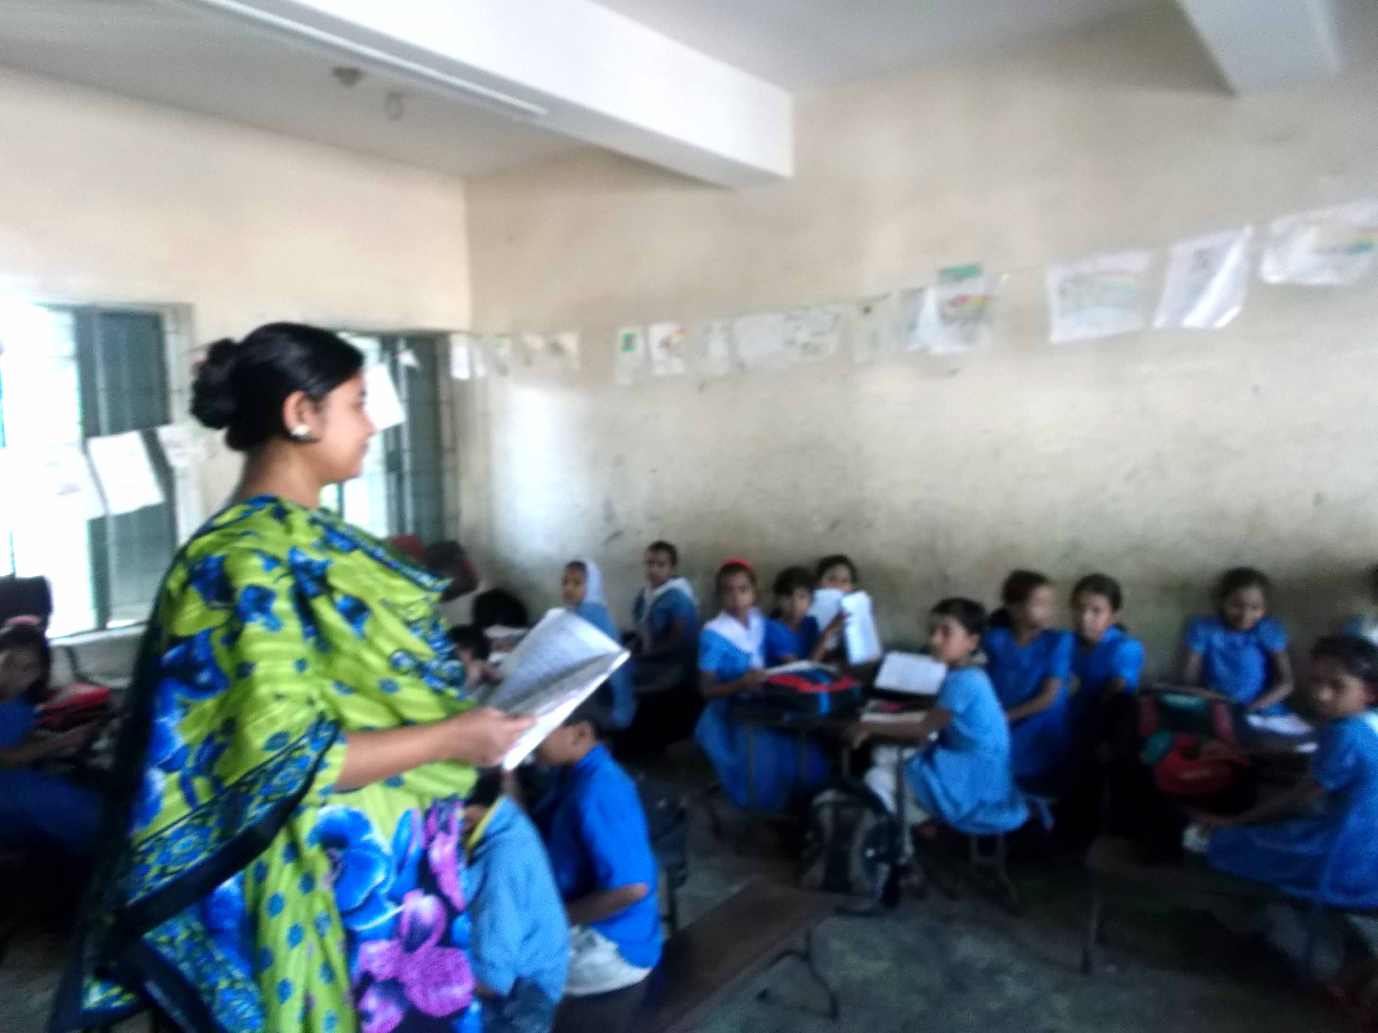
Teachers reading

Slide 12
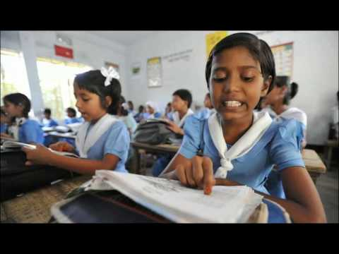
Students reading

Slide 13

GROUP READING

Slide 14
Say True or False
The crow lives in a tree. True
The crow gets up late in the morning False
The crow is lazy False
The crow takes food from people True
The crow is slow False
The crow doesn’t eat dirty things False

Slide 15
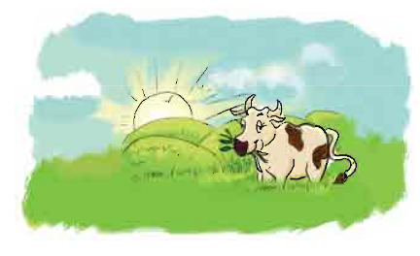
I’m a cow/goat. I live in a stream/shed. I get up early/late. I am slow/quick animal.

Slide 16

THANK YOU

