Slide 1


Slide 2
Identity
Md. Soriful Islam
Assistant Teacher (English)
Chowrapara Fazill Madrasah
Niamatpur, Naogaon
Ph-01715637638
E-mail: soriful03@gmail.com

Slide 3

Class-Six
English 1st Paper
Time-50 minutes

Slide 4
LEARNING OUTCOME
By the end of the lesson, students will be able to-
1. Ask and answer questions
2. Participate in dialogues and conversations on familiar topics
3.Telling the meaning of the words
4. Read and understand written instructions
5. Read and understand text.

Slide 5
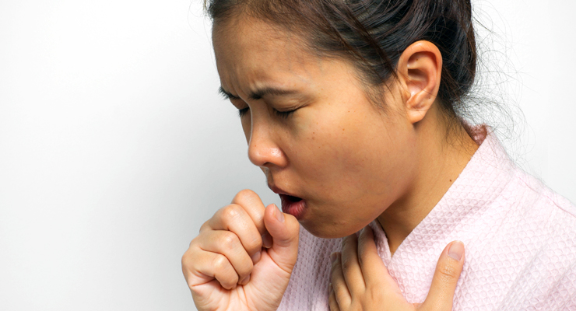
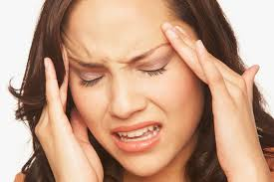
Look
Cough
Headache

Slide 6
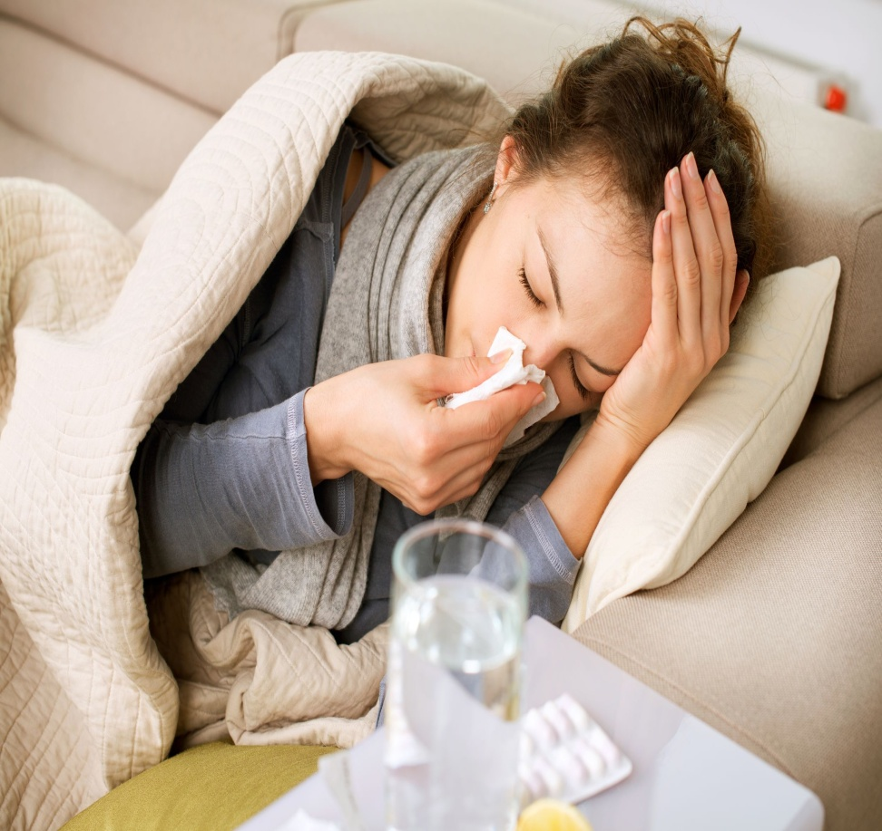
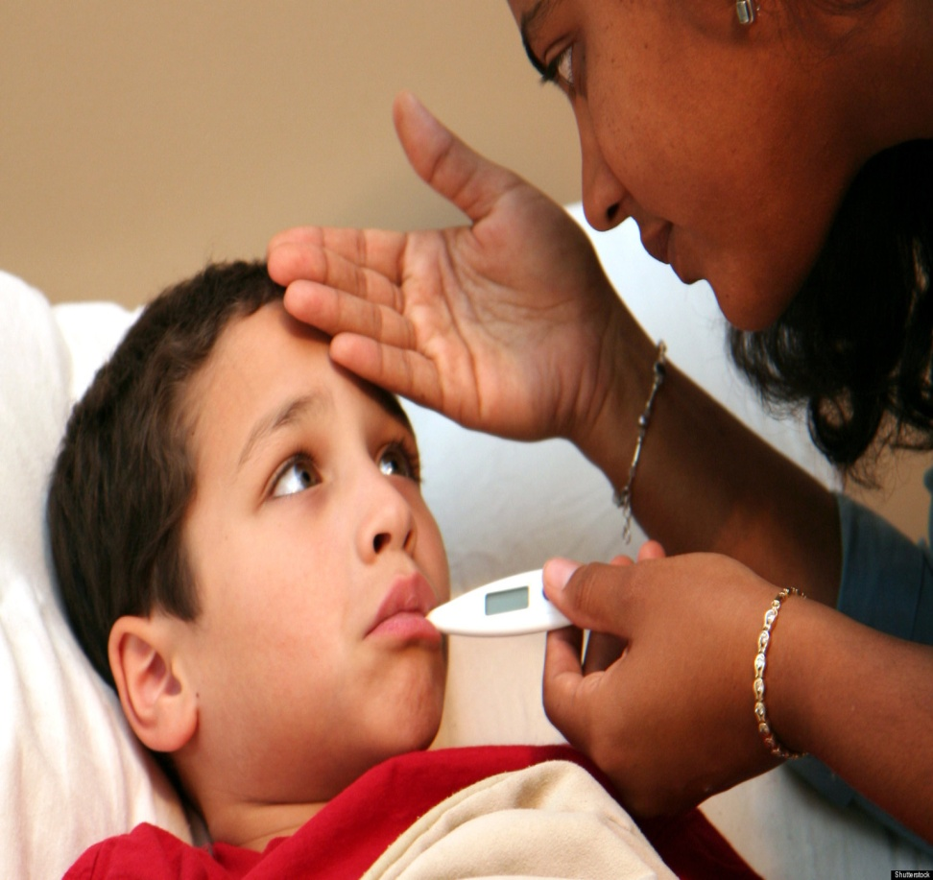
Look
Caught Cold
Fever

Slide 7
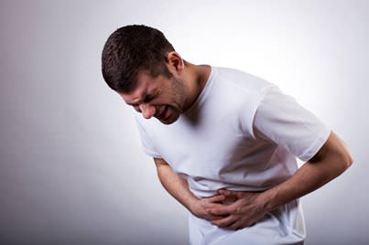
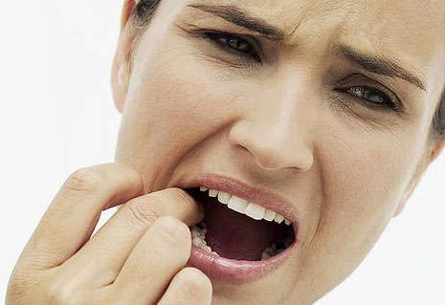
Look
Stomachache
Toothache

Slide 8
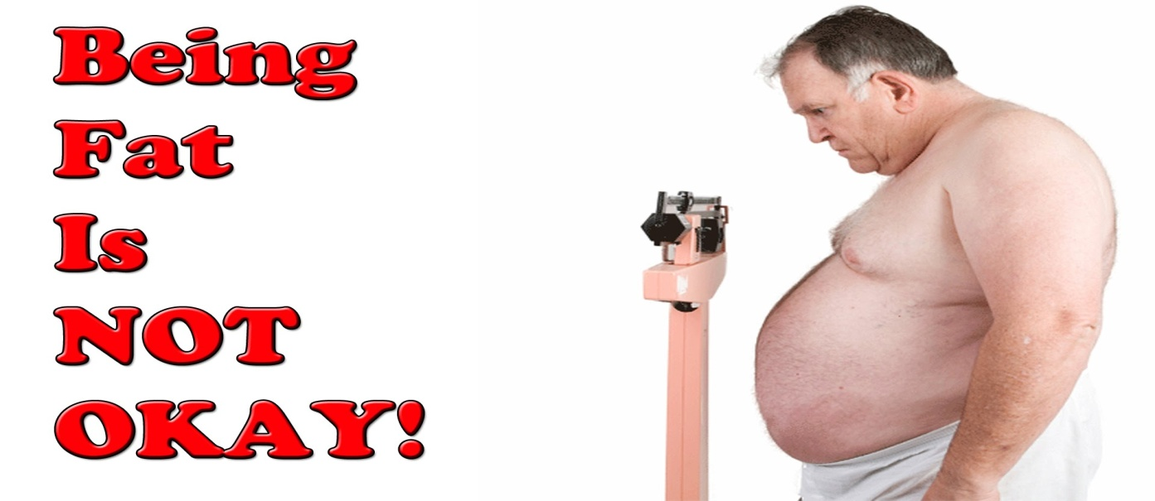
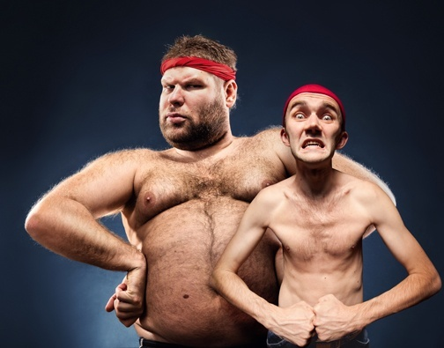
Is he healthy?
No, he is not . He is fat
No, They are not.

Slide 9
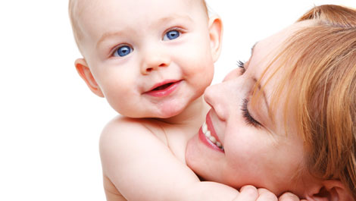

Look
Sick babies
Healthy babies

Slide 10


Today's Topic

Slide 11
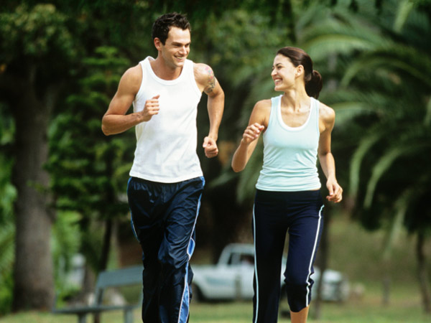
the state of being free from illness or injury.
What is Health?

Slide 12
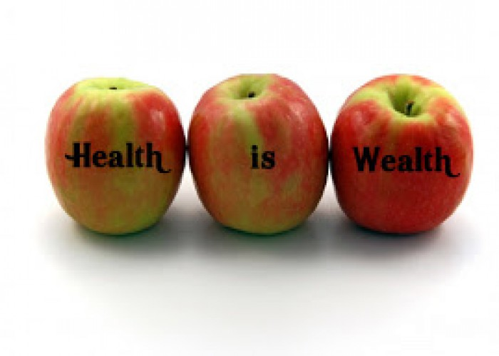
Health
Health is the condition of our body and mind
“A proverb goes that health is wealth”

Slide 13

A healthy body is free from diseases

Slide 14
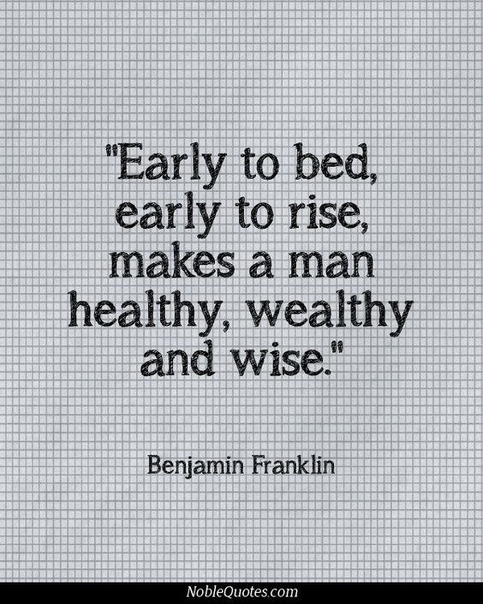

Do you know the old saying about health?

Slide 15

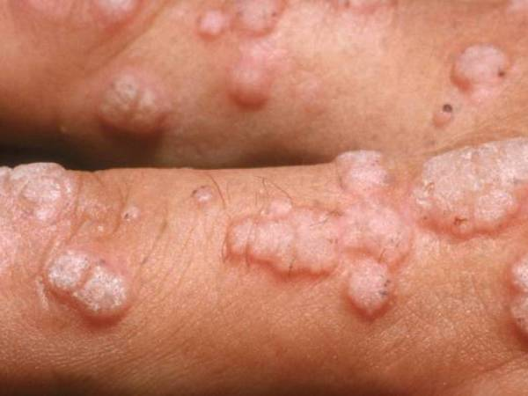
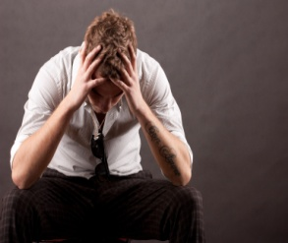
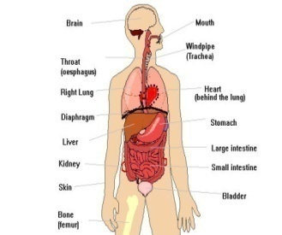
Key Words
Wealth-
Disease-
Anxiety
Organs-
an abundance of valuable possessions or money.
সম্পদ
a particular abnormal condition
রোগ
an emotion characterized
দুচিন্তা
body parts
In biology, an organ is a collection of tissues joined in a structural unit to serve a common function
অঙ্গ

Slide 16
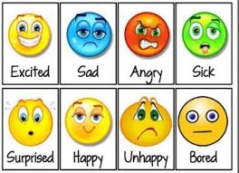
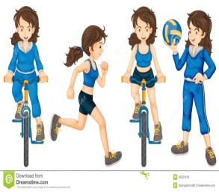

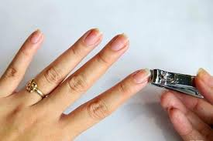
Key Words
Feeling-
Active-
Cheerful-
Hygiene-
an emotional state or reaction.
অনুভুতি
doing things that require physical movement and energy
সক্রিয়
noticeably happy and optimistic.
প্রফুল্ল
Hygiene refers to conditions and practices that help to maintain health and prevent the spread of diseases.
স্বাস্থ্যবিধি

Slide 17
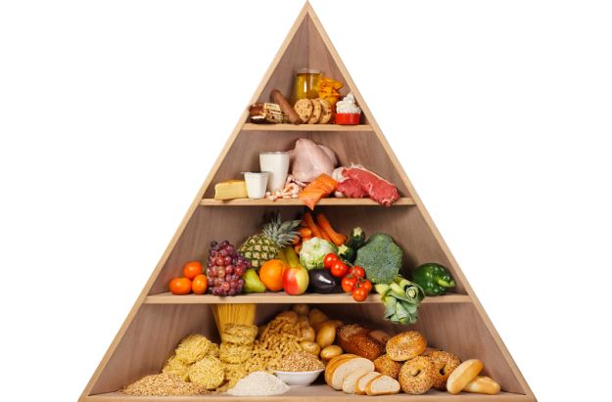
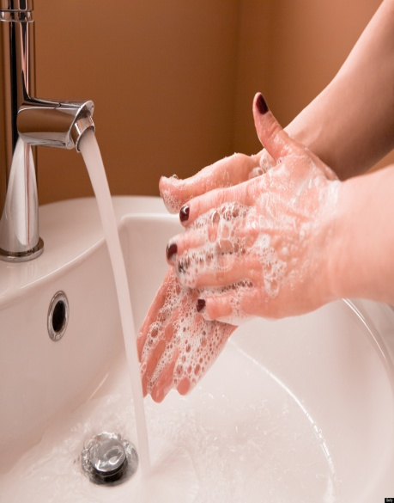
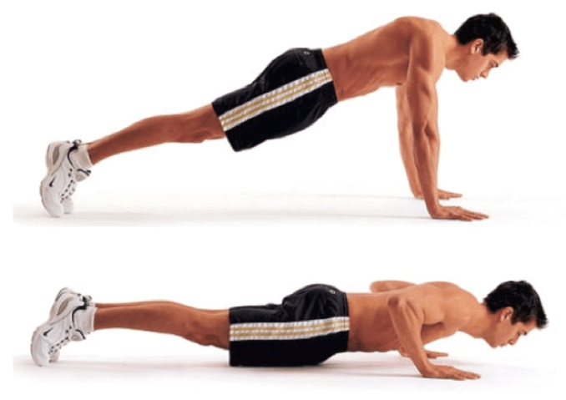
How you can be maintain your good health?
Ans: -
Take a balanced diet
Wash your hands
Cut your nails
Regular exercise

Slide 18
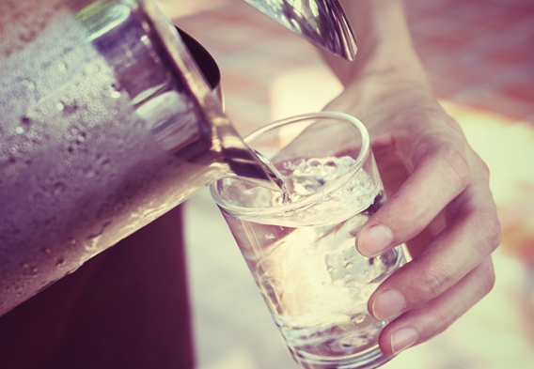
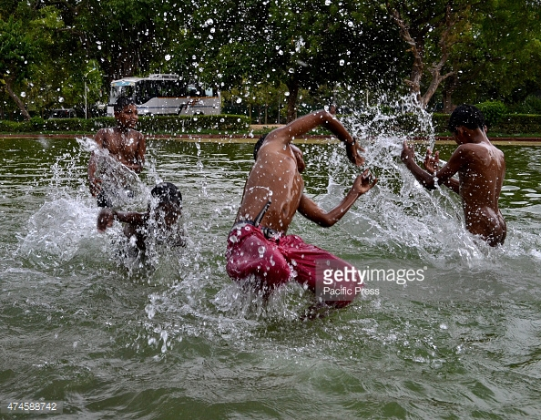
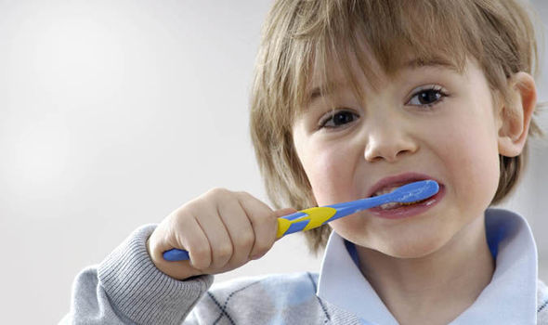

How you can be maintain your good health?
Ans: -
Brush your teeth regularly
Drink clean water
Take regular bath
Proper rest
Get up early in the morning
Should not go to bed lately.

Slide 19

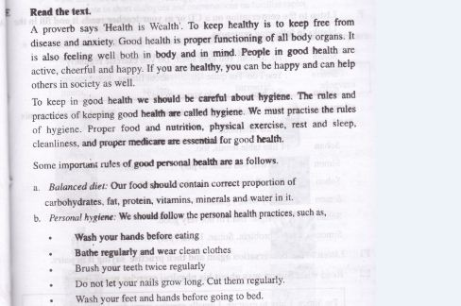
Silent Reading

Slide 20

Individual Work
Write down 3 points about maintaining good health.

Slide 21

Group Work
Why is good health is necessary for us?

Slide 22

Evaluation
What is health?
What do you mean by hygiene?
What do you mean by balanced diet?

Slide 23

Home Work
Write five sentences about good health

Slide 24

Thank you

