Slide 1
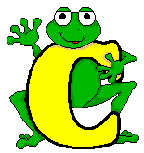
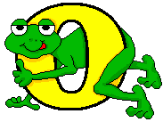
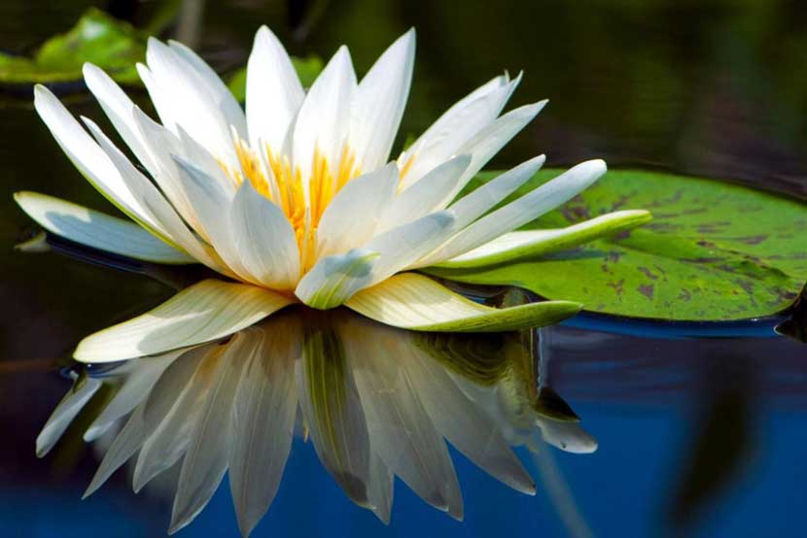
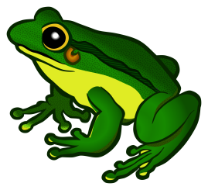

Slide 2
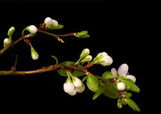
Zulhasnain Md. Omar Furquani
Assistant Teacher
Debarai Govt. Primary School
Beanibazar, Sylhet

Slide 3
Class : Five
Subject: English
Title: Why does the frog croak?
Unit: 25
Lesson: 1
Page: 98

Slide 4
Learning Outcomes
Students will be able to-
1.3.1 recognize which words in a sentence are stressed.
4.2.1 understand and enjoy simple story.
8.1.1 take part in conversations on appropriate topics.

Slide 5
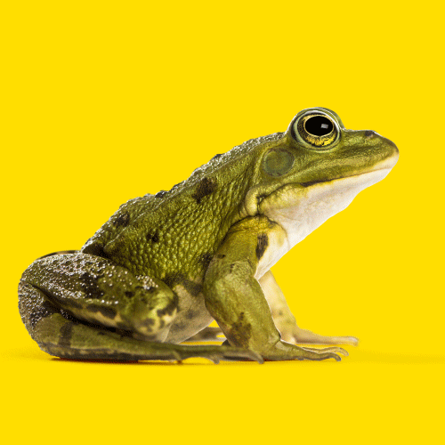
What is this?
A Frog

Slide 6
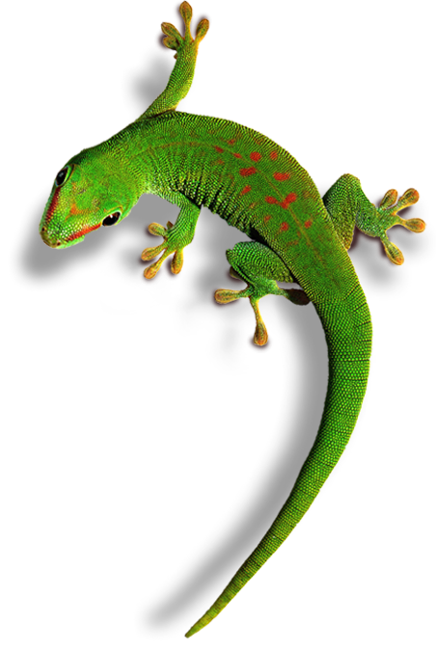
What is this ?
A Lizard

Slide 7
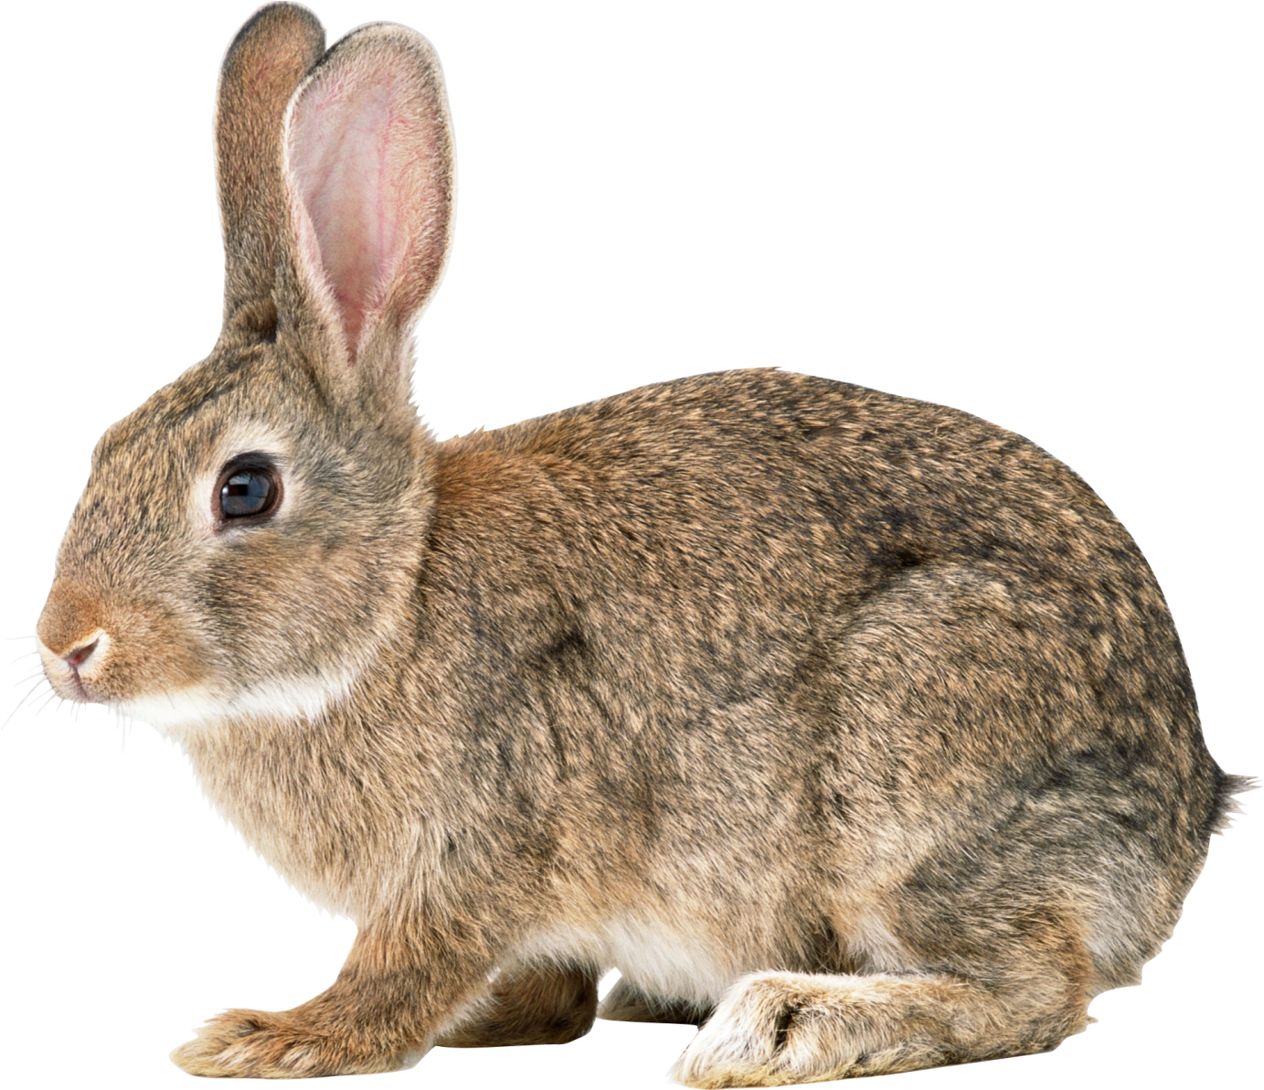
What is this?
A Rabbit

Slide 8
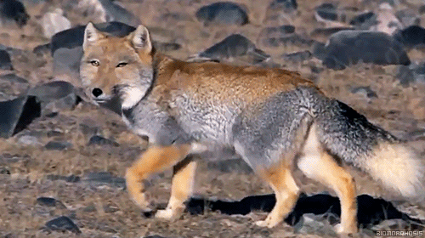
What is this?
A Fox

Slide 9
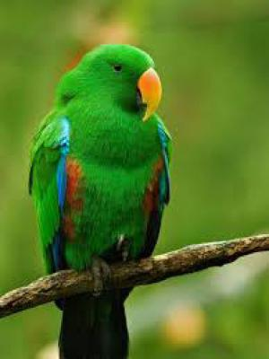
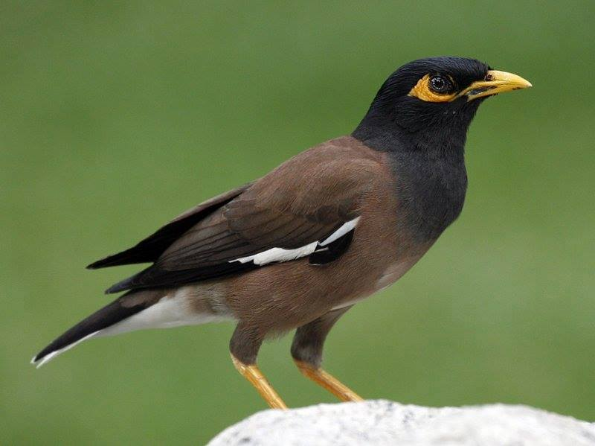
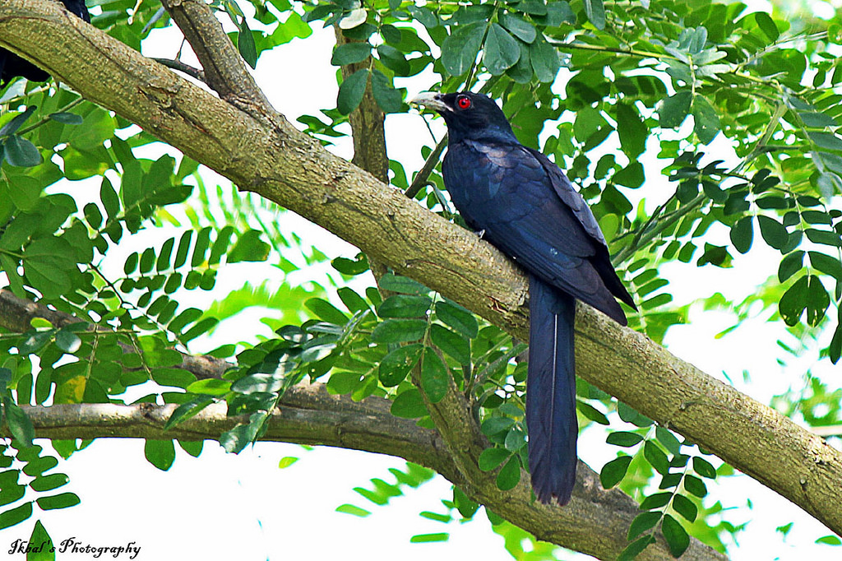
What are they?
Birds

Slide 10
What sound does a frog make? Croak, croak! It isn’t a beautiful sound. But, a long time ago, frogs had beautiful voices. They could sing more beautifully than the birds. This all changed because of one frog named Bluster.
Bluster had the most beautiful voice of all the animals. When he sang, all the other animal came to hear him. They enjoyed listening to him. “Please teach us how to sing!” the animal asked. But Bluster always answered in the same way. “No, no. My voice is mine. I cannot share it,” he said.

Slide 11
listen to the audio carefully
Now read it in your textbook

Slide 12
Answer to the following questions.
1) Who have the beautiful voices?
The frog.
2) What is the frogs name ?
Bluster.
3) Who wants to learn sing?
All the other animal

Slide 13
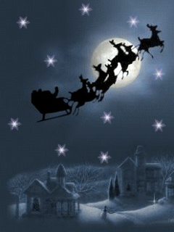
goodbye

