Slide 1

WELCOME
TO ALL

Slide 2

TEACHER IDENTIEY
  Pallab Kumar Goswami
  Asst. Teacher
  Shahanoor Govt. Primary School.
  Bhangoora, Pabona.

Slide 3
CLASS: Five
English

Slide 4
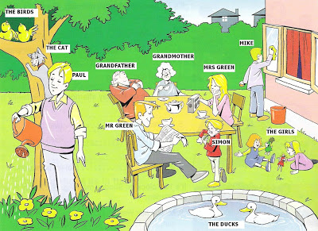
See the picture

Slide 5


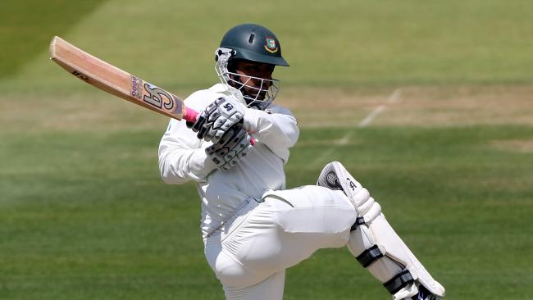

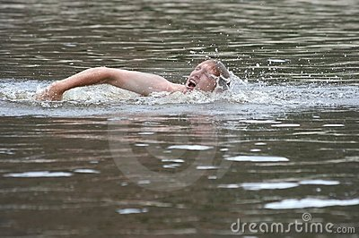

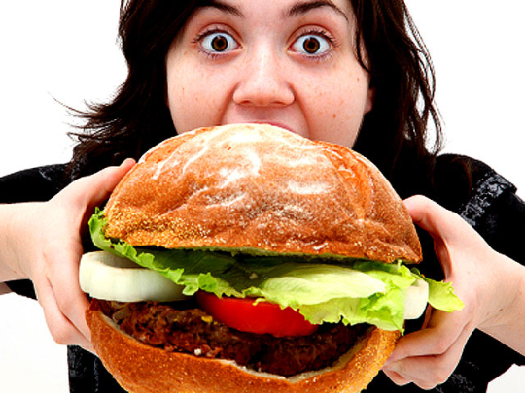
What is he/ she doing

Slide 6
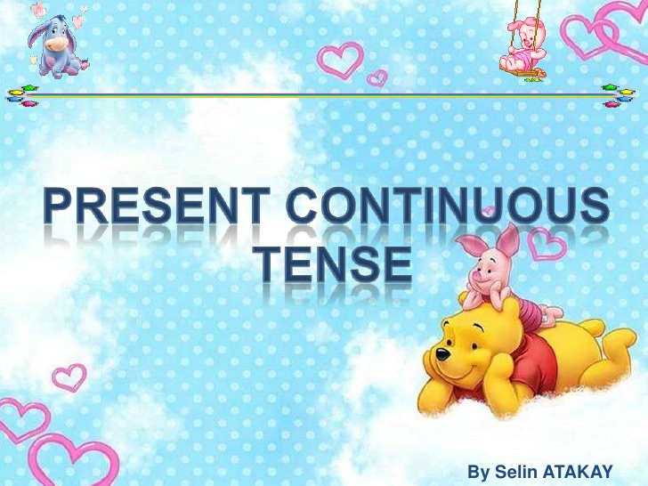
SUBJECT :

Slide 7
Learning outcomes
Identify this tense
Use the structure of present continuous tense to form sentence
Use the right form of verb

Slide 8
যে Tense দ্বারা বর্তমানে কোন কাজ চলছে বা ঘটছে বা নিকট ভবিষ্যতে চলবে বোঝালে তাকে Present Continuous Tense বলে।
Use to talk about action that are happening right now.

Slide 9
বাংলায় চেনার উপায়ঃ বাংলা ক্রিয়া পদের শেষে তেছি, তেছ,তেছে,তেছেন,চ্ছ,চ্ছে,চ্ছেন ইত্যাদি যুক্ত থাকে।

Slide 10
STRUCTURE
hhh
structure
AFEIRMATIVE | Subject+ beverb(am/is/are) +main verb with ing +extension. | Nabil is reading a book.
NEGATIVE | Subject+ beverb(am/is/are)+Not +main verb with ing +extension | Nabil is not reading a book.
INTRROGATIVE | Beverb(am/is/are)+ Subject + +main verb with ing +extension+? | Is Nabil read abook?

Slide 11
person | Number | SUBJECT | Auxiliary verb | verb+ ing
1st | Singular | I | Am / ‘s | verb + ing
 | plural | we | Are /’er | verb + ing
2nd | Singular | you | Are/’er | verb + ing
3rd | Singular | He,she.it ,Nabil (NAME) | Is | verb + ing
 | plural | they | Are/’er | verb + ing

Slide 12
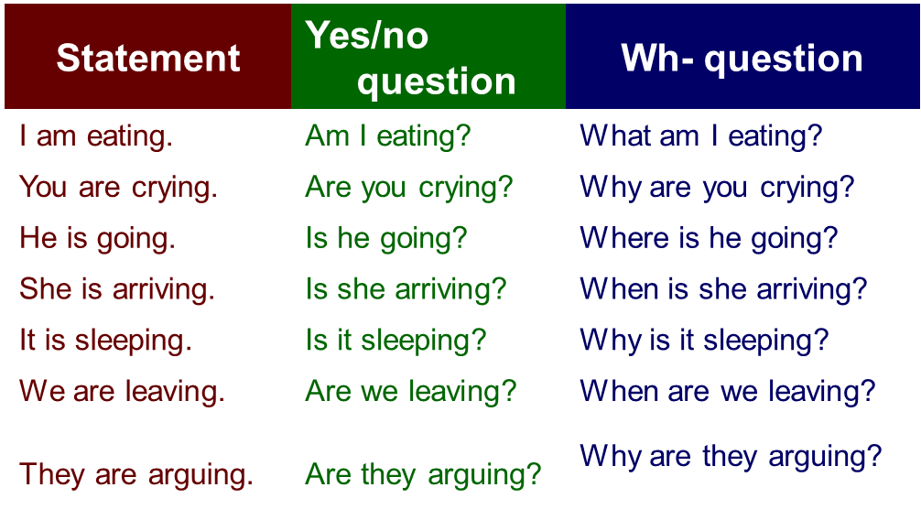


TO FROM PRESENT CONTINUOUS TENSE
I am not eating.
You are not crying.
He is not going.
She is not arriving.
It is not sleeping.
We are not leaving.
They are not arguing.

Slide 13

The table shows how we form the –ing form of a verb.
Most verbs
+ ing
walk
walking
Verbs ending in e
-e + ing
come
coming
Verbs ending in ie
lying
-ie + y + ing
lie
Short verbs ending in a vowel + a consonant
Double the consonant + ing
run
running

Slide 14


PRACTICE WITH PARTNER

Slide 15
HOME WORK
Write a paragraph
Using present continuous tense

Slide 16


