Slide 1
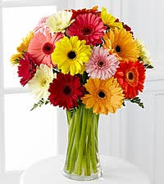
Welcome

Slide 2
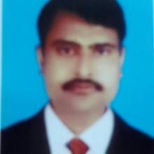
A.K.M Saiful Islam
Asst. Headmaster
Madhabpur Pilot High School
Madhabpur , Habigonj
Mobile no:01718267184
Email:saifulmpur15@gmail.com
Class: Nine/Ten
sub: English For Today
Time: 50 minutes
Date:00/09/2017

Slide 3
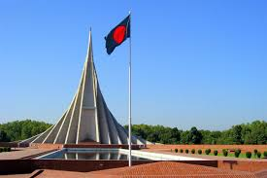
What can you see in the picture?
Where is it?
Why was it built?

Slide 4
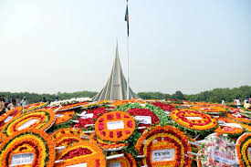
Today’s topic is ‘Independence Day’.
Unit—3, Lesson-5

Slide 5
Learning Outcomes:
After we have studied this lesson, we will be able to-
1.choose the best answers from the alternatives
2.ask and answer questions
3.match the words with their meanings
4.write a paragraph on ‘Independence Day’.

Slide 6
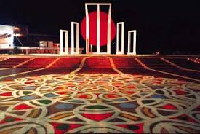
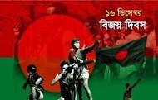
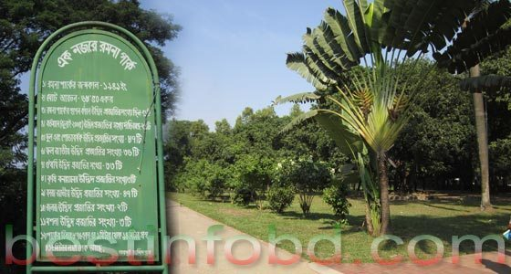
Look at under the pictures and Try to speak what is the most related to our biggest state festival.
There are some important festivals in our country . These are victory day , Shaheed Dibosh, Pahela Baishakh, Independence Day etc. But 26, March, our Independence Day, is the biggest state festival.

Slide 7
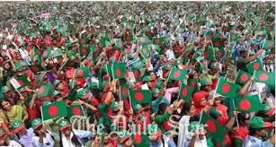
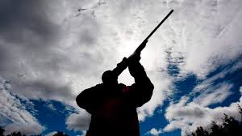
Now look at the pictures and see how does the day(26 march)begin.
Rallies and processions.
Gun shots
G
The day(26 March) begins with 31 gunshots.
People from all walks of life also come there in rallies and processions.

Slide 8
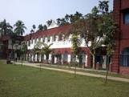
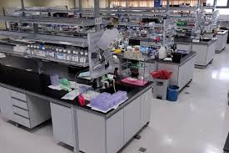
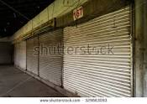
Let’s see under the picture an guess what do the pictures mean.
No students
No employees
Closing Shops
It (26 March) is a national holiday. All offices, educational institutions, shops and factories remain closed on this day.

Slide 9
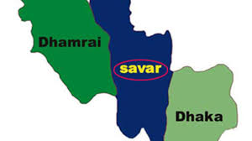
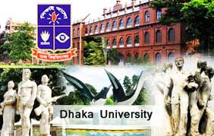
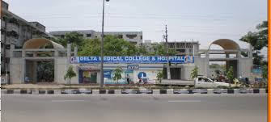
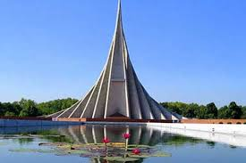
Let’s see the picture and try to understand where ‘The National Mausoleum’ is.
The National Mausoleum is situated at Savar in Dhaka.

Slide 10
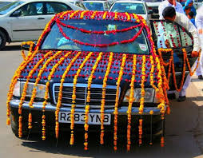
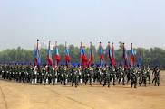
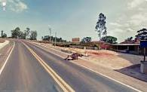
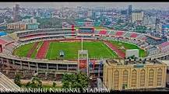
Dear students, look at under the pictures and tell me On Independence Day the national Parade where is held.
A smartly dressed parade of defence forces, border guards, police, ansars, and the VDP at the National Parade Ground.

Slide 11
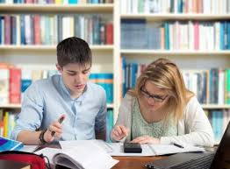
Pair work Time:05 minutes
1
1. Choose the correct answer from the following alternatives.
People from all walks of life go to Savar with--.
i.Rallies ii) processions iii) flowers iv) rallies and processions
b) Our biggest state festival is -i)16 December ii) 21 February iii) Pahela Boishakh iv) 26 March
c) The National Mausoleum is--
On Dhaka University campus ii) at Ramna Park iii) at Savar iv) near Dhaka Medical College.
d) On Independence Day the National parade is held-
i. at the National Parade ground. ii) in the streets iii) in the decorated vehicles.
iv)In Bangabandhu Stadium.

Slide 12
e) All offices, educational institutions, shops and factories remain --- on this day.
i) Open ii) Closed iii) half-opened iv) Half-closed
f) The day of 26 March starts with ---gunshots.
i) 30 ii) 32 iii) 31 iv) 34
Answer key:
a) iv- Rallies and processions b) iv26 March c) -iii at Savar d)- i at the national parade ground e) ii- closed f) - iii 31

Slide 13
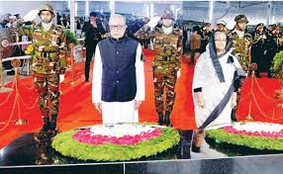
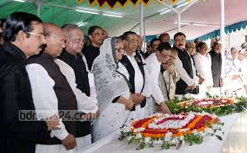
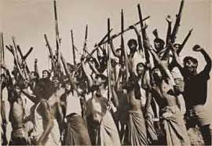
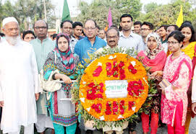
Let’s some importance pictures and see who put floral wreaths at the National Memorial first.
Picture-1
Picture-2
Picture -3
Picture-4
Early in the morning the President and the Prime minister on behalf of the nation place floral wreaths at the National Mausoleum at Savar. Then political parties, social and cultural organisations, and freedom fighters pay homage to the martyrs.

Slide 14
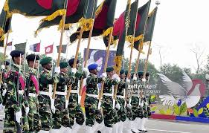
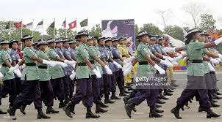
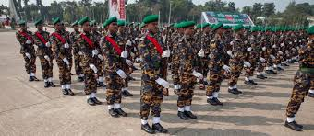
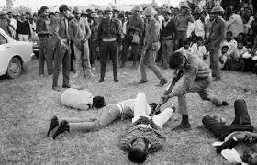
Look at the pictures, try to understand who wear a smartly dressed parade at National Parade Ground and what remind us of the heroic struggle of the freedom fighters.
The country also witnesses a smartly dressed parade of defence forces, Border Guards, Police, Ansars and the VDP (Village Defense Party) at the national parade Ground near the national Parliament. 26 March the independence day, remind us of the heroic struggle and sacrifice of the freedom fighters in 1971.The heroic sons(Freedom fighter) of the soil fought bravely and gained freedom making them surrender to us.

Slide 15
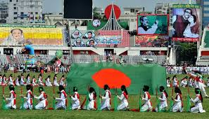
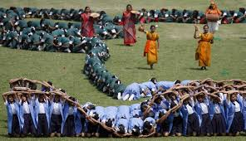
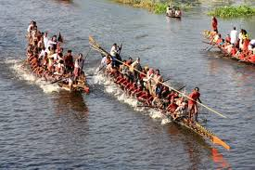
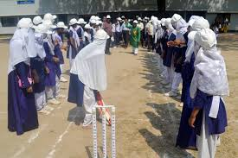
Now notice under the pictures and observe school children,scouts and girl guides what they do.
In Bangabandhu Stadium, school children, scouts and girl guides take part in various displays to entertain thousands of spectators.
Sports meets and tournaments are also organized on the day, including the exciting boat race in the river Buriganga.

Slide 16
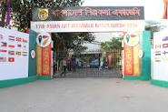
Now let’s see the pictures ant try to guess which organizations arrange cultural functions.
Bangla Academy , Bangladesh Shilpakala Academy and other socio-cultural organization hold cultural functions.

Slide 17
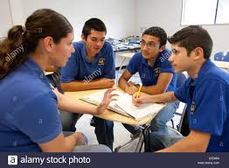
Answer the following questions.
Time: 10 minutes
Group work
What does the country witness at the National Parade Ground this day?
How is our Independence Day celebrated?
What does 26 March remind us?
d) Who puts floral wreaths at national Memorial first?
e)Which organisations hold cultural functions?

Slide 18
Answer key:
The country witnesses a smartly dressed parade of defence forces, border guards, police, ansars and the VDP at the national Parade Ground.
b) Our Independence Day is the biggest festival in our country.So, it is celebrated throughout the country every year with great excitement and interest.
c) 26 Martch, the Independence Day, reminds us of the heroic struggle and sacrifice of the freedom fighters in 1971. It also reminds us of our great protest against the brutal attack of the Pakistani ruler.
The honourable President of the country first puts the floral wreaths at the National Memorial. According to the constitution of Bangladesh, the president is the head of the state. So, he first places flowers at the memorial on behalf of the nation.
e) Bangla Academy, Bangladesh Shilpakala Academy and other socio-cultural organisations hold cultural functions.

Slide 19
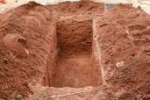
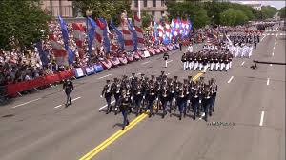
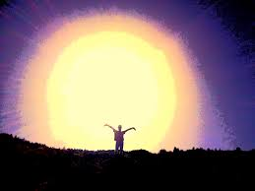
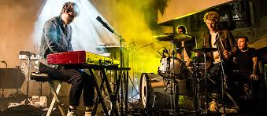
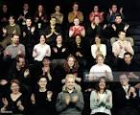
Now match the words with their meaning in the right boxes:
Individual work
Time: 05 minutes
a) Mausoleum | Audience
b) Parade | Light
c) Illuminate | Amuse
d) Entertain | March-past
e) Spectator | Grave

Slide 20
Watch the video and try to understand what does the video meant. Then write a paragraph on ‘Independence Day’ to follow the following questions.
a)Which day is our Independence day and our biggest state festival?
b) From which country did we achieve our freedom?
c) How did we achieve our freedom?
d) How do we observe the day?
e) What should we promise on this day?

Slide 21
Now write a paragraph on ‘Independence Day’ to follow under the questions.
Group work
10 minutes
Which day is our Independence day and our biggest state festival?
b) From which country did we achieve our freedom?
c) How did we achieve our freedom?
d) How do we observe the day?
e) What should we promise on this day?

Slide 22
Now at first see some words meaning then make five sentences with the following words:
Evaluation: 05 minutes
Festival- occasion, celebrate- observe, organization-institution , procession- a formal march, display-exibition
Answer key:
Festival: 26 March is the biggest state festival in Bangladesh.
Celebrate: The day is celebrated every year in the country with great enthusiasm and fervor.
Organization: Political parties, social and cultural organisations, and freedom fighters pay homage to the martyrs.
Procession : People from all walks of life also go there in rallies and processions.
Display: In Bangabandhu Stadium, school children, scouts, and girl guides take part in various displays to entertain thousands of spectators.

Slide 23

Home task:
Write, in brief, how you celebrated this year’s Independence Day at your school.

Slide 24
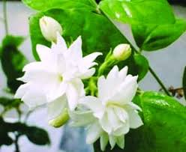
Thank you

