Slide 1
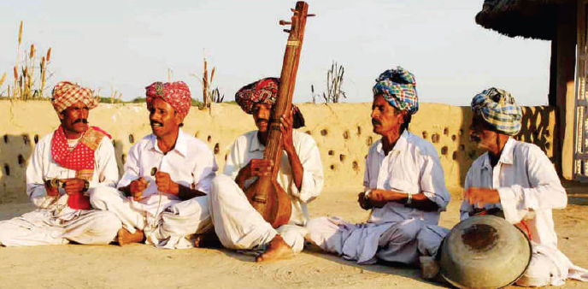
Notes:
We have seen here some flock song singer.

Slide 2
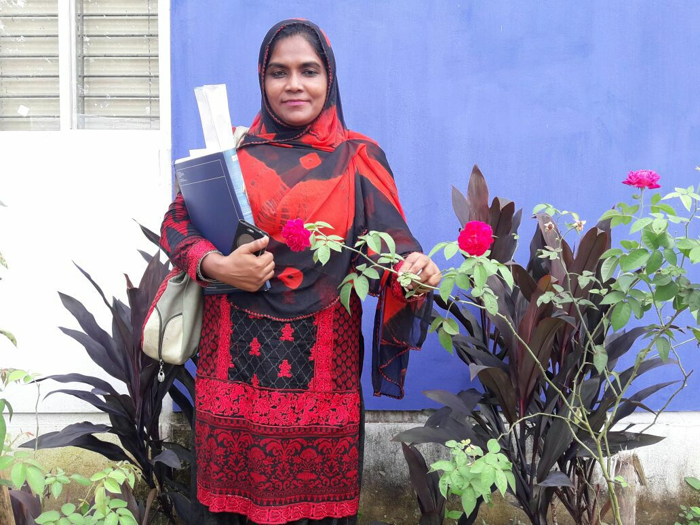
Class Eight,
English 1st Paper
Unit : 01
Introduction:
Mamtaz Rokshana Akhter
Assistant Teacher
Madam Bibirhat Shahjahan High School
Sitakunda, Chittagong

Slide 3
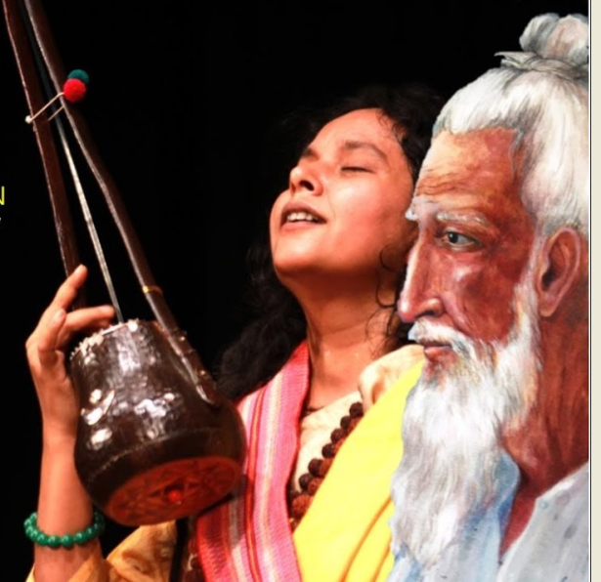
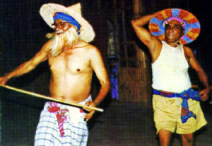
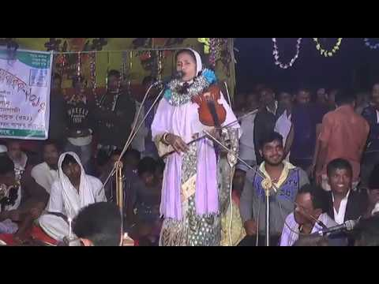
Look at the picture below..
Lalon Gitee.
Gambhira
Pala gan

Slide 4
Let’s we see the video at first
and will say about this..

Slide 5
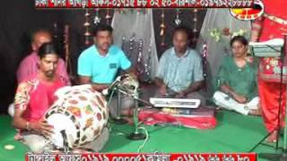
Our folk song.

Slide 6
Learning Outcomes
After we end of the lesson student will be able to--
infer meaning from the context
read and understand texts through silent reading.
write answer to questions.
write a paragraph.

Slide 7
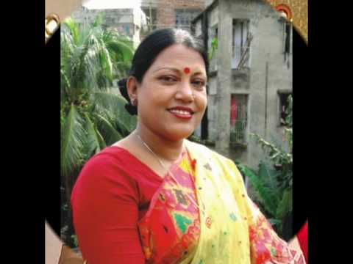
Let us introduce with some key words.
Folk
traditional
conventional
common
Folk song is a tradition
of Bangladesh.
informal

Slide 8
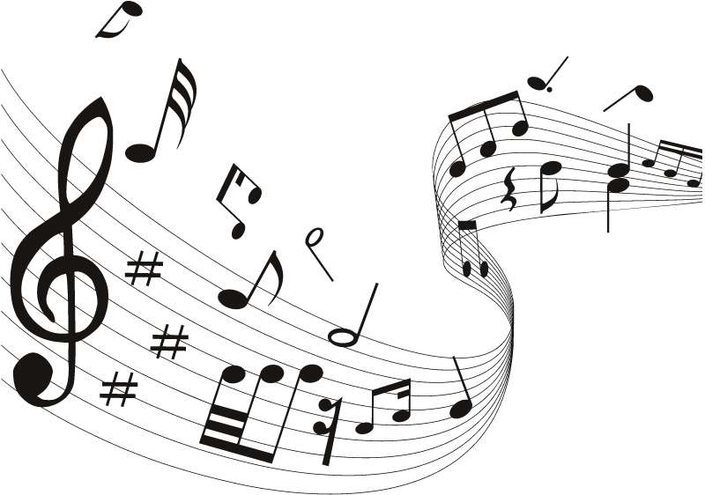
Let us introduce with some key words.
Musical
melodic
harmonious
tuneful
Music becomes interesting with musical instruments.
Music related

Slide 9
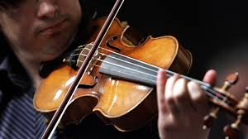
Let us introduce with some key words.
Instruments
apparatuses
devices
Music related element
It is an art to play with musical instruments.

Slide 10
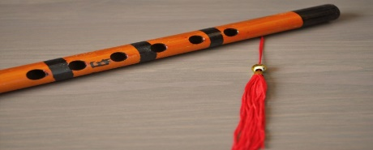
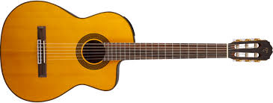
We are seeing some musical instrument, Now say to the name them..
bamboo flute
guitar

Slide 11
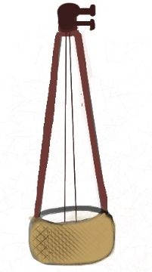
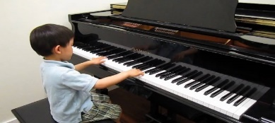
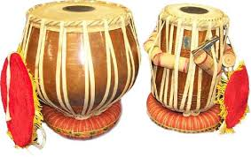
We are seeing some musical instrument, Now say to the name them..
piano
dotara
tabla

Slide 12
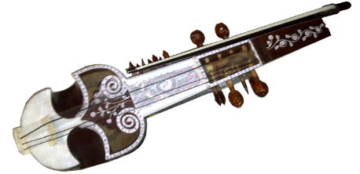
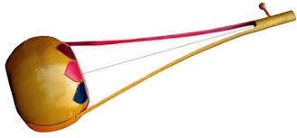
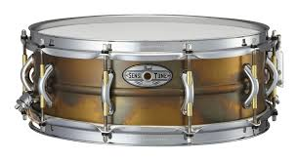
We are seeing some musical instrument, Now say to the name them..
sarinda
ek-tara
drum

Slide 13
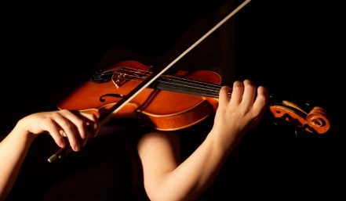
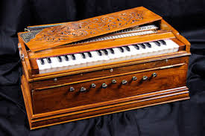
We are seeing some musical instrument, Now say to the name them..
violin
harmonium

Slide 14
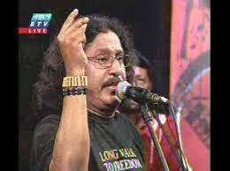
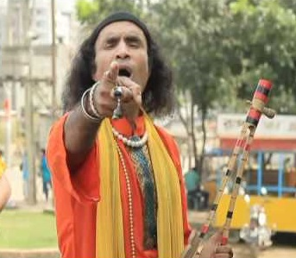
Pair Work
1. Can you sing a song?
2. Can you play any of these musical instruments?
3. Do you know anybody who can play any of these instruments? Tell me what you know about her/him.

Slide 15
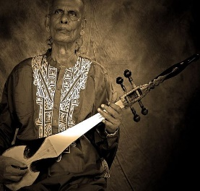
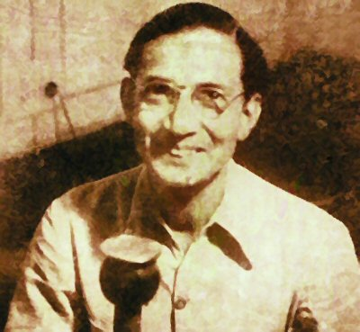
Let us introduce with some folk singers.
Lalon Shah
Hason Raja
Shah Abdul Karim
Abbas Uddin

Slide 16
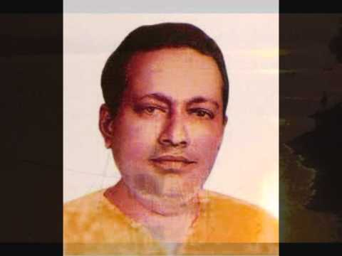
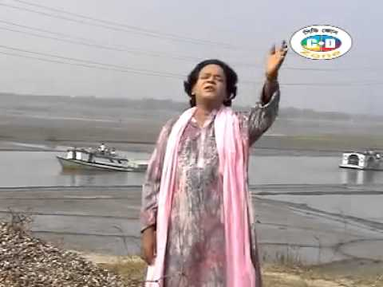
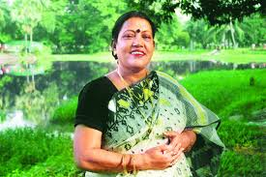
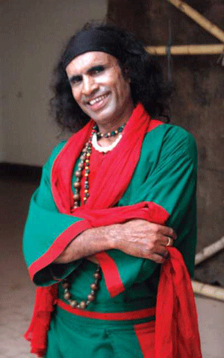
Abdhul Alim
Let us introduce
with some folk singers.
Akkas Dewan
Farida Parveen
Abdul Kuddus

Slide 17
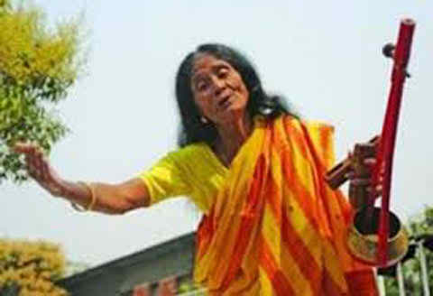
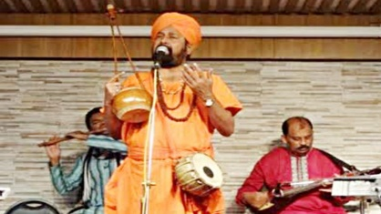
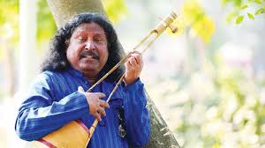
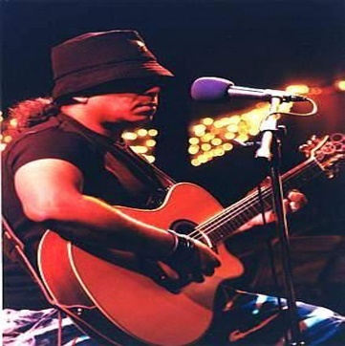
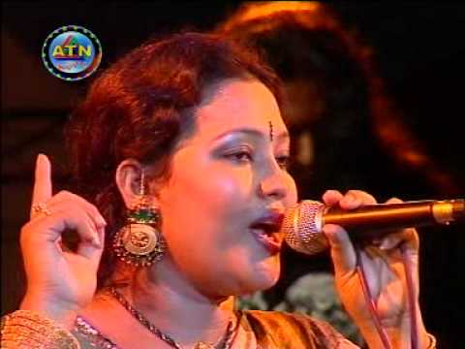
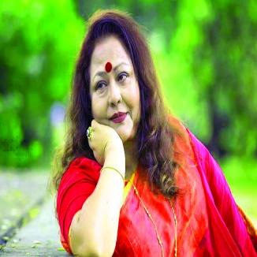
Fakir Alamgir
Sufia Kangalini
Kiron Chandra Roy
Momotaz Begum
Dilruba Khan
Ayub Bachuchu

Slide 18
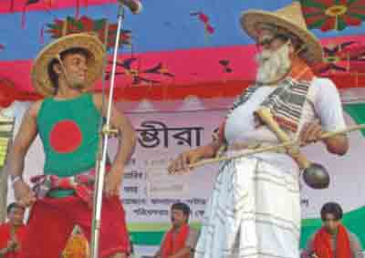
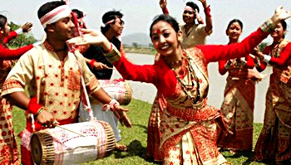
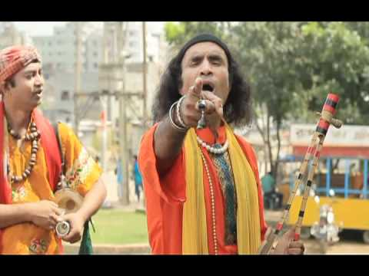
Folk songs are sung in the traditional style.

Slide 19
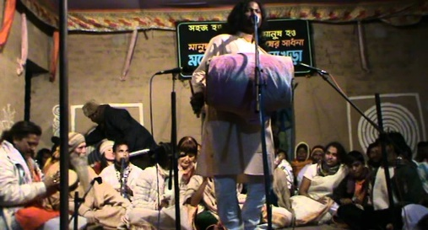
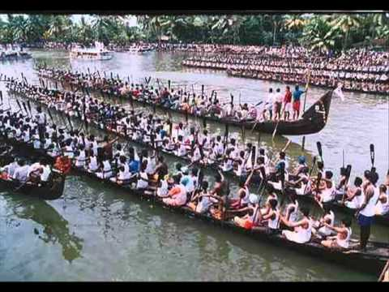
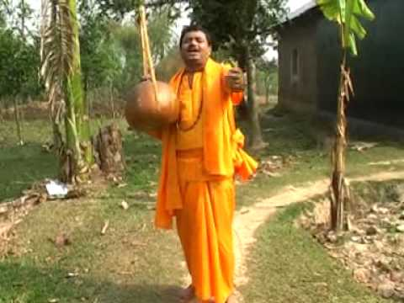
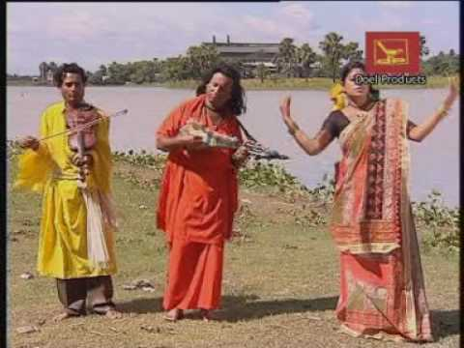
We have a rich history and collection of folk songs in Bangladesh. Of them Palligiti, Bhatiali, Bhawaiya, Jari, Sari, Gambhira, Lalongiti, Palagaan and songs of Hason Raja are very popular.

Slide 20
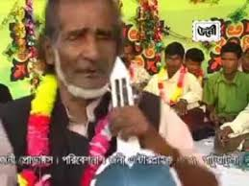
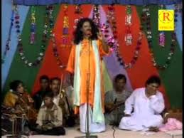
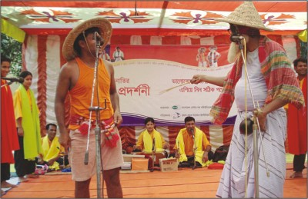
More folk song picture.

Slide 21
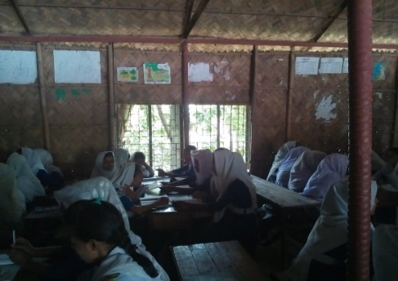
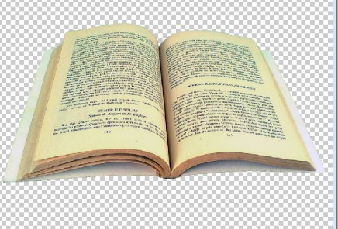
Silent Reading
Folk songs are songs sung in the traditional style of a community or country. Here the traditional style includes the themes, words and tunes of the songs that have existed for a long time among the common people. We have a rich history and collection of folk songs in Bangladesh. Of them Palligiti, Bhatiali, Bhawaiya, Jari, Sari, Gambhira, Lalongiti, Palagaan and songs of Hason Raja are very popular. The traditional musical instruments are usually played with these songs.

Slide 22
Group Work
To correct answer the following questions:
Which kind of people like folk songs?
Write the name of some flok song singer.
Why do you like flock song?
d) Write the name of some flok song related musical instruments.

Slide 23
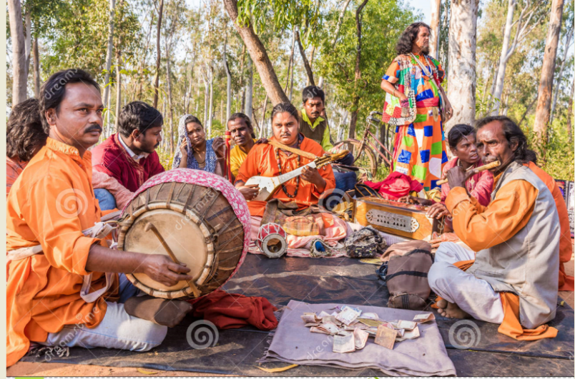
Let’s hear folk songs

Slide 24
Evaluation
Choose the best answer from the alternatives.
1. Gambhira is a kind of ----
(a) Band song
(b) Religious song
(c) Pop song
(d) Folk song
2. Lalon Giti is very popular in ----
(a) India
(b) Pakistan
(c) Bangladesh
(d) Nepal
3. Who is a folk singer ---
(a) Monir Khan
(b) Khalid Hasan
(c) Farida Parveen
(d) Asif

Slide 25
HOME WORK:
Write a paragraph about Folk Songs of Bangladesh.

